Slide 1
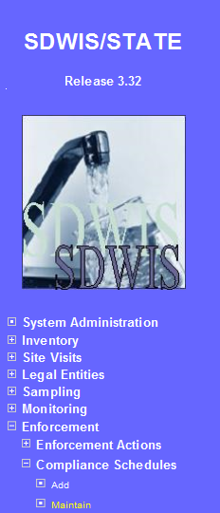
How do I track the RTCR Level 1 Assessment in SDWIS?
Level 1 timeline of activities
Sampling event triggers Level 1 Assessment
Migrate candidate Level 1 Assessment compliance schedule from the SDWIS Bridge
Contact PWS to notify them they’ve triggered a Level 1 Assessment
Edit Level 1 Assessment compliance schedule (page 2)
Enter phone call (notification of Assessment trigger) (page 2)
PWS submits a Level 1 Assessment
Level 1 Assessment not completed appropriately (page 3)
Links to helpful documents
Level 1 Assessment Form Staff Answer Key
Template letters for Level 1 Assessment follow-up
Level 1 Assessment completed appropriately (page 4)
Prepare Assessment follow-up letter and contact system to discuss follow-up actions from the Assessment
Enter phone call (follow-up from assessment) (page 5)
Enter assessment follow-up letter (page 5)
Level 1 Assessment results entered into Site Visits
Level 1 Assessment with no defects identified (pages 6-7)
Level 1 Assessment with defects identified (pages 8-10)
Level 1 Assessment with defects identified, resolved (page 8)
Level 1 Assessment with defects identified, not resolved (page 8-12)
Reset issued for Level 1 Assessment (page 13)
Follow the step by step instructions; DO NOT RELY ON THE SCREEN SHOTS!!!

Slide 2
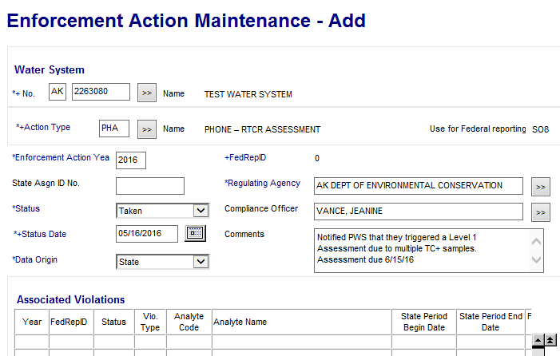
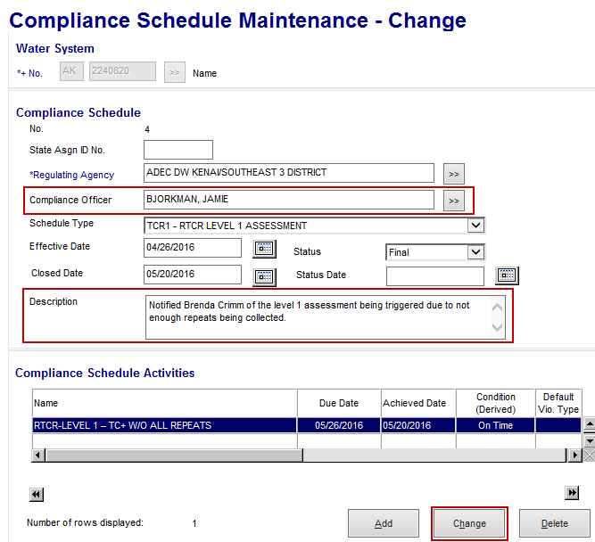
BEFORE THE ASSESSMENT HAS BEEN CONDUCTED
When a Level 1 Assessment has been triggered we need to notify the PWS immediately that it has been triggered. The Level 1 Assessment and corrections of any defects/issues identified is due 30 days after they’ve been notified. The are two items that need to be entered in SDWIS to track this part of the process (items specified below).
Enter the phone call when we notified the PWS the Level 1 Assessment has been triggered
Enforcement→ Enforcement Action→ Add
Water System No: Enter PWSID
Action Type: PHA PHONE – RTCR ASSESSMENT
Compliance Officer: Select the Compliance Officer
Status Date: The date to you notified the PWS that a Level 1 Assessment was triggered.
Comments: “Notified PWS that they triggered a Level 1 Assessment due to [reason], assessment due [enter date].”
Comments must document that you notified the PWS that a Level 1 Assessment was triggered and the due date of the assessment. You could also include what events triggered the Assessment.
Associated violations: There are no violations to associate with a Level 1 Assessment so you do not need to add anything here.
Scroll down and click OK to save the action
Migrate the candidate Level 1 Assessment compliance schedule from the bridge and edit the schedule as appropriate
See SDWIS Bridge instructions for how to migrate the candidate compliance schedule
**UNDER DEVELOPMENT**
Once the Level 1 Assessment compliance schedule has been migrated from the SDWIS Bridge, you’ll need to edit the schedule. The Bridge will set the due date of the Assessment 30 days after the triggering event (ex: date of second TC+ sample) BUT the assessment is due 30 days after the PWS has been NOTIFIED an assessment has been triggered, these dates may differ.
NOTE: Sometimes the Bridge will not create a candidate Level 1 Assessment compliance schedule. If this happens, you will need to enter the schedule manually.
Enforcement→ Compliance Schedules→ Maintain → Select the TCR1 – RTCR LEVEL 1 ASSESSMENT
***Items listed in Red below require input when the Bridge generated the compliance schedule. If you are entering the schedule manually, you will also need to complete the items in Green***
Regulating Agency: Select your office by deleting the default agency and then click the double arrows
Compliance Officer: Select the compliance officer
Schedule Type: TCR1 - RTCR LEVEL 1 ASSESSMENT
Effective Date: Date assessment was triggered
Description: Comments must document when the PWS was notified the Level 1 Assessment was triggered and any other important information about the triggering event.
Review the compliance schedule activity due date. This should match the assessment due date you gave the system when you called to notify them that they triggered an assessment.
If you need to adjust the due date, select the Compliance Schedule Activity and hit the Change button
If you are adding the schedule manually, select the Compliance Schedule Activity and hit the Add button
This will take you to the Compliance Schedule Activity Maintenance page
Compliance Schedule Activity Name: The activity listed here will change depending on how the assessment was triggered RTCR-LEVEL 1 – MULTIPLE TC+ (due to multiple TC+ samples) or RTCR-LEVEL 1 – TC+ W/O ALL REPEATS (due to TC+ routine and missed repeats)
Due Date: Enter the date you gave to the water system.
Comments: Optional
Once you’re done click the OK button this will bring you back to the Compliance Schedule.

Slide 3
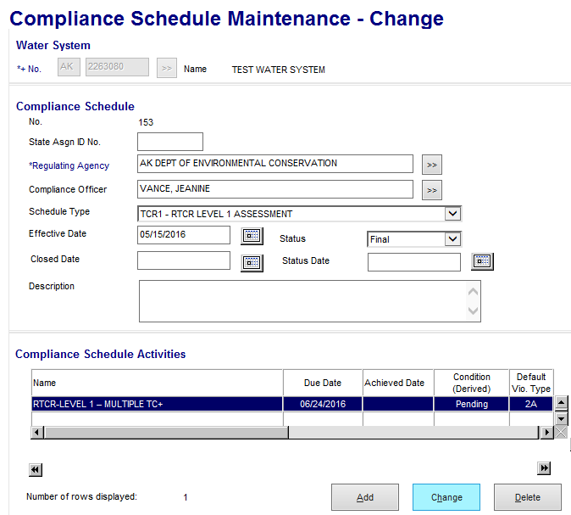
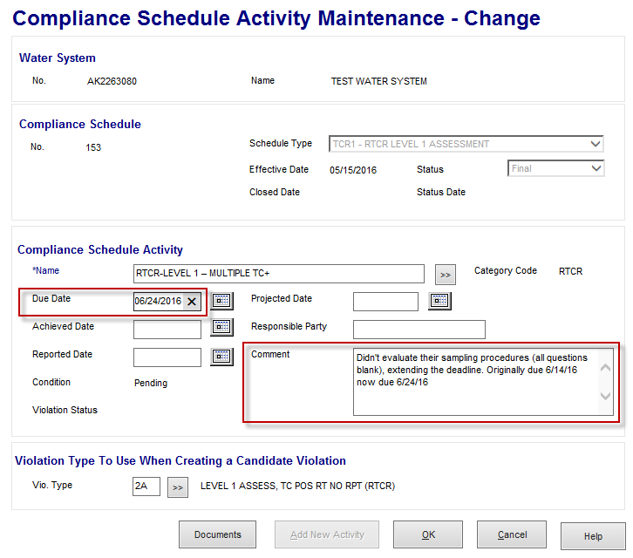
Level 1 Assessment Form has been received but NOT complete
If the Level 1 Assessment has not been completed appropriately contact the PWS and let them know what items need to be corrected. We can extend the deadline up to 30 more days to make corrections to the assessment. We will track the extension through the compliance schedule.
Enforcement → Compliance Schedules→ Maintain → Enter PWSID
From the Compliance Schedule Maintenance list, select RTCR Level 1 Assessment, double click to open (or highlight and from Edit menu select Change)
This will open the Compliance Schedule Maintenance page. Highlight the compliance schedule activity and click the Change button.
***Items listed in Red below require input.***
Due Date: Make note of the previous due date before you delete it, then delete it and enter in the new due date
Comment: Add a comment noting that you extended the deadline, why you extended the deadline and what was the previous deadline date (that you just deleted).
Once you’re done click the OK button this will bring you back to the Compliance Schedule Maintenance page.
Scroll down to the bottom of the screen and click OK again to save your changes.
***Now we wait until the PWS submits the Level 1 Assessment***

Slide 4
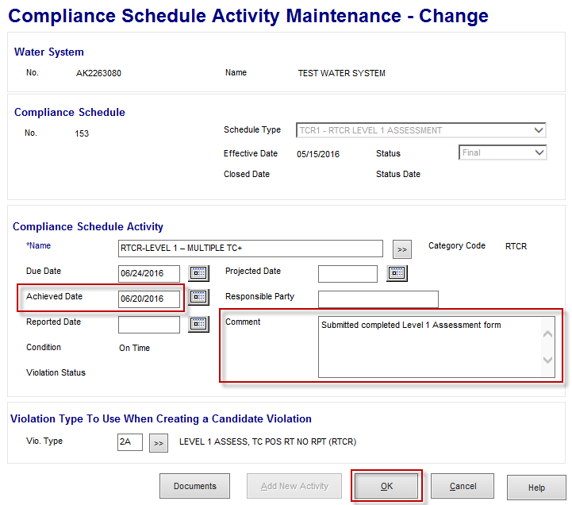
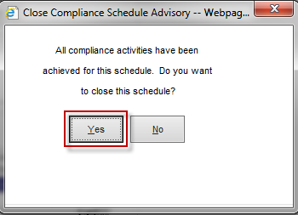
Level 1 Assessment Form has been received and deemed complete
Update the compliance schedule to document the Assessment form has been received
Enforcement → Compliance Schedules→ Maintain → Enter PWSID
From the Compliance Schedule Maintenance list, select RTCR Level 1 Assessment, double click to open (or highlight and from Edit menu select Change)
This will open the Compliance Schedule Maintenance page. Highlight the compliance schedule activity and click the Change button. This will open the compliance schedule activity maintenance-change page.
***Items listed in Red below require input.***
Achieved Date: Date when Level 1 Assessment form was received
Comment: Add a comment noting that the assessment was received
Once you’re done click the OK button. This pop up should appear asking if you want to close the schedule, click Yes
After you’ve clicked yes this will bring you back to the Compliance Schedule Maintenance page.
Scroll down to the bottom of the screen and click OK again to save your changes.

Slide 5
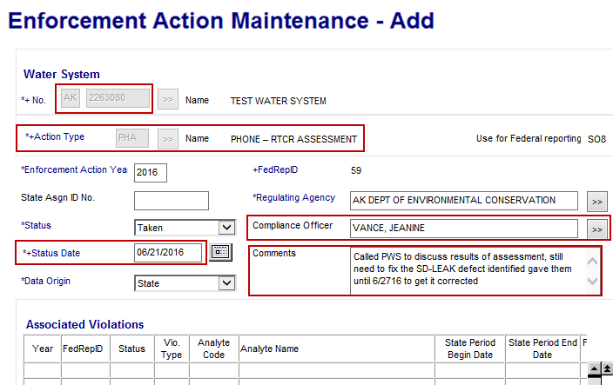
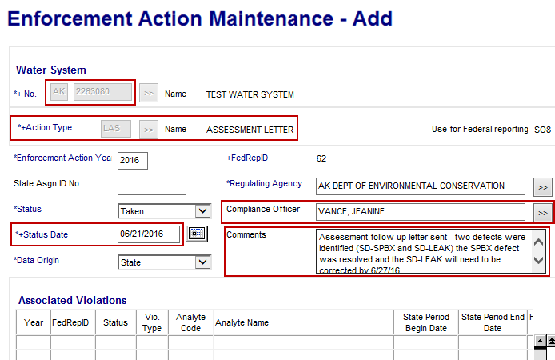
Level 1 Assessment Form has been received and deemed complete continued…
After you’ve determined the assessment is complete you’ll need to review it to see if any sanitary defects were identified and whether or not they’ve been addressed. You’ll need this information for drafting the assessment response letter and for contacting the system to discuss the findings from the assessment. After you’ve called the system and completed the assessment letter, follow the instructions below:
NOTE: The exact order of events described below may vary, they do not need to be entered in this specific order. Just be sure that each item is entered into the database.
Enter the Assessment consultation phone call (phone call discussing results of assessment)
Enforcement→ Enforcement Action→ Add
Water System No: Enter PWSID
Action Type: PHA PHONE – RTCR ASSESSMENT
Compliance Officer: Select the Compliance Officer
Status Date: The date the EPS contacted the system to discuss the results of the Level 1 Assessment
Comments: Comments must document that you contacted the PWS to discuss the results of the Level 1 Assessment. Please note any deadlines you discussed regarding any follow-up actions and deadlines for sanitary defects or other issues identified.
Associated violations: There are no violations to associate with a Level 1 Assessment so you do not need to add anything here
Scroll down and click OK to save the action
Enter the Assessment follow-up letter
Enforcement→ Enforcement Action→ Add
Water System No: Enter PWSID
Action Type: LAS – ASSESSMENT LETTER
Compliance Officer: Select the Compliance Officer
Status Date: The date the follow-up letter was sent to the system describing the results from the Level 1 Assessment
Comments: Comments must document that the follow-up assessment letter was sent. Include details about any corrective actions that still need to be taken and associated deadlines.
Associated violations: There are no violations to associate with a Level 1 Assessment so you do not need to add anything here
Scroll down and click OK to save the action

Slide 6
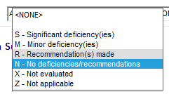
Level 1 Assessment Form has been received and deemed complete continued…
Enter the Level 1 Assessment into Site Visit to document the findings of the assessment
If NO defects were identified continue following instructions below:
If defects were identified skip to page 8
Site Visits → Site Visit→ Add
No: The PWSID number
Status: C-Completed
Due Date: Date the Level 1 Assessment Form was due back to the DW Program
Date of Visit: Date the Level 1 Assessment was conducted (this date should be noted on the form)
NOTE: This is not the date the form was received by the program
Primary Reason: Select LV1A- Level 1 Assessment rTCR
WS Notification Date: The date that you notified the PWS that a Level 1 Assessment had been triggered. This date is very important, it is used by the Standard Response feature to calculate the Due Dates for the Sanitary Defects compliance schedule.
The categories will all be defaulted to Z- Not Applicable. You will need to change each of them to N- No deficiencies/recommendations by clicking on the down arrow and selecting the appropriate status
The Security, Financial, and Other categories can be left as Z-Not Applicable
Once you’re done with this section, scroll down the page to Parties Present.
The individual(s) listed in this section should be those who were present at the time the assessment took place.
To add a person to this section choose Associate and enter the person’s name. Then select the individual who conducted the assessment and select Make Role Primary.
NOTE: If an individual involved with the assessment is not entered in SDWIS you’ll need to enter their name through Legal Entities first, then associate to the inspection.
Make Role Primary: Once an individual is selected, a P for Primary will appear in the Role column.
Leave the Visit Frequency and Next Due Date section blank since these inspections are triggered based on sample results
Since no defects were identified on the Level 1 Assessment you can scroll past the Deficiencies and Schedule Activities by Deficiency sections and go straight to the comments section
Example #1
You must include comments for each assessment. The comments should include the results of the Level 1 Assessment, whether issues or defects were identified, if the issues/defects were corrected, how they were corrected, and whether or not a reset was issued. If a reset is issued please see page 13 for how to document the reset.
Once comments are complete click to save the Site Visit.
See example of completed Site Visit on next page >>>
Example #2

Slide 7
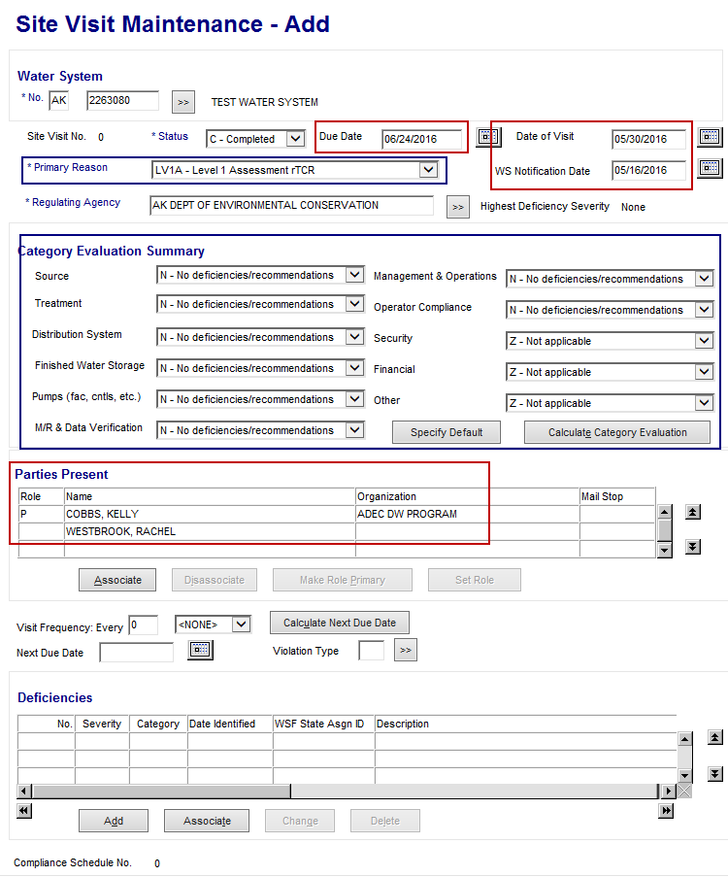
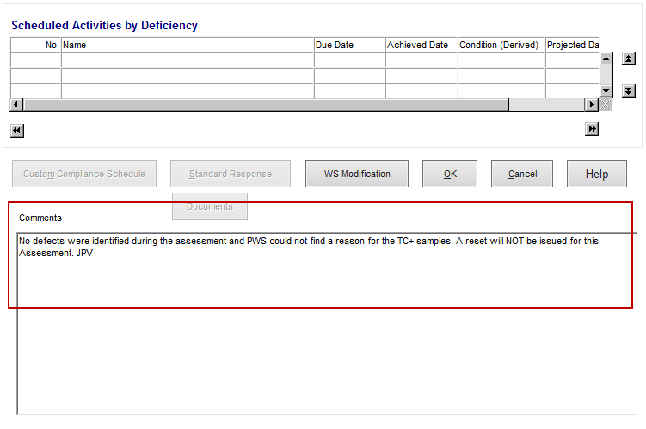
Completed Site Visit for PWS with NO defects identified
Did you close out the Level 1 Assessment Compliance schedule? (pg. 4)
Did you enter the Assessment follow-up phone call? (pg. 5)
Did you enter your Assessment follow-up letter? (pg. 5)
Did you enter the Site Visit? (pg. 6)
If the answer to all of the questions above is YES, congratulations you are DONE with the data entry for this Assessment!

Slide 8
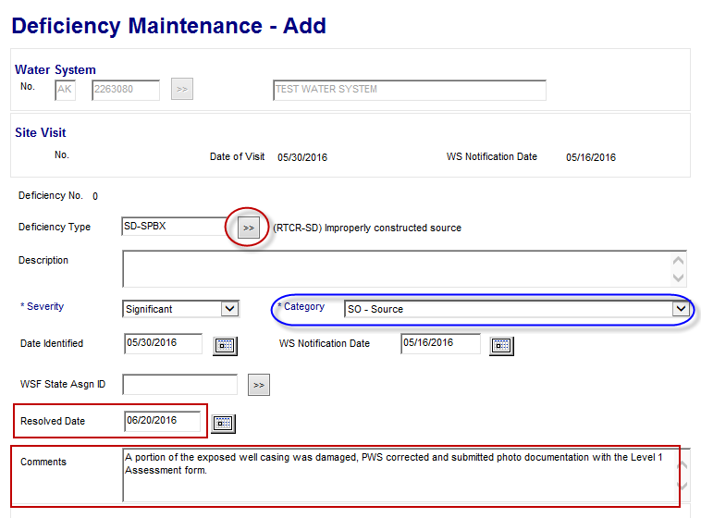
Level 1 Assessment Form has been received and deemed complete continued…
Enter the Level 1 Assessment into Site Visit to document the findings of the assessment
If defects were identified continue following instructions below:
Site Visits → Site Visit→ Add
No: The PWSID number
Status: C-Completed
Due Date: Date the Level 1 Assessment Form was due back to the DW Program
Date of Visit: Date the Level 1 Assessment was conducted (this date should be noted on the form)
NOTE: This is not the date the form was received by the program
Primary Reason: Select LV1A- Level 1 Assessment rTCR
WS Notification Date: The date that you notified the PWS that a Level 1 Assessment had been triggered. This date is very important, it is used by the Standard Response feature to calculate the Due Dates for the Sanitary Defects compliance schedule.
Once you’re done with this section, scroll down the page to Parties Present.
The individual(s) listed in this section should be those who were present at the time the assessment took place.
To add a person to this section choose Associate and enter the person’s name. Then select the individual who conducted the assessment and Make Role Primary.
Make Role Primary: Once an individual is selected, a P for Primary will appear in the Role column.
Leave the Visit Frequency and Next Due Date section blank since these inspections are triggered based on sample results
Now let’s add the Sanitary Defects that were identified during the Level 1 Assessment. You will need to add defects even if the PWS submitted documentation that the defect was resolved.
If the defect has been RESOLVED follow the instructions below:
If the defect has NOT been resolved go to page 9 for instructions
Scroll down the page to the Deficiencies section and click Add.
Deficiency Type: Click on the double arrows and select the defect type. Remember all defects related to RTCR begin with SD-XXXX.
Description: Do NOT enter anything in this field
Category: If the category is not listed, it is because the specific defect selected is related to multiple categories. Check the staff key for which category should be selected
Resolved Date: If documentation was provided showing the defect was resolved, enter that date the documentation was provided to the department.
Comments: You must include comments related to the defect and how it was corrected including what documentation was provided.
Scroll down to the end of the page and click OK.

Slide 9
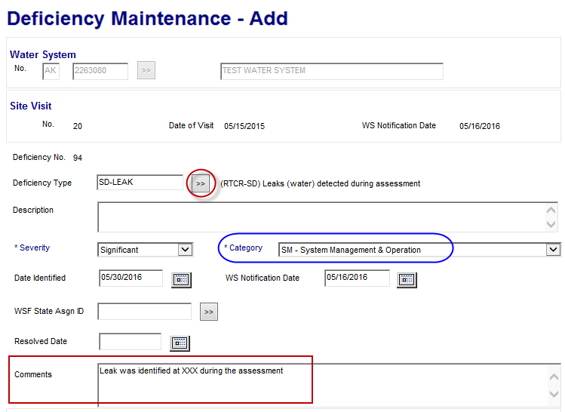
If the defect has NOT BEEN RESOLVED follow the instructions below:
Scroll down the page to the Deficiencies section and click Add.
Deficiency Type: Click on the double arrows and select the defect type. Remember all defects related to RTCR begin with SD-XXXX.
Description: Do NOT enter anything in this field
Category: If the category is not listed, it is because the specific defect selected is related to multiple categories. Check the staff key for which category should be selected
Resolved Date: Leave blank
Comments: You must include comments to provide more details about the defect
Scroll down to the end of the page and click OK.
Continue this process until you’ve added all the defects that were identified during the Level 1 Assessment
The categories will all be defaulted to Z- Not Applicable. You will need to select the appropriate status for each category by first clicking the Calculate Category Evaluation button. This will add the severity level for each of the defects you entered in the appropriate category.
For the remaining categories you will need to change them by clicking on the down arrow and selecting the appropriate status as shown in the box to the right
Select N – No deficiencies/recommendations when the component was evaluated but no defects were identified
Select Z-Not applicable if the PWS does not have the particular component
Select X-Not evaluated or Z-Not applicable for the Security, Financial, and Other categories
Do not leave any categories listed as <NONE> this will generate a data error when we do our quarterly file transfer to EPA
IMPORTANT NOTE!
Each defect type can only be entered once per category (source, treatment, distribution system, etc.).
For example if a system completed the Level 1 Assessment and in the TREATMENT section answered two questions incorrectly that resulted in two SD-FTOA defects. You will only be able to enter one SD-FTOA defect for the Treatment category. You must use the comments section of the defect to explain what two items triggered the defect so that we can be sure the system corrects each item as appropriate.

Slide 10
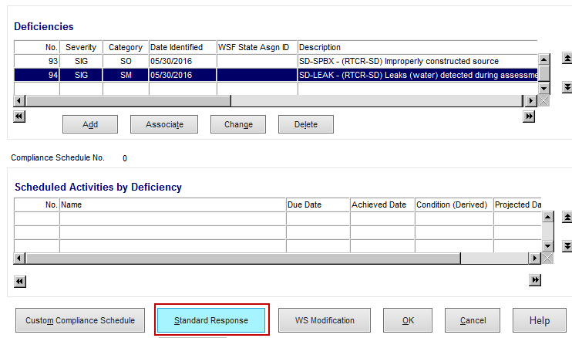
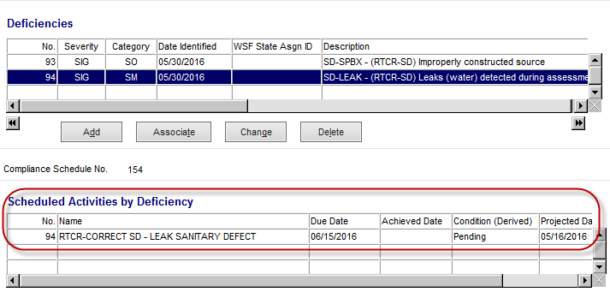
Level 1 Assessment Form complete – defects identified continued…
Now you are ready to apply the Standard Response to each defect that has NOT been resolved. The Standard Response will create a Compliance Schedule and appropriate compliance schedule activities for each unresolved defect.
Highlight the unresolved defect by clicking on it, then click on the Standard Response button.
Be sure to make a note of the defect type code (in this example we would write down SD-LEAK) because you will need this code to select the appropriate Standard Response.
This will bring you to the Standard Response Maintenance List
You will need to scroll down till you find the appropriate RTCR Sanitary Defect Standard Response. They are all formatted as follows:
RTCR–SAN DEFECT–SD–XXXX
Select the appropriate Standard Response by double clicking on the name (or by clicking on the name → Edit menu → Select)
You will be taken back to the Site Visit Maintenance page
Now you can see that the Defect has a compliance schedule activity associated to it.
If you have more unresolved defects, repeat the process until you’ve applied the Standard Response to each unresolved defect.
Please be sure that you only have one defect selected/highlighted at a time in order for the Standard Response to be applied appropriately.
If you accidently apply the Standard Response incorrectly you can make corrections through the Compliance Schedule screen, you cannot make the corrections from here (Site Visit)
Once you applied the appropriate Standard Response to each unresolved defect, scroll down to the Comments section
You must include comments for each assessment. The comments should include the results of the Level 1 Assessment, whether the issues or defects were identified, if the issues/defects were corrected, how they were corrected, and whether or not a reset was issued. If a reset is issued please see page 13 for how to document the reset.
Once comments are complete click to save the Site Visit.
See example of completed Site Visit on next page >>>>

Slide 11
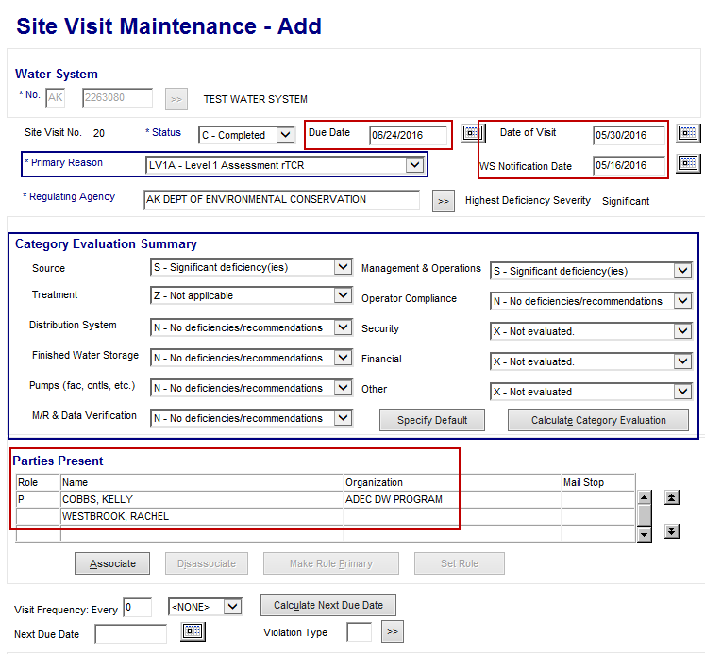
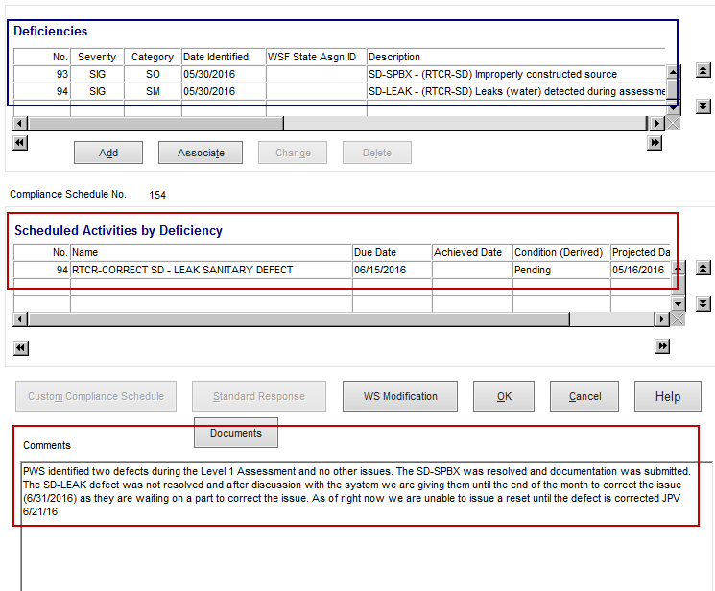
Completed Site Visit for PWS with defects identified
Did you close out the Level 1 Assessment Compliance schedule? (pg. 4)
Did you enter the Assessment follow-up phone call?
(pg. 5)
Did you enter your Assessment follow-up letter? (pg. 5)
Did you enter the Site Visit? (pg. 6)
If the answer to all of the questions above is YES, you are ready to proceed to the final step, completing the Sanitary Defect Compliance schedule (NEXT PAGE)

Slide 12
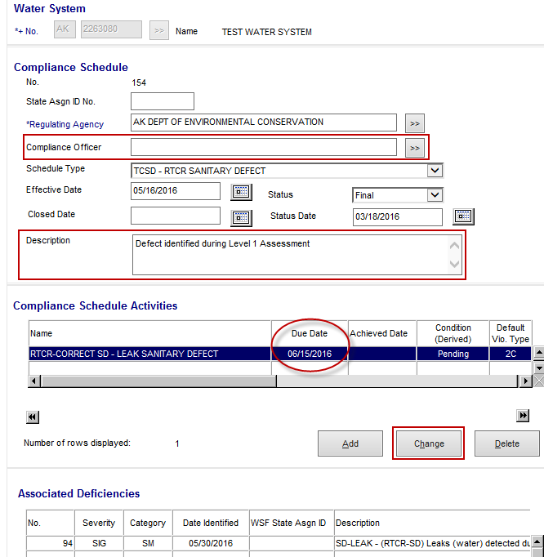
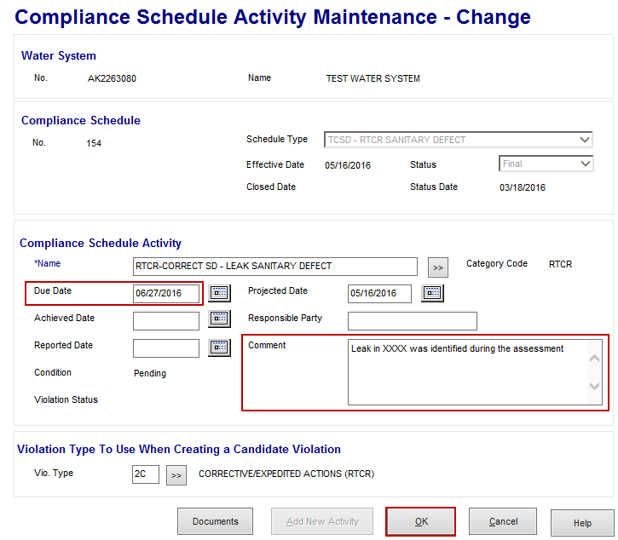
Level 1 Assessment Form complete – defects identified continued…
Review & complete Sanitary Defect compliance schedule
Enforcement→ Compliance Schedule→ Maintain → Enter PWSID
From the Compliance Schedule Maintenance list, select RTCR SANITARY DEFECT compliance schedule, double click to open (or highlight and from Edit menu select Change)
Review the compliance schedule to make sure it includes the compliance schedule activities and associated sanitary defects that you expect. Here are a couple of things you should look for;
Check that each compliance schedule activity has the appropriate defect attached to the schedule.
Check to make sure each compliance schedule activity has only ONE defect attached to it.
Check that each unresolved defect entered into the Site Visit has an activity
Review the corrective action due date for each defect and adjust as needed. This date MUST match the deadline dates that were outlined in the Assessment follow-up letter to the system.
***Items listed in Red below require input.***
Compliance Officer: Add the compliance officer
Description: Must include comments about whether the defects were identified during a Level 1 or Level 2 assessment.
Activity Due Date: This date may need to be adjusted to match the dates outlined in the Assessment follow-up letter. To adjust the due date select the Compliance Schedule Activity and hit the Change button.
This will take you to the Compliance Schedule Activity Maintenance page
Due Date: Delete the due date listed and enter the date from the Assessment follow-up letter.
Comments: Comments should include detail about the defect that needs to be corrected
Once you’re done click the OK button this will bring you back to the Compliance Schedule.
Complete this process for each defect until all the activity due dates match the dates from the Assessment follow-up letter.
Once you’re done click the OK button to save the changes to eh Compliance Schedule.
ONCE THE PWS SUBMITS DOCUMENTATION THAT A DEFECT HAS BEEN CORRECTED, REFER TO THE MANAGING SANITARY DEFECT COMPLIANCE SCHEDULE GUIDANCE DOCUMENT (coming soon)
Congratulations you are DONE with the data entry for this Assessment!

Slide 13
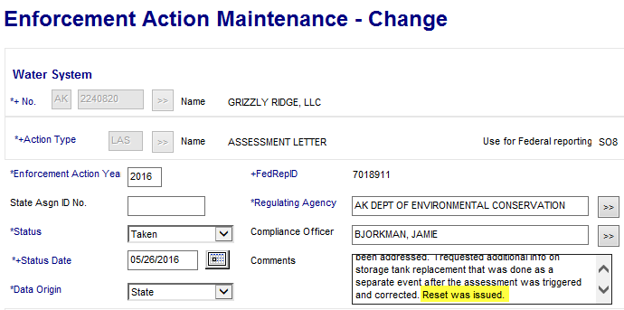
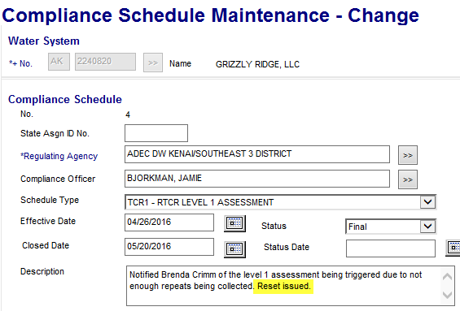
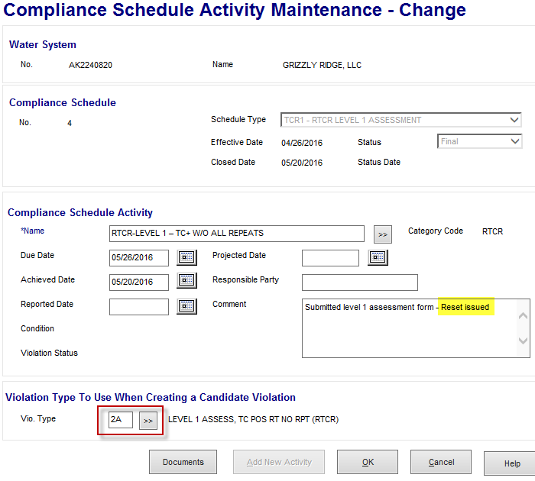
Tracking when a “reset” for the Level 1 Assessment
As a reminder we can issue a Level 1 “reset” when “the State has determined a likely reason that caused the TC+ samples AND has established that the system has corrected the problem.” You must consult with your Program Coordinator prior to issuing a reset.
There are 3 areas in SDWIS to enter information when a reset has been issued, listed below:
Site Visit (page 10) - Add comment that a reset was issued in the Comments section of the Site Visit
Assessment Letter (LAS) Enforcement Action (page 5) - Add comment in the Assessment follow-up letter enforcement action that a reset was issued (be sure that it’s actually included in the letter as well)
Level 1 Assessment Compliance Schedule (page 4)
Add comment that a reset was issued in the Description of the Level 1 Assessment schedule
Add comment that a reset was issued in the Comment section of the compliance schedule activity
Delete the violation from the compliance schedule activity
Delete violation

