Slide 1
Opening Pandora’s Box
Evaluating the Integrity of Water System Monitoring
Nancy Feagin, P.E. and Steve Deem, P.E.
Office of Drinking Water
Washington State Department of Health
ASDWA Webinar January 2017

Slide 2
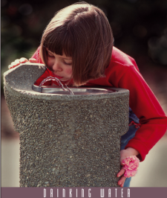
Office of Drinking Water’s Mission
We work with others to protect the health
of the people of Washington State
by ensuring safe
and reliable
drinking water.

Slide 3

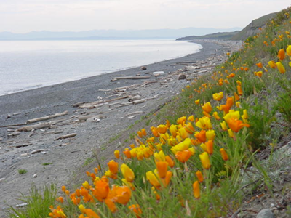
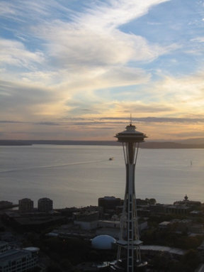
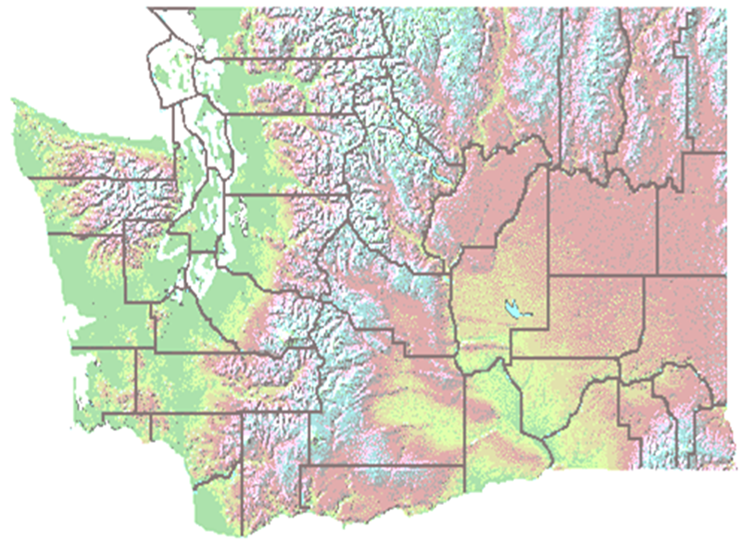
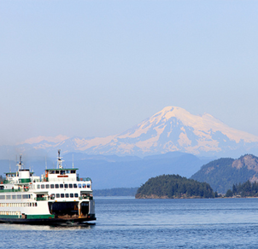

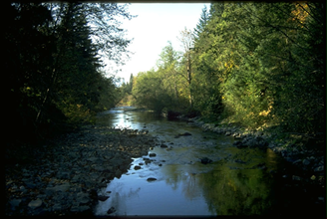

Slide 4
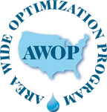
Enhance public health protection by optimizing the performance and operations of existing facilities
EPA Data Integrity Workshops 2012-2015
Turbidity Data Integrity Project (2012-2013)
  25 systems NW Region
  Continuing follow-up across the state

Slide 5
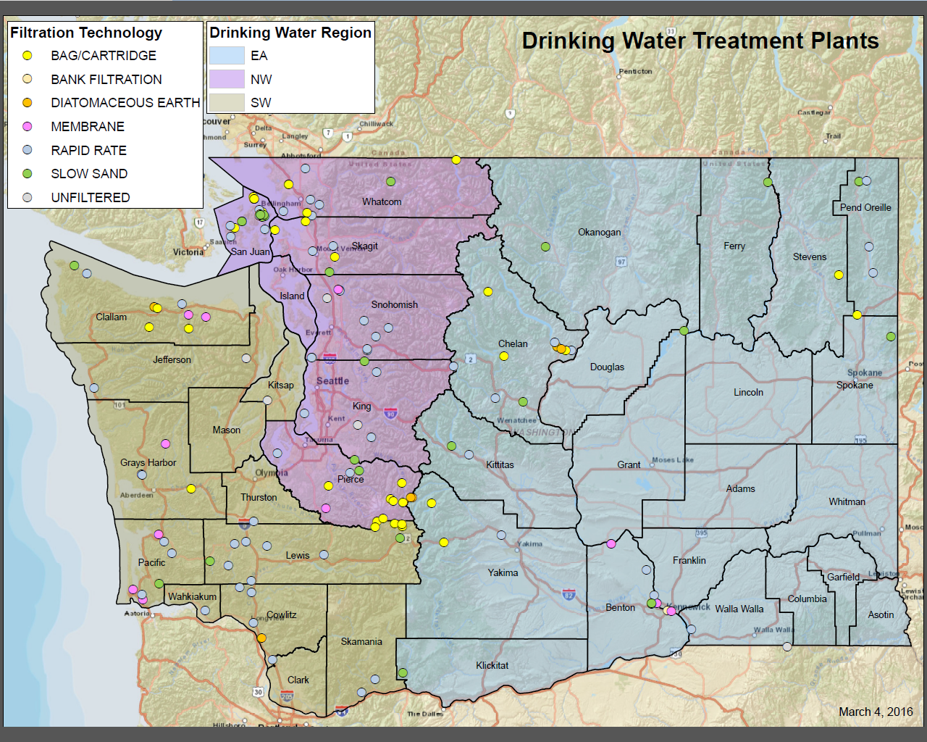

Slide 6
Disinfection Data Integrity Project
33 Surface Water treatment plants in NW region
Diverse treatment technologies
  Unfiltered
  Membrane, bag, slow sand
  UV
  Ozone
  Primary disinfection: free Cl₂
  Huge range in system size (1 gpm to 180 MGD)
  Learn-as-you-go, adaptive approach
  CT Requirements – DOH file review
  Operator interview (SOPs, maintenance, reporting)
  Portable testing equipment

Slide 7
Accuracy and Precision
Accuracy is the closeness of a measured value to a standard or known value.
  You measure 5 kg for a 10 kg weight – not accurate.
Precision is the closeness of two or more measurements to each other. (Consistency)
  If you measure 5 kg three time in a row – you are precise (just not accurate!)
Accuracy and Precision are independent of each other.

Slide 8
What is Data Integrity?
Maintaining and ensuring accuracy and consistency of data from sample collection point until the data is used.
Instrument selection, maintenance and calibration
Replaceable parts (photocells, sample lines, bulbs)
Human factors

Slide 9
Disinfection Barrier – Killing Microbes
Disinfection goal – kill or prevent infectious microbes (virus, bacteria, protozoa) from replicating (inactivate).
More powerful the disinfectant – the less time the disinfectant needs to inactivate the bug.
Disinfectant may physically destroy or damage the organism – oxidize protein coat
Disinfectant may disrupt DNA – UV light

Slide 10
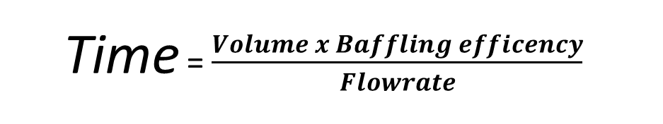
Disinfection Monitoring
Much more complex than turbidity!
  Three water quality parameters:
    pH
    temperature
    disinfectant residual concentration
  PLUS . . .
Effective volume
  Time = $\frac{Volume x Baffling efficency}{Flowrate}$
pH

Slide 11
pH
Ways to measure pH
  Indicators – materials designed to change color at different pH values.
  Colorimeter – reagent added to sample vial, compare resultant color to wheel or spectral standard to interpolate pH.
  pH meter – potentiometric measurement using glass electrode and reference electrode. Precise and Continuous.
Soren Peder Lauritz Sorenson – 1909 - Danish - Carlsburg Laboratory
  Soren measured mV in solutions of known HCl concentration

Slide 12
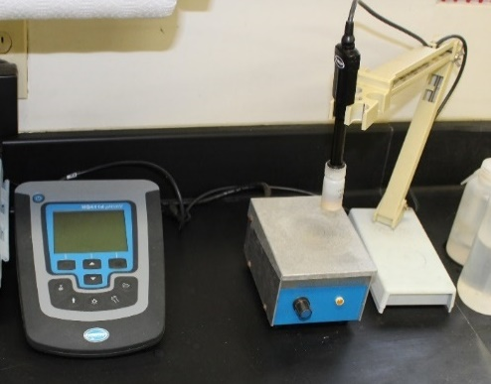
pH
A measurement of
  the hydrogen ion concentration [H⁺]
  the relative acidity of an aqueous solution
A negative logarithmic function pH = -log [H⁺]
Each one-unit decrease in pH = 10x increase in acidity: for example, a pH 6 solution 10 times more acidic than a pH 7 solution
What does the ‘p’ in pH stand for?
  Derived from Potenz – german for power or exponent – “power or potential of hydrogen”

Slide 13
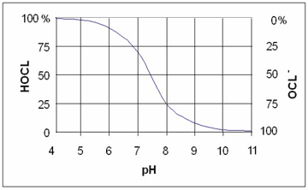
Chlorine Effectiveness and pH
Hypochlorous acid: a stronger disinfectant
Hypochlorite ion: A weaker disinfectant
HOCl ↔ H⁺ + OCl⁻
At 20°C
http://www.hach.com/DisinfectionSeries02

Slide 14
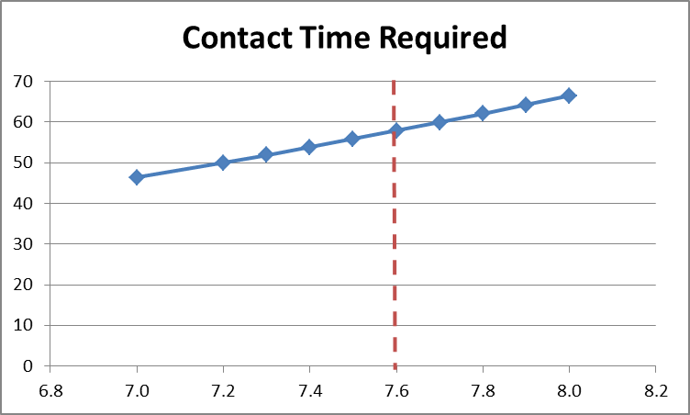

Giardia Inactivation by Cl₂ sensitivity to pH
Example:
Direct filtration plant
1 log Giardia Inactivation
Temp = 7° C
Cl2 = 1.1 mg/L
pH = 7.6
Need 58 minutes
measured
true value
If your pH measurement is low, you will under-estimate how much time you need.
0.5 pH units = 17% error
pH

Slide 15

pH Meter Quiz:
According to Standard Methods, when should you calibrate a bench top pH meter?
A. Before every measurement
B. Once a day
C. Once a month
D. Not needed

Slide 16
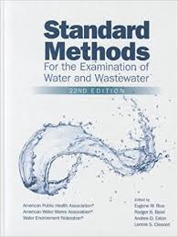
Analytical Methods: pH
Standard Methods 4500 H+
EPA Method 150.1 and 150.2 (online)
New! EPA Method 150.3
ASTM D1293

Slide 17
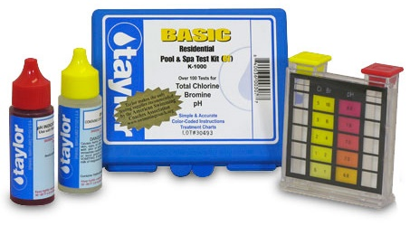
Project Findings: pH
Unapproved equipment (pool style)
Lack of daily calibration: 5/32 never calibrate
5/27 only use one buffer
No SOPs
Aerated sample
Low ionic strength water (<100 µS/cm) needs special probe, hard to consistently measure
Continuous: outdated 1982 method & lack of calibration guidance from manufacturer
  EPA updated method (82 FR 34861, published 7-27-2017)

Slide 18

Trouble with pH
Most difficult to measure
Sensitive to time, temperature, sample collection (aeration), probe care and maintenance, calibration, verification …
Differences in accepted practice (transporting the sample, swirl, stirred, quiescent, calibrate, verify, one buffer, two
Measure in the field
Use consistent procedures
Allow probe to stabilize on both temp and pH
Calibrate minimum 2 buffers (bracket)
Verify with a different buffer

Slide 19

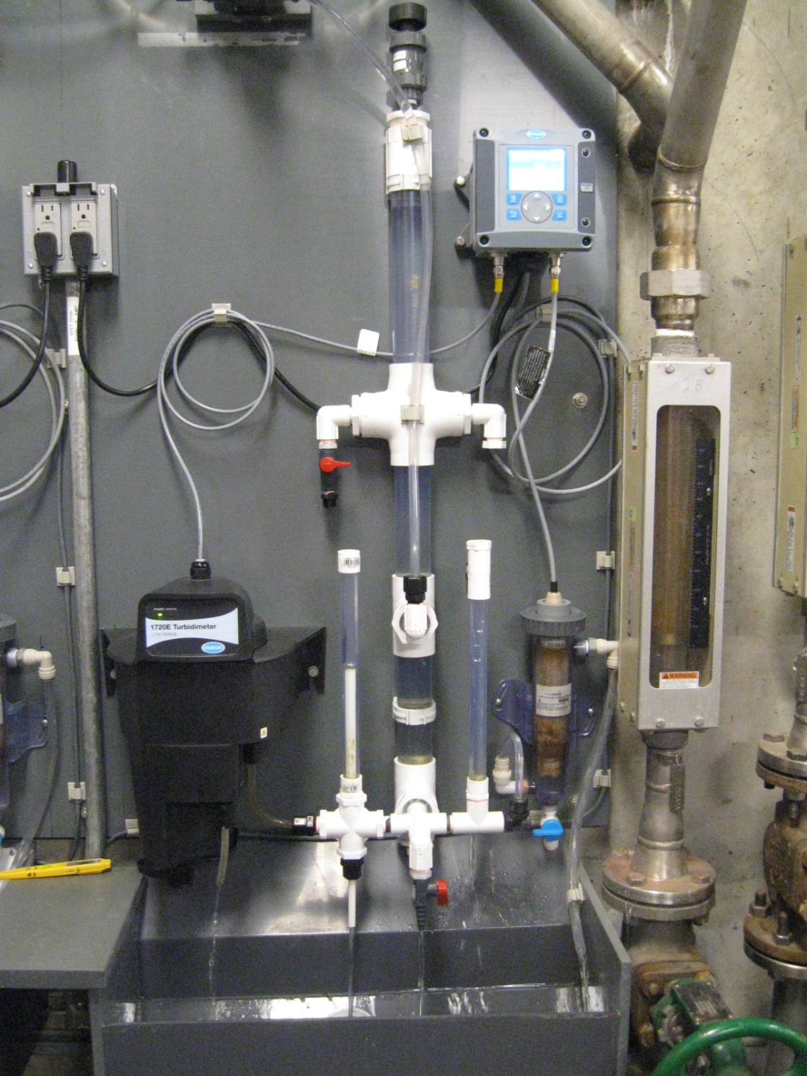
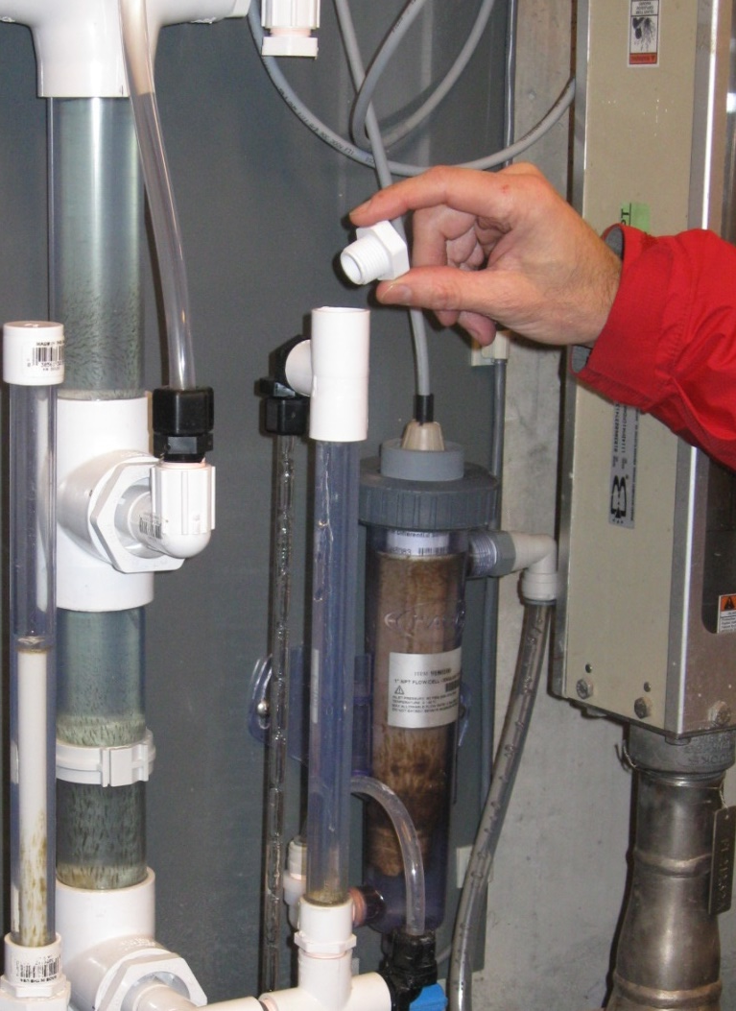
Setup for Easy Maintenance (design by Shane King)

Slide 20
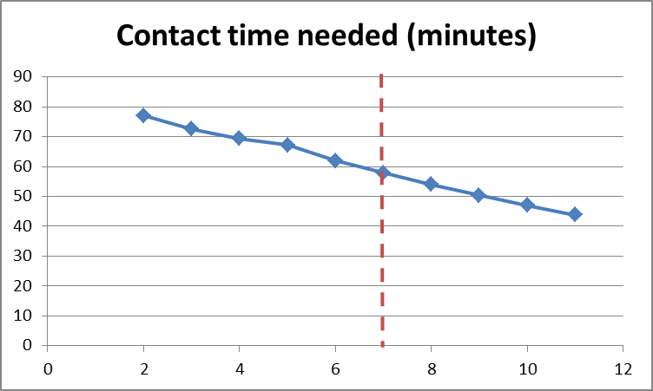
Giardia Inactivation by Cl₂ sensitivity to temperature
Same example:
Direct filtration plant
1 log Giardia Inactivation
Temp = 7° C
Cl2 = 1.1 mg/L
pH = 7.6
Need 58 minutes
measured
true value
If your temperature measurement is high, you will under-estimate how much time you need.
2˚C = 14% error
Temp (C)

Slide 21
Temperature Quiz:
How accurate should your thermometer be?
A. +/- 0.2⁰ C
B. +/- 0.4⁰ C
C. +/- 1.0⁰ C
D. +/- 2.0⁰ C

Slide 22
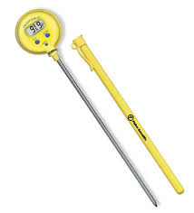
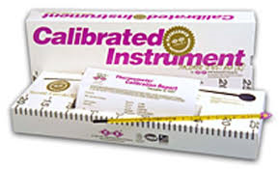
Analytical Methods: temperature
Standard Methods 2550 (22nd Ed)
  Any standard liquid-in-glass or electronic thermometer
  Able to detect temp changes of 0.1° C or less
  +/- 0.4° C accuracy
  Periodically check against NIST-certified precision thermometer (e.g. 1-2 x/year)

Slide 23
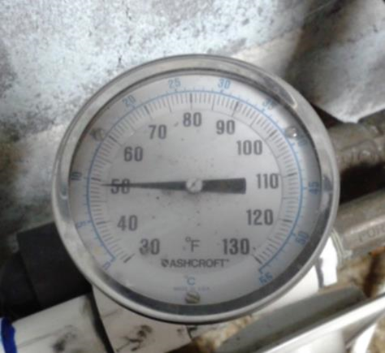
Project Findings: temperature
Questionable equipment: 28/33
No verification: 28/33
Plant thermometer: Only marked in 1°F increments… reading six degrees low!

Slide 24
Analytical Methods: chlorine residual
Standard Methods 4500 series!
  Cl D Amperometric Titration
  Cl F Ferrous Titrimetric Method
  Cl G DPD Colorimetric (N,N-diethyl-p-phenylenediamine)
  Cl H Syringaldazine

Slide 25
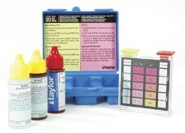
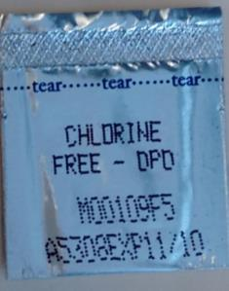
Project Findings: Cl2 residual
Grab sampling:
Unapproved equipment or method: color wheel, pool test kit (11/33)
  No verification (9/11)
Expired reagents (2/33)

Slide 26
Drinking Water Staff Cl₂ Test Method Challenge

Slide 27
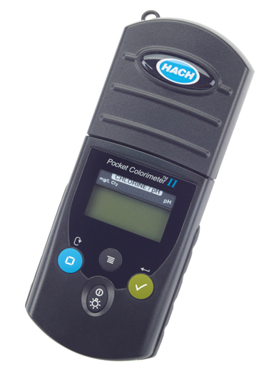
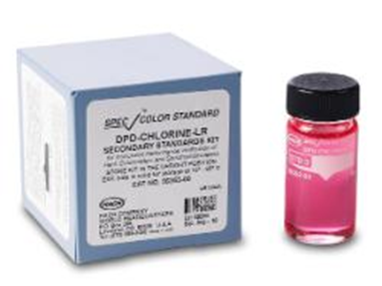
Troubles with Measuring Cl₂ Residual Grab Samples
Wrong vial (high range)
Cap off
Low/high range setting
Time
Mixing: Swirl versus shake
Wet vial
Condensation
Stained vial
Scratched vial
No free chlorine (ammonia?)

Slide 28
Online Chlorine Analyzers
Colorimetric | Amperometric (electrochemical)
Intensity of color from reaction of chlorine with DPD indicator. The deeper the color, the higher the chlorine concentration. | Electrical current generated by reaction of chlorine with electrodes. The larger the current, the higher the chlorine concentration.
Pros Factory calibrated (verification only) Independent of changes in sample pH, temperature, chlorine concentration Only EPA-approved online method (without method 334.0) | Pros Fast response (continuous) Reagentless No waste stream Low maintenance: membrane/electrolyte every 3-6 mo
Cons Slower response (batch process) Reagents (monthly change) waste stream management Tubing replacement every 6 months | Cons Greater sensitivity to changes in sample pH, temperature, flow, pressure, chlorine Fouling by Fe/Mn Must calibrate by comparison with portable or lab instrument Must follow method 334.0

Slide 29
Amperometric Analyzers
EPA Method 334.0
A performance-based method
Allows any on-line chlorine analyzer
Requires a grab sample reference method
Requires proof of performance and routine QC for:
  Grab sample method
  Sample collector
  Online analyzer
IDC - Initial Demonstration of Capability. Initial verification of accuracy & precision of a grab sample method, sample collector and/or online analyzer.

Slide 30
Project Findings: Cl2 residual
Continuous/On-line Analyzers: 15 Systems
Inadequate maintenance/setup (Cl-17) 6/11 (55%)
Not verifying every 5 days - 11 / 15 (73%)
Inadequate sample flow (Cl-17) - 8/11 (73%)

Slide 31
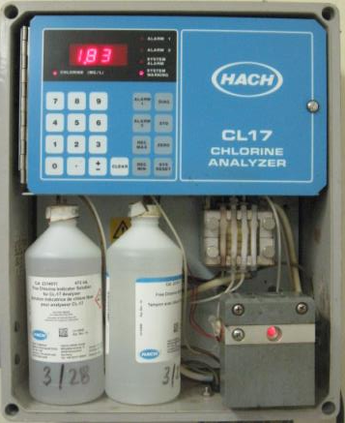
HACH Cl-17
Colorimetric-intensity of light passing through a colored sample
Factory-programmed calibration converts absorbance into mg/L chlorine residual
Batch mode (2.5 minute cycle)
A two-step process: ZERO then READ
Range 0-5 mg/L
Signal averaging: four options
  Option 4: highest of last 2 readings

Slide 32
HACH Cl-17 sample flow
Specifications: 200-500 mL/min
“Ideal” = 300 mL/min
Low flow causes low readings due to incomplete cell flushing
High flow causes low readings due to constant flushing
How to measure:
  From the drain during the 30 second flush (pink color)
  Multiply by 2 to get mL/min

Slide 33
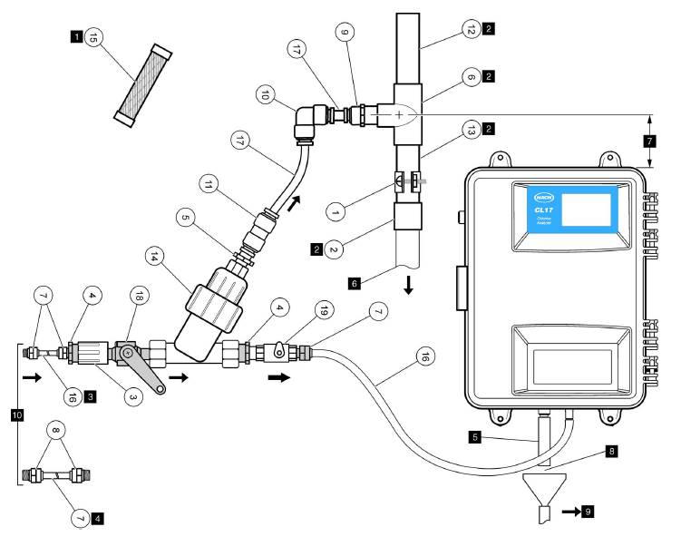
Hach Cl-17 setup & maintenance in the manual
Needs constant head 24 inches above the box
Change buffer/reagents monthly
Replace internal tubing every 6 months
Replace external tubing every 12 months

Slide 34
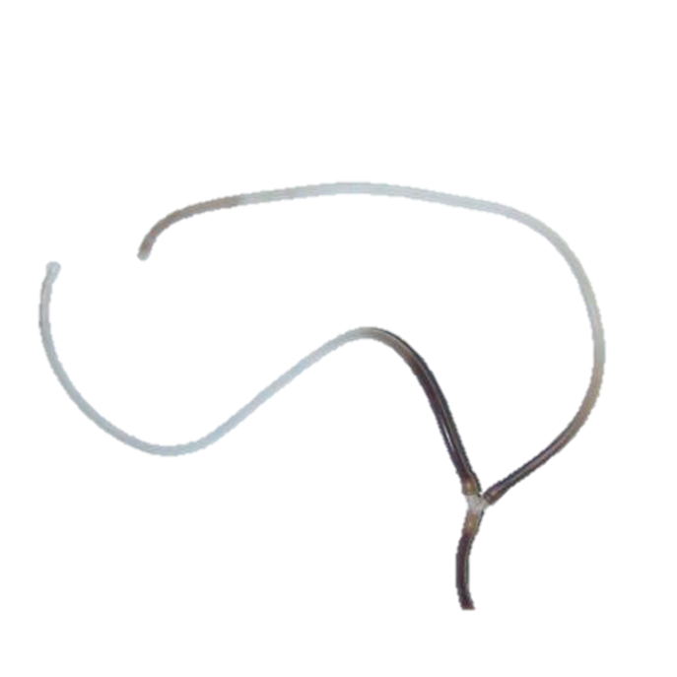
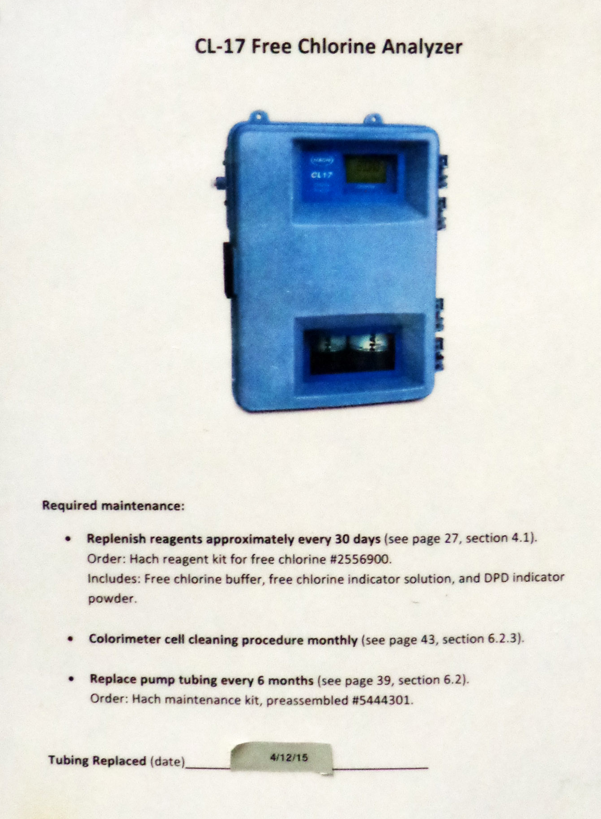

Don’t Forget Maintenance!
Tubing Replacement Interval:
Four years
Post maintenance tasks & instructions on the instrument

Slide 35
Online Analyzer Quiz:
How often should you verify the online instrument to a benchtop chlorine test unit?
A. Daily
B. Twice a week
C. Every 5 days
D. Monthly
C. Never

Slide 36
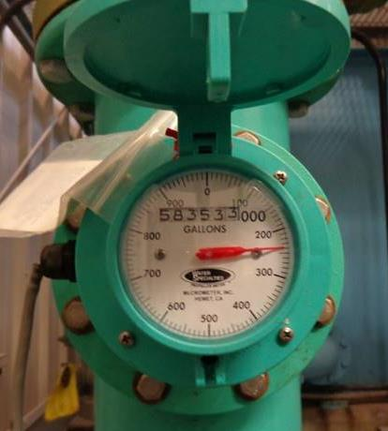
Peak Hourly Flow (PHF)
Measured directly (flow meter) (14/33)
Estimated using daily plant production (7/33)
Estimated from historical meter readings
Assumed constant using engineering calculations
We’ve always done it that way (no idea why)
  12/33 use assumed values
No routine WTP or PHF meter verification (28/33)
Direct measurement of peak hourly flow with a calibrated flowmeter is best

Slide 37
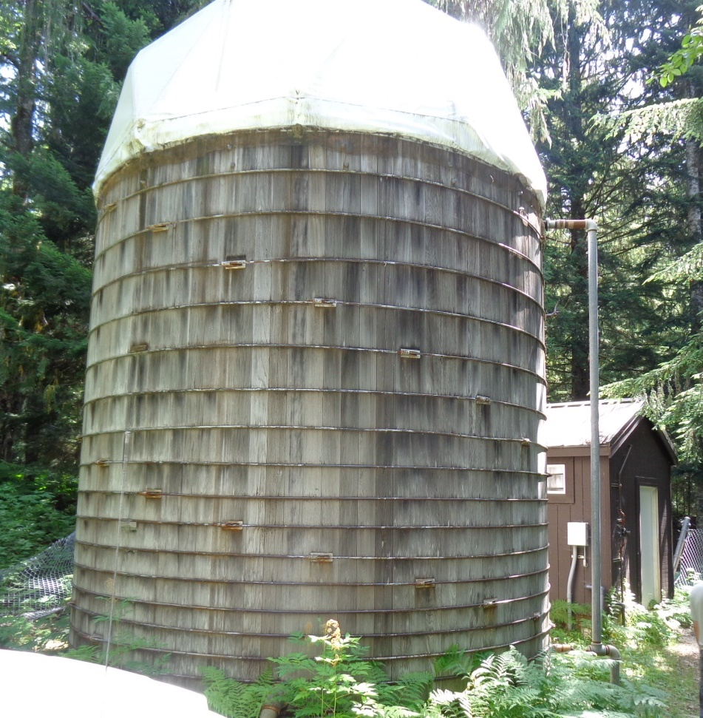
Project Findings-Contact Volume
Physical Dimensions
  18/33 (54%) not verify dimensions
  5/11 don’t match calculations
Volume/Water Level
27 Systems use storage tanks / clearwells for CT
Don’t record water level – 13/27
Can’t (easily) measure
  Five systems had no level measuring devices
Operator unaware of minimum depth assumption

Slide 38
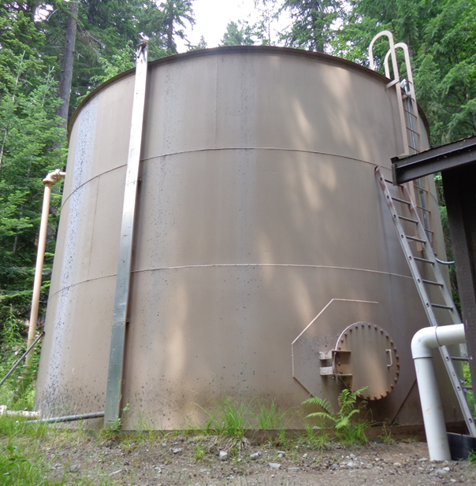
Project Findings-Contact Volume
Physical Dimensions:
Calculations assume 50,000 gal
Measured Volume: 44,600 gal
  11% error
Assumed Minimum Water Level:
Calculations assume tank is full (15 ft)
Actual water depth=11 feet: 32,700 gal
  35 % less total volume than we thought!

Slide 39
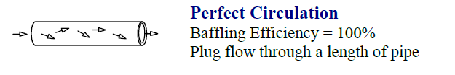
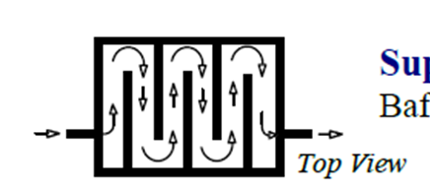
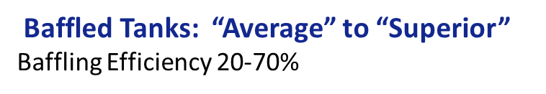
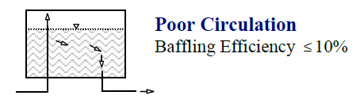
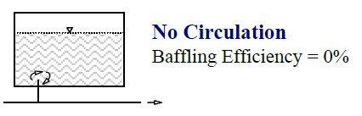
Baffling Efficiency (BE) aka T₁₀/T higher BE means less short circuiting
None

Slide 40
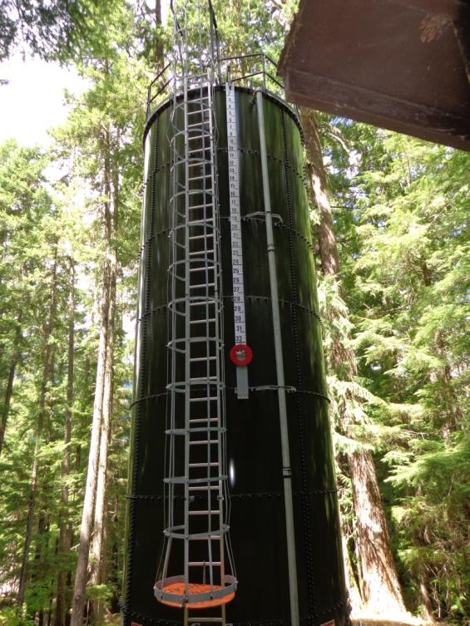
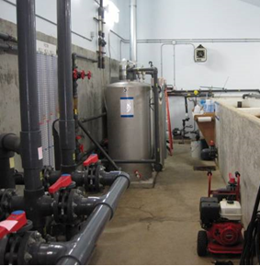
Findings-Baffling Efficiency
9/27 contact tank BE > 0.1
8/9 not verified by tracer study – assumed values
5/7 w/ internal baffles not Inspected
?
Baffled tank? (Assigned BE = 0.7)
Unbaffled tank (Assigned BE = 0.3)

Slide 41
Other Findings: Inappropriate sample locations
Cl₂
A
  pH/temp: 12/33
  chlorine residual: 3/32
B
B
A
Cl₂

Slide 42
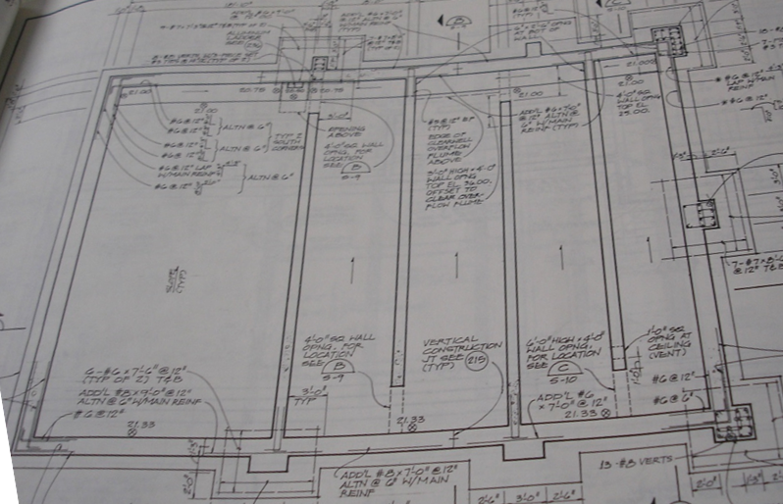
A
D
C
B
A – filtered water entering clearwell; B – chlorine injection point;
C – pH adjustment; D – pump wet well (4 finished water pumps)

Slide 43
Other Findings: Monitoring/Reporting
Not calculating inactivation ratio daily: 6/33
No Standard Operating Procedures (SOPs): 30/33

Slide 44
Standard Operating Procedures (SOPs)
A tool to ensure that everyone does it the right way every time. They need to be:
Written down
Up-to-date
Consistent with industry best practices
Aligned with regulatory requirements

Slide 45

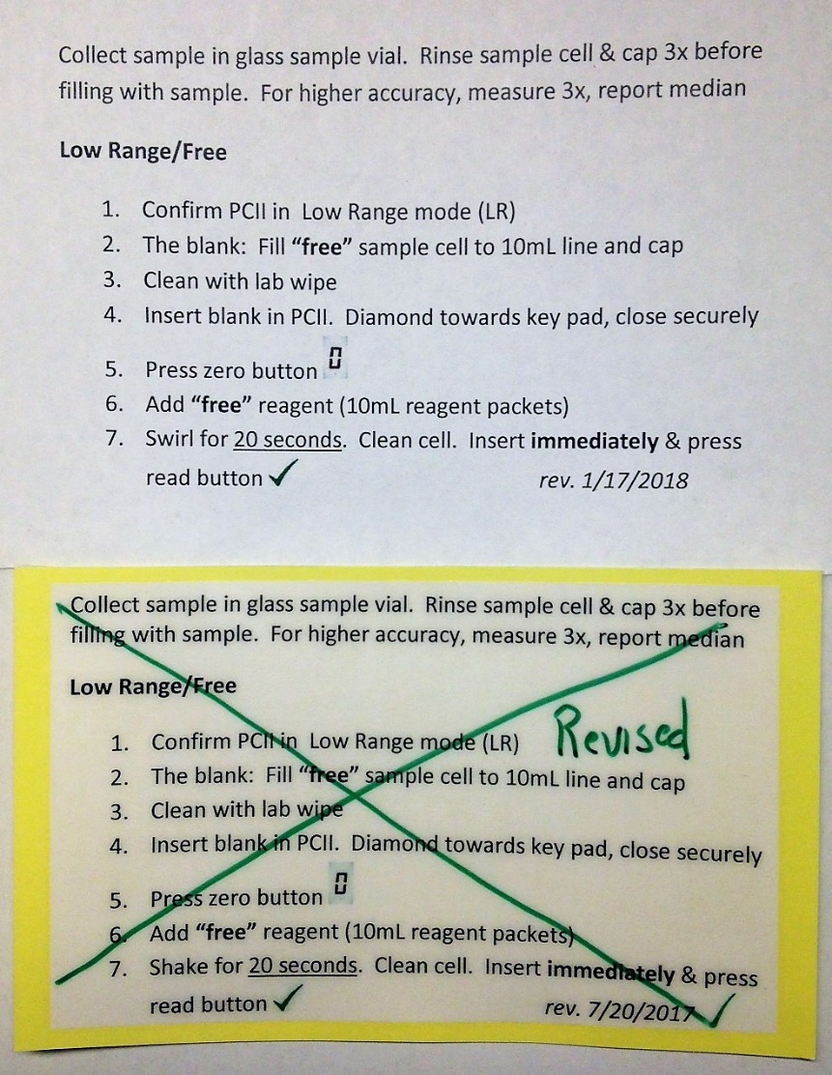
Standard Operating Procedures (SOPs)
Can be as simple as you want
Make sure it works-have someone read it and perform the task (new employee?)
Keep a revision date on each SOP
Review periodically (annual preferred for critical activities & processes)

Slide 46
Ddip- Number of Issues Observed
Issues that could impact data accuracy and precision were found at every plant
One system had only 2 issues, all the rest had more
Eleven systems had at least 9 separate issues
The average across all 33 plants was eight issues

Slide 47

So What Difference Does it Make Quiz:
Which parameter produced the greatest percent error in the disinfection inactivation ratio (IR)?
A. Contact time
B. Temperature
C. pH
D. Chlorine residual
How great was the error?
183%
39%
38%
19%

Slide 48
dDIP Follow-up: Tracer Study Project
Goal: confirm unverified baffling factors (T₁₀/T)
Selection criteria:
  Empirical baffling 0.3 or greater, OR
  Previous tracer issues (tracer or flow interruptions, single flow)
39 systems identified statewide, 32 participated
Funded by SRF setaside
April 2016 - June 2017

Slide 49
Overall results: assumed T₁₀/T values too high
5 were better than assumed
3 were equal to assumed
18 were worse than assumed
6 were better than assumed
5 were equal to assumed
20 were worse than assumed

Slide 50
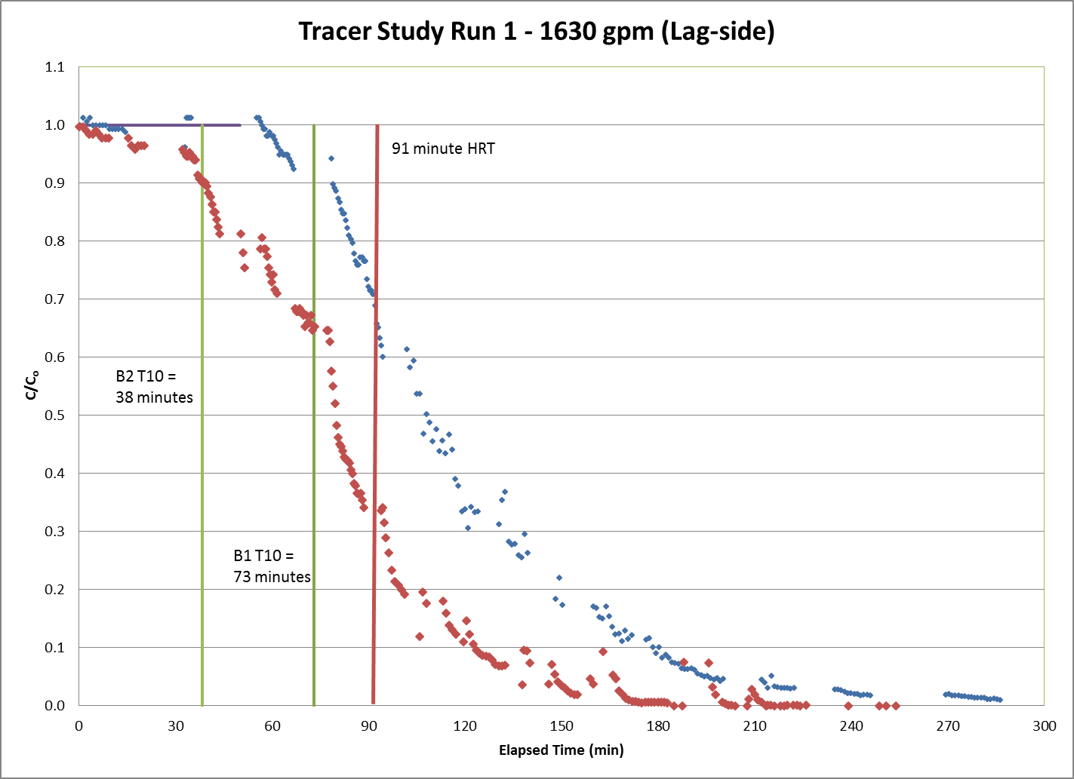
Surprises: unequal flow splitting
Basin construction same → poor flow splitting
T₁₀ values vastly different 38 minutes versus 73 minutes
34%:66% flow splitting assuming similar BE

Slide 51
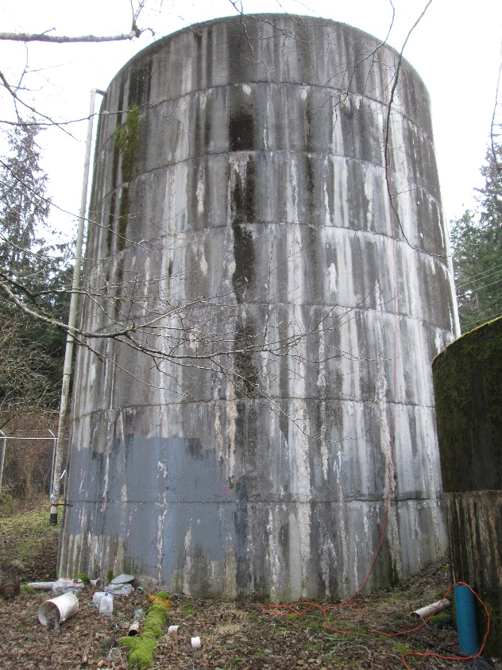
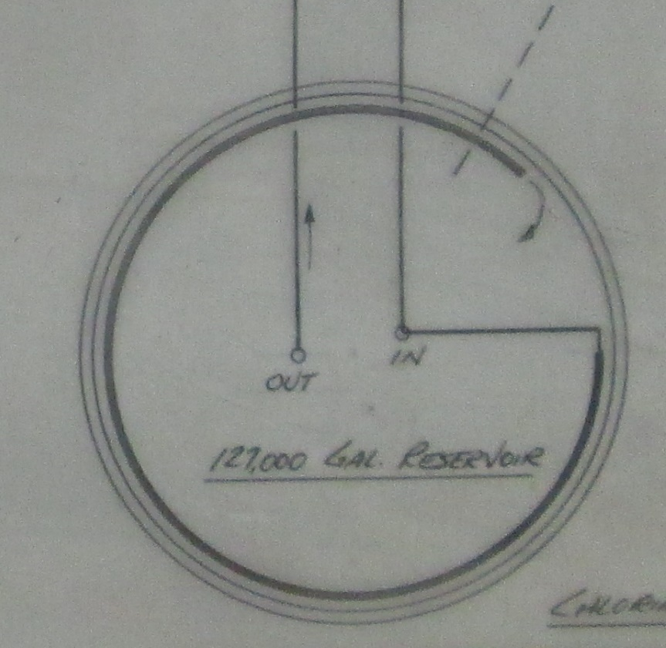
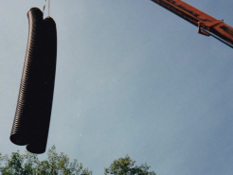

Surprises:
Coiled pipe inside storage reservoir used for CT T₁₀/T=1.0 in pipe
Coiled pipe inside storage reservoir used for CT T₁₀/T=1.0 in pipe.
Inlet Pipe
Outlet Pipe
18” Corrugated CT Piping Inside Reservoir

Slide 52
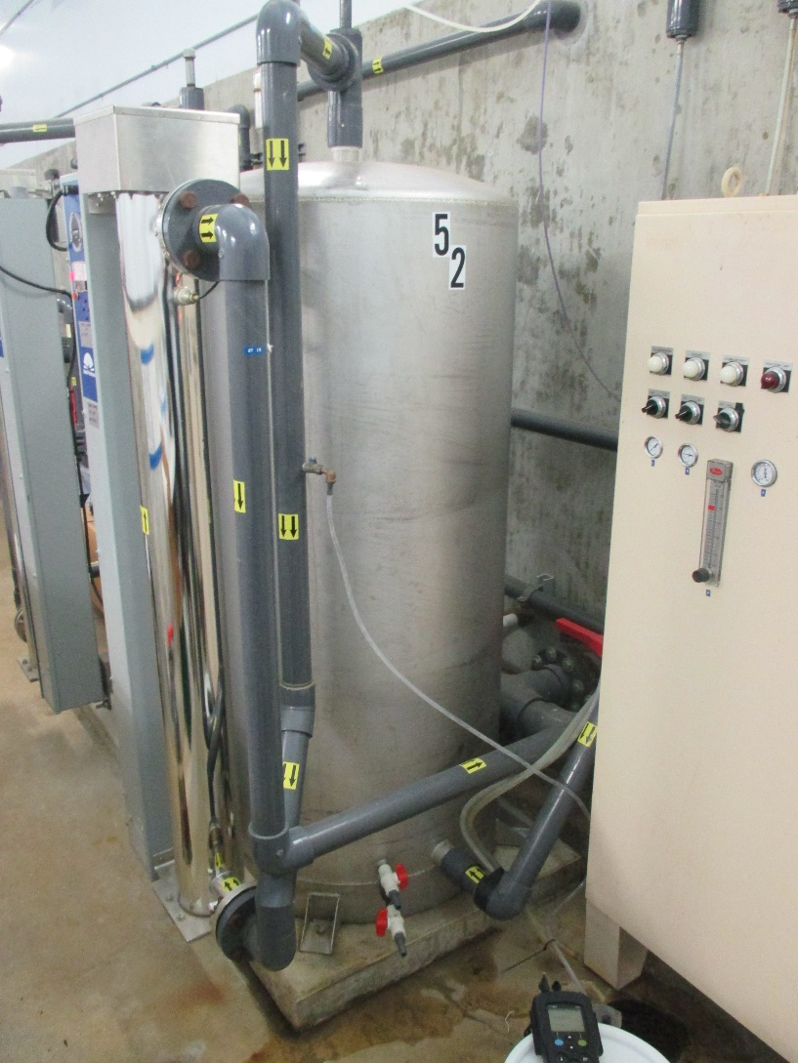
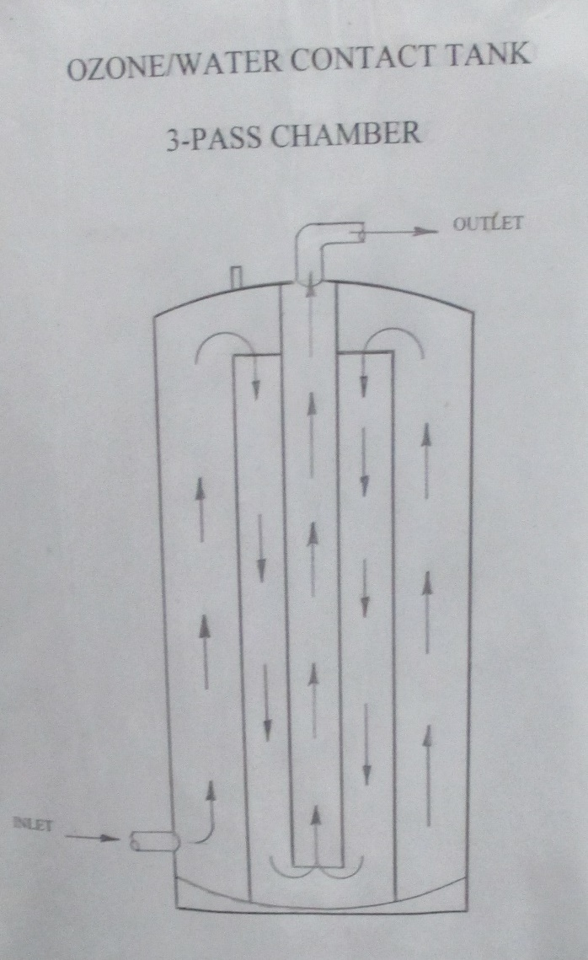
Baffled Custom Tank – Concentric Chambers, Vertical Flow
Assumed T₁₀/T = 0.7
Standard Design Practice – Well-baffled T₁₀/T = 0.7
Tracer Analysis – 0.38 to 0.51
Recommended T₁₀/T=0.4

Slide 53
dDIP Follow-up
Provide Lab skills training
Continue to investigate pH methods (utility, research, EPA 150.3, Vendors, water quality labs)
Eliminate color comparator methods (color wheel, strips)
Revise treatment plant report forms
Develop/refine monitoring guidance for systems
Evaluate more site visits (101!)
Explore impact on other programs (LCR, GW disinfection, fluoridation)

Slide 54
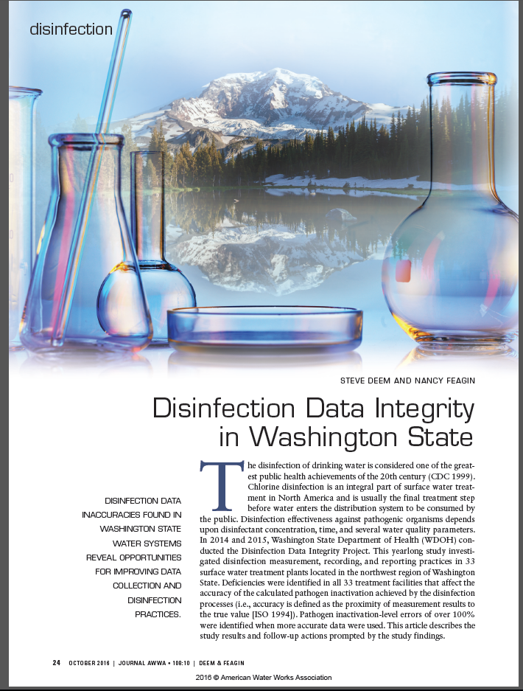
For More Information
JAWWA (Oct 2016)
Englehardt & Malkov, 2015, “Plumbing Sample to a Process Analyzer”, Chlorination, Chloramination and Chlorine Measurement, Appendix C. Hach Company, Loveland.

Slide 55











THANKS!
Kapowsin Water District
Camp Berachah
Doe Bay Community
McHaven Inc
Spring Point Homeowner’s Association
Madrona Community
Oyster Creek Inn
Olga Water Users Association

Slide 56
What is Data Integrity?
Maintaining and ensuring accuracy and consistency of data from sample collection point until the data is used.
VERIFY often so we can TRUST our data and so customers will TRUST us!

Slide 57
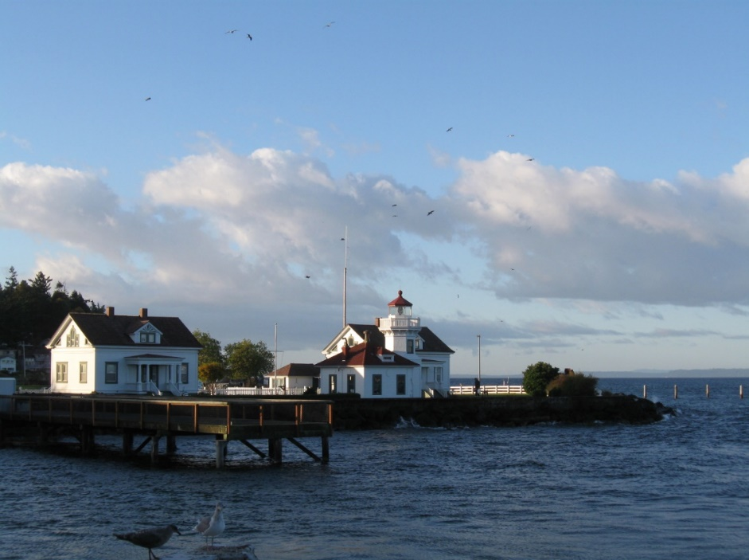

Questions? Comments?
Steve Deem, P.E.
253.395.6767
steve.deem@doh.wa.gov
Nancy Feagin, P.E.
253.395.6765
nancy.feagin@doh.wa.gov

