Slide 1
Introduction To Drinking Water Policy
J. Alan Roberson, P.E.
ASDWA Executive Director
Association of State Drinking Water Administrators
1401 Wilson Blvd. - Suite 1225 - Arlington, VA 22209 - (703) 812-9505 - www.ASDWA.org

Slide 2
Presentation Outline
Why we need more drinking water policy research now
Alan’s limited policy research
Interns’ policy research
Recommendations
Association of State Drinking Water Administrators
1401 Wilson Blvd. - Suite 1225 - Arlington, VA 22209 - (703) 812-9505 - www.ASDWA.org

Slide 3
Drinking Water Policy Research Needed
Limited research to answer critical questions
How effective are the regulations?
Are the right things being regulated?
How are regulatory decisions being made?
What might be the impacts of future regulations and/or revised regulations?
Current regulatory slowdown provides an opportunity to conduct policy research
Target opportunities for future regulations
Maximize future risk reduction
Future regulations will be reducing smaller risks

Slide 4
Alan’s Limited Policy Research
First policy paper published in Journal-AWWA in 1995
Compilation of numbers from DBP negotiated rulemaking
Policy topics began to broaden but were used to feed into EPA’s regulatory development process
Compliance statistics
Contaminant Candidate List(s): example on next slide
Uncertainties with microbial methods and the data
Others
Brainstorm-summer interns could do the analysis
Full of ideas but didn’t have the bandwidth to collect the data & conduct the analysis

Slide 5
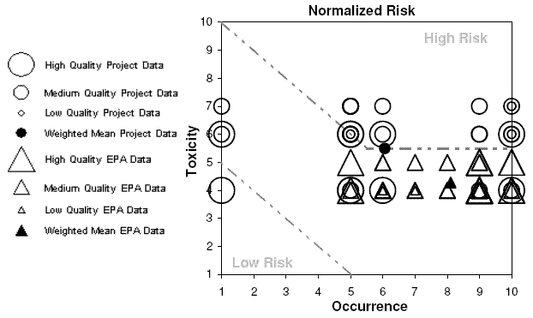
Space Diagram
From “Risk Indices from Draft CCL3 Chemicals”; Roberson, et al; September, 2009 Journal-AWWA
Figure used with permission

Slide 6
Interns’ Policy Research
Goal: pick a project where the work could be done in the summer and then published
Asking a manageable question
Six published papers (publication date shown)
2009: Reiling, et al, on energy costs
2011: Weir, et al, on costs of revised nitrate reg.
2012: Aubuchon, et al, on rates
2013: McGavisk, et al, on arsenic compliance
2015: Alfredo, et al, on chlorate
2016 : Ress, et al, on water loss

Slide 7
Recommendations
Time is ripe for more drinking water policy research
Funding is a big issue
Project development & oversight
Collaborations with universities?
Capstone projects??

Slide 8
Interested in Working on Drinking Water Policy?
For more information, contact
arorberson@asdwa.org
Direct line: (703) 812-9507
Association of State Drinking Water Administrators
1401 Wilson Blvd. - Suite 1225 - Arlington, VA 22209 - (703) 812-9505 - www.ASDWA.org

Slide 9
Research Priorities
to Help Reduce Drinking Water Violations
.
Maura Allaire
Assistant Professor of Water Economics and Policy
University of California, Irvine
ASDWA Webinar
March 26, 2018

Slide 10
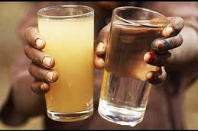
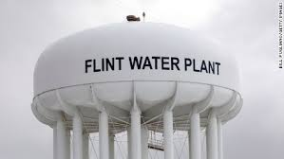
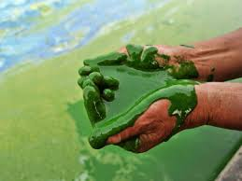

Slide 11
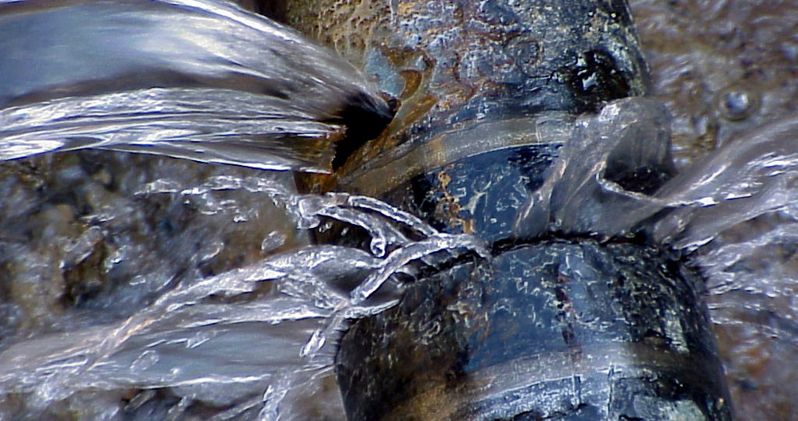
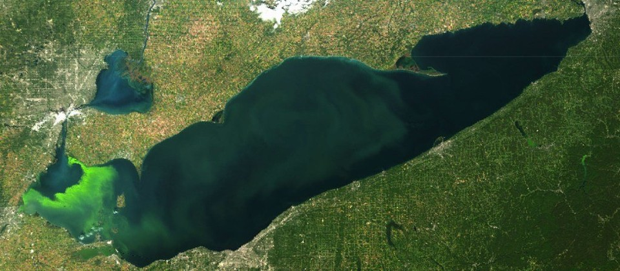
Emerging concerns
Aging infrastructure
Impaired source water
Strained finances
Lake Erie algal blooms (2008-2017)
Corpus Christi, petro-chemicals (2016)
Elk River Chemical Spill (2014, West Virginia)
NOAA, 2017

Slide 12
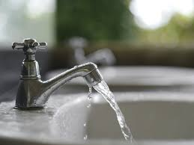
Questions
1. How widespread are violations?
2. Spatial and temporal patterns?
3. Which types of communities are most vulnerable?

Slide 13
Methods
Spatial trends:
Local spatial autocorrelation
Vulnerability factors:
Probit regression: model violation occurrence
Data
Health-based violations (EPA Safe Drinking Water Information System), 1982-2015
Utility characteristics (EPA SDWIS): source water; service population
Community characteristics (U.S. Census): income; housing density; % nonwhite

Slide 14
Health-Based Violations

Slide 15
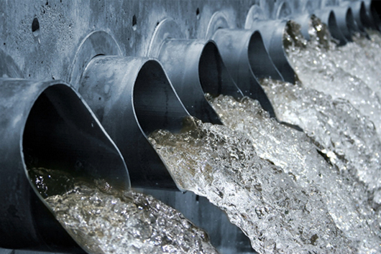
Violations in 2015:
34,000 violations health-related violations
9% of water systems → 3,100 systems
21 million people

Slide 17
Violations across time
Notes:
DBPs

Slide 18
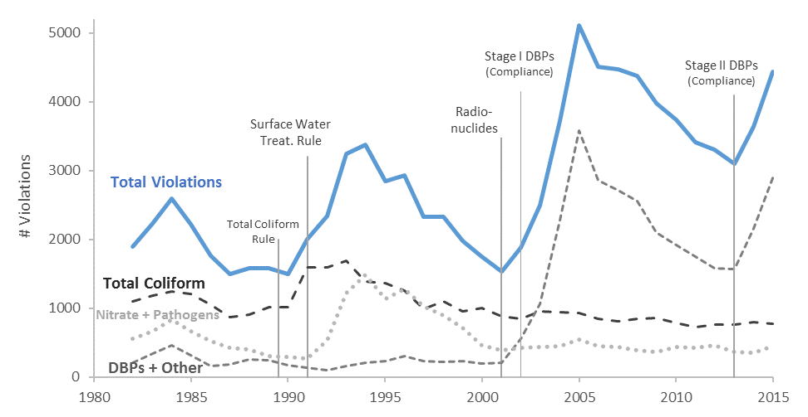
Total # Systems = 17,900

Slide 19
Regional Trends
DBPs in Southwest after early 2000s
(Southwest = Texas, Oklahoma, Arizona, New Mexico)

Slide 20
States that break from national trends
Increasing time trends (greater than national trend):
Nebraska, Arkansas, NM, TX, NC, OK

Slide 21
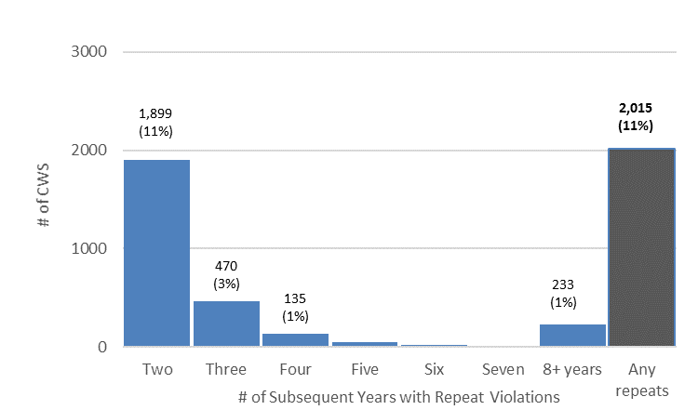
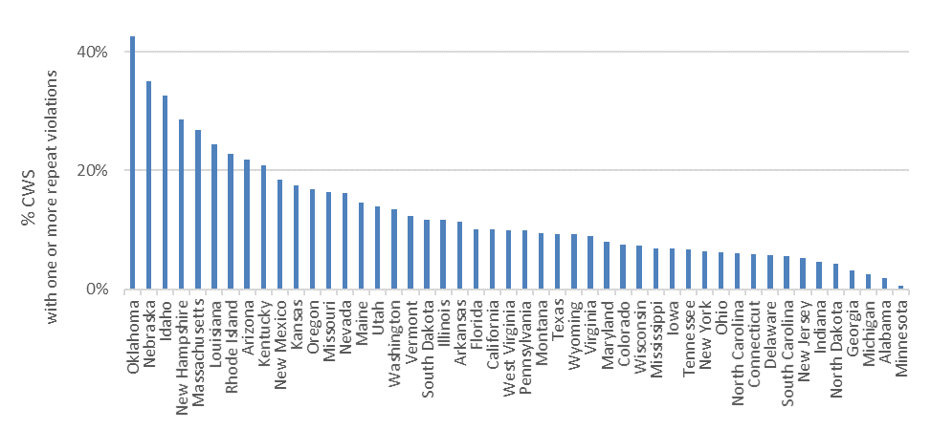
Repeat Violations
Few systems have repeat violations
Yet, some states have large proportion of systems with repeat violations

Slide 22
Vulnerability factors
Violation occurrence modeled with probit regressions
Factors associated with violations:
Utility characteristics (source water, size, etc.)
Demographics (income, population density, racial diversity, etc.)
Control for year & state
Water systems included if:
-Service population > 500 people
-Report violations 1982-2015

Slide 23
Compliance Gap:
Emerged in early 1990s (Surface Water Treatment Rule)
Dramatic increase in 2000s (Disinfection By-Product Rules)

Slide 24
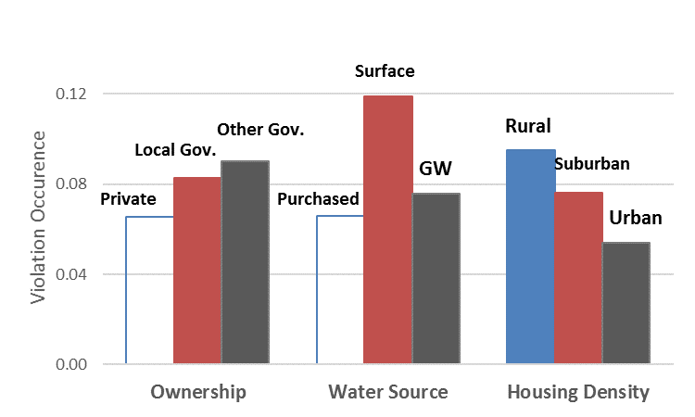
Results: Water System Characteristics
Ownership:
Private least likely to violate
Water Source:
Purchased least likely
Purchased water contracts → option for compliance

Slide 25
Possible Ways Forward
Advanced reporting (SDWIS Prime) & Monitoring
Linkages between Clean Water Act and SDWA
Sub-national SDWA rules: regulate location-specific contaminants

Slide 26
Research Priorities
What is the full-scale of the problem?
Detect unreported violations through:
Consumer purchasing behavior
Develop a tool to rapidly detect quality concerns
How can we reduce violations?
Link between violations and:
Utility finance
Source water quality
Extreme events (heavy rainfall, drought, wildfires)

Slide 27
Questions, Comments, & Interest in Working on Drinking Water Policy:
Maura Allaire
Assistant Professor of Water Economics and Policy
University of California, Irvine
maura.allaire@uci.edu 949-824-5797

