Slide 1
Data Out: Creating a Local Replication Data Repository and using Virtual Exchange Services
Justin Wright, OGWDW Infrastructure Branch
and Harold Valle, Systalex
July 11, 2018

Slide 2
What is a Local Replication Data Repository (LRDR)?
The Local Replication Data Repository is SDWIS State 3.3 formatted data tables, housed on a Primacy Agency’s server, containing a replication of the data in the SDWIS Prime database
Can be a new instance of S/S 3.3 or your existing S/S database
Interfacing applications then continue to connect to the LRDR like they currently do to SDWIS State
Formerly referred to as the “Data Mart”

Slide 3
What are the goals of this effort?
Create a “data out” solution to help Primacy Agencies transition to Prime more quickly
Extend the life of interfacing applications while reconfiguring them to work with APIs
Provide platform to expand SDWIS Prime functionality

Slide 4
Title | Description
SDWIS/ State Data Model | As a SDWIS Administrator, I want the Data Mart structure to include the current SDWIS/State data structure, but expanded to include new SDWIS Prime data elements as they occur.
On Demand | As the SDWIS Admin, I want to have the sync process check the difference between the Data Mart and the SDWIS Prime data partition for my primacy agency on demand so that I can have the latest, most up to date synchronization.
Sync Data Subsets | As a SDWIS Administrator, I want to routinely sync one or more subsets of my data between SDWIS Prime and my local Data Mart because some of my datasets are more time-sensitive than other (e.g., sample results versus facilities).
Schedule Subsets | As the SDWIS Admin, I want to apply a schedule so that the sync process checks for differences between different business objects so that I can tailor the process for my primacy agency’s workload. For example, if my primacy agency processes sample results every morning before noon, I want to have the sync process check for differences at a set time shortly after noon once per day.

Slide 5
Title | Description
Automated Process | As the SDWIS Administrator, I want the data sync process between SDWIS and my local Data Mart to be fully automated, requiring no involvement on either end of the sync process.
Sync Everything | As a SDWIS Administrator, I want to routinely sync all my agency's data between SDWIS Prime and my local Data Mart so that we are working with current data across all modules in the Data Mart.
Set a Schedule | As the SDWIS Admin, I want to set the frequency of how often the sync process detects changes in the state of the SDWIS Prime database partition for my primacy agency so that I can control how often differences are checked so that they do not affect the performance of the Data Mart.
Delay Sync Option | As a system administrator, I need the ability to elect to delay sync of the data mart if a bulk upload transaction(s) is pending. I need the ability for the system to notify any related administrator(s) of the pending bulk upload(s) and wait to process the sync request until it's complete. This way the local system will have all of the changes in the local data mart.

Slide 6
Title | Description
Bulk Data Upload Migration Tables | As a data manager, I would like to query Bulk Data Upload information when records were rejected during bulk data upload process. This relates to Bulk Upload user story for “feedback”.
Time Impact | I'd like the sync engine to evaluate the time needed and the potential impact of every data sync before they are run and delay the sync to another time if it determines that there will be an unacceptable impact to SDWIS Prime performance during normal business hours.
Sampling Migration Tables | As a developer, I would to query sampling migration status from Sampling Migration Tables if Sampling Migration Tables is available for Prime
Performance Feedback | As the SDWIS Admin, I want the sync process to generate reports showing the volume of my agency's data exchanged between the Data Mart and the SDWIS Prime database and estimates of how long it will take before sync starts and completes so that I can *refine the scheduled syncs to make them more efficient*.

Slide 7
How Does it Work? (VES)
“The Virtual Exchange Service (VES) is a cloud-based platform for creating data exchanges on the Exchange Network. The VES eliminates the need for Partners to create and maintain a node server. The VES supports all of the functions of a node and simplifies the creation of data exchanges.” It allows Primacy Agencies to configure replications of the SDWIS Prime database to their Local Replication Data Repository
The VES is a cloud-based platform designed to minimize the burden of building data exchanges by using standard templates that define much of the processing

Slide 8
How Does it Work? (VES cont.)
If you have a node, agencies can use VES to supplement their existing node or to replace their node
The exchanges (e.g. SDWIS) are configured not installed
Agencies can get started quickly using the VES web application wizards
All new components and features such as dataflow definitions and services are shareable (from VES or between partners)

Slide 9
How Does it Work? (VES cont.)
After initial run, only updated content pulled from Prime into LRDR to expedite transfers
Replication schedule will be customizable (weekly, daily, hourly)
On demand runs to update data as needed

Slide 10
Who is using VES? (VES cont.) VES Partners and Dataflows
Hualapai Tribe: WQX production flow
San Joaquin Valley Air District: ICIS AIR
Jefferson County Health Dept: ICIS Air
Klamath Tribe: WQX
Alabama: ICIS-AIR
Georgia: ICIS-AIR dataflows , EIS
Region 1: Storm 3 Buoy Flow, SPCC Tanks
Tennessee: ICIS-AIR, ICIS NPDES
Texas: AQS, Facility FRS
Maine: ICIS data access (Export)
Gold Systems: WQX, ICIS-AIR, AQWMS
New Hampshire: Facility, AQS, etc..
South Dakota: TRI-OUT, ICIS-AIR, EIS
Pacific States Marine Fisheries Commission: Fishery information publishing service

Slide 11
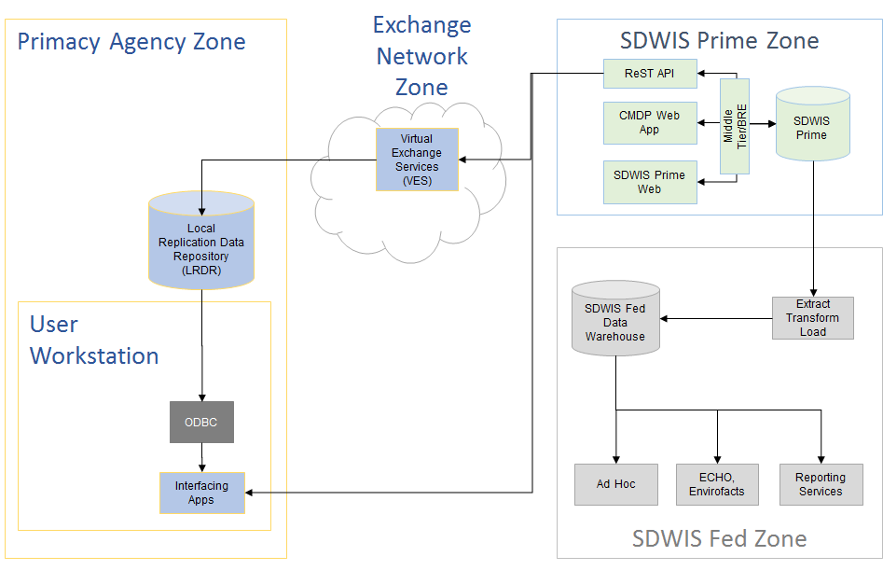

Slide 12
What do Primacy Agencies need to do to use these services?
Run scripts and follow instructions provided by EPA to establish an LRDR
Install the VES Connector software (Windows required); on any workstation or server that can connect to the database server
Contact EPA personnel to establish connections & accounts
Configure VES to replicate at regular intervals

Slide 13
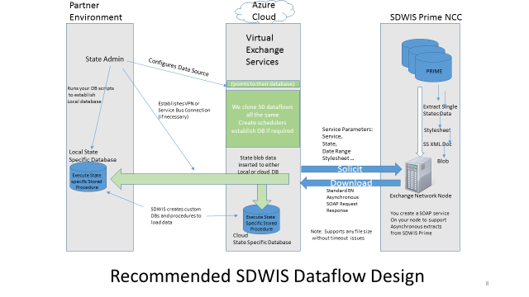

Slide 14
Where Are We? Status and Plans
All connections established in staging environment
Able to pull XML file from SDWIS Prime and move it to Systalex server
Working on parsing the XML into staging tables
Virginia and Utah using EN grant funding to participate in development
Working with Virginia now to set up VES Connector on their server; drafting instructions on establishing the LRDR; Utah will be next
Finalize instructions & States’ LRDR: September
Primacy Agencies will then be able to follow instructions to set up their own LRDR/VES

Slide 15
Install Local Replication Data Repository (LRDR)
LRDR database script provided creates the following database objects under a new database/schema/user. LRDR will house tables and procedures to store and process the SDWIS Prime XML. No external dependencies.
Tables
Store incoming SDWIS Prime .zip file.
SDWIS Staging tables (prefixed STG_)
Store Job information for processing the incoming .zip file .
Job error table ( records any errors during processing
Job Log ( records # of records extracted , inserted, updated, deleted during processing)
Data base Procedures (Oracle/SQL Server)
Uncompress zip file
Process to parse XML file into SDWIS Staging tables (Xquery/Xpath)
Synchronize data in Staging tables with Local SDWIS
Scheduler
Schedule a job to check for incoming files.

Slide 16
Install Local Replication Data Repository (LRDR)

Slide 17
Install VES Connector
The virtual node connector is a component for establishing secure network connectivity between virtual node in the cloud and database server in your enterprise environment without opening firewall. It uses several layers of security to safeguard the access:
Token Authentication: The virtual node connector connects to the Internet Service Bus using a secure authentication token.
Transport Security: All communications between your node and database server are encrypted and signed through IPSec.
Application Authentication: Database layer authentication is enforced by the virtual node. All incoming request to database servers are authenticated.
Node Access: All requests to Virtual Node must be authenticated through NAAS.
The virtual node connector can be installed on any Windows Server as long as it has local network connectivity to the database server.

Slide 18
Install VES Connector

Slide 19
Install VES Connector
Installation Directory

Slide 20
Install VES Connector
Service Bus Token

Slide 21
Install VES Connector
Sub Namespace & Database IP
Enter an appropriate value for Sub namespace, [State abbreviation]-[Organization abbreviation], e.g. MD-DNR. Please make a note of the Sub-namespace; it is needed later to setup connectivity from the Virtual Node.
Input the internal IP address and port for your database server, e.g. 192.168.0.10:1433. You may configure more than one databases with different IP addresses separated by commas.

Slide 22
Install VES Connector
Sub Namespace & Database IP

Slide 23
Install VES Connector
Software Installation Complete

Slide 24
Install VES Connector
Software Installation Complete
Once installation is complete:
Confirm CDX Connector windows service is started. If the service has not started automatically, start it manually.
Once your connector is up and running, please contact the Exchange Network Helpdesk with your Sub Namespace and the database local IP address. They will provide a special port #, i.e., 1000, associated with your Sub Namespace. This port # will be used to configure your data source in the VES in a future step

Slide 25
NAAS Account
A CDX Network Authentication and Authorization Service (NAAS) Account is required to login to the VES cloud and call the SDWISVES service.
If you don’t have a NAAS account, email the CDX node helpdesk(nodehelpdesk@epacdx.net ) to request a NAAS account with the VES Admin Role and access to the SDWISVES dataflow.
An account name and password will be provided which will server as your login to VES Admin portal.
If you have an existing NAAS account , email the CDX node helpdesk(nodehelpdesk@epacdx.net ) and request the VES Admin Role and access to SDWISVES dataflow be added to your NAAS account.
Your existing NAAS credentials will be used to login to the VES Admin portal.

Slide 26
Virtual Exchange Service Admin
The Virtual Exchange Service Admin allows for :
Creating a Virtual Node
Create/Configuring a data source that allows VES to connect to your database and write data.
Create/configure a service which calls the SDWIS VES Dataflow and writes the data to your database
Create/Configure a task which calls the Service at specified interval(hourly, daily, weekly,etc)
Viewing of transaction logs to review status of service calls.
To start, log in with your Naas credentials in the upper right corner of the site.

Slide 27
Virtual Exchange Service Admin

Slide 28
Virtual Exchange Service Admin
Node Dashboard
Links to configure Virtual nodes, data sources, dataflows, services, tasks,view transactions ,etc
Summary of registered Nodes , data sources, services, tasks, etc.

Slide 29
Virtual Exchange Service Admin
Node Dashboard

Slide 30
Virtual Exchange Service Admin
Virtual Node
A virtual node must be requested and approved to start using VES. Click the “Create a Node” link to request creation of a Virtual Node.
Node request is reviewed and approved by CDX

Slide 31
Virtual Exchange Service Admin
Add a Virtual Node

Slide 32
Virtual Exchange Service Admin
Data Source
A data source configures the connection between VES and your state database.
Note: The VES Connector Port is the port # provided from VES Connector step.

Slide 33
Virtual Exchange Service Admin
Add a Data Source

Slide 34
Virtual Exchange Service Admin
Data Flow
The dataflow page specifies the CDX data flow being used for the data extract.

Slide 35
Virtual Exchange Service Admin
Add a Data Flow

Slide 36
Virtual Exchange Service Admin
Service
The service page specifies what is done with the data extracted from the data flow, in this case we are writing it to the state database.

Slide 37
Virtual Exchange Service Admin
Add a Service

Slide 38
Virtual Exchange Service Admin
Task
The task page specifies the schedule for calling a service.

Slide 39
Virtual Exchange Service Admin
Add a Task

Slide 40
Virtual Exchange Service Admin
Test Service
The test service page allows for calling a service on adhoc basis

Slide 41
Virtual Exchange Service Admin
Test Service

Slide 42
Virtual Exchange Service Admin
Search Transactions
The search transactions page allows for viewing transaction log

Slide 43
Virtual Exchange Service Admin
Search Transactions

Slide 44
Virtual Exchange Service Admin
Transaction Details
Transaction details page shows detailed account of a transaction.

Slide 45
Virtual Exchange Service Admin
Transaction Details

Slide 46
Virtual Exchange Service Admin
File written to LRDR table

Slide 47
Virtual Exchange Service Admin
Scheduler Extract XML from ZIP

Slide 48
Virtual Exchange Services
Resources
Website
http://www.exchangenetwork.net/virtual-exchange-service/
VES Connector Guide
VES Administrator Guide
https://vnap.cloudapp.net/vnap
VES Overview
Getting Started Guide

Slide 49
Comments? Questions?
Contact:
Justin Wright, OGWDW
202-564-0678
wright.justin@epa.gov

