Slide 1
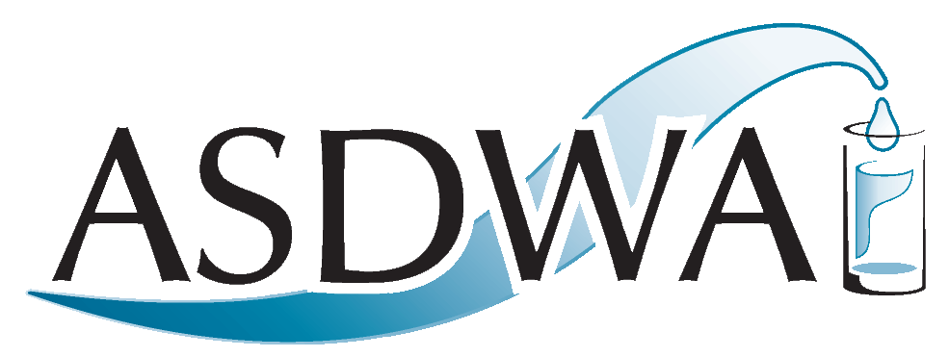
USDA Natural Resources Conservation Service (NRCS) National Water Quality Initiative (NWQI) Source Water Protection WEBINAR
Deirdre Mason
Association of State Drinking Water Administrators
August 1, 2018

Slide 2
About ASDWA
Mission: To protect public health and the economy through the provision of safe drinking water
Members: Drinking Water Program Administrators: 50 states, territories, the Navajo Nation, and the District of Columbia
Public Water System Oversight
Regulation
Technical assistance
Funding – DWSRF, set-asides
Coordination with Multiple Partners
Prioritize and support source water protection

Slide 3
Today’s Webinar
Purpose:
To share information about the new USDA NRCS National Water Quality Initiative (NWQI) Source Water Protection “Readiness” Pilot set to launch in FY 2019.
To offer tips and perspectives for state source water protection programs on how to collaborate with NRCS State Conservationists, state clean water programs, and local partners on projects for this NWQI pilot.
To provide an example of an NWQI source water protection project proposal being developed in Connecticut that highlights the value of collaborating with each partner.
Presenters:
Dee Carlson, NWQI Program Coordinator for NRCS
Martin Lowenfish, Conservation Initiatives Team Leader for NRCS
Erika Larsen, Nonpoint Source Management Branch at EPA’s Office of Water
Tom Morgart, NRCS State Conservationist for Connecticut

Slide 4
After the Webinar
Please note that a video recording of today’s webinar will be made available for viewing on ASDWA’s web site within the next few days at
http://www.asdwa.org/source-water

Slide 5
Please Type In Your Questions!
Please type your questions into the box on your webinar control panel.
We will not be taking verbal questions.
You may type in your questions at any time during the webinar.
We will answer questions after all of the presenters are finished speaking.

