Slide 1
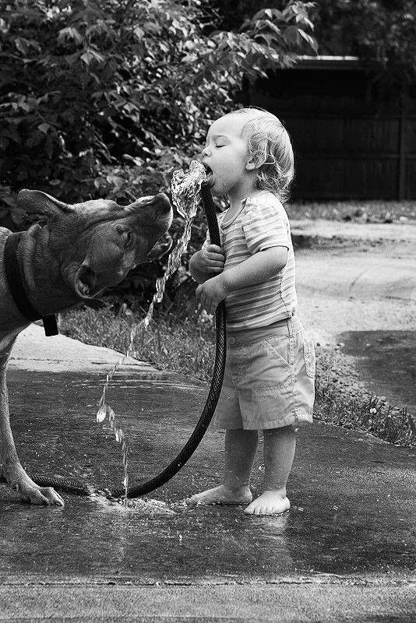
National Water Quality Initiative (NWQI)
Accelerating voluntary conservation for clean water, and fostering rural community partnerships across the US

Slide 2
How NRCS Provides Assistance for Conservation
NRCS first works one-on-one with landowners to develop a conservation plan that meets their goals and vision for their land.
The conservation plan is a roadmap for which conservation practices best meet the landowner needs and that address resource concerns.
Financial assistance covers part of the costs to implement conservation practices.
Financial assistance applications are ranked, and those ranked highest in addressing resource concerns will receive financial assistance for the cost of implementing practices.
Payment rates for conservation practices are reviewed and set each fiscal year.

Slide 3
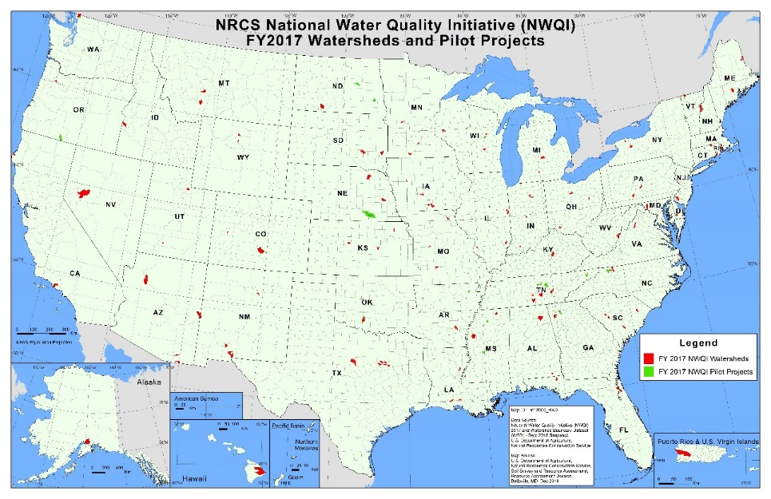
NWQI Launched in 2012
Provides an opportunity for partners to work with NRCS on a shared vision for water quality priorities, targeting funding for water quality improvement
Priority watersheds selected in collaboration with state water quality agencies, facilitated by EPA
Notes:
Currently 201 watersheds throughout the US receiving accelerated funding

Slide 4
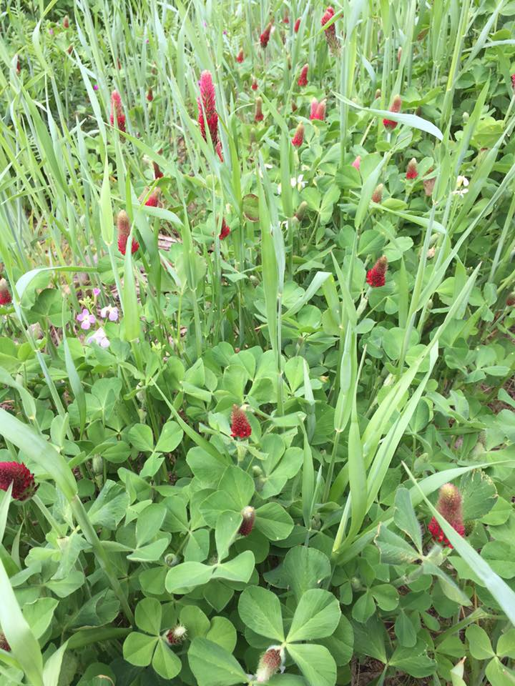
Locally-Led Voluntary Conservation
Assists producers to voluntarily implement practices to address water quality in small watersheds
Primary goal to reduce nonpoint sources of nutrients, sediment, and pathogens related to agriculture

Slide 5
Watershed Selection
NRCS State Conservationists (STCs) consult with State water quality agencies and partners to evaluate the status of NWQI watersheds, and propose to add or withdraw watersheds based on NWQI criteria and State priorities
The watershed must be associated with a water body that:
Is impaired
Has a TMDL
Is threatened (water quality data documenting an impairment, but is not documented in the Integrated Report
Is critical (upstream of an impaired segment that is determined to be a significant contributing source of a downstream impairment)
For SWP pilot, there are no specific selection criteria other than there is agreement among partners that the SWP area is a priority for the state

Slide 6
Watershed Selection Considerations
There needs to be sufficient technical capacity and producer interest to warrant a long-term investment in the selected watershed/SWP area:
Adequate technical capacity in the watershed/area, from NRCS or partners, to conduct sufficient outreach and technical assistance to meet project goals?
Does a network of partnering agencies already exist that can carry out identified activities needed to meet goals?
Is there sufficient density of producers and producer interest to meet project goals?
Can partners conduct instream monitoring to track the change in water quality attributed to NWQI practices?

Slide 7
Adaptive Approach
Initiatives continue to be adapted to meet the needs of NRCS, customers and partners
Results of program evaluation are used to make improvements
In FY 2017, a pilot project was initiated to provide for watershed assessments and outreach plans prior to funding (“readiness phase”)
The readiness phase was mainstreamed in FY 2018

Slide 8
Changes for FY2019-FY2023
FY 2019 changes to NWQI will strengthen water quality efforts
Expansion of program
All watersheds will have watershed/SWP assessments that identify critical source areas
Multi-year watershed budget proposals
Changes will be phased in over FY2019 and FY2020

Slide 9
NWQI Expansion – Source Water Protection Pilot
Original focus on addressing surface water bodies impaired under the Clean Water Act
In FY2015 special consideration for watershed selection was provided if the impaired water body was a source of drinking water
In FY 2019, NWQI will initiate a pilot to address source water protection, including surface and ground water sources
Priority SWP areas can be selected independently of NWQI watersheds that are selected for surface water assessment and implementation
Any SWP areas proposed must be delineated by the state SWP program/utility and have a SWPP available
Notes:
SWP pilot areas can be selected independently of NWQI watersheds, but partner groups can select hybrid projects that address impaired waterbodies and source water concerns as well. Expectations for partners and monitoring would be the same as for other watersheds.

Slide 10
Phased Adoption of Changes: Readiness Phase
Readiness Phase Watersheds (need watershed assessment):
States that have identified new priority watersheds that need watershed assessments can request the readiness phase for FY2019
For the SWP pilot, SWP areas can be proposed for a readiness phase in FY 2019 to expand on existing SWPPs to provide comprehensive assessment for implementation needs

Slide 11
NWQI Watershed Assessments (Readiness Phase)
Watershed assessment at the HUC-12 scale (or SWP area) helps to identify critical source areas needing treatment, and assess effective conservation systems amenable to producers
Assessment ties into/complements existing plan(s) – it is not a stand-alone plan
Assessment is a useful document to inform conservation planning at the field level
Beginning in FY2020, all approved NWQI watersheds/SWP areas will have assessments completed.
Notes:
Watershed assessments for NWQI are done at the HUC12 level. These assessments provide more information about the pollutant transport mechanisms, and help identify risk factors in the watershed. These assessments complement the existing watershed plan and help to achieve the goals of the plan. The assessments follow area wide planning policy and include the first 6 steps of planning. The assessment should be a useful document which helps identify areas in the watershed most in need of treatment, and which helps to determine the best suites of practices to address the water quality concern, while fitting the types of operations and the producers’ needs. We know that staff time is often limited in the field and that additional planning beyond the field or operation level is difficult. To address this, NWQI initiated a pilot project in FY 17 to provide CTA funding to assist with planning. There are 17 states with 21 watersheds developing watershed assessments and outreach strategies to complement the existing watershed plans.

Slide 12
Watershed/SWP Area Assessments
There must be an actionable watershed/SWP plan that meets NWQI Assessment Guidance:
Sufficient assessment to guide the siting and implementation of conservation practices at the HUC-12 level/SWP area for greatest water quality benefit
Identification of critical source areas within the watershed for identified pollutants of concern
Established goals for water quality improvement, with specific metrics that can establish progress towards these goals
Outreach strategies for implementation on vulnerable acres
These assessments can be in any format and information can be provided in multiple documents for the watershed/SWP area

Slide 13
Phased Adoption of Changes: Implementation
Implementation Phase Watersheds (ready for accelerated funding):
Current approved NWQI implementation watersheds can receive continued funding in FY2019
In FY2020, current approved watersheds must provide a watershed assessment and a multi-year proposal in order to continue accelerated funding
In FY2019, current readiness phase watersheds that have completed their watershed assessments may submit a multi-year proposal for funding
New priority watershed multi-year implementation plans will be solicited in FY2020
This gives NRCS time to work with partners to develop watershed assessments and comprehensive implementation plans during FY2019

Slide 14
NWQI Funding
Funding assistance is provided directly to landowners to implement conservation practices through NRCS’s Environmental Quality Incentives Program (EQIP)
NRCS State Offices determine funding level needs based on watershed/SWP area assessment
Assistance with assessment development may be provided through Conservation Technical Assistance $$
Beginning in FY 2020, all NWQI watersheds/SWP areas will have a multi-year implementation plan that includes budget with anticipated annual funding needs through FY23.
Strengthens commitment of NRCS and partners to accelerated efforts
Notes:
Which agency or organization will lead implementation and monitoring efforts in project areas?
What level of commitment is expected of state and other partners? Will state drinking water programs or other partners (utilities) be expected to commit to implementation support, monitoring, and/or outreach tasks throughout the life of the project (through 2023)?

Slide 15
Multi-Year Implementation Plan
Required for new NWQI watersheds/SWP areas beginning in FY2020
Developed by NRCS with assistance from partners
Based on information from the watershed assessment/watershed plans
Includes information on:
Watershed characteristics
Proposed budget by year
Conservation systems that will be used and list of practices
Primary resource concerns (NRCS specific) and metrics to measure progress
Description of targeting methods and identification of critical source areas
Producer interest and partner involvement/assistance

Slide 16
Measuring Progress
All NWQI watersheds/SWP areas will assess progress toward meeting goals:
When possible, select watersheds where baseline water quality monitoring data already exist.
Track implementation on the identified critical source areas within the watershed.
Report on the specific metrics that were developed with partner input to demonstrate progress in meeting goals.
Interim metrics must be directly related to the water quality concern (e.g., load reduction percentage, pounds of P prevented from leaving field, change in biotic integrity score, change in P index results weighted across the watershed, reduction in violations, monitored nitrate levels in groundwater, etc.).

Slide 17
Interim Metrics to Measure Progress - Examples
Goal |  | Unit of measurement
REQUIRED: Maximize practice implementation on critical source areas within the watershed. The % of critical source areas with conservation by the end of the project should be a value (e.g. 50%) determined through the assessment/planning process. |  | % of critical source areas with conservation
(Example) 35% increase in the amount of acres with conservation that have received full treatment (avoid, control and trap) by the end of the project for identified water quality concerns. |  | % of treated acres that moved to full treatment status over the course of the project
(Example) Achieve a documented % in N and P loads through water quality modeling at pour point in sub-watershed by 2023. |  | lb/yr measured from baseline
Baseline condition
REQUIRED: Current % of critical acres in the watershed with at least one conservation practice intended to treat water quality.
(Example) The NRCS CCBI is used to determine that only 10% of acres treated with conservation practices are fully treated (avoid, control, and trap practices implemented)
(Example) Modeled flow weighted total N and P loads at the pour point have averaged 5000 lbs of P and and 21,000 lbs of N prior to project.
How will goal be assessed, and how often? Does the assessment require partners?
REQUIRED: Compare the final % of critical source areas with practice implementation to the baseline condition to get an implementation rate over the life of the project. Determine whether the goaled amount (e.g. 50% of critical sources acres with implementation) was met.
(Example) The NRCS CCBI is used to determine that by the project end, 30% of treated acres within the watershed are now fully treated for identified water quality concerns.
(Example) Modeling provided by partner. N and P loads with practices implemented demonstrate slight positive trends for the watershed. Average P loads are reduced by 10% and N loads by 15% after 4 years of accelerated implementation.
SWP Example: Current median nitrate level in groundwater is 15 mg/L. Established goal is a 25% reduction. Ongoing monitoring to determine reduction achieved after conservation implementation
Notes:
Nitrate level in groundwater – goal is a 25% reduction. Current median level 15 mg/L nitrate. Ongoing monitoring to determine reduction achieved after 4 years – modeling identified % contributions from different land use/operations and can estimate nitrate load reduction based on implemented acres

Slide 18
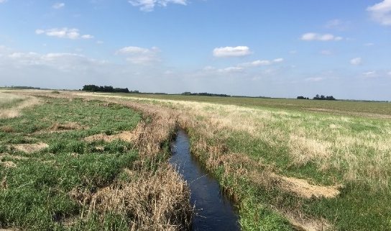
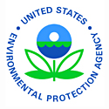
The Role of State Water Quality Agencies and EPA in the National Water Quality Initiative (NWQI) Lynda Hall and Erika Larsen, Nonpoint Source Management Branch
Office of Water, EPA

Slide 19
Role of EPA, NRCS, State Water Quality Agencies
NRCS | EPA | State Water Quality Agency
Targeted water quality conservation practice implementation and technical assistance through EQIP NWQI watershed selection Assessment and planning through NWQI readiness phase and Source water/Drinking water pilot Report on NRCS metrics annually | Promote coordination between NRCS and state water quality agencies Guidance on NWQI instream monitoring efforts Support state use of 319 funds Technical support on monitoring and watershed planning Report on state metrics annually | Focused water quality monitoring in ~60 watersheds Coordinate with NRCS on watershed selection process Direct use of 319 funds to support variety of activities Annually report to EPA on NWQI progress

Slide 20
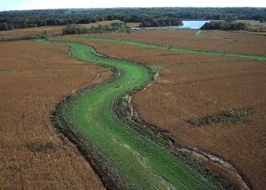
Ensuring Water Quality Success through NWQI and beyond*
Keys to NWQI success
Focused partnership efforts in small watersheds
Targeted implementation of key practices in the right places (critical areas)
Watershed planning efforts underway include coordination between state agencies and NRCS
Sharing appropriate data to assess progress through instream monitoring
Principles that increase likelihood of measured water quality improvement:
Adequately describe problems and pollution sources
Watershed plan developed and implemented with local stakeholders
Critical areas and appropriate conservation practices defined
Quantitative water quality and monitoring goals
Anticipate high level of implementation and landowner participation, with good outreach capacity
Have stable funding and effective information, education, technology transfer mechanisms
* Per USDA, Land-grant University, and EPA science

Slide 21
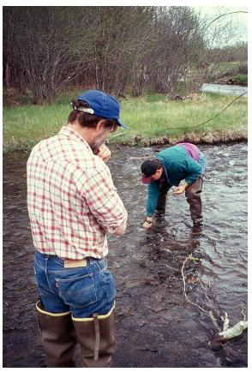
NWQI Water Quality Monitoring Goals & Objectives
Monitoring Goal: assess NWQI implementation impacts on water quality for nutrients, sediment, and/or pathogens
document that water quality has improved beyond what would be expected given natural variability and other factors in the watershed
NPS effectiveness monitoring is challenging, can take 7-10+ years
NWQI FY16 state reporting- focus on monitoring activity
Preliminary results indicate:
States use a variety of monitoring approaches, but majority use multi-station long term trend, single station long term trend or multiple approaches
States indicated that water quality changes have been detected in ~>15 watersheds, and majority of those improvements associated with agricultural activity

Slide 22
Lessons learned from ~6 years of NWQI Implementation
Understand the importance of your role in the NWQI
NRCS and State agencies have a shared goals and distinct roles
Start planning early!
Keep lines of communication open throughout the year
Engage local partners
Need for plans at the right scale
Ability to ID critical source areas and develop outreach strategies
Communicate about needs and successes
Identify and report on metrics
Notes:
Allocation formula the same since early 1990’s; largely a function of population and acres of cropland; includes several other factors including extent of water features
Territories get a small percentage of funds that in recent FYs have been ~ $400K for most territories, $800K for PR.
Tribes get 5% or $8M, whichever is greater – program policy. Tribes operate under separate guidance and funding structure.
Match - many states leverage these funds well beyond the required match; 2011 report noted 20 states invested 2-4x the value of their §319 funds beyond expected match, through other state and local funding sources
50/50 split - ensures robust focus on environmental results (OMB interest when GL updated).

Slide 23
APPENDIX

Slide 24
NWQI Metrics and Measures
Short-term (1 to 5 years)
Total amount of 319 funds and match invested in NWQI watersheds, and activities funded (EPA)
Trends in coordination and partnership between states and NRCS based on response to questions (EPA)
Focused watershed monitoring efforts – report on monitoring design and activity in ~60 NWQI watersheds (EPA)
Acceleration of conservation practice system implementation compared to general programs (NRCS)
Increase in producer participation in NWQI watersheds (NRCS)
Modeled nutrient and sediment load reduction estimates and number of edge of field monitoring sites (NRCS)

Slide 25
NWQI Metrics and Measures
Long-term (5 to 10+ years)
Number of focus watersheds documenting positive water quality changes through accelerated implementation of conservation practice systems (EPA)
Number of impaired segments/waters proposed for delisting for one or more priority pollutants (nutrients, sediments, pathogens, related parameters) (EPA)
Indication of long-term coordination and effective state-NRCS partnerships as a result of NWQI (EPA)
Number of watersheds meeting a conservation treatment need documented by NRCS state offices (NRCS)

Slide 26
Connecticut Source Water Activities
August 1, 2018 Thomas L. Morgart
Notes:
GO TO VIEW > MASTER > SLIDE MASTER TO EDIT THE IMAGES ON THE TITLE AND DIVIDER SLIDES
RIGHT CLICK ON THE INDIVIDUAL IMAGES TO CHANGE THE IMAGE

Slide 27
Source Water Protection Readiness
How did Connecticut NRCS get Started on Source Water Protection?
NB 300-18-26 LTP – National Water Quality Initiative (NWQI) Watershed Selection and Criteria for Implementation and Readiness Phases of NWQI – Fiscal Year (FY) 2019. This bulletin included a source water protection readiness component.
Get to Know your EPA Source Water Protection Coordinators.
EPA Region 1 Kira Jacobs and Ted Lavery

Slide 28
EPA Source Water Connections
EPA connected CT NRCS to the Connecticut Department of Public Health’s Drinking Water Section and provided introductions via conference call.
Discussed the opportunities of the source water protection readiness phase and information NRCS would need in order to be able to consider developing a readiness application.
CT Dept. of Public Health was able to provide CT NRCS with a GIS layer that included source water areas including well heads.
Some states consider the GIS layers to be private and will not share this data. A Memorandum of Understanding might be required to gain access to the source water data layer.

Slide 29
Analyzing Source Water Protection Opportunities
Analyze source water areas using NRCS data layers
Land use
Cropland
Forestry
Urban
303d Ag Impaired Watersheds
303d Ag Impaired Public Water Supply Areas *
Conservation planning data (IDEA)
Financial assistance data (IDEA)

Slide 30
303d Ag Impaired Watersheds

Slide 31
303d Ag Impaired Public Water Supply
Ask your State Water Quality Agency for this layer.

Slide 32
Land Cover Layer

Slide 33
Analyzing Source Water Protection Opportunities
After analyzing the data layers, Connecticut had a short list (2) of source water areas where NRCS conservation practices could have an effect on water quality.
Additional evaluation factors added
Local knowledge – willingness of producers to participate
Number of ag operations
Google Earth to ground truth current conditions
Changes in land use to non agricultural
Changes in agricultural use

Slide 34
Potential Source Water Readiness Project

Slide 35
Building a Partnership
Held a meeting with potential key partners including:
Regional Water Authority
Connecticut Department of Public Health
Connecticut Department of Energy and Environmental Protection.
Environmental Protection Agency
Source Water Protection Liaison
Agricultural Liaison

Slide 36
Topic discussed
Opportunities available through National Water Quality Initiative and the Source Water Protection Readiness Pilot.
Support of all the key partners
Source water protection plans or evaluations
Need to define impairments
Ag producer and community support
Funding sources, NRCS-EQIP, EPA-319, rate payer funds
Current monitoring and a commitment to future monitoring

Slide 37
Next steps
Discuss this opportunity with the State Technical Advisory Committee
Continued conversations with partners
Request a source water protection pilot area by September 14th.

Slide 38
Contact Info
Contact information: Tom Morgart Thomas.Morgart@ct.usda.gov
860-871-4014

Slide 39
In accordance with Federal civil rights law and U.S. Department of Agriculture (USDA) civil rights regulations and policies, the USDA, its Agencies, offices, and employees, and institutions participating in or administering USDA programs are prohibited from discriminating based on race, color, national origin, religion, sex, gender identity (including gender expression), sexual orientation, disability, age, marital status, family/parental status, income derived from a public assistance program, political beliefs, or reprisal or retaliation for prior civil rights activity, in any program or activity conducted or funded by USDA (not all bases apply to all programs). Remedies and complaint filing deadlines vary by program or incident.
Persons with disabilities who require alternative means of communication for program information (e.g., Braille, large print, audiotape, American Sign Language, etc.) should contact the responsible Agency or USDA’s TARGET Center at (202) 720-2600 (voice and TTY) or contact USDA through the Federal Relay Service at (800) 877-8339. Additionally, program information may be made available in languages other than English.
To file a program discrimination complaint, complete the USDA Program Discrimination Complaint Form, AD-3027, found online at How to File a Program Discrimination Complaint and at any USDA office or write a letter addressed to USDA and provide in the letter all of the information requested in the form. To request a copy of the complaint form, call (866) 632-9992. Submit your completed form or letter to USDA by:
mail: U.S. Department of Agriculture
Office of the Assistant Secretary for Civil Rights
1400 Independence Avenue, SW
Washington, D.C. 20250-9410;
(2) fax: (202) 690-7442; or
(3) email: program.intake@usda.gov.

Slide 40
Helpful Resources
Source Water Collaborative website
Toolkit on How to Work with NRCS State Conservationists
NRCS website
List of current NWQI FY 2018 approved watersheds
NRCS State Offices Directory
ASDWA website
www.asdwa.org/sourcewatercontacts
AWWA website
USDA Tools to Support Source Water Protection
(Guide for Water Utilities)

Slide 41
Contacts
Deirdre Mason - dmason@asdwa.org
Karen Wirth – Wirth.Karen@epa.gov
Dee Carlson - Dee.carlson@wdc.usda.gov
Martin Lowenfish - Martin.Lowenfish@wdc.usda.gov
Erika Larsen - Larsen.Erika@epa.gov
Tom Morgart - Thomas.Morgart@ct.usda.gov
ASDWA website
VIEW THE WEBINAR RECORDING at
www.asdwa.org/source-water

Slide 42
Please Type In Your Questions!

