Slide 1

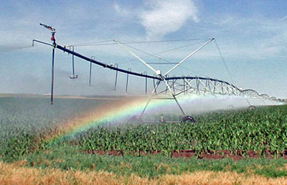
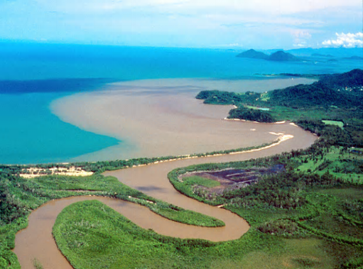
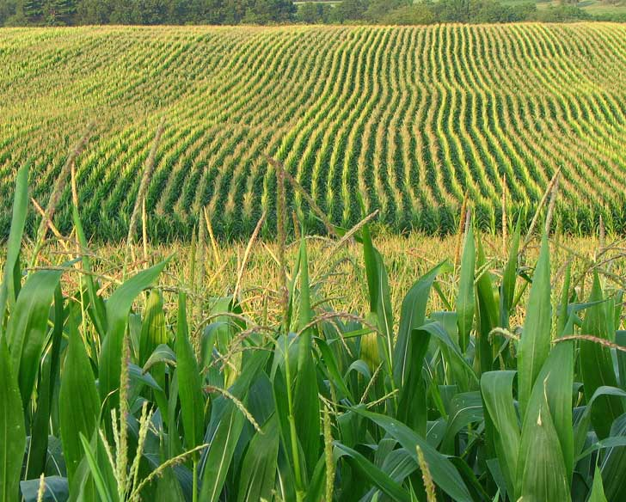
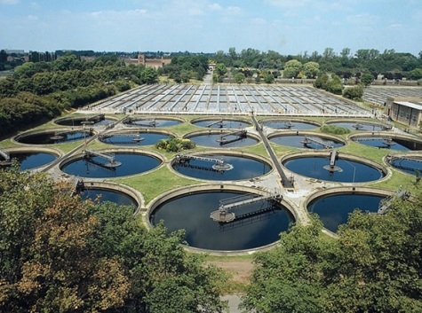
Current and Emerging Tools for the Assessment of Water-Quality Conditions in Waters of the
Conterminous U.S.
Stephen D. Preston
National Water Quality Programs
U.S. Geological Survey

Slide 2

Current and Emerging Tools
* Updated spatially explicit models for the U.S.
* New and updated national geospatial data sets
* New web-based water-quality mapping systems
* New models for assessing benchmark exceedance probabilities
2

Slide 3
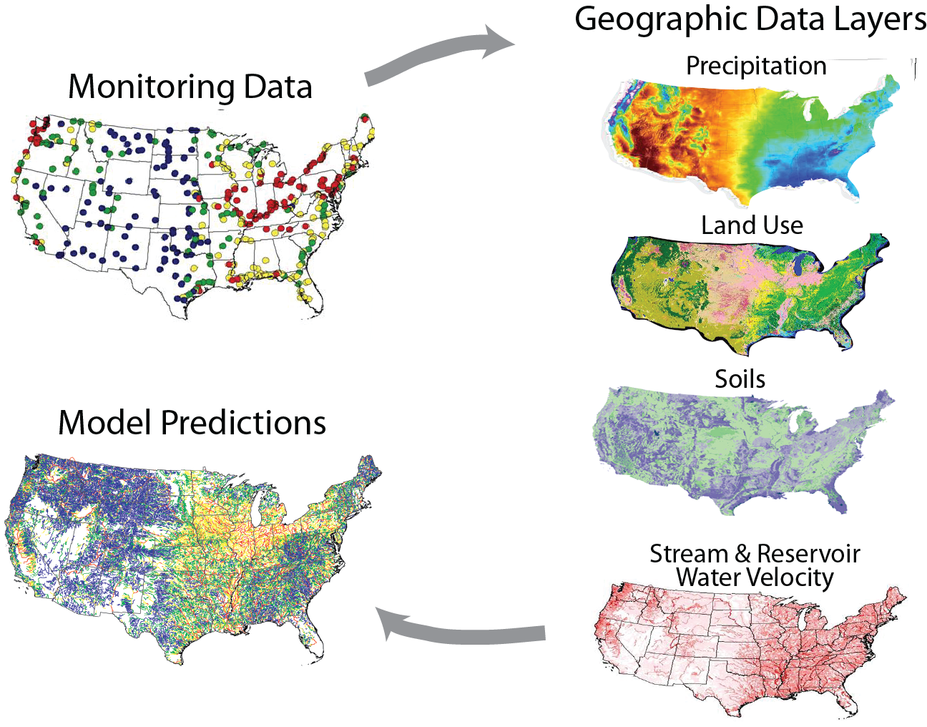
SPARROW Water-Quality Model
SPAtially Referenced Regression on Watershed Attributes)
Model Predictions
3

Slide 4
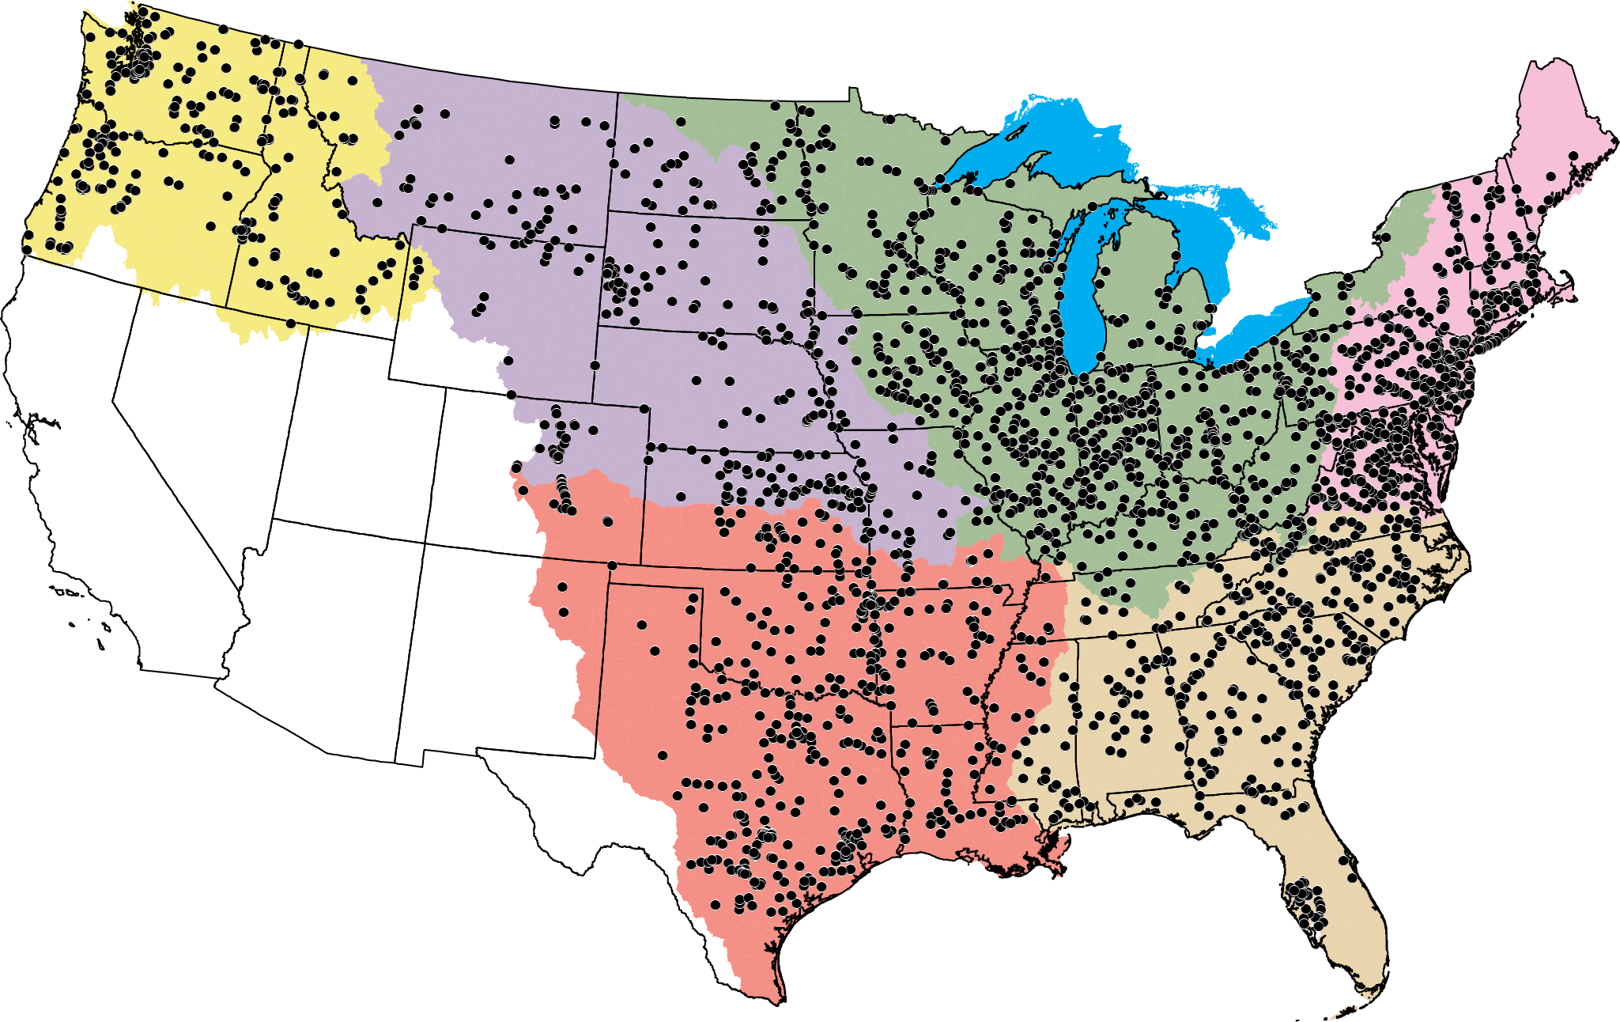
Monitoring Data Are Critical for Modeling
2,700 calibration sites with data from 73 agencies
4

Slide 5
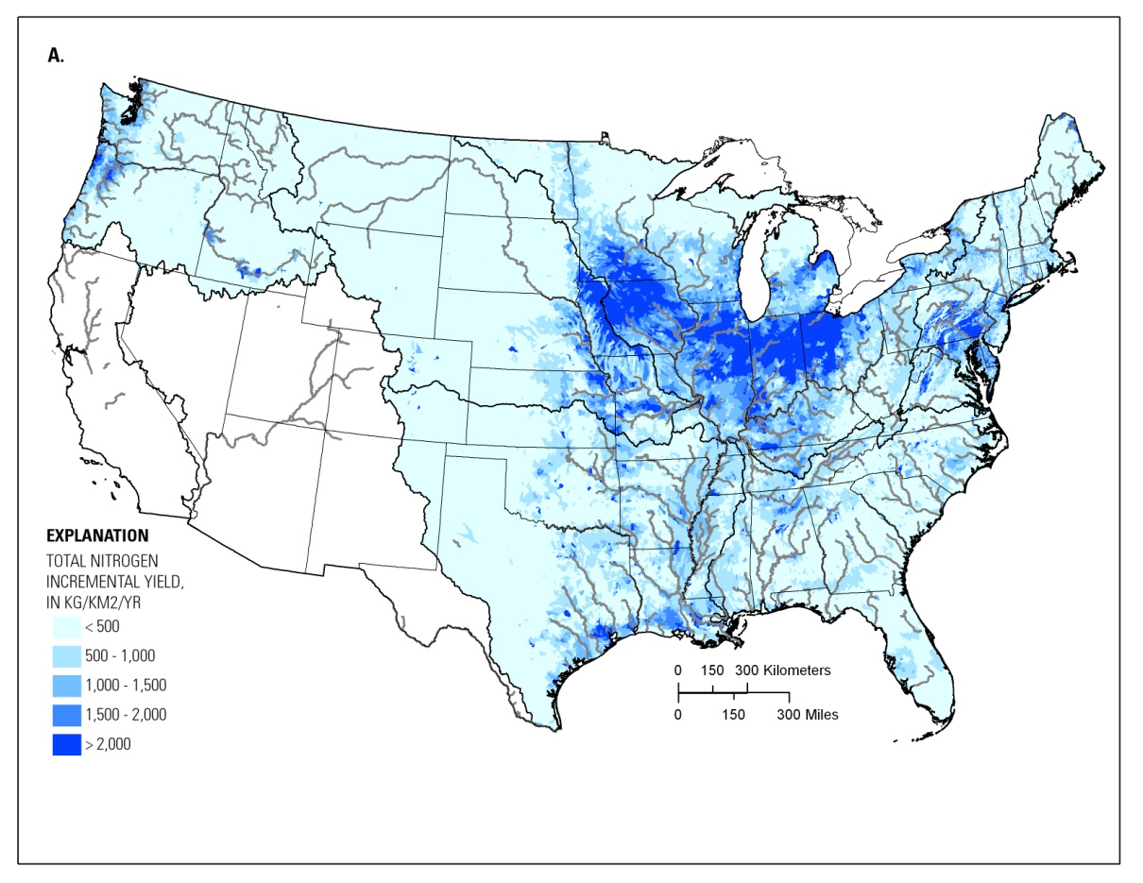
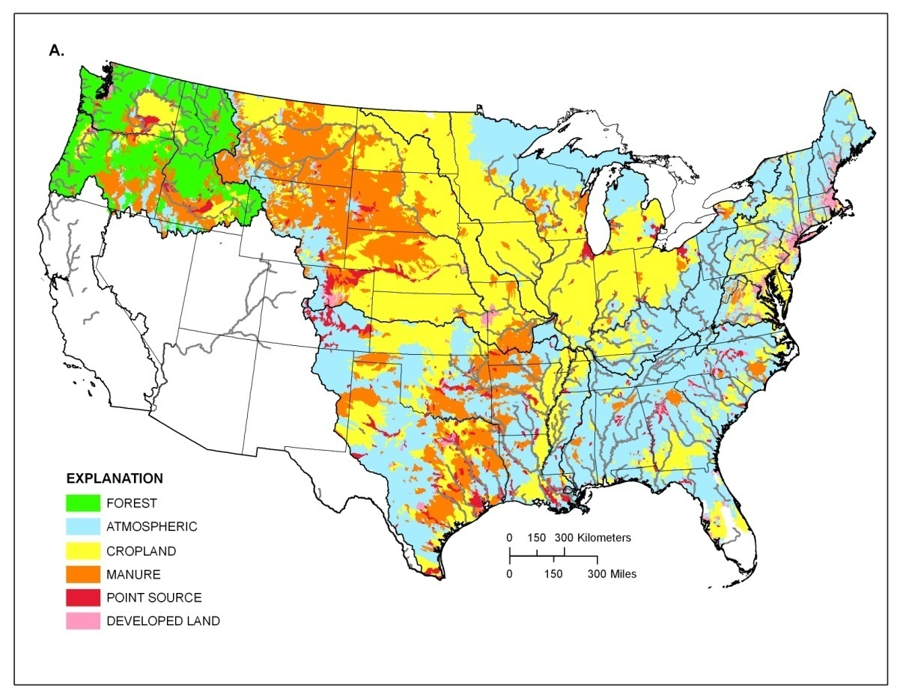
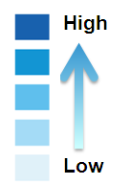
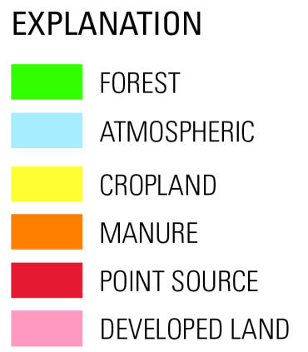
Total Nitrogen Yields and Sources
Yields
Largest Sources
Preston, et al (2011) Factors Affecting Stream Nutrient Loads: A Synthesis of Regional SPARROW Model Results for the Continental United States. https://doi.org/10.1111/j.1752-1688.2011.00577.x
5

Slide 6
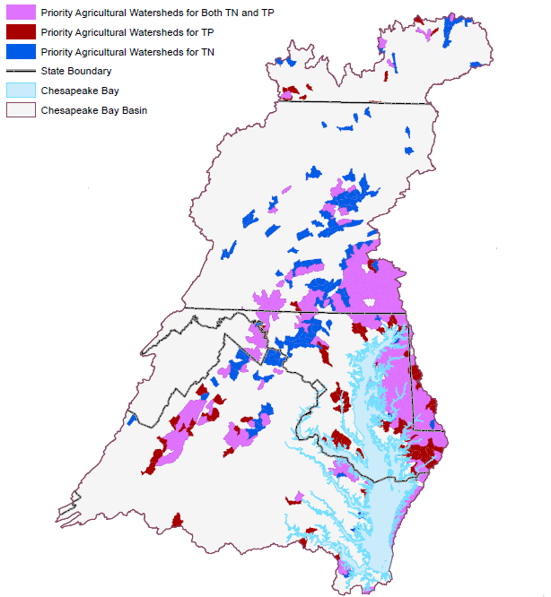
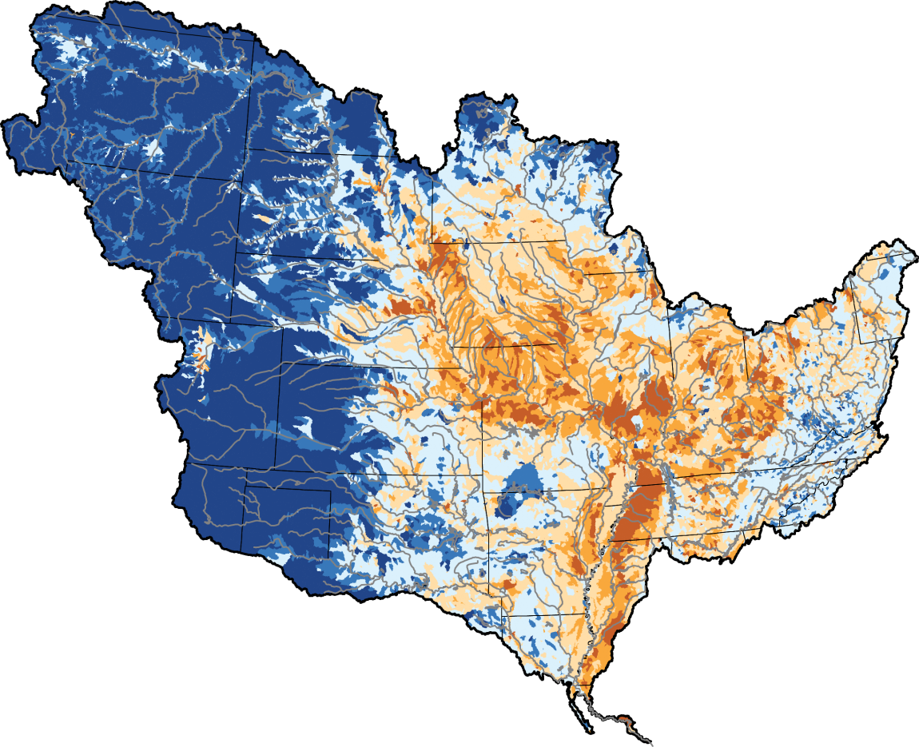


How SPARROW Models Can Inform
Nutrient Management Decisions
Relative Contributions of Phosphorus to the Gulf of Mexico
Chesapeake Bay Priority Agricultural Watersheds
Largest Sources of Nitrogen to U.S. Streams
Predict mean-annual flux, yield and concentration for unmonitored streams
Predict contaminant flux to downstream receiving waters such as estuaries
Apportion stream loads to major nutrient sources and upstream watersheds
Provide a framework for prioritizing areas for management actions
Evaluate the potential effects of landscape change scenarios on water quality
SPARROW Predictions of Stream Nitrogen Flux
Both TN and TP
TP
TN
High
Low
6

Slide 7
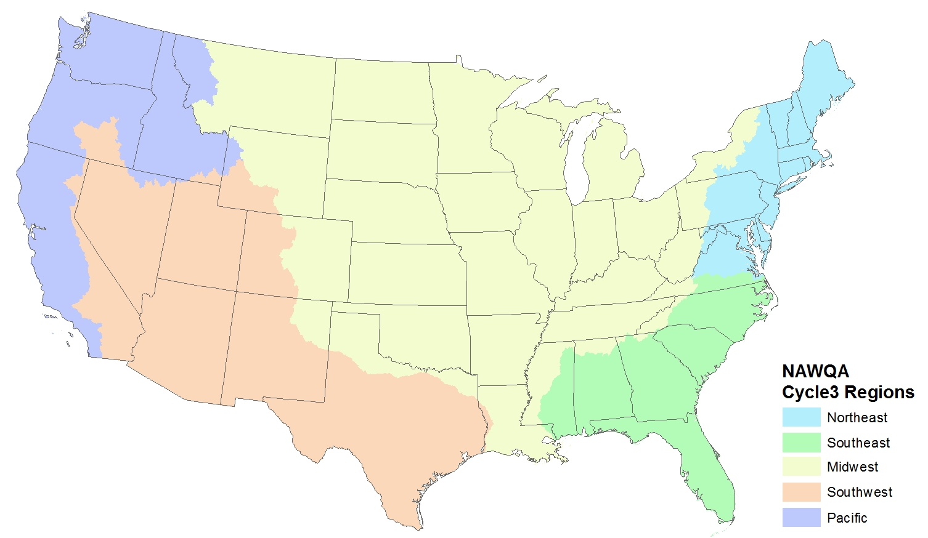
SPARROW Model Updates for 2012
* Models for 5 regions covering the conterminous U.S.
* Models based on NHDPlus (100K) spatial framework
* Models based on improved geospatial data sets
* Models developed for each of 4 constituents: water balance, nutrients (N&P), sediment
NAWQA
SPARROW Modeling Regions
* Expected completion 2019
7

Slide 8
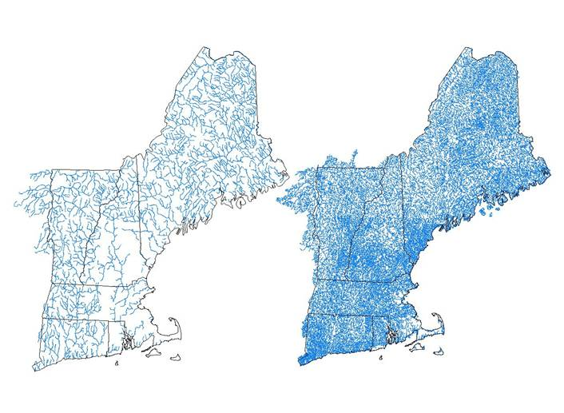
NAWQA Cycle 3 SPARROW Modeling
Improved Stream Network Data
RF1 (1:500,000)
2,462 Reaches
NE SPARROW Enhanced NHD (1:100,000)
42,000 Reaches
8

Slide 9
NAWQA SPARROW Model Development
Stream Network Data Improvements
9

Slide 10
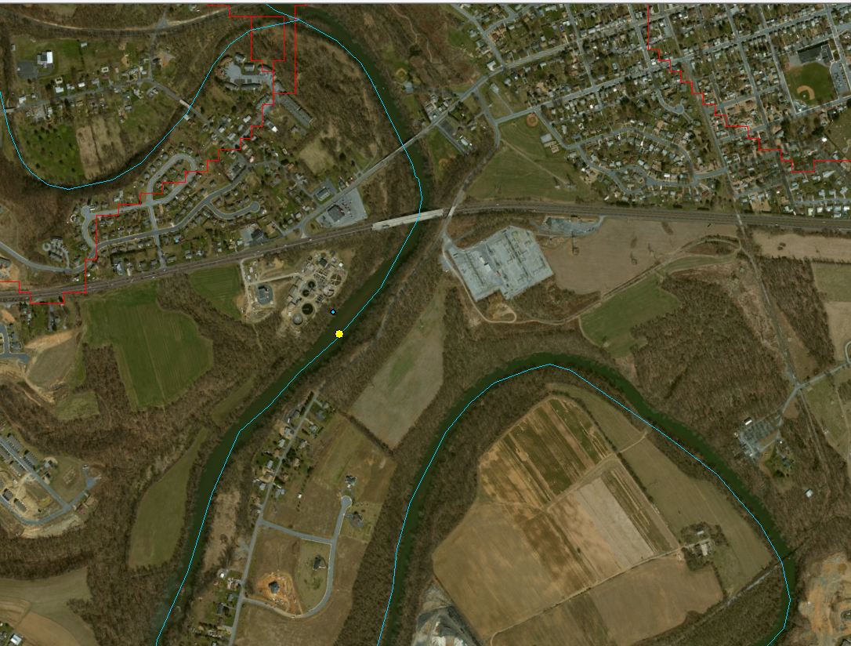
10

Slide 11
NAWQA SPARROW Model Development
Water Balance Models – Statistically Significant Predictors
Sources of Water to Streams
* Runoff – (Precipitation – evapotranspiration)
* Wastewater Discharge (all regions)
* Springflow (most regions)
* Transfers (western regions)
Delivery of Water to Streams
* Vegetation, temperature, soil characteristics, others
Loss of Water from Streams
* Reservoirs – (all regions)
* Losses from Streams (western regions)
* Public Supply (most regions)
* Irrigation (western regions)
11

Slide 12
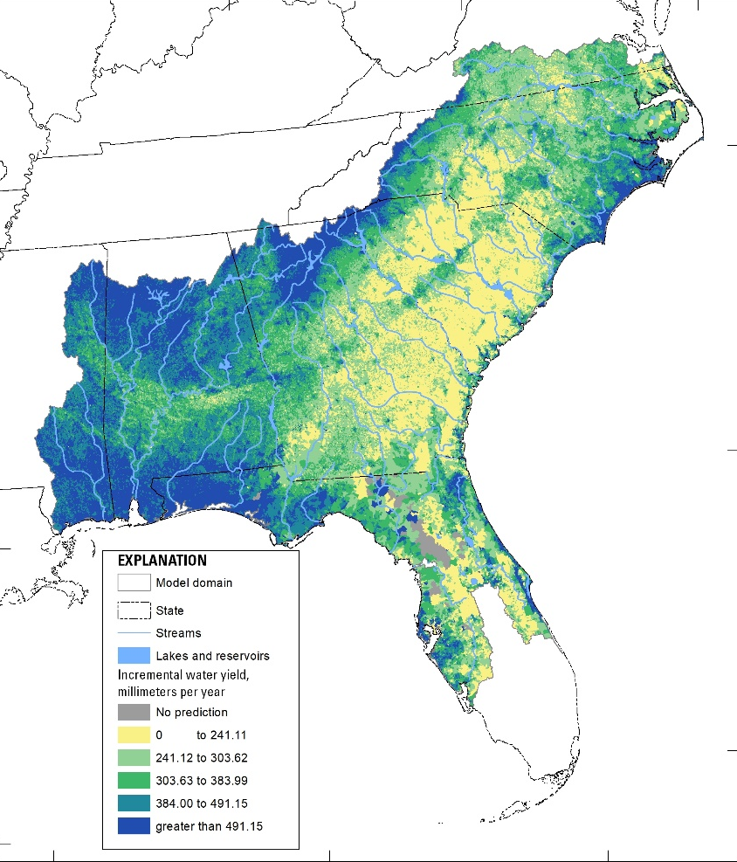
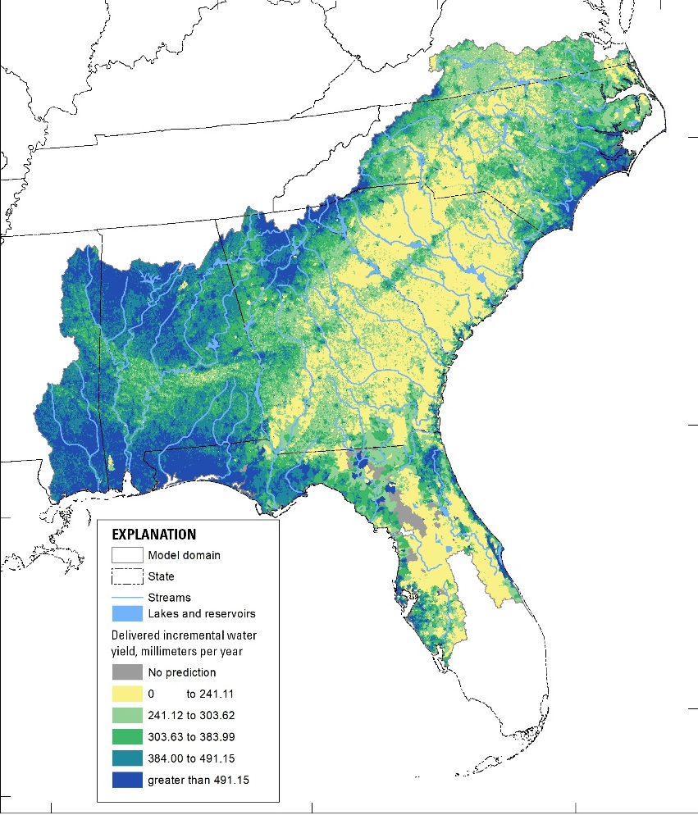
NAWQA SPARROW Model Development
Water Balance Models – Preliminary Predictions
Incremental Water Yield (mm/yr)
Delivered Water Yield (mm/yr)
12
Preliminary Information-Subject to Revision. Not for Citation or Distribution

Slide 13
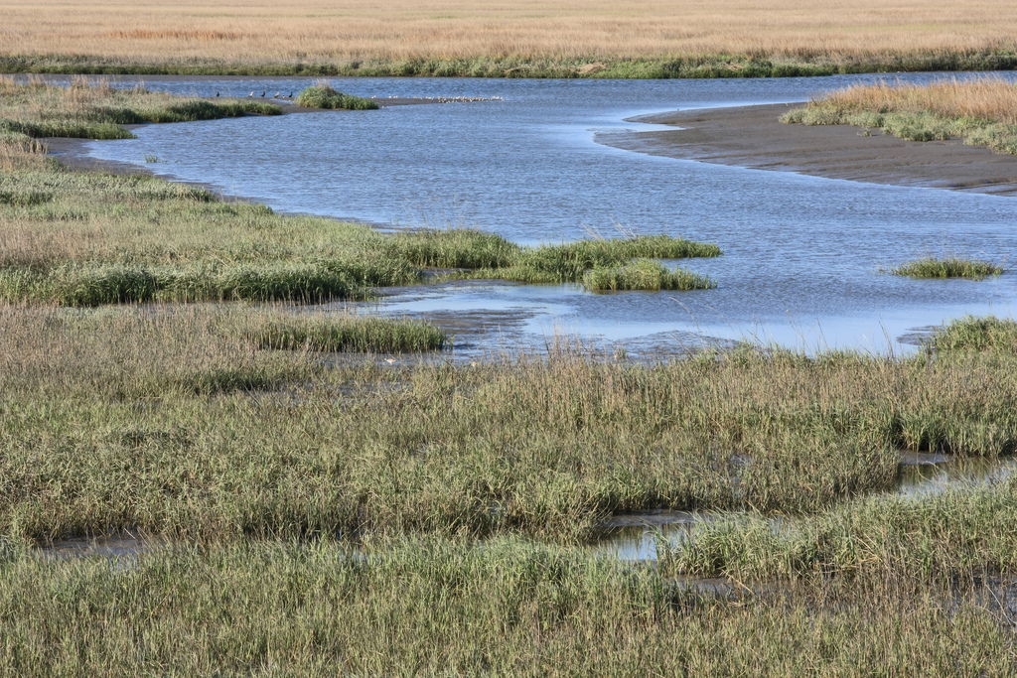
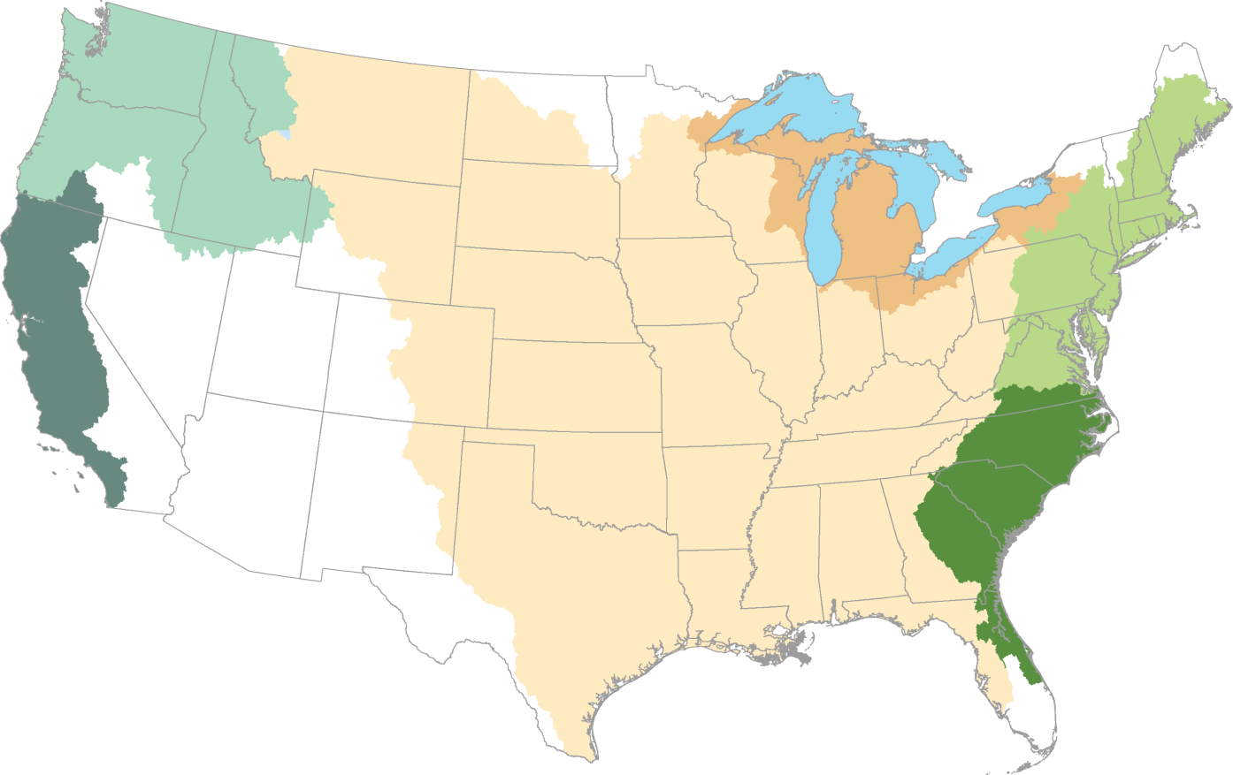
Tracking Nutrient Loading to the Nation’s Estuaries and Great Lakes
Pacific Northwest
Great Lakes
Atlantic
Coast
California
Coast
(coming soon)
Gulf of Mexico
http://water.usgs.gov/nawqa/sparrow/estuary
13

Slide 14
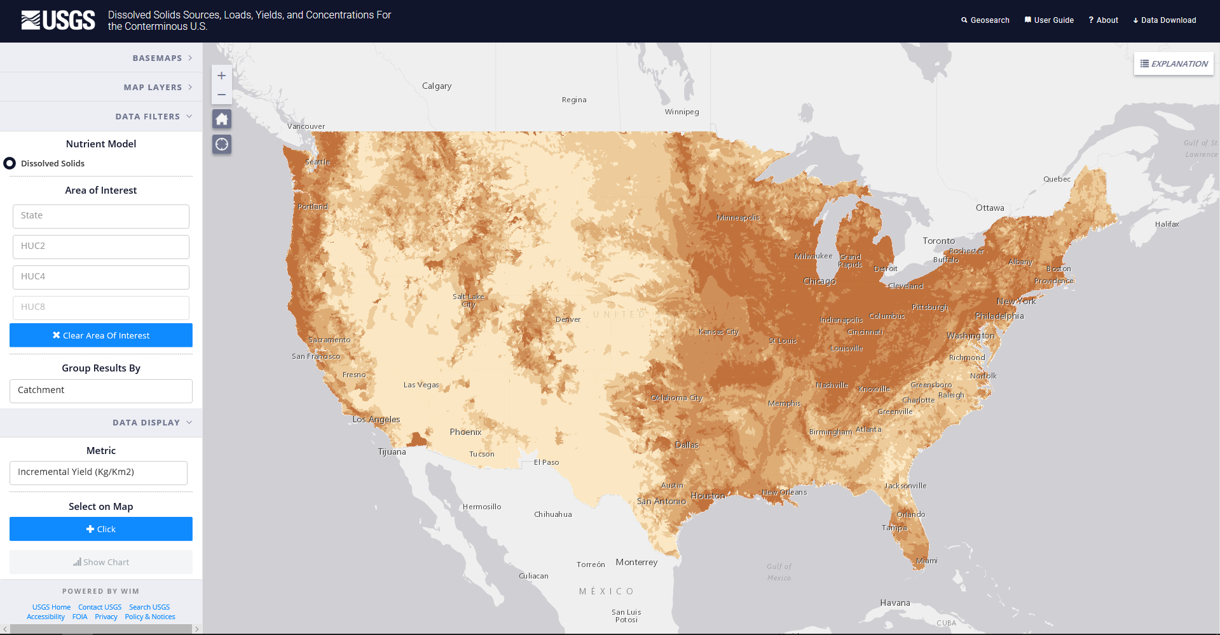
NAWQA SPARROW Model Development
Web-based Mapping Tools – Total Dissolved Solids
Anning and Flynn (2014) Dissolved-Solids Sources, Loads, Yields, and Concentrations in Streams of the Conterminous United States (https://pubs.usgs.gov/sir/2014/5012/).
14

Slide 15
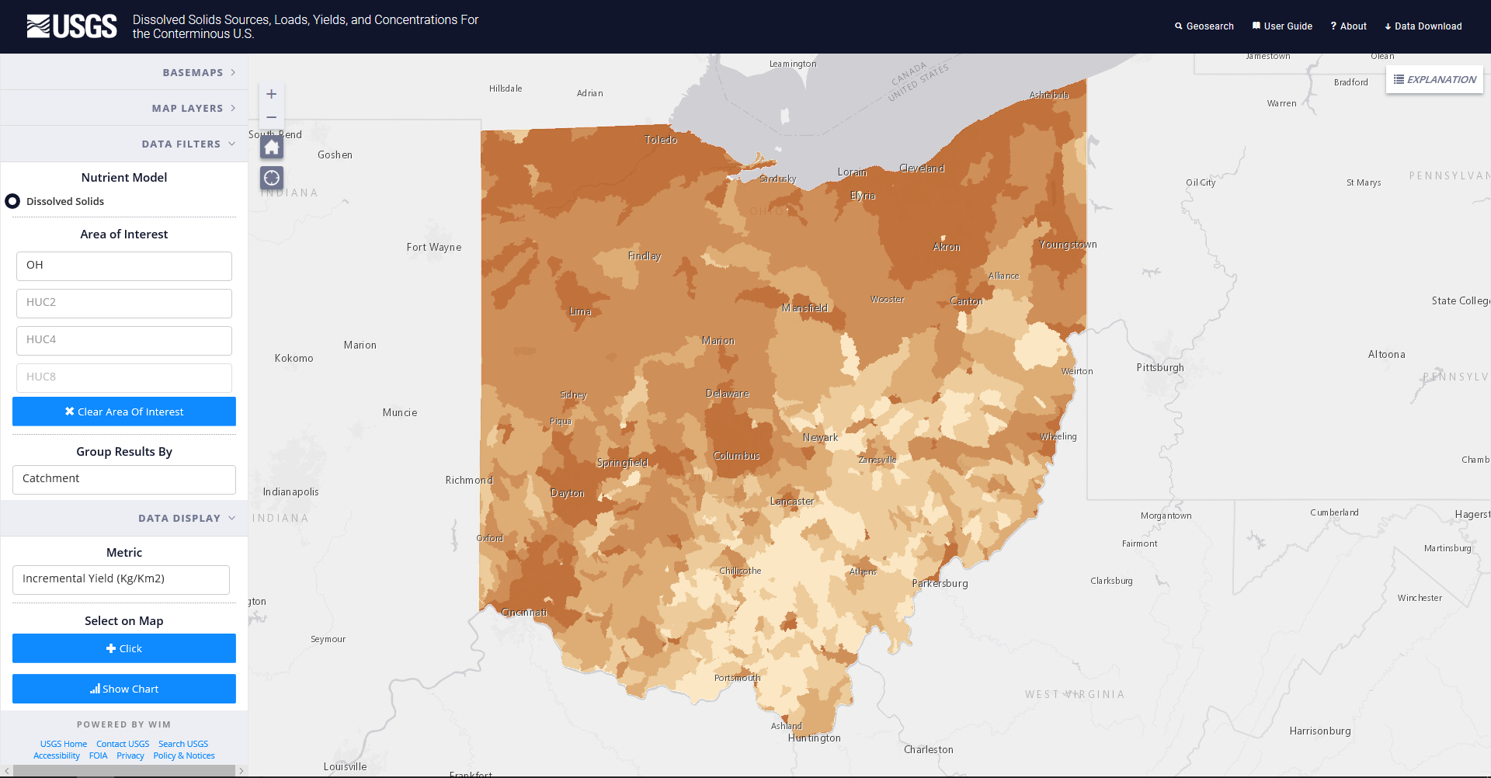
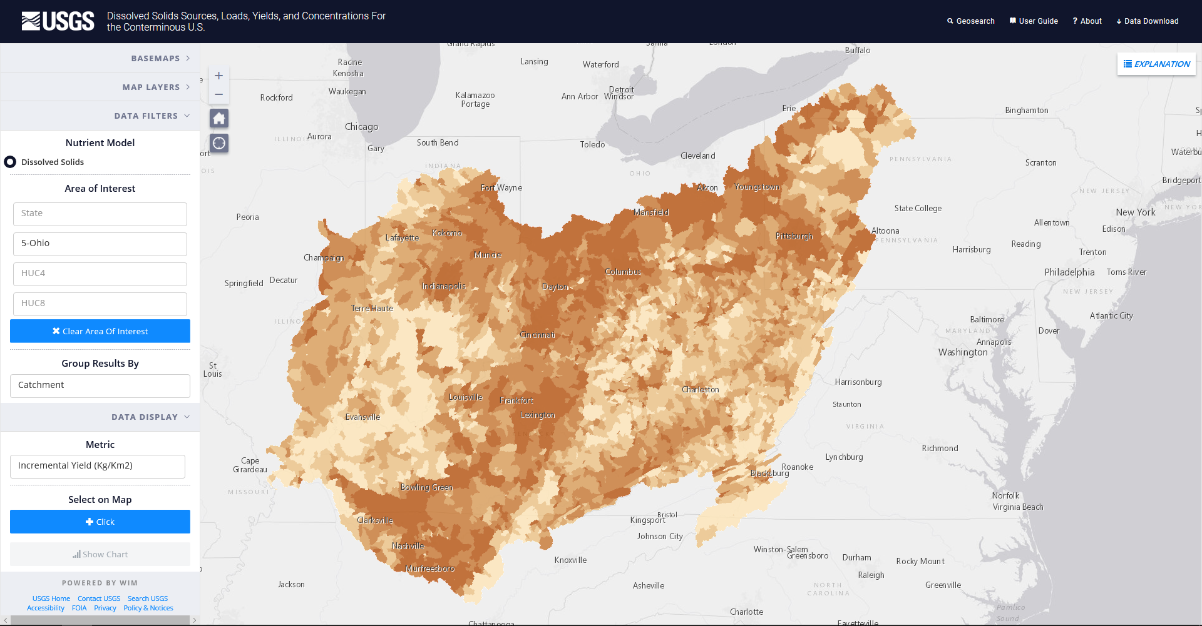
NAWQA SPARROW Model Development
Web-based Mapping Tools – Total Dissolved Solids
Anning and Flynn (2014) Dissolved-Solids Sources, Loads, Yields, and Concentrations in Streams of the Conterminous United States (https://pubs.usgs.gov/sir/2014/5012/).
15

Slide 16
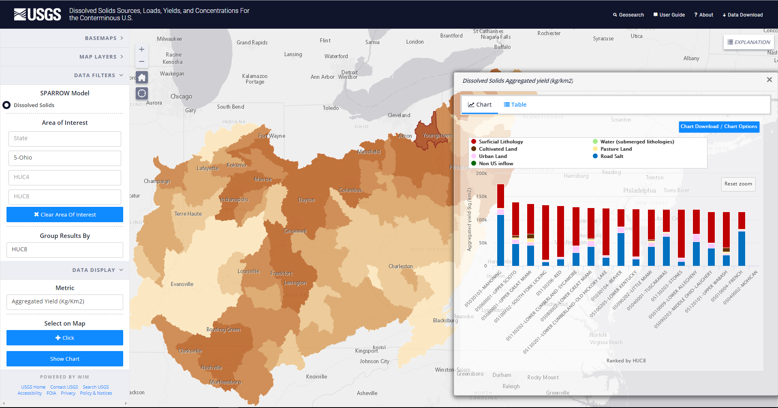
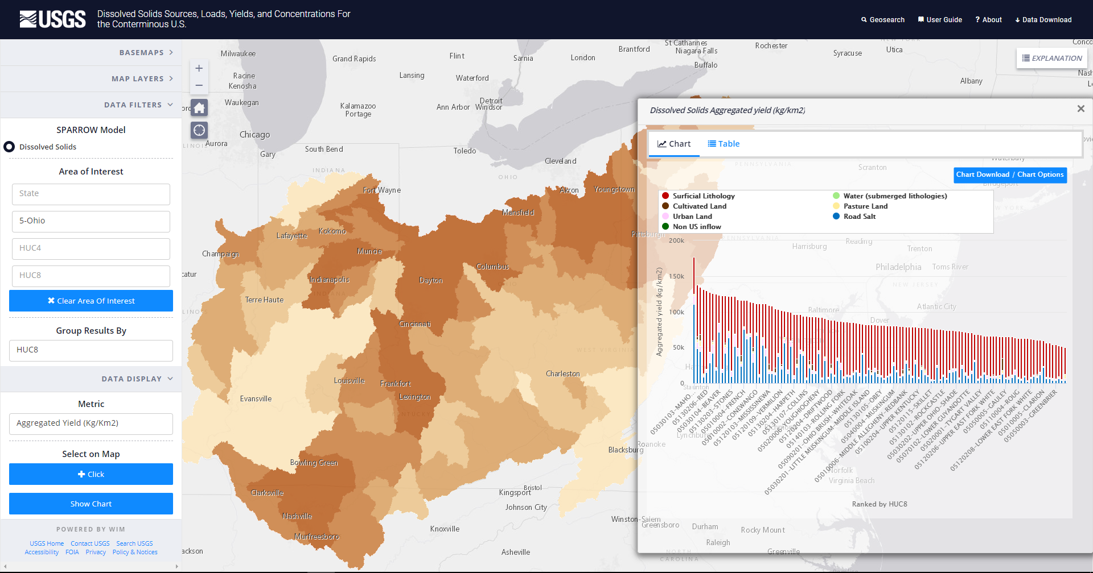
NAWQA SPARROW Model Development
Web-based Mapping Tools – Total Dissolved Solids
Anning and Flynn (2014) Dissolved-Solids Sources, Loads, Yields, and Concentrations in Streams of the Conterminous United States (https://pubs.usgs.gov/sir/2014/5012/).
16

Slide 17
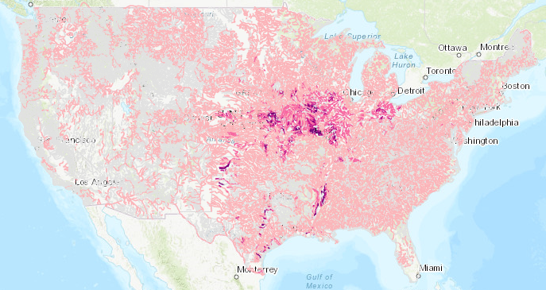
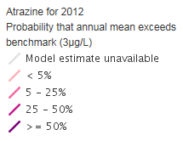
Models predict benchmark exceedance probabilities in streams & rivers: pesticides
Stone et al: Watershed Regressions for Pesticides (WARP) models https://cida.usgs.gov/warp/home/
17

Slide 18
Models predict benchmark exceedance probabilities in groundwater: manganese
Mn > 50 ug/L
Mn > 150 ug/L
Mn > 300 ug/L
Domestic wells
Mn > 50 ug/L
Mn > 150 ug/L
Mn > 300 ug/L
Public supply wells
Rosecrans and others, 2017, Prediction and visualization of redox conditions in the groundwater of Central Valley, California, Journal of Hydrology; https://doi.org/10.1016/j.jhydrol.2017.01.014
18

Slide 19

Additional Information
Further Details of SPARROW:
http://water.usgs.gov/nawqa/sparrow
Contact Information:
spreston@usgs.gov
19

