Slide 1
America’s Water Infrastructure Act of 2018 (PL 115-270)
J. Alan Roberson, P.E.
Executive Director
Association of State Drinking Water Administrators
1401 Wilson Blvd. - Suite 1225 - Arlington, VA 22209 - (703) 812-9505 - www.ASDWA.org

Slide 2
Statutory Changes to SDWA Since 1996 Amendments
2002
Bio-Terrorism Act
2005
Energy Policy Act
2011
Reduction of Lead in Drinking Water Act
2013
Community Fire Safety Act
2015
Drinking Water Protection Act
2015
Grassroots Rural and Community Water Assistance Act
2016
Water Infrastructure Improvements for the Nation (WIIN) Act
2018
America’s Water Infrastructure Act (AWIA)

Slide 3
Background
The final bill included elements from three different bills
House’s traditional Water Resource Development Act (HR 8, 2017)
House-passed Drinking Water System Improvement Act of 2017 (HR 3387)
Senator John Boozman’s (R-AR) SRF-WIN Act that grew into S 2800, a foundational version of the present America’s Water Infrastructure Act
27 sections that impact drinking water

Slide 4
Outline
This Presentation is divided into four general categories:
Elements that have an immediate impact for state programs
Elements that will impact state programs in one to two years
Elements that will impact state programs in three to five years
Elements that will have a minor impact on state programs
Under each of the above four categories there are the following subcategories:
No Federal money needed
Italics indicate budget appropriations needed, cannot implement under Continuing Resolution (CR)
Bold indicates additional Federal appropriations needed

Slide 5
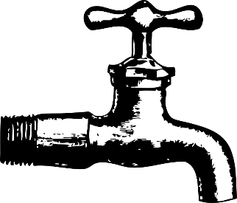
Immediate Impacts
DWSRF Eligibility & Uses
Source Water
Consumer Confidence Reports
Spill Response
American Iron and Steel
Asset Management
Compliance Monitoring Data
State DWSRF Capitalization Grants
Disaster Assistance
Bold indicates additional Federal appropriations needed

Slide 6
Immediate Impacts
DWSRF Eligibility & Uses
Replacement/rehabilitation now included
Davis Bacon prevails for loans using state funds
Needs Survey to add LSL inventory and replacement costs data
Source water protection areas now eligible for updates
Additional impacts included in 3-5 years
Source Water
Source water protection assessments now eligible under 15% set-aside
CCRs
Formalizes ability to distribute CCRs electronically
Additional impacts included in 1-2 years

Slide 7
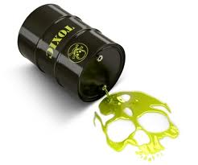
Immediate Impacts
Spill Response
State emergency response must notify applicable state agencies and provide a written follow-up emergency notice
Receiving state agencies shall then alert CWS with affected source waters
American Iron & Steel
Extends AIS requirements through FY 2023

Slide 8
Immediate Impacts
Asset Management (AM)
Adds new Capacity Development strategy requirement to include:
How PWS will be encouraged to develop AM plans that include best practices
Assist PWS in implementing AM plans
Add information about state AM efforts to the triennial report to the Governor
EPA shall review and update relevant educational and training materials at least every 5 years
Compliance Monitoring Data
By October 2019, EPA shall develop a strategic plan for improving the accuracy and availability of compliance monitoring data
SDWIS Prime might (??) be the answer

Slide 9
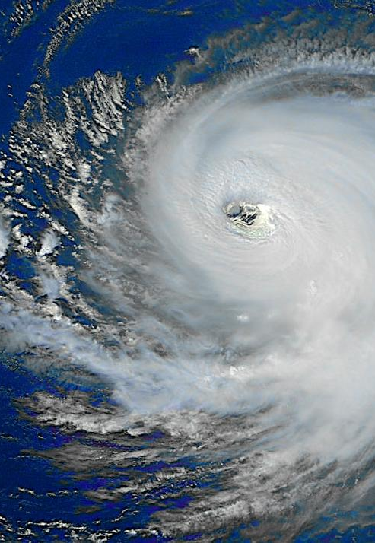
Immediate Impacts
State DWSRF Capitalization Grants
Authorizes (not appropriated) DWSRF capitalization grants for:
FY19 - $1.17B
FY20 - $1.3B
FY21 - $1.95B
Disaster Assistance
Allows DWSRF use by systems in an area with a post 1/1/17 Stafford Act declaration
Authorizes (not appropriated) $100M for EPA to provide additional capitalization grants to eligible states for 24 months
Bold indicates additional Federal appropriations needed

Slide 10
Impacts in 1 to 2 Years
Consumer Confidence Reports
Consolidation Considerations and Contractual Agreements
Intractable Water Systems
PWSS Grants
Voluntary School/Childcare Lead Testing
Resiliency and Sustainability
Source Water Petition Program
Italics indicate budget appropriations needed, cannot implement under Continuing Resolution (CR)
Bold indicates additional Federal appropriations needed

Slide 11
Impacts in 1 to 2 Years
Consumer Confidence Reports
New information on exceedances
Adds corrosion control language
EPA to revise regulations by October 2020
CWSs > 10,000 to provide CCRs at least biannually
Consolidation Considerations and Contractual Agreements
States may require an unwilling/struggling PWS to consider consolidation
Can use the DWSRF to achieve consolidation
EPA issue regulations by October 2020
Allow contractual agreements for significant management or administrative functions as a violation corrective action
Italics indicate budget appropriations needed, cannot implement under Continuing Resolution (CR)

Slide 12
Impacts in 1 to 2 Years
Intractable Water Systems
Calls for EPA, USDA & HHS to identify intractable systems and describe barriers to delivery of potable water within 2 years
PWSS Grants
Increase PWSS program authorizations (not appropriated) to $125M for each FY20 and FY21
Italics indicate budget appropriations needed, cannot implement under Continuing Resolution (CR)
Bold indicates additional Federal appropriations needed

Slide 13
ASDWA released Beyond Tight Budgets (BTB) in response to increasing demands combined with a lack of funding that threatens public health protection
Workload increase 1.1% to 12.5%, with average 4.3%
2013 Report – 38%-41% funding gap
PWSS and the set-asides from DWSRF have remained flat for the past decade
Still a significant funding gap even if $125M for each FY20 and FY21 is fully appropriated

Slide 14
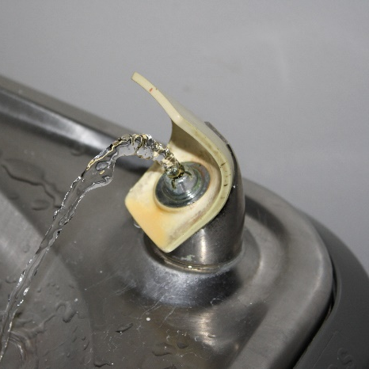
Impacts in 1 to 2 Years
Voluntary School/Childcare Lead Testing
Requires EPA to provide technical assistance to the existing grant program to:
Assist in source identification
Share other Federal/state lead elimination grant opportunities and applications
Provide information on other financing options
Connect grant recipients with nonprofit or other assistance organizations
Authorizes (not appropriated) $25M for each FY20 and FY21
Adds new drinking water fountain replacement grant to replace water fountains manufactured prior to 1988
Authorizes (not appropriated) $5M for each FY19, FY20 and FY21 for this grant

Slide 15
Impacts in 1 to 2 Years
Resiliency and Sustainability
EPA may issue grants to requesting states on behalf of underserved communities to assist in activities related to harmful contaminants
Creates the option for EPA to establish a new Drinking Water Infrastructure Resilience and Sustainability grant program and authorizes (not appropriated) $4M for each FY19 and 20
The grants may be used for planning, design, construction, implementation, O&M to increase resilience to natural hazards

Slide 16
Impacts in 1 to 2 Years
Source Water Petition Program
Authorizes (not appropriated) $5M for FY20 and FY21 for the Source Water Petition Program

Slide 17
Impacts in 3 to 5 Years
DWSRF Eligibility and Uses
UCMR Monitoring

Slide 18
Impacts in 3 to 5 Years
DWSRF Eligibility and Uses
Requires EPA to collect “best DWSRF loan application practice” information from states including:
Streamlined application processes
Application assistance
Incentives for large/small system partnering options
Practices to ensure that state loan fund amounts are used to provide loans, loan guarantees, or other assistance in a timely fashion
Tools to enhance financial management skills
Financial measures to evaluate state loan fund operations
EPA shall disseminate the results to states within 3 years of enactment

Slide 19
Impacts in 3 to 5 Years
UCMR Monitoring
PWS between 3,300 and 10,000 to monitor for unregulated contaminants if funding is available and there is sufficient lab capacity
If so, authorizes (not appropriated) $15M to cover the additional costs of testing and lab analyses
Reauthorizes (not appropriated) $10M for FY19, 20, and 21 for UCMR monitoring

Slide 20
Minor Impacts
Non-Potable Water
WaterSense
HABs
Federal Cross-Cutters
Regional Liaisons
Innovative Technologies
CWS Risk and Resilience
WIFIA Reauthorization
Water Infrastructure and Workforce Investment
Technology Review
Italics indicate budget appropriations needed, cannot implement under Continuing Resolution (CR)
Bold indicates additional Federal appropriations needed

Slide 21
Minor Impacts
Non-Potable Water
Sense of Congress that access to non-potable sources for industry can relieve the supply and demand challenges in water-stressed regions
WaterSense
Formally establishes WaterSense
HABs
Calls for USACE to implement a 5-year HABs technology development demonstration program under the Aquatic Nuisance Research program

Slide 22
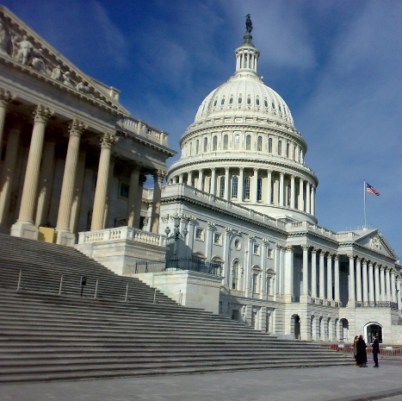
Minor Impacts
Federal Cross-Cutters
Comptroller General shall report to Congress the results of a study to identify compliance with a state or local environmental law that may be substantially equivalent to any demonstration required by EPA for Federal cross-cutters
Regional Liaisons for Minority, Tribal, and Low Income Communities
Calls for EPA to assign at least one employee in each Regional Office to serve as a liaison to these communities

Slide 23
Minor Impacts
Innovative Technologies
EPA shall carry out a competitive grant program to accelerate development and deployment of innovative water technologies
Authorizes (not appropriated) $10M For FY19-20
CWS Risk and Resilience
CWSs serving >3,300 shall conduct risk assessments for built, technological, cyber, and financial infrastructure
Population-based schedule for compliance
Certifications of completion to be sent to EPA
Similar provisions for emergency response plans and certifications
Compliance & enforcement strategy TBD
CWS must review and update assessment every 5 years
EPA to provide guidance and technical assistance from EPA
EPA shall establish a grant program (Drinking Water Infrastructure Risk and Resilience Program) for CWS owners and operators to increase resilience
Authorizes (not appropriated) $25M for each FY20 and 21
EPA may use up to $5M/year & small system grants of not more than $10M may be used

Slide 24
Minor Impacts
WIFIA Reauthorization
Disallows state borrowers to use Federal DWSRF or CWSRF capitalization grant funds as sources of repayment
Authorizes (not appropriated) $50M for each FY20 and 21 and allows EPA to use not more than $5M/year for administration and technical assistance
State infrastructure and finance authorities shall be held solely responsible for repayment of any provided assistance should the project default
DWSRF and CWSRF funds must be the greater of either 2018 levels or 104% of the previous fiscal year’s appropriation, for funds to be made available under WIFIA

Slide 25
Minor Impacts
Water Infrastructure and Workforce Investment
Congress urges collaboration among Federal, state and local governments to align workforce training programs to accelerate career pipelines
Requires EPA to establish a competitive grant program
Authorizes (not appropriated) $1M for each FY19 and 20
Technology Review
Requires EPA to review existing and potential methods, means, equipment, and technologies dealing with physical integrity, NPDWRs, alternate supplies, and source water assessment and protection
Authorizes (not appropriated) $10M for FY19

Slide 26
Questions?
Alan Roberson
Executive Director
aroberson@asdwa.org
(703)-812-9507
Twitter @AlanTheWaterMan
Association of State Drinking Water Administrators
1401 Wilson Blvd. - Suite 1225 - Arlington, VA 22209 - (703) 812-9505 - www.ASDWA.org

