Slide 1
SCS REGISTRATION GUIDANCE FOR LABORATORIES (CMDP)
This document provides step-by-step instructions for how to register for the Compliance Monitoring Data Portal (CMDP) through the Shared Cross-Media Electronic Reporting Regulation (CROMERR) Services and identifies additional resources that will help laboratories become familiar with CMDP.
Part 2: Register for Shared CROMERR Services (SCS)
Part 3: Log into CMDP
Reminder: Training References
Part 1: Identify User CMDP Role(s)
Part 4: Role Sponsorship as a Lab Administrator
Part 1: Identify User CMDP Role(s)
Before registering with EPA’s Shared CROMERR Services (SCS) and using CMDP, you will need to identify your CMDP User Role. Four hierarchical roles for laboratories to consider exist within CMDP and are listed in the figure to the left. Roles are listed in the order of functionality. For instance, the CMDP Lab System Administrator role has the most functionality.
To fully understand the functionality of each role, please review the CMDP Role Registration Guide [http://dec.alaska.gov/media/10787/cmdp-role-registration-user-guide.pdf] to determine who will be designated the Lab System Administration, Certifier, Reviewer, and Preparer.
Laboratory Roles
2. Certifier
3. Reviewer
4. Preparer
1. Lab System Administrator
The following are a few things to keep in mind when selecting roles within your laboratory:
Lab System Administrators must register with SCS first. Once registered, Administrators can invite/accept other role requests (i.e., Preparers, Reviewers, and Certifiers) from individuals within their organization.
Only the Lab CMDP Administrator and Certifier can submit data to the State.
Larger laboratories should consider having two Lab System Administrators.
Each role assumes the functionality of the role below it. For example, the Certifier can perform the functions of the Reviewer and Preparer.
NOTE: The steps in the registration process listed in this document may vary by User Role, we have included notes to indicate the differences.
Part 2: Register for Shared CROMERR Services (SCS)
Before using CMDP, each user must first register with EPA’s Shared CROMERR Services (SCS) to receive a user name and password (credentials). Once the registrant is approved as a CMDP User, they will be able to access the CMDP application using the credentials received from SCS.
The flow chart below highlights the major steps when registering for SCS. Detailed instructions for how to register begin on page 2.
Watch the registration process in action!
Click the picture to the right
for a screen recorded demonstration of registering with Shared CROMEER Services.
Step 1: Go to SCS Home Page
Step 2: Select Partner, Program, Role
Step 3: Accept Privacy/Terms and Conditions
Step 4: Accept Rules of Behavior
Step 5: Enter User Information in Account Profile
Step 6: Choose Organization
Step 7: Verification Email with Validation Code
Step 8: Enter Personal Information/ Identity Verification
Step 11: Certification Acknowledgement
Step 12: State Approval
Step 10: Electronic Signature Agreement
Step 9: Choose Challenge Questions
Registration steps will vary depending on the role of the user.

Slide 2
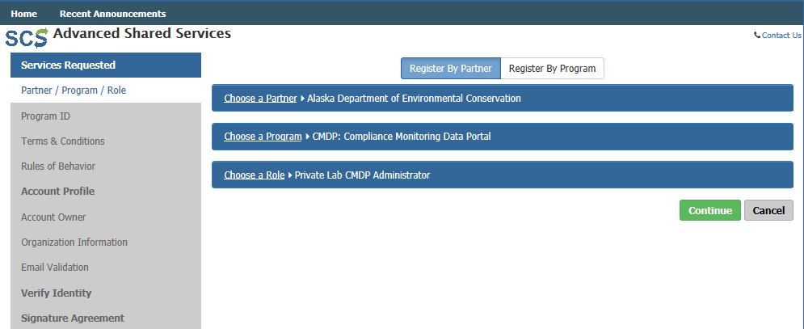
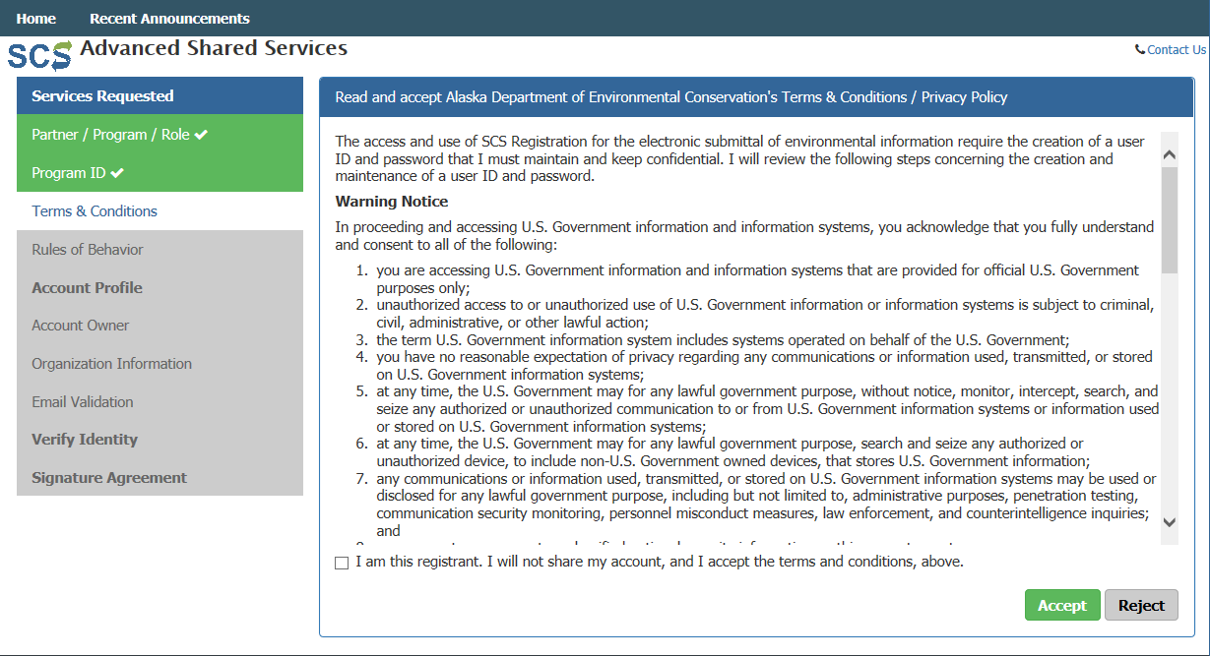
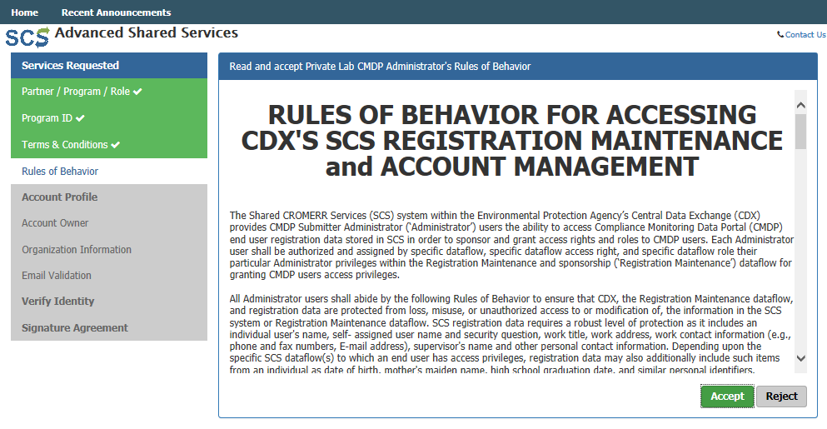
HOW TO REGISTER FOR SHARED CHROMERR SERVICES
Step 1: In order to use CMDP, create an account in SCS first. To do so, go to the following URL: https://encromerr.epa.gov/. On the home page, click on Register with SCS.
Step 2: At the top of the page, select Register By Partner.
Then, choose a Partner (in the screen shot to the right, the Alaska Department of Environmental Conservation was selected).
Then, select CMDP: Compliance Monitoring Data Portal as the Program.
Finally, choose the desired role. In this example, the user selects a Private Lab CMDP Administrator.
Click Continue.
Step 3: Read the terms & conditions/privacy policy for the use of these services.
If you agree to these conditions, check the box stating “I am a registrant. I will not share my account, and I accept the terms and conditions, above.”
If you agree to the Terms & Conditions/Privacy Policy, click Accept to move forward.
Step 4: Read through the Rules of Behavior, because you are accessing SCS Registration maintenance and account management pages as Administrators.
If you agree to the conditions in the Rules of Behaviors, click Accept at the bottom of the page.
NOTE: Lab Certifiers, Lab Reviewers and Lab Preparers will not see this step.

Slide 3
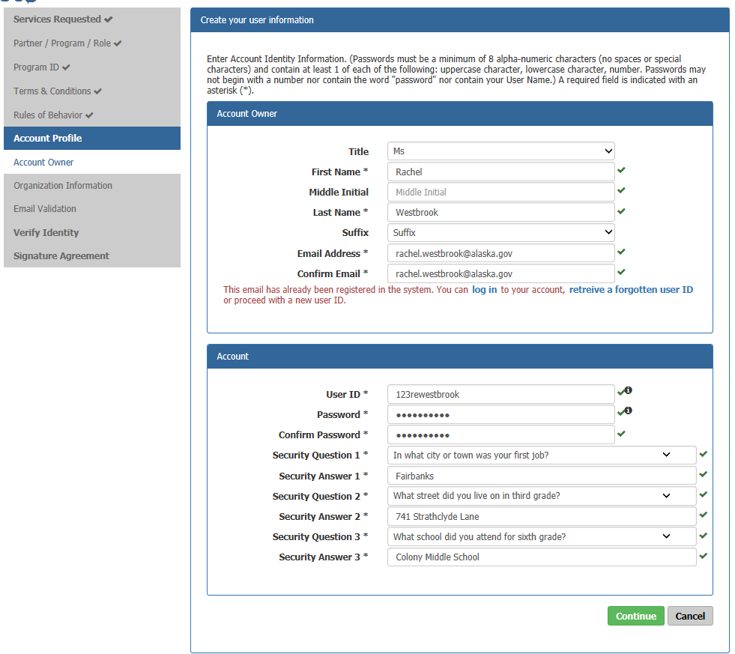
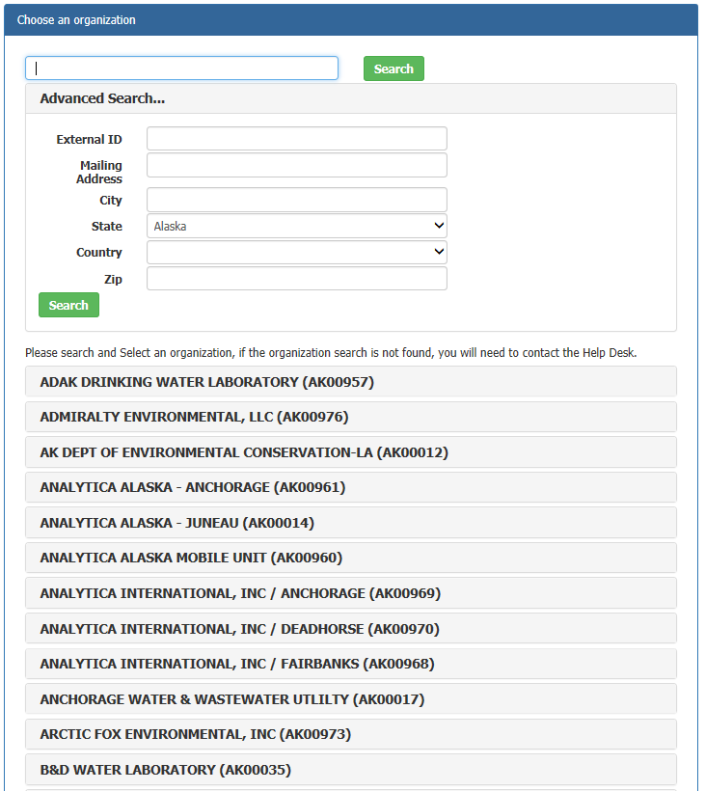
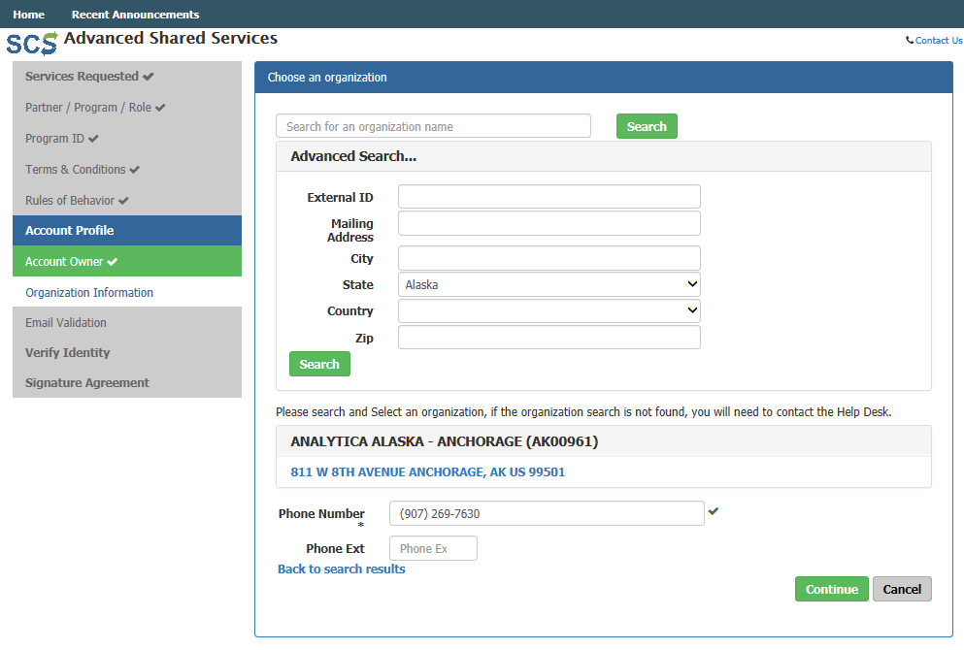
HOW TO REGISTER FOR SHARED CHROMERR SERVICES
Step 5: In the next step, you will have to enter individual information as displayed to the right including full name and email address. You will also enter your account information and select three security questions/answers.
Click Continue to move forward.
NOTE: If the user also has access to the Test version of CMDP, it is recommended to create a different User ID and Password.
Step 6: Choose your organization. Use the search feature to narrow down the list of organizations. Proceed by entering the organization name then click search.
In this case, we entered “Alaska” in the Advanced Search field and a list of laboratories within Alaska appeared. We selected Analytica Alaska- Anchorage (AK00961).
You will have to click on the address located below the name to select the appropriate laboratory.
Add the phone number for your laboratory and click Continue to move forward.
NOTE: If your organization is not listed, contact the CMDP Transition Team for assistance.

Slide 4
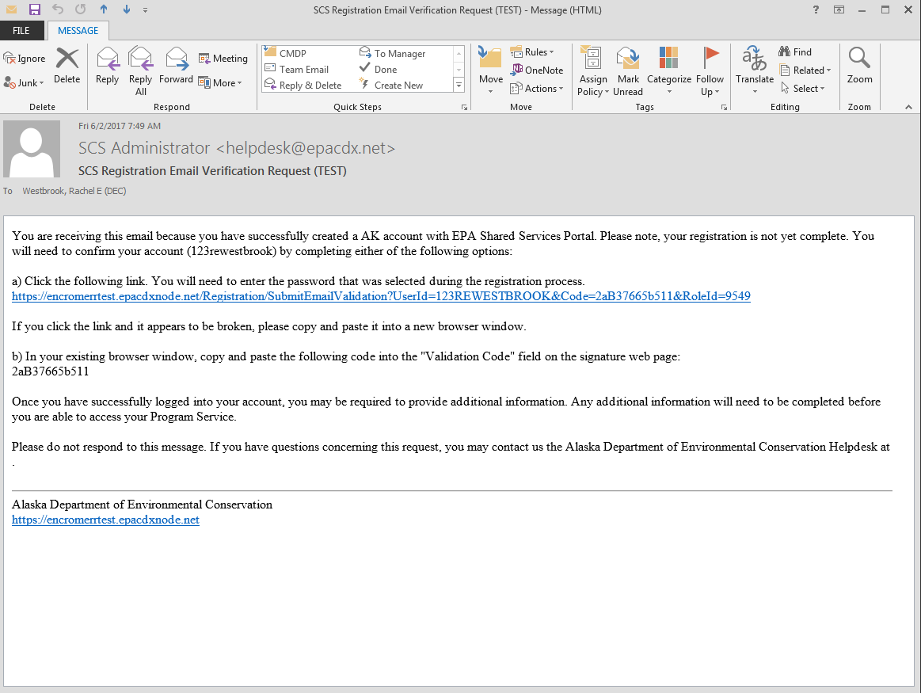
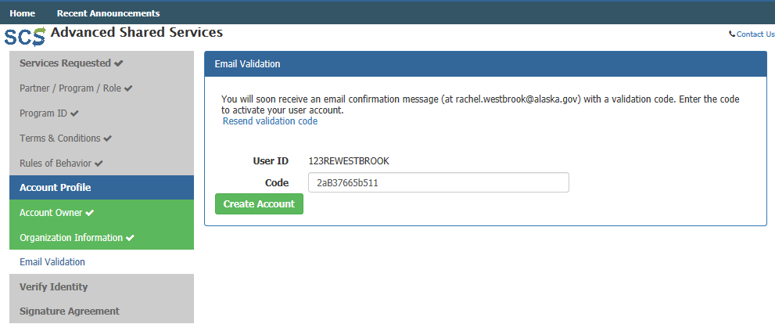
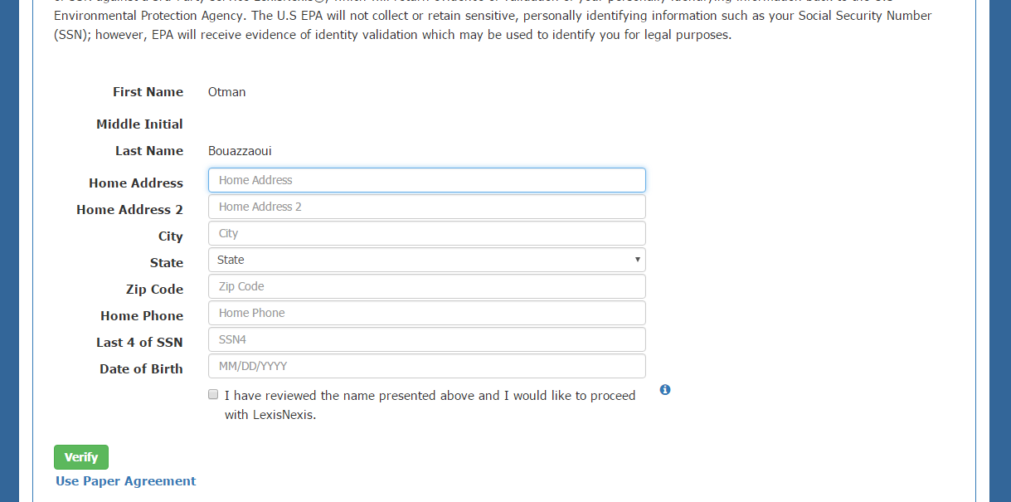
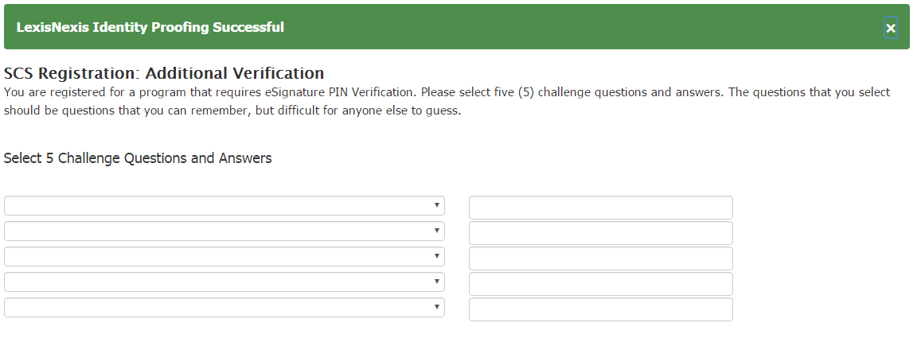
HOW TO REGISTER FOR SHARED CHROMERR SERVICES
Step 7: An email will be sent to the address entered previously during the registration process.
Copy the validation code found in that email and paste it into the Code field in the Email Validation step. Once you entered the code, click Create Account.
Step 8: Enter your personal information (i.e., home address, city, zip code, etc.) in order for SCS to verify your identify.
NOTE: Private Laboratory CMDP Administrators and Private Laboratory Certifiers need to complete this LexisNexis verification step because they are requesting authorization to electronically sign Sample Jobs in CMDP.
Once all the information is entered, click Verify.
NOTE: If SCS fails to verify any information on Step 8, please contact the Drinking Water Program’s CMDP Helpdesk or select Use Paper Agreement. You will need to print and sign the agreement and submit the form to the Program.
NOTE: Lab Reviewers and Lab Preparers will not have to complete Steps 9-12 of this document.
Instead, Lab Reviewers and Lab Preparers will use the Sponsor Information web form to request sponsorship from the CMDP Administrator. Refer to the CMDP Role Registration Guide for additional guidance.
Meanwhile, Lab Certifiers will use the Sponsor Information web form to request sponsorship from the CMDP Lab Administrator then complete Steps 9-12 upon approval.
Step 9: Once the LexisNexis identity proofing is complete, you will be requested to choose 5 Challenge Questions that will be used randomly when using the electronic signature service in CMDP.
NOTE: You will be asked one of these security questions every time data is submitted to the State in order to verify your credentials.
After picking five questions and providing answers, click Save Answers.

Slide 5
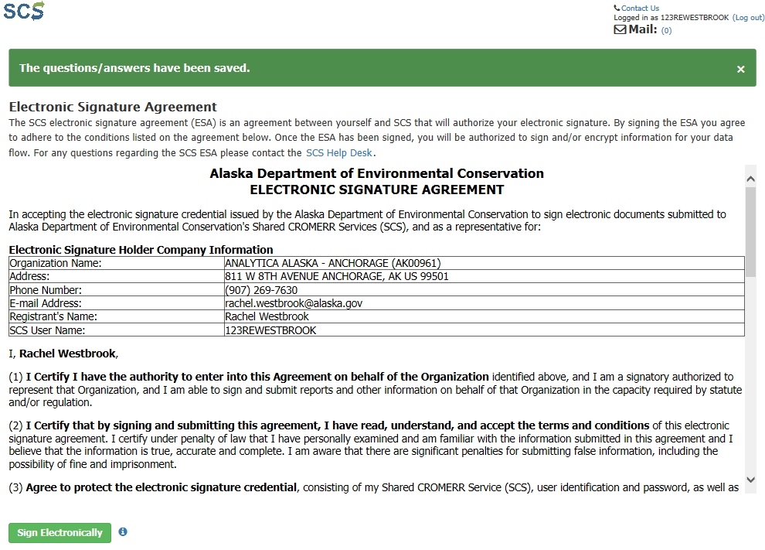
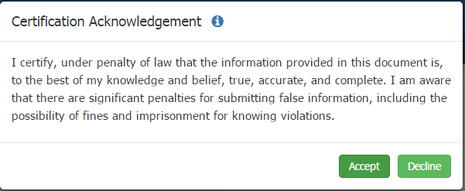
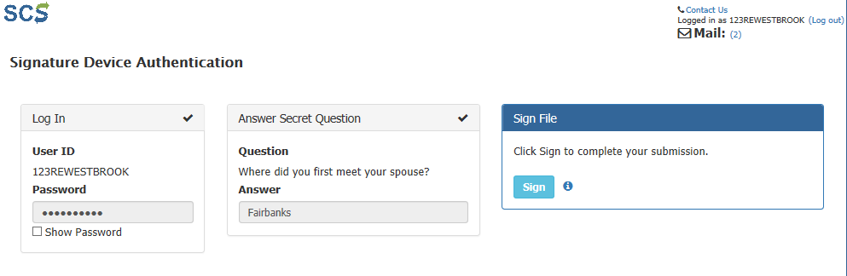
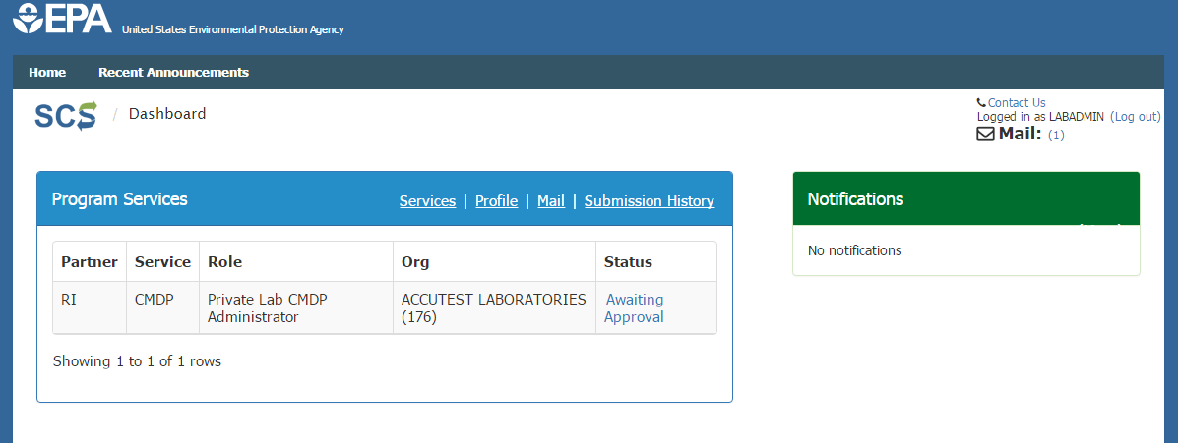
HOW TO REGISTER FOR SHARED CHROMERR SERVICES
Step 10: You will be redirected to the Electronic Signature Agreement (ESA) screen (and you will receive an “eSig-PIN” e-mail from SCS).
If you agree to the conditions in the Electronic Signature Agreement, click Sign Electronically at the bottom of the page.
Step 11: A Certification Acknowledgement dialog window will be displayed as seen in the screen shot to the right. Click Accept to move forward.
You will then be asked to enter the password you already set for this account previously and answer one of the challenge questions you chose for the LexisNexis identity verification.
Click Sign to move forward.
c
Step 12: Because you are requesting an account as Private Laboratory CMDP Administrator, your request will be forwarded to the state CMDP Administrator. Once your account has been activated, you will receive a notification indicating you now can access the CMDP application with the Login and Password you defined during registration.
The Status will change from Awaiting Approval to Active.

Slide 6
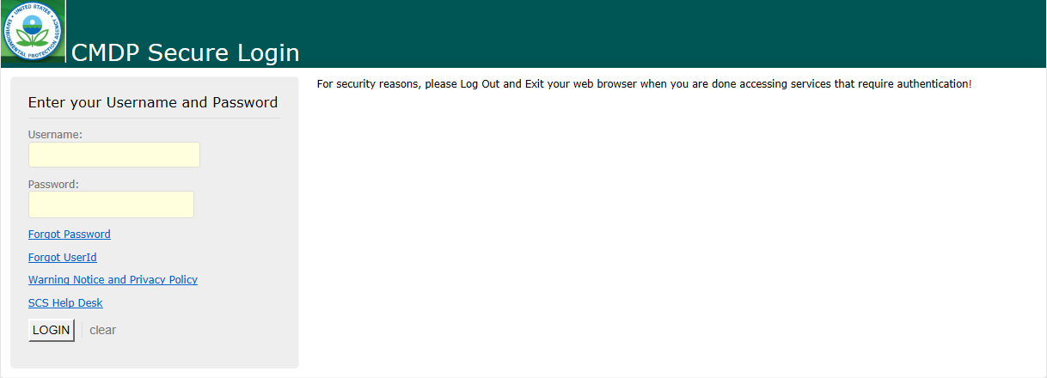
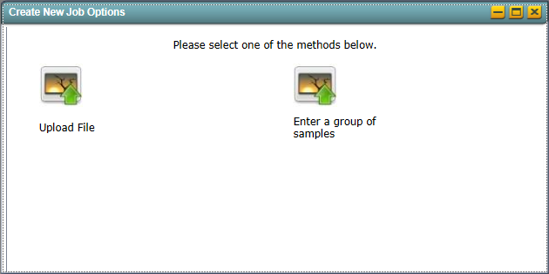
HOW TO REGISTER FOR SHARED CHROMERR SERVICES
Part 3: Log into CMDP
Step 1: After you have registered with SCS, users can now access the CMDP application. To begin, go to the CMDP Secure Login website [https://cmdpapp1.epa.gov/] and enter your username and password information.
NOTE: If the user also has access to the Test version of CMDP, it is very important to keep these links separate (differences noted below) so that test data is not accidently uploaded into the live version of CMDP.
Step 2: To submit data to the Department, go to the Drinking Water Sample Jobs tab and select Create New Job.
The Production application is differentiated by the papp1 in the link.
CMDP Production is: [https://cmdpapp1.epa.gov/]
CMDP Pre-Production is: [https://cmdpprep.epa.gov/]
Step 3: Data Submission
If you are submitting data via web entry, select Enter a group of samples.
If you are submitting data via an excel spreadsheet, select Upload File.
Remember, users can refer to the EPA training videos/DEC Lab Reporting Guides (described on page 7) when submitting samples and help ensure a successful data submittal.

Slide 7
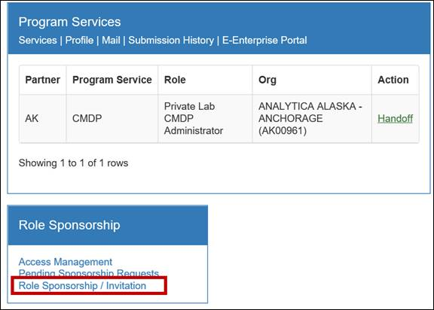
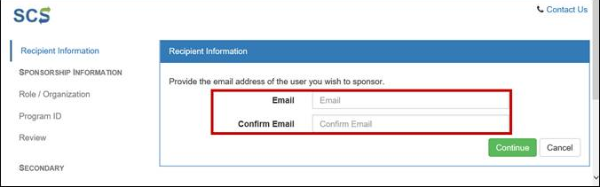
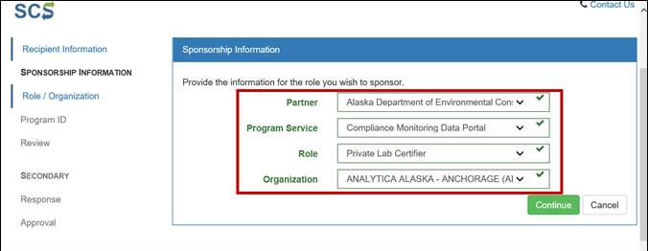
HOW TO REGISTER FOR SHARED CHROMERR SERVICES
Part 4: Role Sponsorship as a Lab Administrator
As a Private Lab Administrator, the user can sponsor other lab staff to be a Certifier, Reviewer, or Preparer. Sponsoring a laboratory role will allow the individual to begin registering for SCS.
Step 1: Log into SCS [https://encromerr.epa.gov/] using credentials.
Step 2: From the main Dashboard page, click on the Role Sponsorship/Invitation button under the Role Sponsorship heading.
Step 3: Enter the email address of the individual you would like to sponsor (must enter twice). Click Continue.
Step 4: Enter the information of the role you wish to sponsor.
Choose a Partner (in the screen shot to the right, the Alaska Department of Environmental Conservation was selected).
Then, select CMDP: Compliance Monitoring Data Portal as the Program Service.
Choose the desired role. In this example, the user selects a Private Lab Certifier.
Finally, select your laboratory name under the Organization from drop down menu. Then, click Continue.
Step 5: Review the Sponsorship Information, and if everything is correct, click Continue.
Step 6: A notification will indicate that an email has been sent to the person you sponsored (screen shot to the right).
Step 7: Then, the sponsored individual will have to complete the appropriate SCS registration steps beginning on page 2 of this document.
NOTE: Some steps outlined in this document, like Step 4, do not apply to Lab Certifiers, Lab Reviewers and/or Lab Preparers and as such users will not see these steps.

Slide 8
HOW TO REGISTER FOR SHARED CHROMERR SERVICES
Reminder: Training References
Remember the Drinking Water Program has consolidated/developed different forms of training materials designed to assist laboratories with navigating through and identifying required fields necessary for a successful data submittal. Review the following below for more information:
EPA Training Videos: Users can review and/or download EPA developed training materials and video tutorials designed to assist laboratories with navigating through the application.
If your laboratory submits data online via web entry, be sure to watch the following videos on the CMDP webpage:
Introduction to the CMDP
Entering PWS and Lab Profiles
Searching Sampling
Submission Workflow
Using Data Entry Screens to Enter Microbial, Chem, and Rad Samples
Using Data Entry Screens to Enter Composite Samples
If your laboratory submits data via excel files/XML, watch the videos listed below:
Introduction to the CMDP
Entering PWS and Lab Profiles
Searching Sampling
Submission Workflow
Manually Uploading Files Using CMDP Templates
DEC Lab Data Submission Guides: Users can review and print out the DEC Lab Data Submission Guides (as appropriate). These document are not step-by-step instructions on how to use/navigate through the application. Instead the documents identify state and federal required reporting field when submitting sample results. Samples will be rejected if required fields are left blank. The guides generated are listed below and highlight the following:
TC/EC samples for RTCR Online Data Entry Web Form
Required fields for Total Coliform and E.coli sample submissions via web entry form.
TC/EC samples for RTCR Excel Reporting
Required fields for Total Coliform and E.coli sample submissions via Excel worksheets (located on the Microbiological tab).
Chemical/Radiological samples Online Data Entry Web Form
Required fields for all regulated Chemical and Radiological sample submissions via web entry form.
Chemical/Radiological samples Excel Reporting
Required fields for all regulated Chemical and Radiological sample submissions via Excel worksheets (located on the Chem-Rads tab).
Disinfection By-Product Samples Web Entry
Required fields for reporting disinfection by-product samples (specifically TTHMs and HAA5s) via web entry form.
Disinfection By-Product Samples Excel Reporting
Required fields for reporting disinfection by-product samples (specifically TTHMs and HAA5s) samples via Excel template.
Shipping Blank Web Entry
Required fields for reporting shipping blank samples via web entry form.
Shipping Blank Excel Reporting
Required fields for reporting shipping blank samples via Excel template.
LT2 samples Web Entry
Required fields for reporting LT2 samples via web entry form.
LT2 samples Excel Reporting
Required fields for reporting LT2 samples via Excel template.
Unanalyzed Samples
Optional submission. DO NOT report unanalyzed sample information through CMDP. This document indicates how to submit this data to the State and the information to be included with the submission.
Fecal Coliform samples for filtration avoidance systems Web Entry
Required fields for reporting Fecal Coliform samples for systems who avoid filtration (covered under the Surface Water Treatment Rule) via web entry form.
PFOS/PFOA samples Web Entry
Required fields for reporting PFOS/PFOA samples via web entry form.
PFOS/PFOA samples Excel Reporting
Required fields for reporting PFOS/PFOA samples via Excel template.
Remember to contact the CMDP Helpdesk at dec.cmdpsupport@alaska.gov if you have any questions or concerns when registering through SCS or submitting data through CMDP.

