Slide 1
AWOP
How We Built This

Slide 2
Some Insights from Entrepreneurs
They learn the most by going out and doing things
They are resilient in the face of adversity
They recognize the value of their people – everyone is treated as peers
They focus less on growth and more on lasting (tenacity!)
They find a unique product that nobody else has thought of
They own their products forever
From a discussion on complexity and simplicity … “The more you know, the less you need”

Slide 3
The Genesis of AWOP – The Composite Correction Program
The water CCP was developed and demonstrated in Montana with PAI and the Montana DEQ in 1988
The CCP was piloted and demonstrated
It got the attention of EPA in Cincinnati
Jon Bender travelled to Montana and manually collected samples to assess filter backwash spikes
Hardin, MT 1990

Slide 4
Successes and Challenges
The successes:
The Composite Correction Program expanded through the support of EPA
Twelve CPEs were demonstrated in Ohio, Kentucky, West Virginia, Maryland, Montana, and Pennsylvania
The CPE Handbook was first published in 1991
The challenges:
State program Institutional barriers were taking their toll on the growth of the national optimization program – staffing turnover, agency reorganizations
Resource realities – we could achieve excellent results when working with one plant at a time, but …

Slide 5
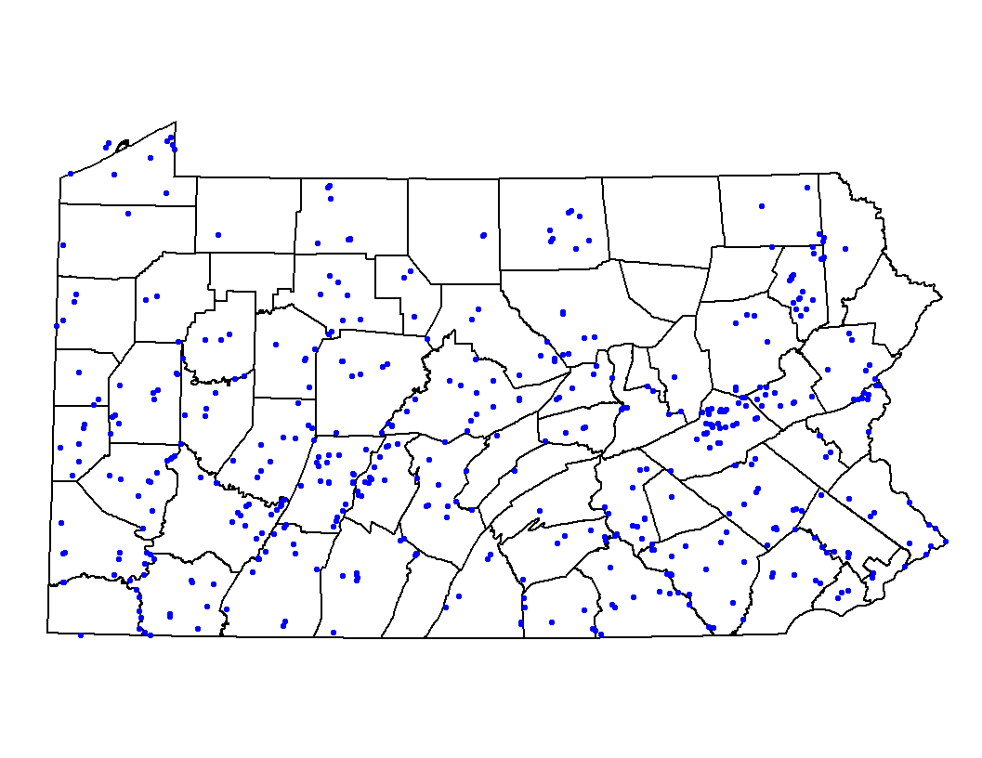
The Concept of “Area Wide”
Some long road-trips to SW Pennsylvania were more fruitful than we thought
One person in the SW District DEP office started tracking turbidity data from all his plants
The potential of the area wide idea was realized
Assess status of all plants based on risk (turbidity)
Apply resources (appropriate tools and people) based on status
Document impacts
Surface Water Systems in State

Slide 6
AWOP was Born
The first regional AWOP meeting was held in Louisville, KY in 1997 (Region 4)
The Region 6 AWOP started in 1998
Regions 3 and 10 started holding regional meetings in 2003
Commitments were made:
Attendance at quarterly meetings (including hosting)
At least 10 plants in a status component
Win-win was defined:
Collaboration with peers and EPA/PAI
Working with water systems to improve performance
Region 4 PBT Demonstration
March 2001
Hardin, MT 1990

Slide 7
What Makes our AWOP Product Unique
AWOP is:
Implemented using a facilitated training approach
Data-based driven (the optimization assessment spreadsheet was developed in 1999)
Committed to improving water quality at the individual plant or system level
Shaped by a strategic planning process (NOLT)
We learn by going out in the field and doing it
We have some awesome, adaptable optimization tools – CCP, PBT, modular training, regional meeting workshops
We are accountable to ourselves – status ⇒ approach ⇒ action items
STATUS
Track
Assess
Prioritize
TPI
(Targeted Performance
Improvement)
MAINTENANCE
Sustain
Integrate
Enhance
CPE
CTA
PBT
Enhanced SS

Slide 8
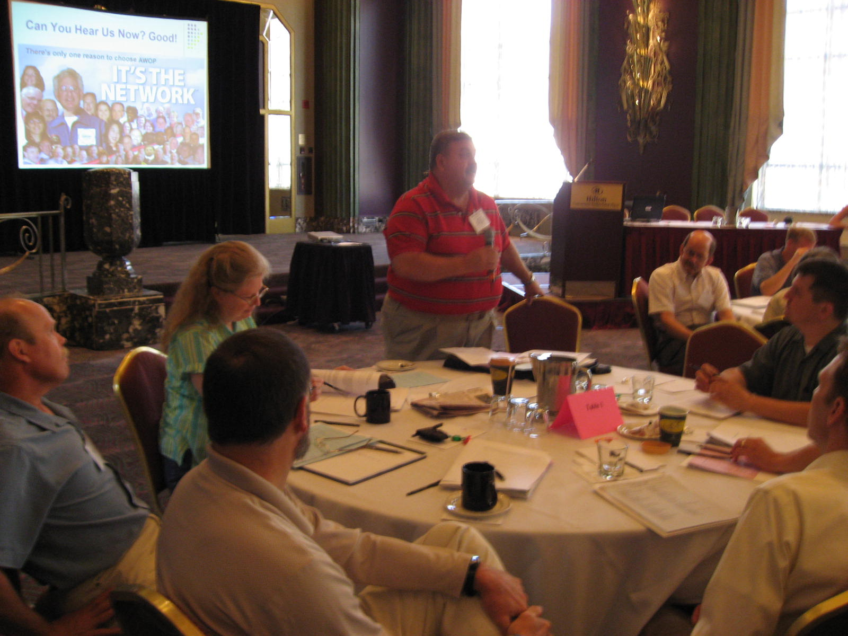
Commitment to our Peers – The AWOP Network
The transition from the CCP-focused approach to AWOP greatly expanded our ability to reach more:
Regions
States
Water systems
The Network began to build when regional staff joined the NOLT meetings in 2004
The first National AWOP Meeting was held in this hotel in 2005
National AWOP Meeting 2007

Slide 9
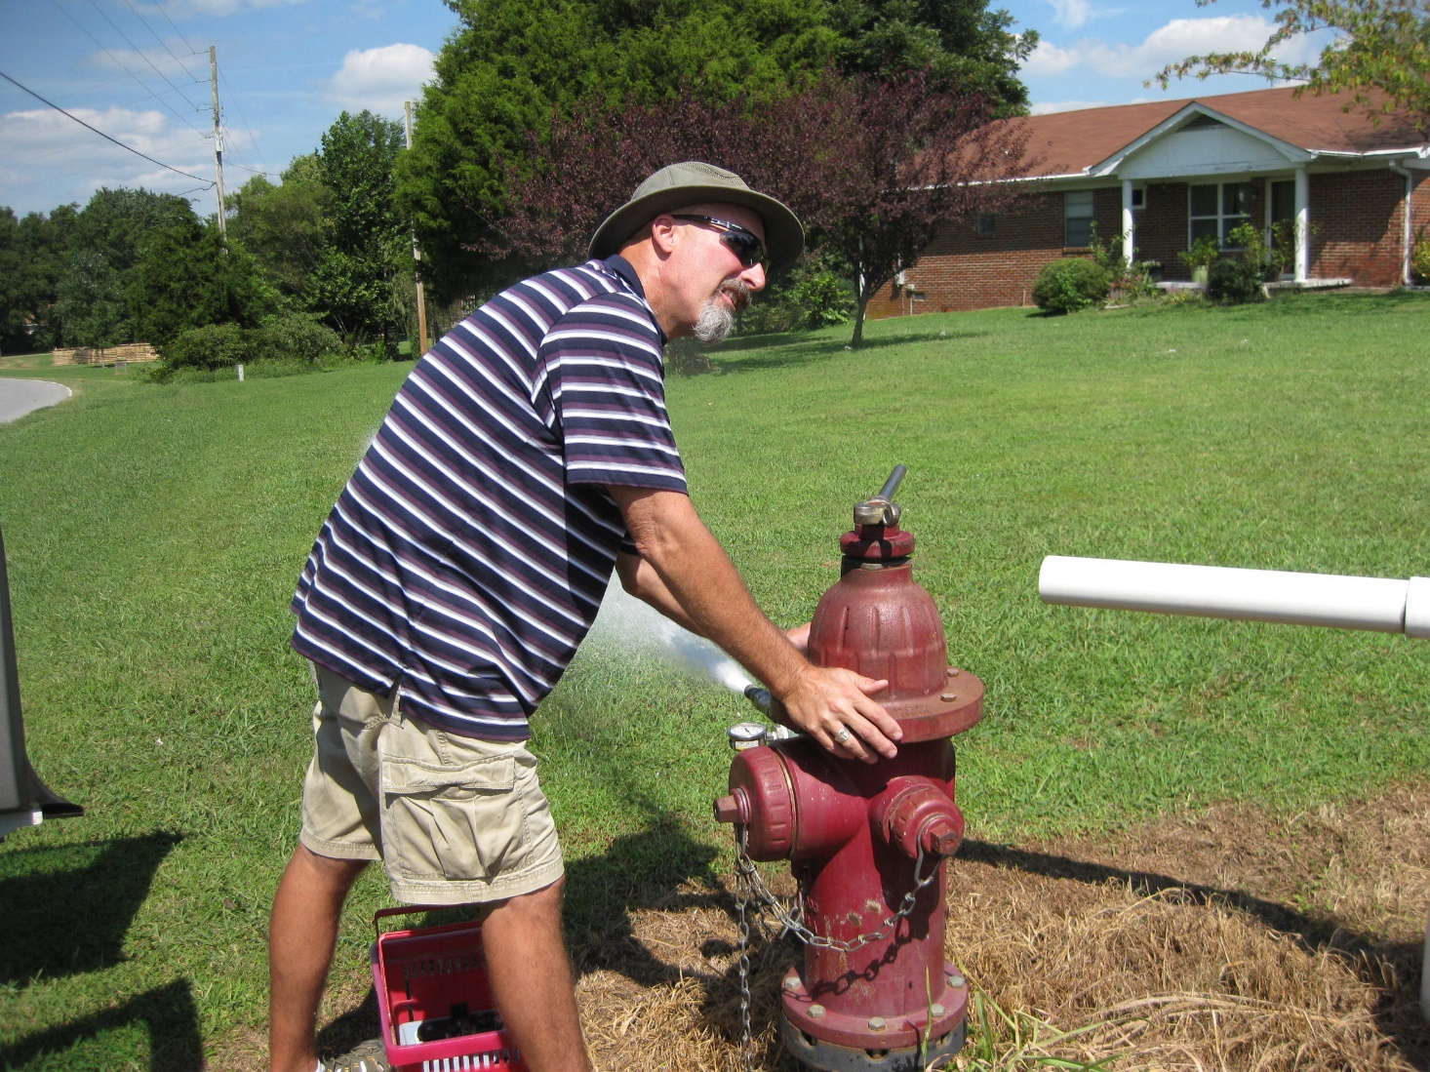
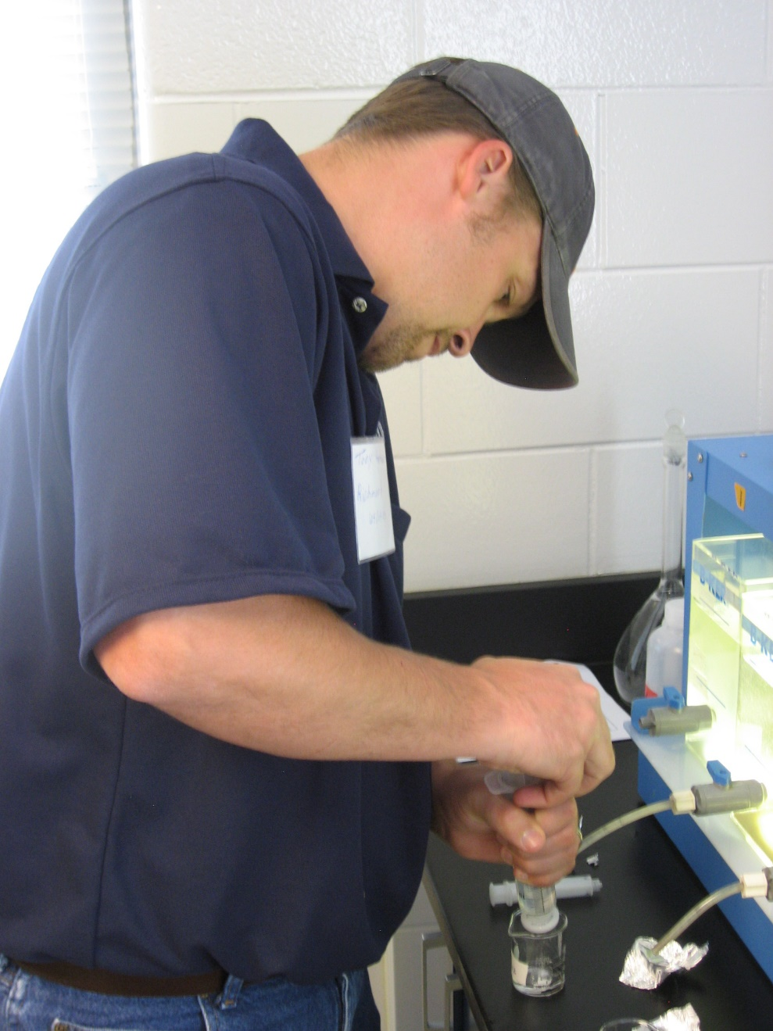
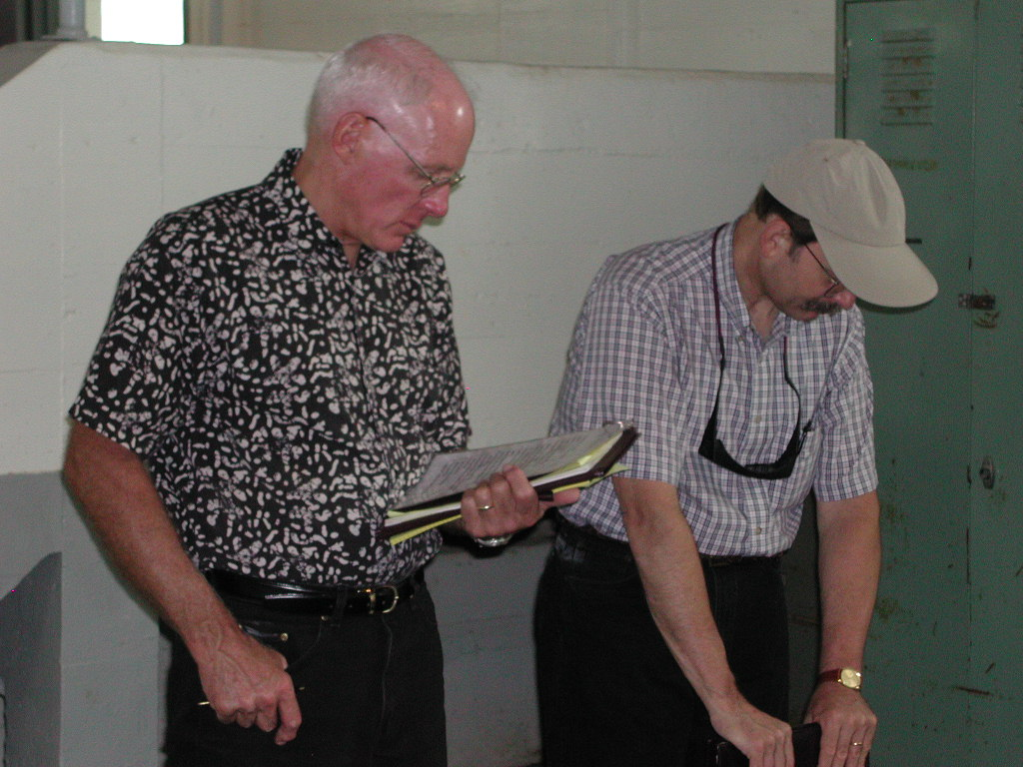
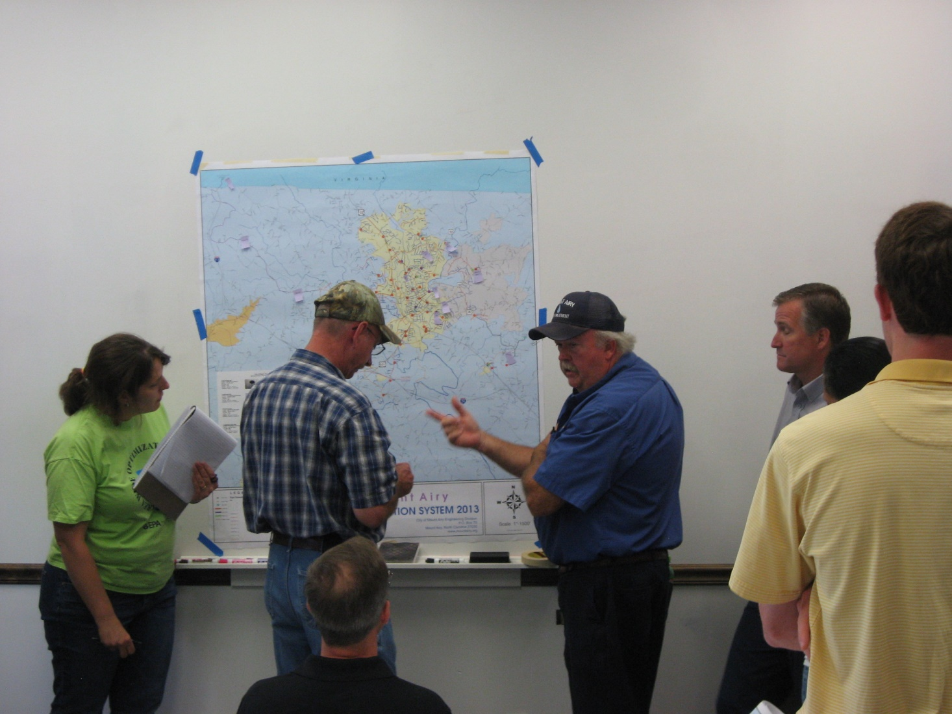
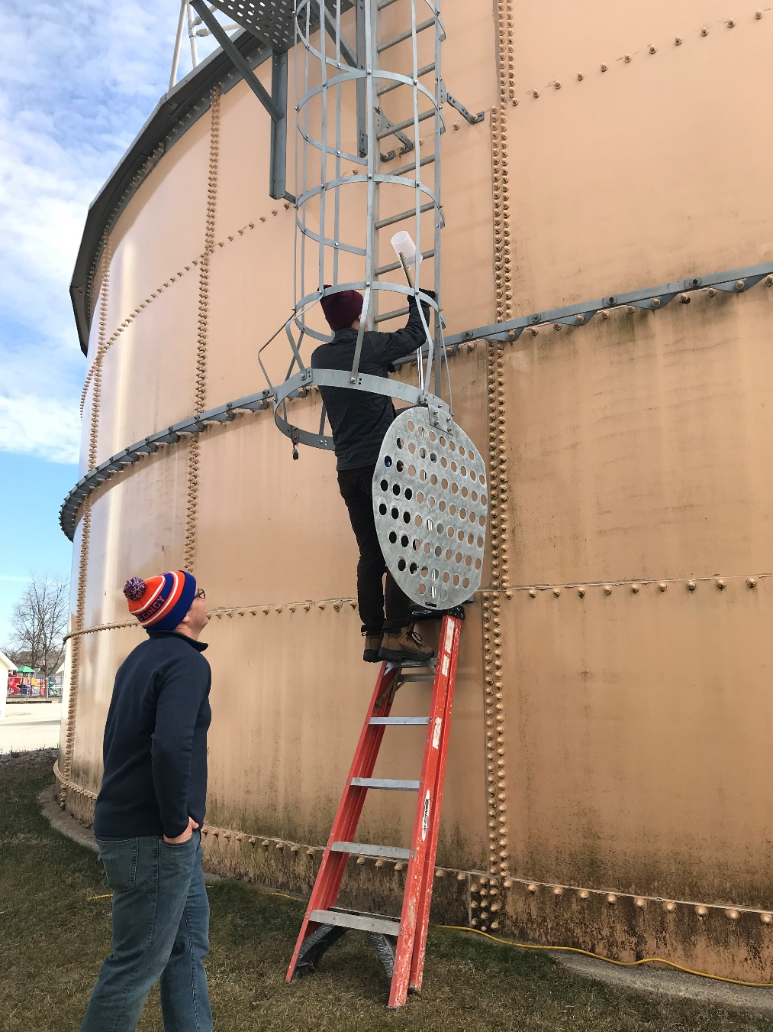
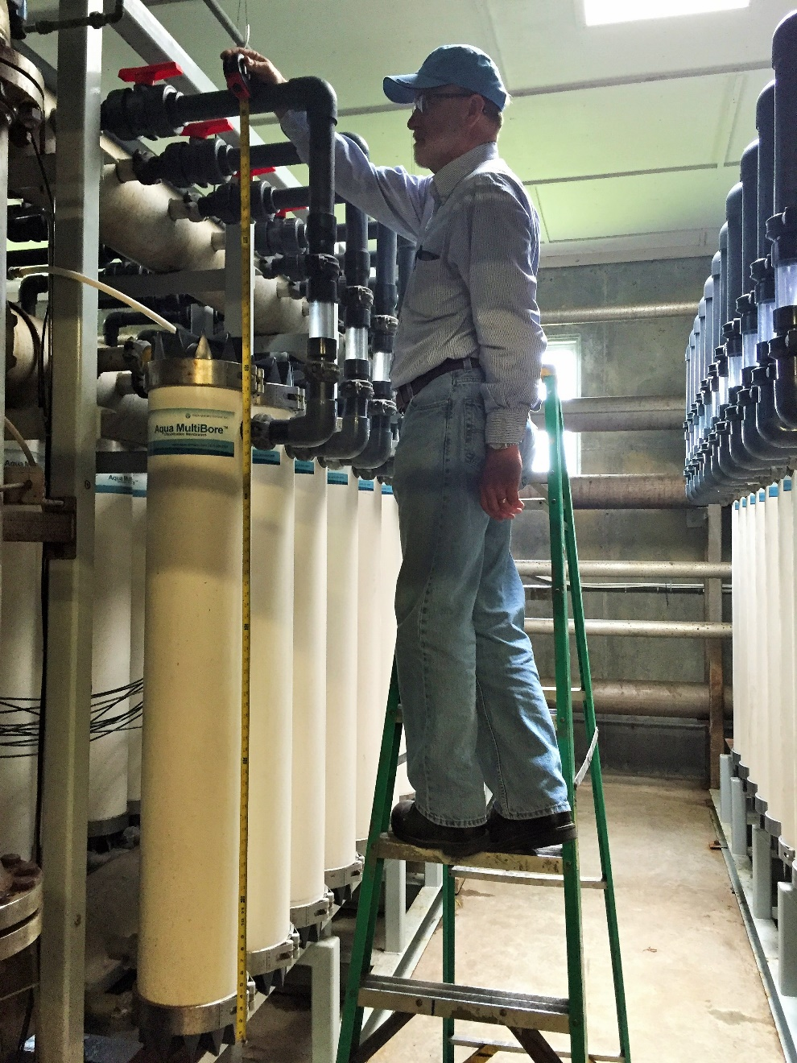
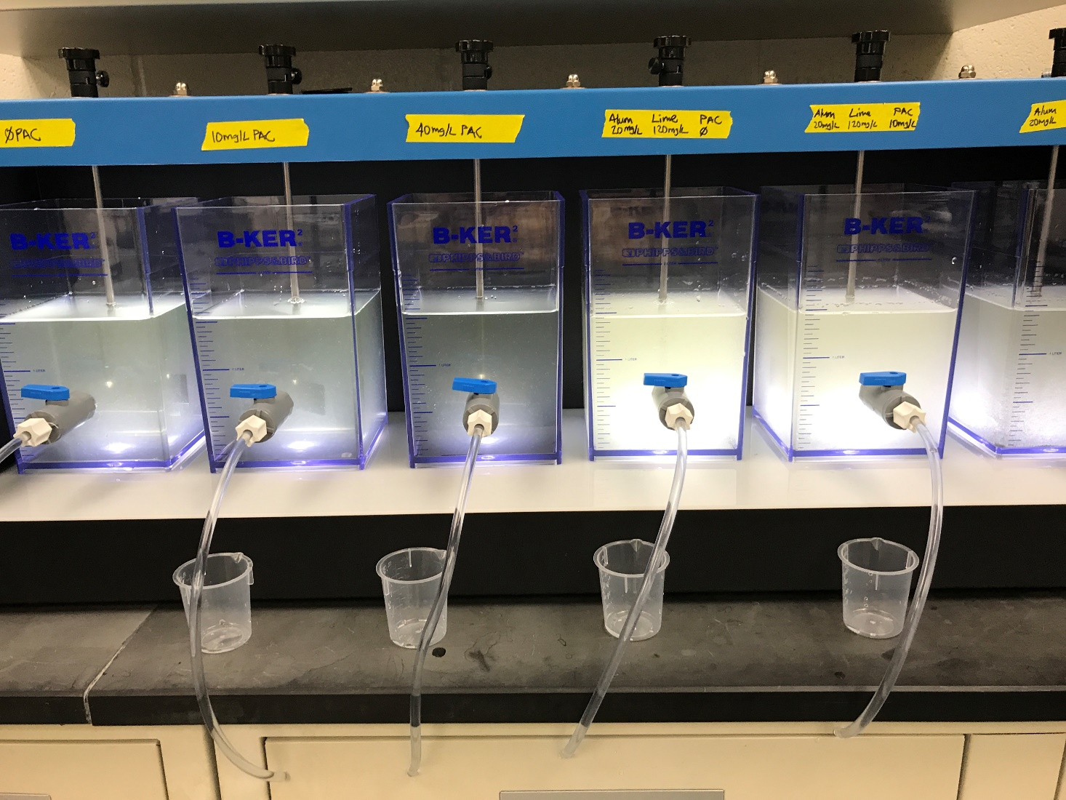
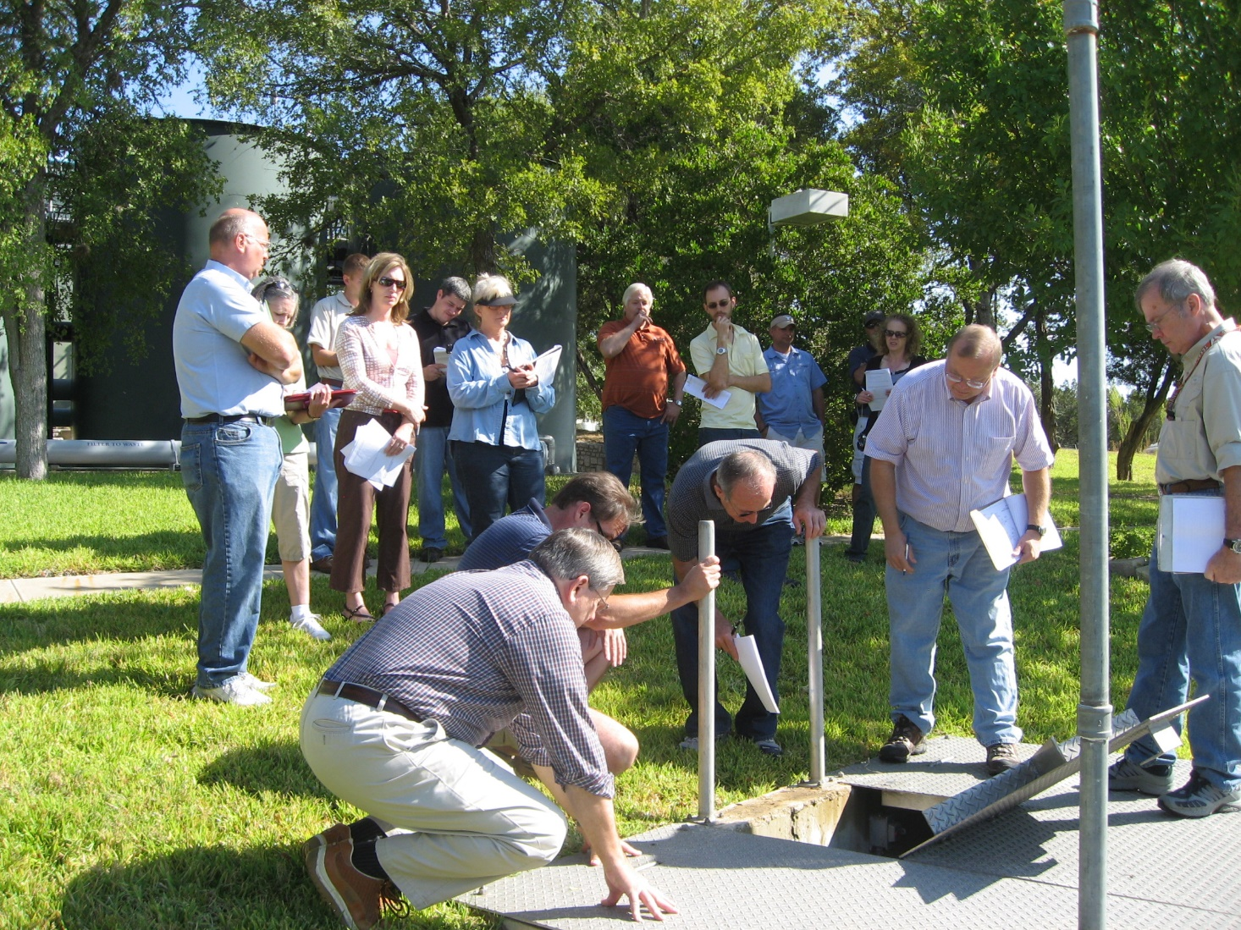
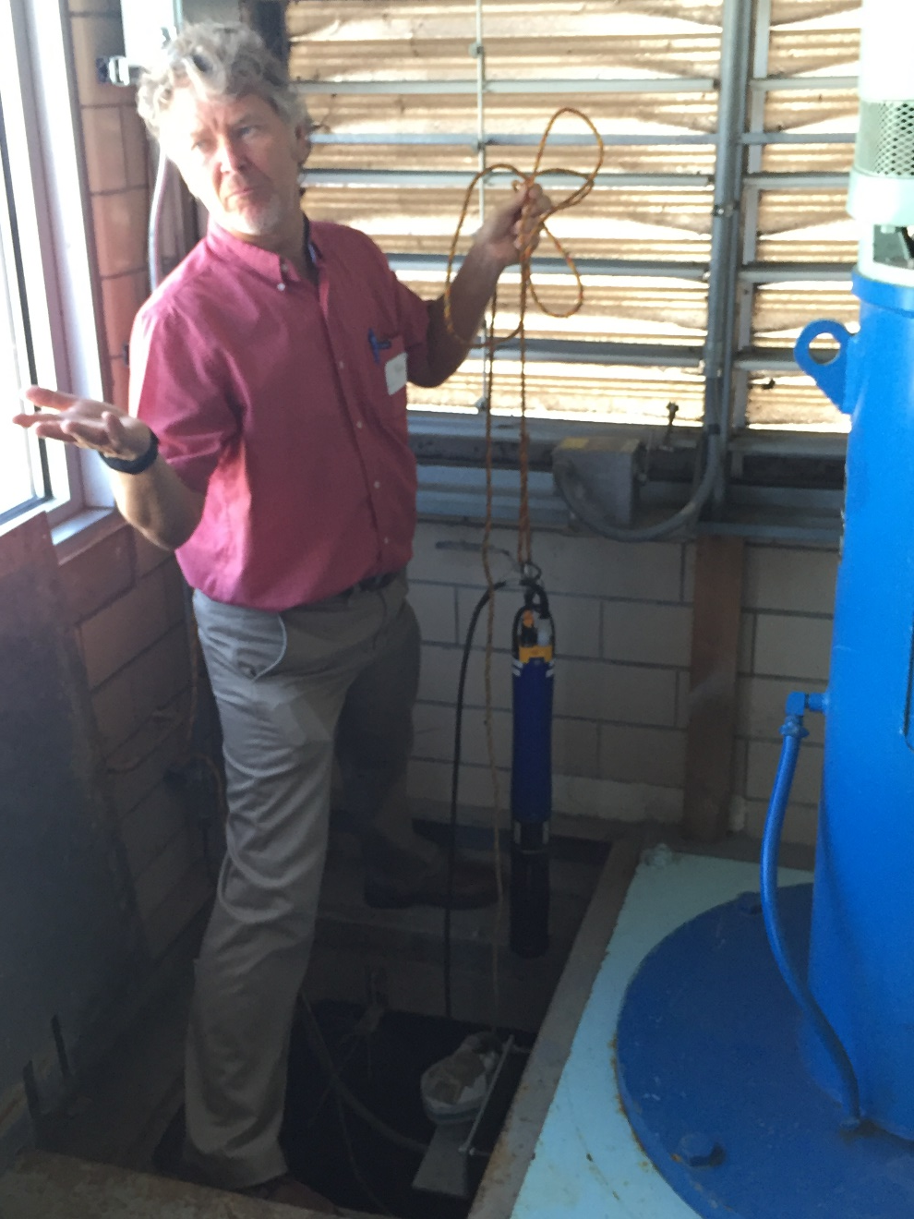
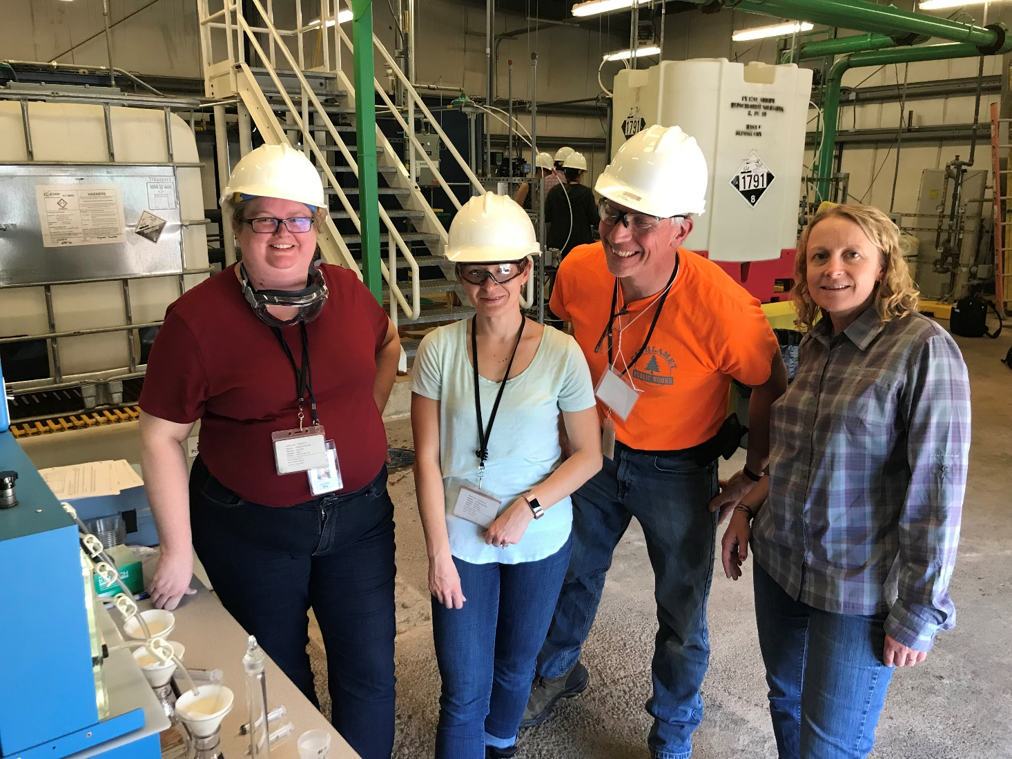
AWOP Growth 1997 - 2019

Slide 10
AWOP – How We Built This
We learn by doing
We recognize the value of our people
We focus less on growth and more on lasting
We developed and implemented a unique product(s)
We realize that the more you know as an AWOP trainer, facilitator, coordinator, operator, the less you need
Newport, OR 2002
then
and
now
You can see more background on this presentation at the following link:
https://1drv.ms/f/s!ArwBe63sLZY0gqFXxz7D7vO8BnXmDA
Grand Ronde, OR 2019

