Slide 1


AWOP
B
A
ENVISIONING THE FUTURE
of the PROGRAM
2019 AWOP National Meeting
August 6-7, 2019

Slide 2

DARRELL OSTERHOUDT
Retired June 30, 2019
Notes:
ASDWA: Big Shoes to Fill

Slide 3
Future Direction
Stay true to our principles
Maintain program relevance
Seize opportunities to enhance the program
Measure AWOP Impacts: Draw the Graph!
Outreach

Slide 4
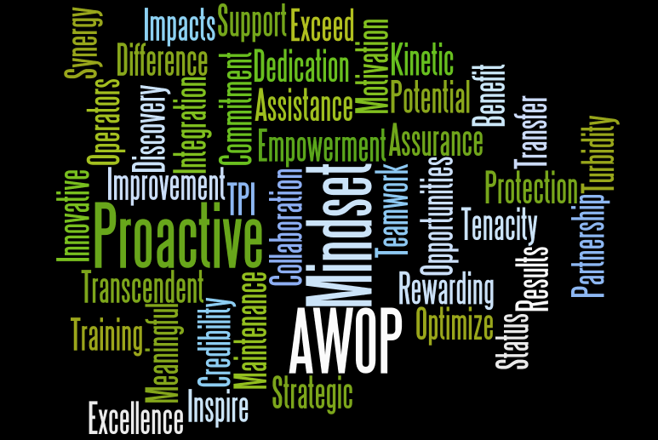

Slide 5

Maintain Program Relevance
Continue strategic implementation process (aka planning meetings)
  Report on AWOP implementation activities
  Nominal Group Process to select relevant topics
  Seek and “approach” for every discussion topic to identify potential action items

Slide 6
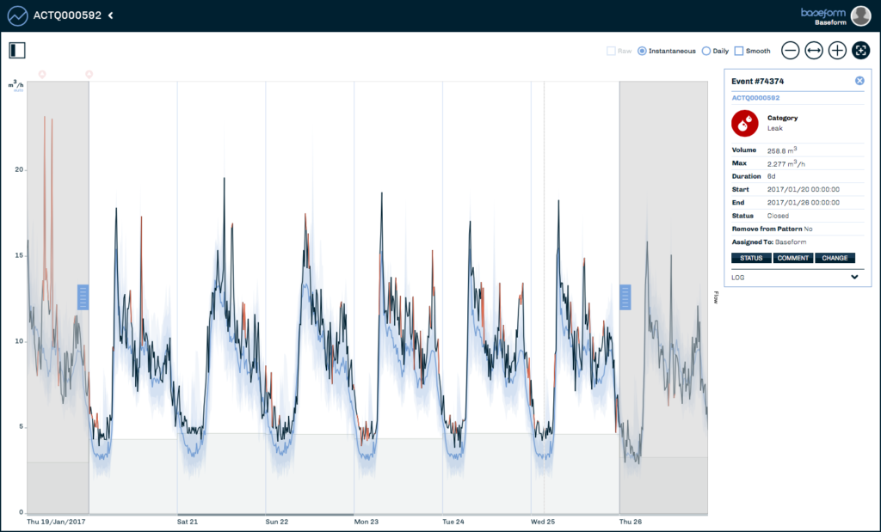

Enhancing the Program

Slide 7
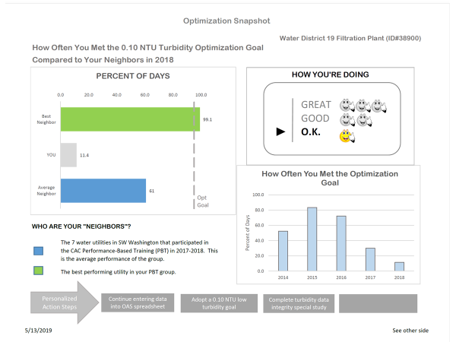
Enhancing the Program:
Embrace Creativity!

Slide 8
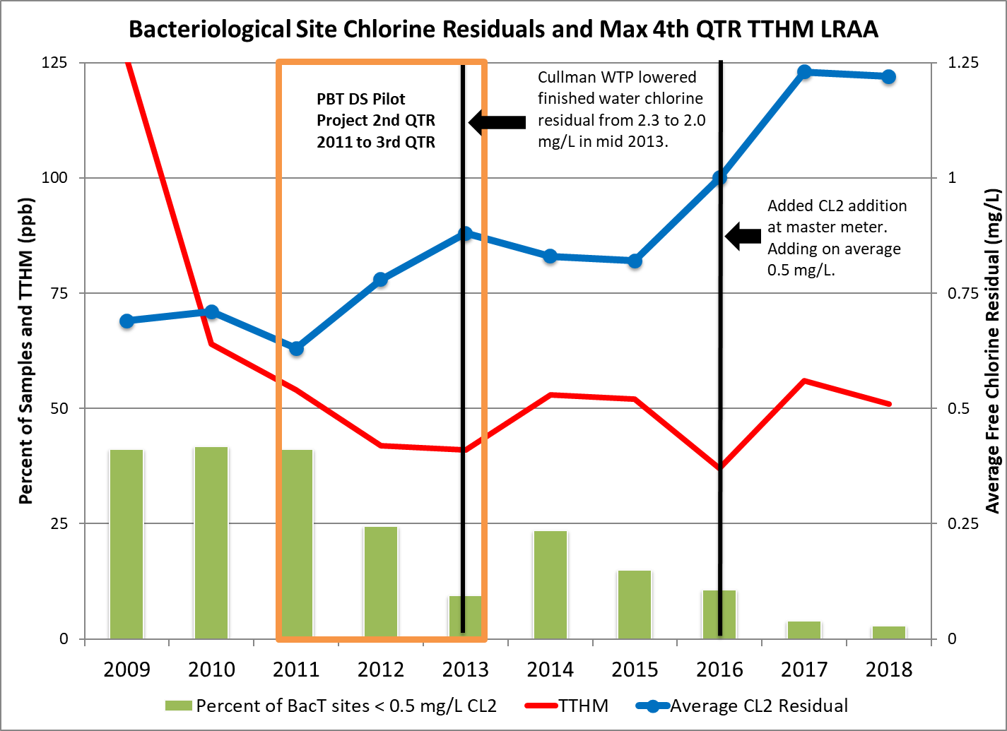
Example: AWOP Impacts
PBT Still Working 5 Years Later

Slide 9
Draw the Graph!
AWOP Network-Wide “National” Graph
Future AWOP: input from all participating PWSS programs

Slide 10
