Slide 1
Region 3
Where is AWOP in 5 years?

Slide 2
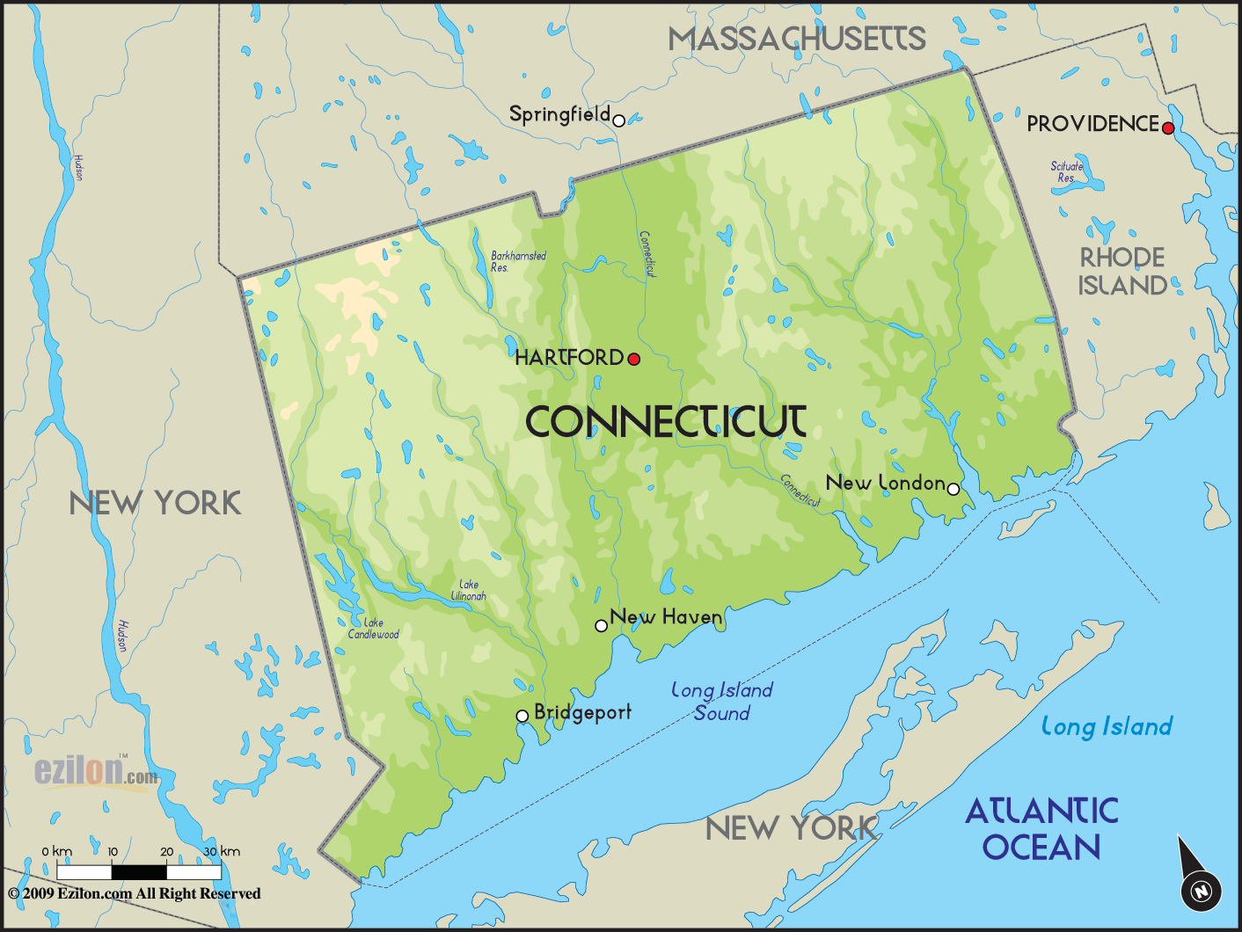
Connecticut

Slide 3
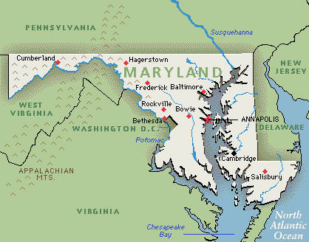
Maryland

Slide 4
Maryland AWOP
AWOP National Meeting
August 6-7, 2019

Slide 5
General Update
Continued to incorporate optimization section in sanitary surveys at surface water treatment systems
Summer intern is working on data entry for annual turbidity graphs and status component
Chlorine residual mapping activity with water system having difficulty meeting DBP rule compliance
Coordinating follow-up mapping activity for the summer

Slide 6
MDE Engineering & Technical Assistance Division
Alex McNamee, Division Chief
Zoe Goodson, AWOP Team Lead
Chris Carski, CPE Lead
Stephanie Eatinger, AWOP Team Member
Dee Settar
Tony Sierra
Virgiline Ongkingco

Slide 7
Goals for MD AWOP in Next 5 Years
Maintain AWOP program, continue to track SWTP filter performance.
Utilize status component ranking to identify water systems that are in need of technical assistance
Utilize DBP compliance sample data to identify water systems that would benefit from DBP optimization activities
Continue providing technical assistance to water systems not meeting compliance with DBP rule through optimization activities (primarily day long activities) and begin reaching out to water systems that are nearing non-compliance
Reintroduce CPE's & get buy in from large CWS's
Implement optimization awards
Notes:
Over the next 5 years I believe we can accomplish the following with our AWOP program, if we are to receive adequate support from our administrators and we are able to increase staffing levels:

Slide 8
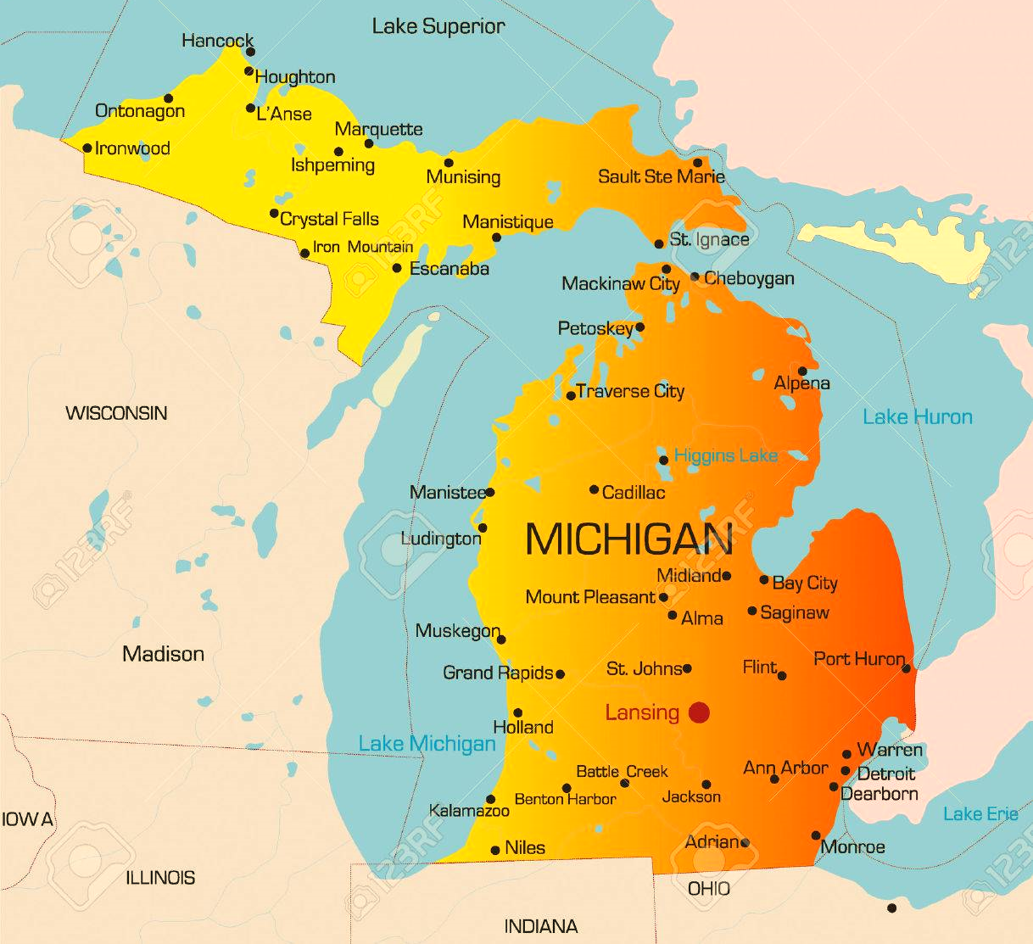
Michigan

Slide 9
MICHIGAN AWOP
Mike Bolf
Drinking Water – Engineering Unit
906-630-4107| bolfm@michigan.gov

Slide 10
MI AWOP Timeline
Oct-17: Secured management support
Dec-17: Memo to all SW plants announcing MI’s participation
Aug-18: Data integrity workshop
Feb-19: New state training – Status Component
Aug-19: Demonstration CPE

Slide 11
Goals for MI AWOP in next 5 years:
Maintain necessary resources!
Disseminate AWOP concepts and seek PWS buy-in
Populate OAS software for SW plants
Establish priority ranking
Develop and introduce awards program

Slide 12
Desired Outcomes
Improve public health protection
Increase optimization awareness
Enhance customer confidence in EGLE
Water customers
PWSs
Third Parties
Empower WTPs to troubleshoot and problem solve
Build/maintain regional and national networks
Promote participation in Region 5 (states & EPA)

Slide 13
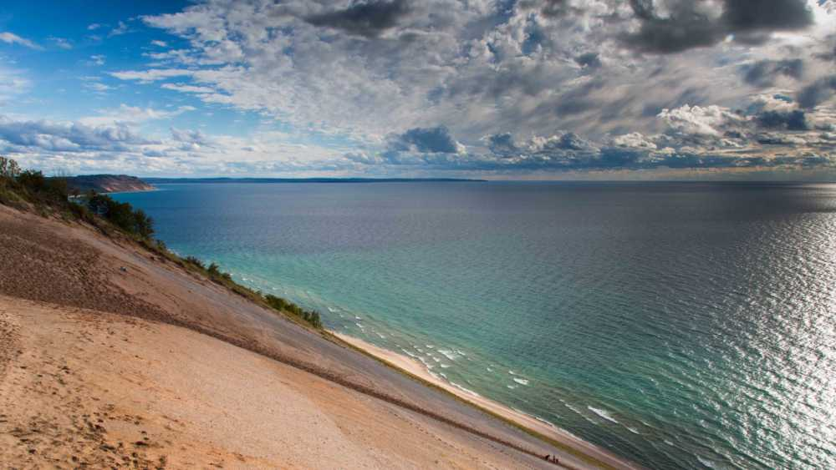
Consumer Confidence?
Lead
PFAS
HABs
Legionella
Aging Infrastructure
State and local resources

Slide 14
Michigan Department of
Environment, Great Lakes, and Energy
800-662-9278
Michigan.gov/EGLE
Follow us at: Michigan.gov/EGLEConnect

Slide 15
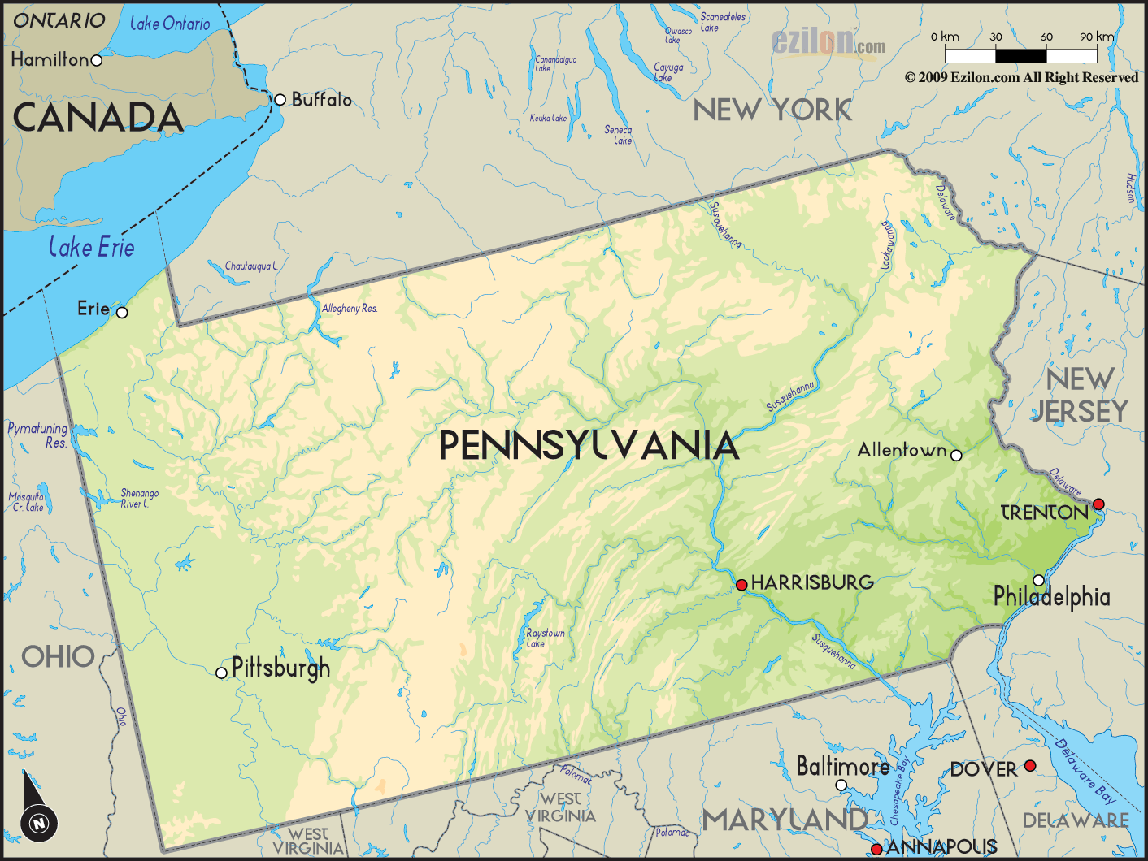
Pennsylvania

Slide 16
Pennsylvania’s AWOP in 5 Years
National AWOP Meeting
August 6-7, 2019
Tom Wolf, Governor
Patrick McDonnell, Secretary

Slide 17
Pennsylvania Optimization Staff
Kevin Anderson- Technical Assistance Section
Justin Blashaw- Distribution
Kurt Smith- Filter Plants
Stephanie Stoner- Distribution and Filter Plants
Notes:
Read Slide

Slide 18
Disinfection Requirements Rule
Minimum Distribution Residual
0.2 mg/L
Report individual sample sites and residual data
Calculate and Report CTs Daily
Nitrification Control Plans
Speciated DBP Reporting
Notes:
Read Slide

Slide 19
General Update-Filtration
Automated Alarm and Shutdown
Continuous IFE and CFE Turbidity Monitoring
Filter Bed Evaluation Program
F-t-W Requirements
Membrane Treatment Technique
Notes:
Read Slide

Slide 20
AWOP in 5 Years
Availability of Performance Data
Better awareness
Process control
Early detection
Prioritize technical assistance and training
More Stringent Requirements
New incentive to improve water quality
Increased demand for AWOP assistance
Notes:
Read Slide

Slide 21
National AWOP Meeting
Kevin Anderson
keanderson@pa.gov
717-783-9764

Slide 22
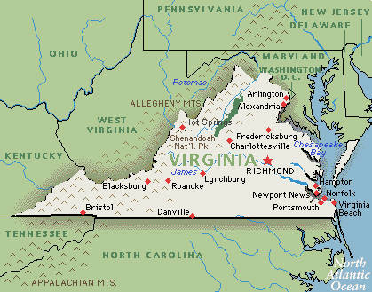
Virginia

Slide 23
Virginia Optimization Program Beginnings, Current, Path Forward
August 6, 2019
Dixon Tucker, PE, VOPC Chair

Slide 24
Notes:
Organized in 2003. Had our first awards in 2005. Good growth trend so far, but still need to reach a few more waterworks.

Slide 25
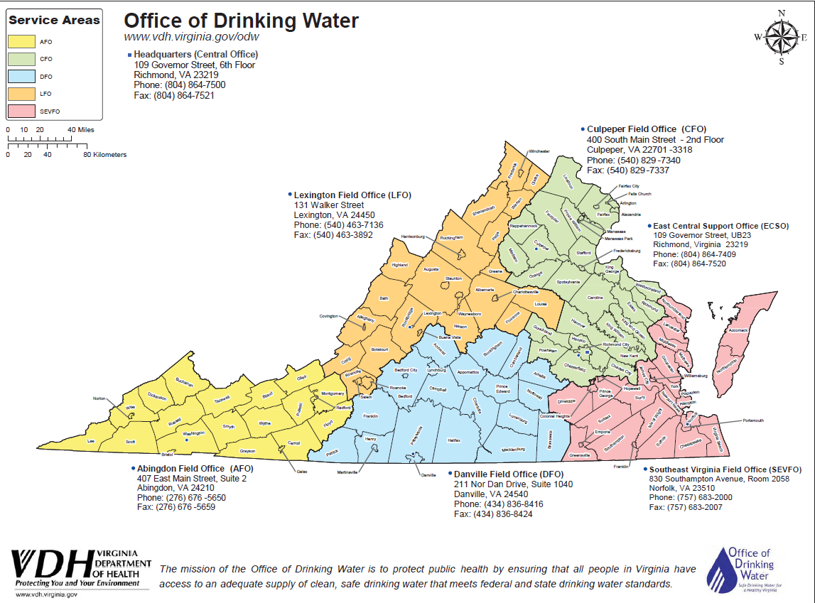
Office of Drinking Water
?
Notes:
We have about 120 staff and 6 field offices. We are in the process of standing up the 6th field office in the Richmond area.

Slide 26
Currently
VOP Committee composed of representatives from six field offices and the Central Office
David Dawson, PE– Abingdon Field Office*
Thomas Thompson, PE – Lexington Field Office
Dixon Tucker, PE – Southeast Virginia Field Office
Nyibe Smith – East Central Support Office*
Bernard Proctor – Danville Field Office*
James Keating– Culpeper Field Office*
Susan Miner, CapDev – Central Office*
Aaron Moses, PE, Central Office
Robert Edelman, PE, Central Office
Notes:
*Half the membership has been on the committee less than 2 years

Slide 27
THE PROGRAM
Core Team Structure and Capacity –
One VOPC chair (turned over four times in 16 years)
One VOPC team member from each of six offices
Three CO representatives
Team turnover by attrition – five offices have changed team members
Team is responsible for implementation at each of six offices.
Notes:
The core team has grown to include two more representatives from the Central Office. There is one member still on the team from 2003 (Dixon Tucker).
First Chair – Charles Rest, Second Chair – Robert Edelman, Third Chair – Aaron Moses, Four Chair – Dixon Tucker

Slide 28
Looking Forward
Targeted technical assistance via Sanitary Surveys and other meetings with WTPs.
Annual VOP data review letter to WTPs, OR
Notify WTPs of rank in sanitary surveys.
Targeted technical assistance or intervention at low-performing WTPs.

Slide 29
Looking Forward
DBP PBT – Disinfection By-Products, Performance Based Training – looking to have more of these.
Distribution System Optimization will be doing these to address DBP issues.
Continue quarterly AWOP meetings with EPA Region 3
Continue sharing lessons learned

Slide 30
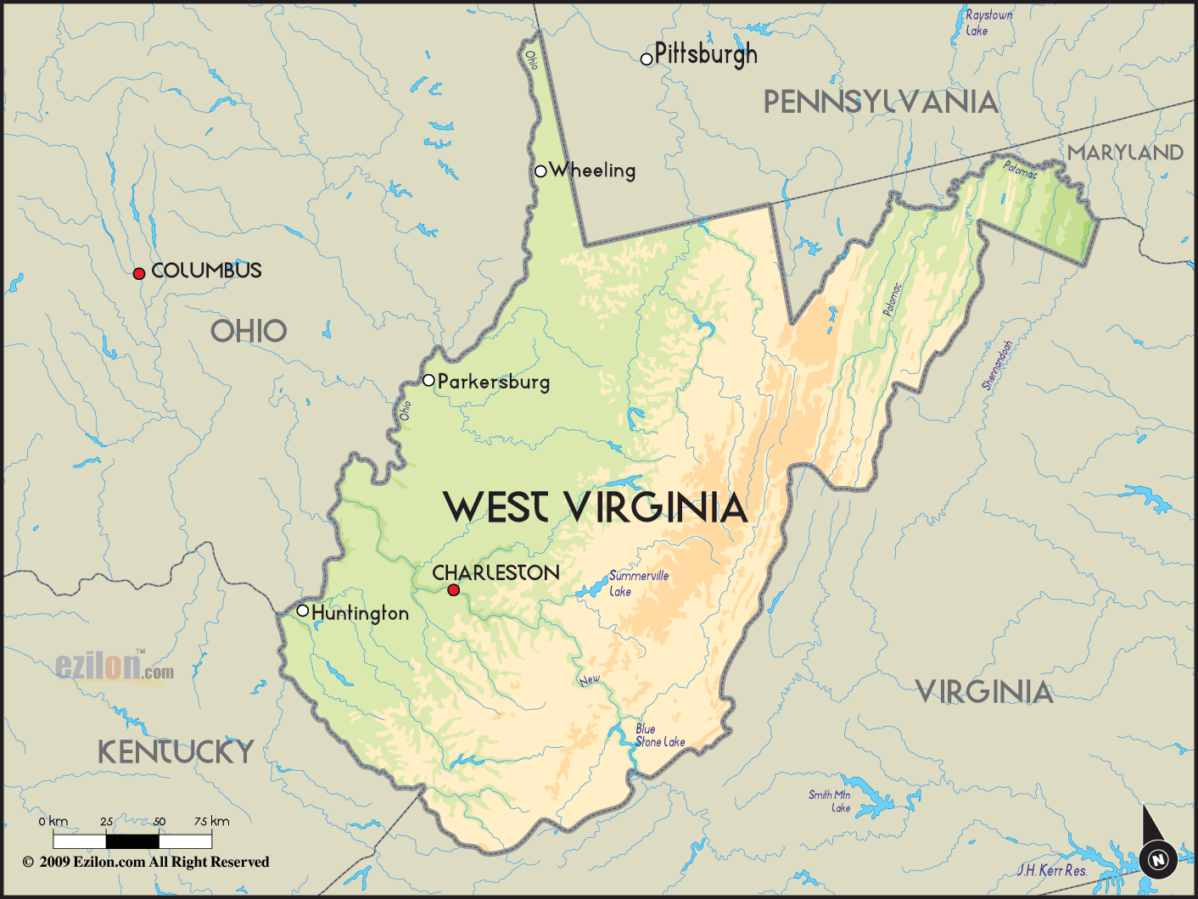
West Virginia

Slide 31
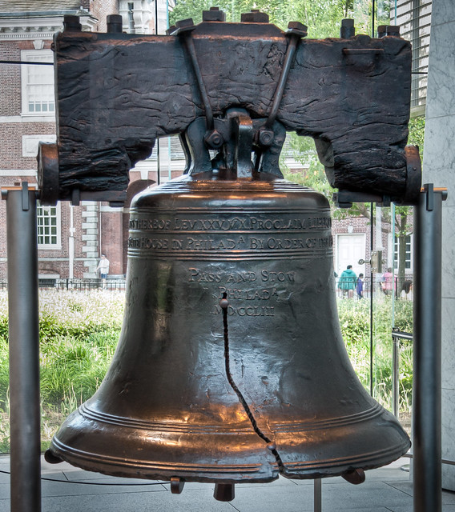
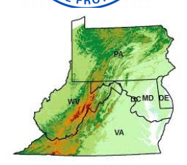
EPA Region 3
Philadelphia

Slide 32
EPA Region 3 AWOP Program
Administered by the Drinking Water Section
Two Objectives: facilitation and direct implementation
Member States: CT, MD, MI, PA, VA, WV
Consideration states: NJ, MA
Successful example of cooperative federalism
EPA working collaboratively with states and local governments to benefit the public
Notes:
Cooperative Federalism: EPA working collaboratively with states and local governments to benefit the public

Slide 33
5 Year Forecast: Maintaining the Region 3 Program
AWOP program responsibilities
Regional Facilitation
Direct Implementation (DC)
Regional Facilitation Goals
Champion continued participation by veteran states
Encourage and support new members, and continue engagement with interested states
Increase responsibility for meeting preparation and execution to reduce burden on EPA-TSC

Slide 34
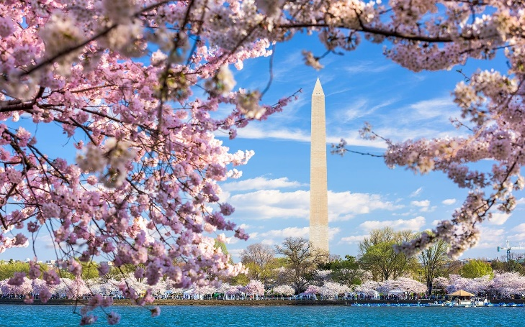
EPA Region 3 AWOP Program DC Direct Implementation
6 public water systems
1 wholesaler (2 SW treatment plants)
5 consecutives
4 military bases
No treatment, no storage
1 hotel
Chloramine treatment (hot and cold)

Slide 35
5 Year Forecast: Maintaining the Region 3 Program
AWOP program responsibilities
Regional Facilitation
Direct Implementation (DC)
DC Direct Implementation Goals
Implement optimization tools in DC program
Investigate and develop DC status component with management approval
Emphasize data integrity and distribution system optimization
Continue training initiative for consecutive systems
Sampling training May 2019 (included hydrant flushing live demo)

Slide 36
EPA Region 3 AWOP Program
Alysa Zirilli
EPA Region 3
Alysa.Zirilli@epa.gov
(215) 814-5733

