Slide 1

Executive Director’s Report
Annual Conference Preview
J. Alan Roberson
ASDWA Executive Director
Association of State Drinking Water Administrators
1401 Wilson Blvd. - Suite 1225 - Arlington, VA 22209 - (703) 812-9505 - www.ASDWA.org

Slide 2
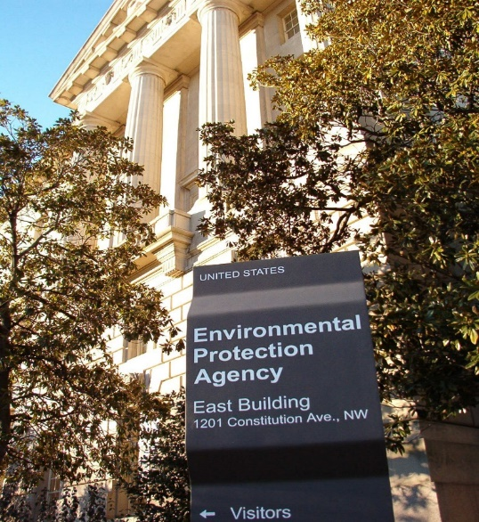
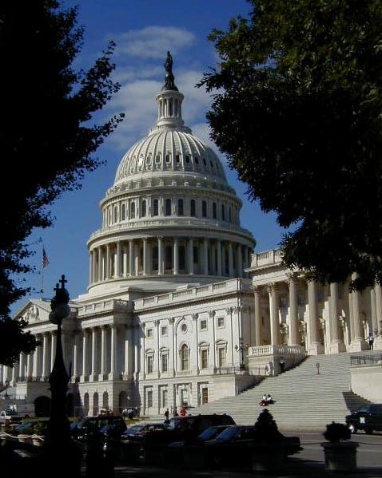
Presentation Outline
EPA overview
  Regulations
  AWIA implementation
  WIIN grants
  OECA
Congressional overview
ASDWA 2020-2022 Strategic Plan
ASDWA 2021-2025 dues
New process for regional reports
Two ongoing ASDWA projects
Association of State Drinking Water Administrators
1401 Wilson Blvd. - Suite 1225 - Arlington, VA 22209 - (703) 812-9505 - www.ASDWA.org

Slide 3
SDWA Regulatory Development Process
Draft CCL
Preliminary Regulatory Determinations (RD)
Public Review
and Comment
Final CCL
Draft UCMR
Proposed Rule (NPDWR)
Final Regulatory Determinations (RD)
Final UCMR
UCMR Monitoring Results
Six Year Review of Existing NPDWRs
Final
Rule (NPDWR)
No further action or develop health advisory
Notes:
3

Slide 4
Regulatory Decisions: 1998-2016
CCLs, UCMRs, RegDets
 | FIRST | SECOND | THIRD | FOURTH
CCL | 1998 | 2005 | 2009 | 2016
 | 60 contaminants | 51 contaminants | 116 contaminants | 109 contaminants
UCMR | 1999 | 2007 | 2012 | 2016
 | 26 contaminants | 25 contaminants | 30 contaminants | 30 contaminants
RegDet | 2003 | 2008 | 2016 | Final to be published in 2021
 | 9–Not regulated | 11-Not regulated | 4-Not regulated 1-Needs more research

Slide 5

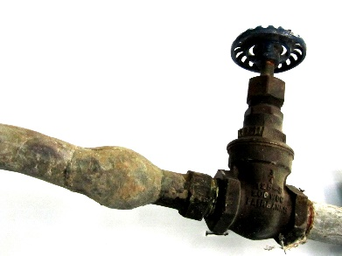
EPA Regulations for 2019
Perchlorate - proposed on 6/26
  Four proposed options
    Proposal: 56 ug/L
      Options: 18 & 90 ug/L and negative regulatory determination
  Court deadline for final – June 19, 2020
Lead and Copper Rule Revisions (LCRR)
  Signed by EPA Administrator Wheeler on 10/10
  Pre-publication version weighs in at 347 pages

Slide 6
LCRR Highlights
“Trigger level” (ASDWA suggestion) of 10 ppb will be established to require systems to take certain actions to be better prepared in case of a future exceedance of the 15 ppb AL.
Water systems will be required to develop LSL replacement plan when above the “trigger level”
  Start replacing LSLs at a minimum of three percent a year with an action level exceedance (ALE).
Water systems will be required to notify the public within 24 hours of an ALE
  Notify residents within 24 hours if an individual sample is above the 15 ppb AL.
Water systems will be required to annually sample 20% of the schools and licensed child care centers in the service area.
Improves water quality parameter monitoring and CCR language
  Strengthens sampling protocols but does not change any copper related requirements.
Alternatives to OCCT would be allowed for small systems and NTNCWS that exceed the 15 ppb AL

Slide 7
Potential LCRR Issues
Flexibility for states
  What’s the right balance?
  Too much flexibility leads to more transactions
Number of transactions between states and water systems
  Pre-publication version lists 30 transactions
    What’s the number of hours for implementation?
Other issues TBD

Slide 8
LCRR Next Steps
List of issues where EPA is requesting comment
  Comment period extension letter (extend to 90 days)
Conference calls
  ASDWA Workgroup on Thursday, 10/17
    Weekly calls in November
  Board on Friday, 10/18 – Meeting Sunday, 10/27
Contract – Confluence Engineering Group
  Darrell is helping on a part-time basis

Slide 9
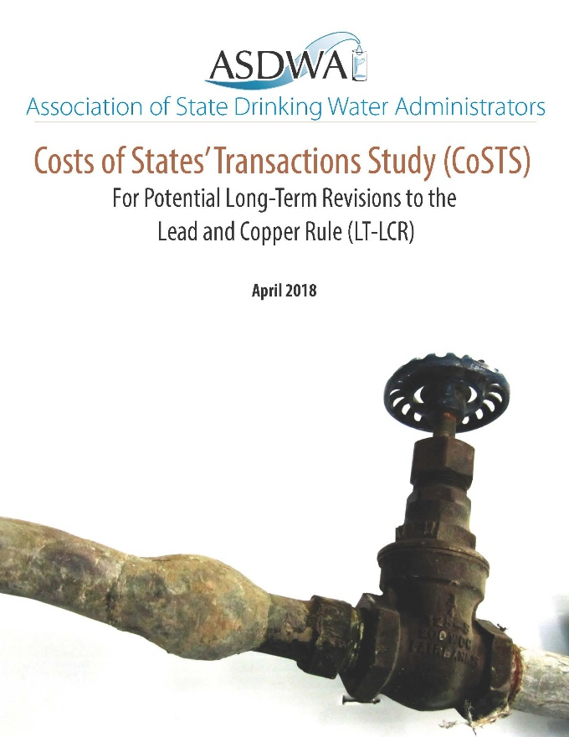
More LCRR Next Steps
LCRR pre-publication lists 30 different state activities
  Likely a significant increase in states’ workload
Working to update CoSTS report to reflect the proposed LCRR

Slide 10
EPA Regulations in 2020
SDWA CCL Processes (five-year cycles)
  Preliminary RegDet 4 (1/21 deadline for final)
  Draft CCL5 (11/21 deadline for final)
  Proposed UCMR5 (1/22 deadline for final)
Restructuring (10/20 deadline)
  May require systems w/ repeated violations to assess options for consolidation or transfer of ownership
    New primacy package for states
CCR (10/20 deadline)
  Biannual delivery for systems >10,000 people
  More readable and understandable
    Minimal work so far by EPA
Public Notification (PN) Handbook to be revised in the future

Slide 11
WIIN and AWIA
Implementation
Water Infrastructure Improvements for the Nation (WIIN) Act Grant Programs
Drinking Water State Revolving Fund (DWSRF)
Intractable Systems Report to Congress
Asset Management and Capacity Development Strategies
Consumer Confidence Report (CCR) – previous slide
Water System Restructuring Rule (WSRR) – previous
Community Water System Risk and Resilience Assessments
Amendments to the Emergency Planning and Community Right-to-Know Act

Slide 12
WIIN Grants
Lead testing in schools and child care centers
  Workplans for grants being reviewed/revised
  3 Ts MOU announced on 10/3
    Concerns with what actions should be taken based on the test results?
Grants for small & disadvantaged systems
  Application process just opened up
  NEPA reviews instead of SEPR
Grants for reducing lead – out in the fall

Slide 13
AWIA and DWSRF
Drinking Water State Revolving Fund (DWSRF)
  Disadvantaged Communities: New state maximum of 35%, minimum of 6%
  Loan Terms:
    Extends loan period to 30 years (from 20 years)
    Increases loan period for disadvantaged communities to 40 years
    Extends the time period for initial repayments to 18 months after project completion (from 12 months)
  Lead Service Lines: Future EPA drinking water needs surveys must include cost estimates for lead service line replacement
  Source Water Protection Set-asides: Authorizes assistance for delineating source water protection areas and conducting and updating assessments
  EPA Best Practices Report: EPA must collect state best practices on DWSRF administration and disseminate them within 3 years

Slide 14
Intractable Systems, Asset Mgmt., & Capacity Development Strategies
Intractable Systems Report to Congress: List of systems that had at least one open health-based violation for at least 274 days in all 3 calendar years of 2016, 2017, and 2018
  Report will include case studies and information about barriers
  June/July 2019 - Draft report provided to states and EPA Regions
  October 2020 - Final report due (will include summary data only)
Asset Management and Capacity Development Strategies: ​States must amend their state capacity development strategies to include actions that encourage the development of asset management plans
  Fall 2019 - Expected release of EPA guidance
  Fall 2021 - Expected two-year timeframe for states to complete amended strategies

Slide 15
Emergency Planning & Response
Community Water System Risk and Resilience Assessments
  Requires community water systems serving more than 3,300 people to develop or update risk assessments and emergency response plans (ERPs)
    Must certify completion to EPA
    Every 5 years – Initial deadlines -> 2020 for large & medium systems
      2021 for small systems
Amendments to the Emergency Planning and Community Right-to-Know Act
  Requires state and tribal emergency response commissions to:
    Notify the drinking water primacy agency of any reportable releases (spills)
    Provide water systems with hazardous chemical inventory data
  EPA Resource - “Guide for Community Water Systems and State Drinking Water Primacy Agencies”

Slide 16
OECA
National Compliance Initiative
  Ongoing OECA dialogue – Board conference call on Aug. 1st
    OECA visits to states
  Still waiting on implementation strategy
SDWA Section 1431 – Emergency Powers
  New guidance released in 2018
  Implementation issues became apparent in 2019
    ASDWA survey in August/September
    Board/OECA/OGWDW Conference Call on September 27th
  More work is needed on this issue

Slide 17
Congress
Continuing Resolution (CR)
  Through November 21st
    Beyond that, who knows
Appropriations
  Possible $ increase for STAG?
NDAA – “must-pass” bill
  Potential PFAS provisions

Slide 18
Strategic Plan Development Process
Fall, 2018
Staff and board surveys
Winter, 2018
Staff workshop
Spring, 2019
Board review
Summer, 2019
Board adoption
Fall, 2019
Incorporate plan objectives and strategies into 2020 staff workplans

Slide 19
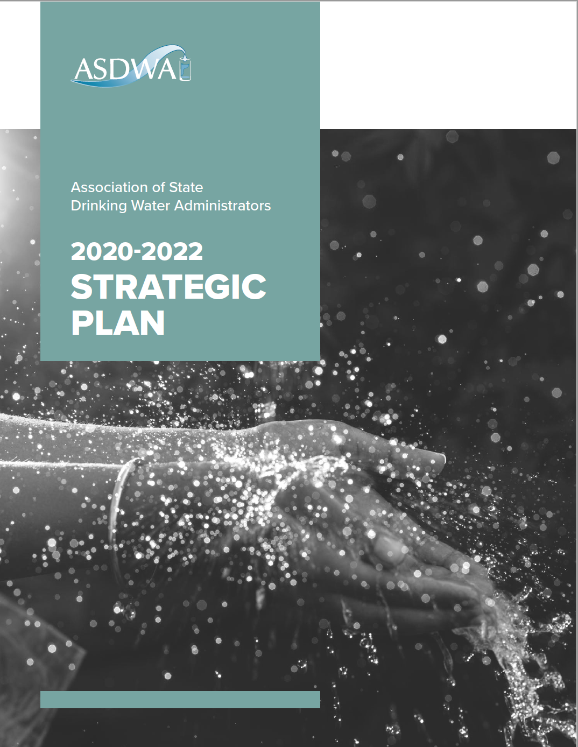
Strategic Plan Influencing Factors
Economic Uncertainty
Internal Culture
Environment
Industry Convergence
Political Leadership
Public Expectation
Regulation
Workforce Issues

Slide 20
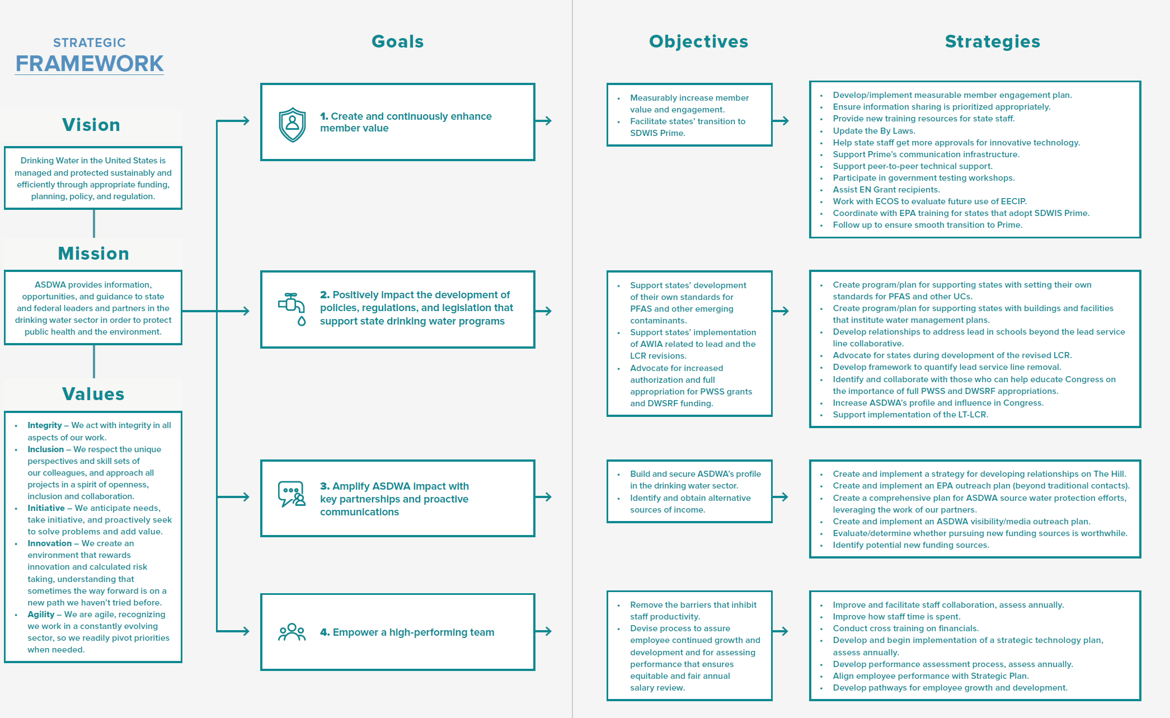

Slide 21
2021-2025 Dues
ASDWA’s dues generally based on PWSS grants
Last dues increase in 2006
Revenue from EPA Cooperative Agreement has been over 50% six out of the past ten years
  Goal is to be under 50%
Drivers -> increased travel for states & project funding for issues not being addressed by EPA

Slide 22
2021-2025 Dues (cont.)
ASDWA currently has 10 tiers of dues for states
Needs to be simplified
  ASTSWMO – 3 tiers looking to shift to 1
  ACWA – 3 tiers
  ECOS – 3 tiers
New dues structure has 5 tiers of dues for states
  Maintain the same 4 tiers for territories, D.C., and Navajo Nation

Slide 23
2021-2025 Dues (cont.)
Board discussed options for dues increase at March Meeting
Executive Committee refined options during the spring
Board fine-tuned preferred option in July
Board approved on August 22nd conference call

Slide 24
2021-2025 Dues (cont.)
For states remaining in the upper half of 5 tiers
  5% increase for 2 years, 1% increase thereafter
    Same % for territories, D.C., and Navajo Nation
For states moving up into the upper half
  Constant percentage for 5 years, 1% increase thereafter
Starts in 2021 – dues for 2020 remain the same

Slide 25

Two ASDWA Projects
Update of 2013 State Resource Needs Report
Toolkit for State Standard-Setting

Slide 26
State Resource Needs Project
Signed a contract with Cadmus in February 2019
Convened the State Resource Needs Advisory Panel
  MT, SD, CO, CT, NY, OK, PA, ID, OK, TX
Four conference our calls with the Advisory Panel and Cadmus and completed the in-person meeting (6/15-6/16)
  Conference calls were designed to gather state input on the methodology

Slide 27
Resource Needs Status
Currently collecting financial information and questionnaires
  The questionnaire seeks input on some information new to the model not covered in calls (For example, sanitary Survey: State-specific Requirements and Site-travel Estimates).
Information at the Annual Conference presented will reflect the preliminary numbers in the updated model
  Questionnaire input, once collection has finished, will influence some calculations.
Expected completion date - end of 2019
  Dependent on state responses – we need your help!

Slide 28
Toolkit for State Standard-Setting
States are having to set their own standards
  Based on public/legislative pressures
Some states setting standards for the 1st time
  How to assess the foundation for standards
    Health effects
    Occurrence
    Analytical methods
    Treatment
    Benefit-cost analysis

Slide 29
Toolkit (cont.)
Signed a contract with Ross Strategic on 6/20
  Corona Environmental Consulting assisting with cost-benefit analysis
States providing input and guidance
  CA, NH, NJ, NY, MI, VT, PA, CO, MA, CT, MN
    Workshop in Chicago on 8/21-8/22
Ongoing follow-up webinars to refine modules
  First draft for final review in December
  Final toolkit in January

Slide 30
Toolkit Modules
0 – Self-assessment of regulatory context and capacity - undertake emergency measures, if needed
Health effects characterization
Occurrence characterization
Analytical methods
Treatment & compliance options characterization
Benefits, costs, and economic considerations
Intermediate management strategies
Regulation – MCL and treatment technique

Slide 31
Questions?
Discussion??

