Slide 1
Compliance monitoring data portal (CMDP)
Barrett Brown
The Group, LLC
September 23, 2020

Slide 2
AGENDA
CMDP Overview/Prerequisites
SDWIS State
Data Synchronization Engine (DSE)
Shared CROMERR Services(SCS) Accounts ( State / PWS / Lab )
CMDP Getting Started
Data Synchronization Engine (DSE) Overview
CMDP Sample Prerequisites (SDWIS State Data Tie-in)
Compare SDWIS State LE entry migrated to the CMDP
Compare SDWIS State Inventory entry migrated to the CMDP
Break (15 minutes)
Notes:
Presentation targets both agencies looking into CMDP as well as experienced users.
Touch on questions that agencies have as well as bring up some user support issues.

Slide 3
AGENDA
CMDP Sample submissions
Various methods to enter a sample
TC / E. Coli sample
Nitrate / Nitrite sample
Promote / Certify
Run DSE for SDWIS XML Sampling
SDWIS State
Pull submitted jobs from SDWIS XML Sampling
Run compliance determination on the samples submitted
Break (15 minutes)
Notes:
Take the data from CMDP into SDWIS State and run compliance on it.

Slide 4
AGENDA
CMDP State Perspective (Alaska)
Transition Project / Lessons Learned
Managing CMDP experience / Day to day what to expect
CMDP Q&A / Interactive Session

Slide 5
CMDP prerequisites
SDWIS State and SDWIS XMLSampling
Agencies not using SDWIS State can use CMDP, however
extract from their data system will not be automatic
DSE can download data from CMDP, however it will not automatically import into their data system
DSE Installation
Discussed if further detail in next segment
Registrations with Shared CROMERR Services (SCS)
CMDP State Administrator(s)
CMDP Lab/PWS Administrators
Notes:
It’s through SCS that Authentication and Authorization are managed.
There are sub-roles, but these are key.

Slide 6
CMDP OVERVIEw
Compliance Monitoring Data Portal (CMDP)
Facilitate the electronic reporting of compliance sample results from laboratories and public water systems (PWSs) to primacy agencies under the National Primary and Secondary Drinking Water Regulations.
EPA hosted web-based system comprising of several components:
web application
web services
synchronization tools
Provides the functionality for labs(private and state) and PWSs to submit and certify samples

Slide 7
CMDP PREreQUISiTES
SDWIS State
CMDP uses an agency’s SDWIS State database to extract the required information to submit a sample, this includes:
Laboratories (Lab IDs , Lab names, etc)
Public Water System inventory ( PWS IDs, name, etc)
Water System Facilities (Facility IDs , Facility Name, etc)
Sampling points.
SDWIS XMLSampling
CMDP feeds the SDWIS XML Sampling installation with certified samples in XML format.
The sample XML files are processed by SDWIS XMLSampling and loaded into SDWIS State.

Slide 8
CMDP PREreQUISiTES
Data Synchronization Engine (DSE)
DSE synchronizes SDWIS State Data with CMDP
DSE synchronization frequencies(ex. every 20 minutes) are configured in the DSE settings
Java webapp that is installed at the state, typically along with SDWIS state and other SDWIS apps
Data is transferred securely over HTTPS

Slide 9
CMDP PREreQUISiTES
Shared CROMERR Services(SCS) accounts
EPA’s Cross-Media Electronic Reporting Rule (CROMERR) provides the legal framework for electronic reporting under EPA’s regulatory programs.
CMDP uses Shared CROMERR Services to provide:
User account management ( user registration, approvals, password management, etc)
User Authentication
Role management
Identify management
Electronic Signature ( used during sample certification)

Slide 10
CMDP PREreQUISiTES
Shared CROMERR Services CMDP Roles
State CMDP Administrator
Push SDWIS State data to CMDP (DSE)
Pull down CMDP certified samples (DSE)
Approve other CMDP State accounts, Lab(Private or State) and PWS Admin accounts
View certified samples submitted to the state
Approve/Reject PWS/Lab profile data change requests
Notes:
The CMDP State Admin account is used to perform the following: Should have multiple state admin accnt.
Dedicated DSEAdmin account

Slide 11
CMDP PREreQUISiTES
Shared CROMERR Services CMDP Roles
 | Private/State Lab and PWS
Function | Preparer | Reviewer | Certifier | Administrator
Approve Private Lab Preparer/Reviewer/Certifier SCS accounts |  |  |  | ✔
Submit a Sample Job | ✔ | ✔ | ✔ | ✔
Edit/Remove Sample Job In Preparer Status | ✔ | ✔ | ✔ | ✔
Edit/Reject Sample Job In Reviewer Status |  | ✔ | ✔ | ✔
Edit/Reject Sample Job In Certifier Status |  |  | ✔ | ✔
Assign sample job to Reviewer | ✔ |  | ✔ | ✔
Assign sample job to Certifier |  | ✔ | ✔ | ✔
Certify a Sample Job |  |  | ✔ | ✔
View sample jobs submitted by lab | ✔ | ✔ | ✔ | ✔
View state CMDP PWS profile data | ✔ | ✔ | ✔ | ✔
View private lab CMDP profile data | ✔ | ✔ | ✔ | ✔
Submit PWS/Lab profile data change requests |  |  |  | ✔
Notes:
Viewable data will be restricted based on registration, organizations, roles.

Slide 12
Data Synchronization Engine (DSE)
High level overview of the DSE
Detailed review of how the DSE works
Deep dive into the data extracted from SDWIS State
Overview of data transferred from CMDP to SDWIS State
Notes:
Begin the dive into the DSE

Slide 13
Data Synchronization Engine (DSE)
What is it
An application that supports two-way data exchange between CMDP and SDWIS State
Extracts data from SDWIS State, passes it to CMDP
Extracts data from CMDP, sample data is passed to SDWIS State via SDWIS XMLSampling
Where is it installed
Installed in a primacy agency’s local environment
Can be installed in the same Tomcat deployment that the SDWIS applications are installed

Slide 14
DSE
How does it work?
State to CMDP (S2C) Process
Runs a series of four queries to extract data from SDWIS State
Extracts all desired data, depending on configuration
or
Extracts the data changed since the last time the extract ran
Transforms and pushes the extracted data to CMDP
CMDP to State (C2S) Process
Extracts the “Submitted” data from CMDP and places data into specified folder
Changes the job status from “Submitted” to “Accepted by State” in CMDP
Notes:
Two main processes SCC and C2S
All data or recently updated
After job has been “Certify and Submit to State”, extracted
“Accepted by State” means DSE has successfully extracted the data from CMDP and placed the file in folder, does not mean data is in SDWIS, still needs to pass validations

Slide 15
Data Flow between SDWIS State and CMDP
SDWIS
DSE
CMDP
Notes:
Begin deep dive into specifics of SDWIS extraction

Slide 16
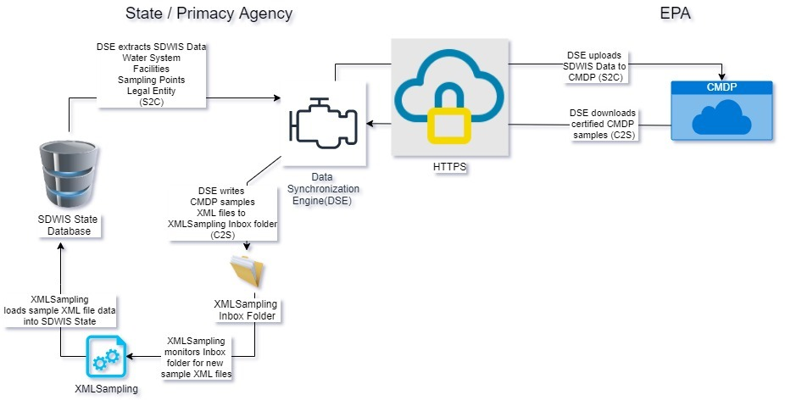
DSE Data Flow
Notes:
Make note of the connections to CMDP going through SCS for Authentication and Authorization

Slide 17
Questions?

Slide 18
Data Extraction from SDWIS State
4 Main Components of Data Extraction
Legal Entities (Laboratories)
Water Systems
Water System Facilities
Sample Points

Slide 19
Data Extraction – Legal Entities (Laboratories)
Extracts data from 4 tables in SDWIS
TSALAB - Laboratory
TSALLEA - Lab to Legal Entity Association
TINLGENT - Legal Entity
TINLGCOM - Legal Entity Communication
Extraction Triggered by Timestamp Update to Either:
TSALAB
TINLGENT
Notes:
Note the association is not part of the trigger

Slide 20
Data Extract - Laboratory
Primacy Agency Code | Lab Name*
Certifying Agency | Lab ID Number
Address Line 1* | Address Line 2*
City* | State*
Zip Code/International Postal Code* | Country Code*
Email/URL | Phone (BUS/EMERG/HOME/MOB/FAX)
* = Active Administrative Contact Associated to Lab record
Not Extracted
Additional Contacts | Certification Information
Notes:
Items in yellow are visible in CMDP

Slide 21
Data Extraction – Water System
Extracts data from 7 tables in SDWIS
TINWSYS – Water System
TINWSLEC – Water System to Legal Entity Association
TINLGENT - Legal Entity
TININDIV - Individual
TINAOPRD – Annual Operating Period
TINPOPSV – Population Served
TINWASH – Water System History
Extraction Triggered by Timestamp Update to Either:
TINWSYS
TINLGENT
TININDIV
TINAOPRD
TINPOPSV
Notes:
Note the association isn’t part of the trigger.

Slide 22
Data Extraction – Water System
PWS Number | PWS Name
Alternate State Number | Local Name
Activity Status | Activity Date
Water Ratios (GW, GWP, SW, SWP, GU, GUP) | Fed Primary Source Type
State PWS Type (if null, then Federal PWS Type) | Water System Deleted Date
Items of Note:
Federal PWS Type is NOT extracted | TINWSYS.D_Population_Count is not extracted
Extract is for Active/Inactive/Potential water systems and any system with a “Deleted” record in the Water System History table
Notes:
No federal pws type
Water System Deleted Date will be used to populate a “Removed Date” in CMDP

Slide 23
Data Extraction – Water System
Population
Type Code | Average Daily Count (Not from TINWSYS)
Effective Dates | Seasonal Dates
Contact Information
First Name* | Last Name*
Address Line 1* | Address Line 2*
City* | State*
Zip Code/International Postal Code* | Country Code*
Admin Contact Begin Date
* = Active Individual Administrative Contact associated to water system
No phone/email
Notes:
Population will be the sum of the individual populations.
No phone/email information

Slide 24
Data Extraction – Water System FAcilities
Extracts data from 3 tables in SDWIS
TINWSF – Water System Facility
TINWSFC – Water System Facility to Legal Entity Association
TINLGENT - Legal Entity
Extraction Triggered by Timestamp Update to Either:
TINWSF
TINLGENT

Slide 25
Data Extraction – Water System facility
State Assigned ID Number | External System Number (Federal Facility ID)
Facility Type Code | Facility Name if null (“No Value From State”)
Local Name if null (“No Value From State”) | Activity Status
Activity Date | Availability Code
Water Source Type | Water Source Type Date
Treatment Status Code
Note: All Facilities for Extracted PWSs
Address Line 1* | Address Line 2*
City* | State*
Zip Code/International Postal Code*
* = Active Contacts for WSF

Slide 26
Data Extraction – Sample Point
Extracts data from 1 table in SDWIS
TSASMPPT – Sample Point
Extraction Triggered by Timestamp Update to:
TSASMPPT
Notes:
Nothing of designations

Slide 27
Data Extraction – Sample Point
Identification Code | Description Text
Activity Date | Activity Status
Source Type Code | Type Code
Note 1 | Note 2
Note 3 (as a comment)
All Sample Points for Extracted WSFs
Notes:
Source type is required, or error will occur

Slide 28
Notable items
Lab ID Change or Lab/PWS Name Change
Sample Point ID Change
Sample Point Activity Status Changes

Slide 29
Lab ID or Lab/PWS Name Change
Laboratories and Public Water Systems are referred to Organizations in Shared CROMERR Services (SCS)
SCS uses the name of an organization as part of the identifier.
Therefore if a name of an organization changes, that constitutes a new organization.
Requiring all users registered to the original organization to register with the new organization. (Working on a process to help automate this.)
This is not triggered by any limitation in CMDP, it is triggered by SCS policy.

Slide 30
Sample point ID/Status Change
SDWIS State allows a user to change Sample Point ID value.
CMDP does NOT have the ability to update a Sample Point ID
Therefore
A new Sample Point ID value will constitute a new sample point in CMDP
Old sample point will still exist and is considered valid by CMDP
Sequence of events will determine what data is in CMDP

Slide 31
Sample Point ID change Scenario 1
Sample Point ID (RTCR001) – In SDWIS State and CMDP
Changed Sample Point ID to (RTCR002) in SDWIS State
Run DSE
In SDWIS State you will only have (RTCR002)
In CMDP you will have (RTCR001) and (RTCR002)

Slide 32
Sample Point ID and status Change Scenario 2
Sample Point ID (RTCR001) – Active in SDWIS State and CMDP
Change status to Inactive and change to (RTCR001-old) in SDWIS State
Create new Active Sample Point ID (RTCR002) in SDWIS State
Run DSE
In SDWIS State you will have (RTCR001-old) with status of Inactive and Active (RTCR002)
In CMDP you will have
Active (RTCR001)
Inactive (RTCR001-old)
Active (RTCR002)

Slide 33
Questions?

Slide 34
Data from CMDP to SDWIS state
Samples/Sample Results/Field Results
Chemical/Microbial/Cryptosporidium/Composite
Operational Summary
Combined Filter Effluent Maximum Turbidity (MAXT)
Combined Filter Effluent 95% Turbidity (95PT)
Individual Filter Effluent (IFT)
Entry Point Residual Disinfectant Concentration (EPRD)
Distribution Residual Disinfectant Concentration (DSRD)
Chlorine/Chloramine Maximum Residual Disinfectant Level (MRDL)
Not Migrated
Chlorine Dioxide and Chlorite / LCR WQP / TOC / Ozone Treatment (Bromate)

Slide 35
Demonstration
SDWIS State inventory update pushed to CMDP
Templates
Web forms
Certify/Submit
Download via DSE
Migrate into SDWIS State via SDWIS XMLSampling
Run Compliance in SDWIS State

Slide 36
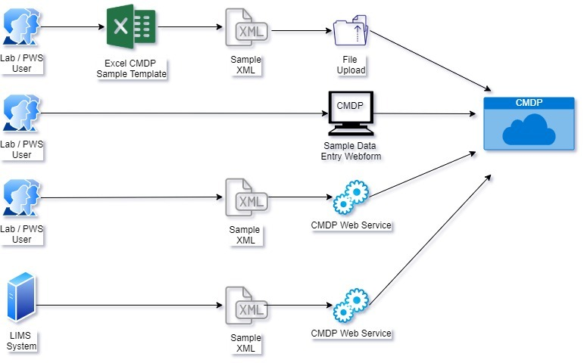

Slide 37
Questions?

