Slide 1
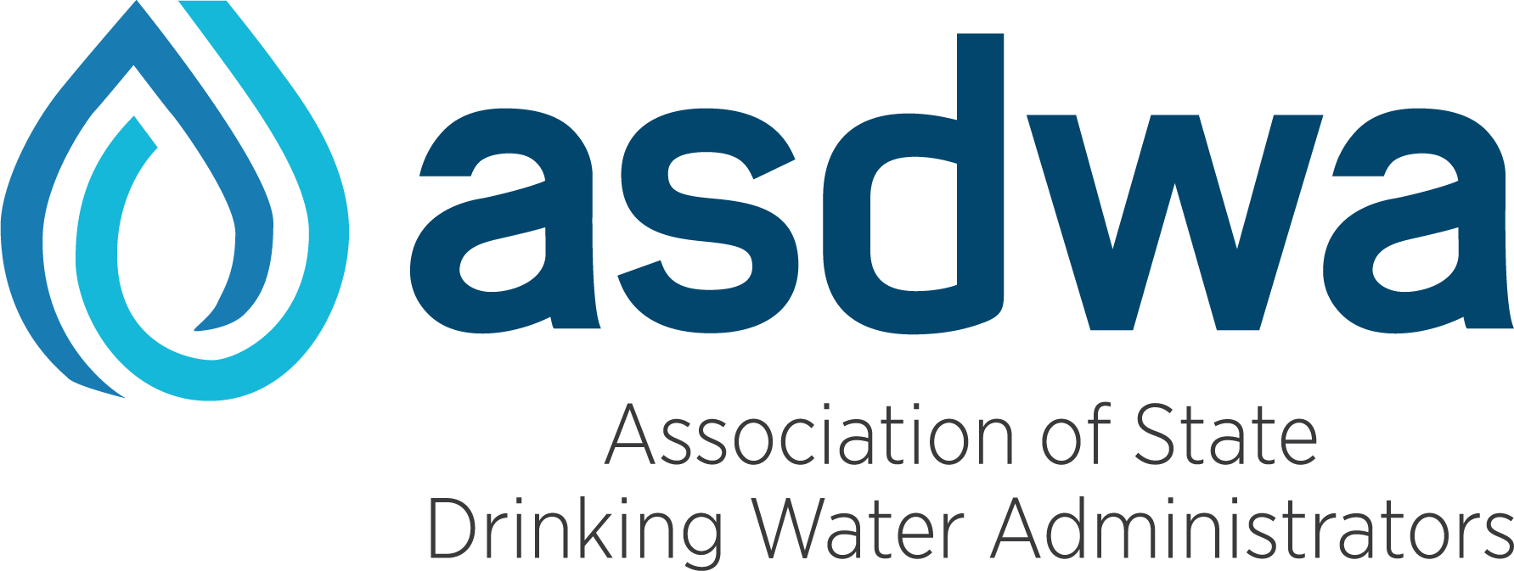
Everything But the Bagel
Executive Director’s Report
October 20, 2020

Slide 2
Good Times

Slide 3
Welcome

Slide 4
Covid-19 Response
Staff transitioned to working remotely-week of 3/16
Timeframe for return to normal occupancy TBD
Mass transit for commuting
Maintaining momentum while working remotely until ???
All conferences shifted to virtual format
Will continue through the start of 2021
Developed COVID-19 resource page for Members
Conducted COVID-19 webinars
https://elemental.medium.com/your-surge-capacity-is-depleted-it-s-why-you-feel-awful-de285d542f4c

Slide 5
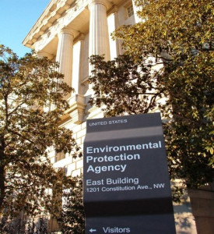
EPA Regulations
Substantial comments on proposed Lead and Copper Rule Revisions (LCRR)
Comments on preliminary Fourth Reg Determinations
Recommendations for potential CCR revisions
Comments on nutrient criteria for reservoirs
Four sets of comments on TSCA Significant New Use Rules (SNURs)
Other comments submitted
Transparency in Guidance & Transparency in Science,
OECA National Compliance Initiative (NCI)
EPA Water Reuse Action Plan (WRAP)
Co-leader with ACWA for second State Summit on Water Reuse (September 2020)

Slide 6
EPA NON-Regulations
PFAS – beyond the prelim. Fourth Reg Determinations
Legionella & building water quality issues
Manganese and UCMR4
The use of health advisories in general
Start of the stakeholder process for potential revisions to the M/DBP Cluster of regulations
July 2024 court deadline for revisions
AWIA implementation
WIIN grants implementation

Slide 7
EPA dialogue and workshops
OECA NCI and National Water Program Guidance
SDWIS Modernization & DMUC
National Capacity Development/Operator Certification Workshop
ORD Drinking Water Workshop
Region 4 Drinking Water Workshop
Ongoing AWOP Support
Monthly meetings with Sustainable System Team
Continued participation in relevant WRAP actions

Slide 8
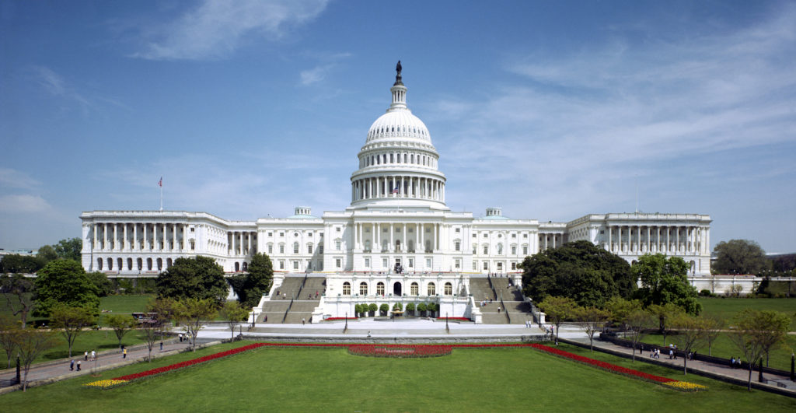
Working with Congress
PWSS appropriation was increased 4% for FY2020 to $106 million
Two ASDWA officers testified before Congress
Cathy Tucker-Vogel testified in person in February at a House Energy & Commerce Committee hearing on Lead and Copper Rule
Shellie Chard testified virtually in July at a House Energy & Commerce hearing on potential SDWA amendments
Submitted appropriations testimony to both House and Senate
Submitted written testimony to Senate EPW on DWIA

Slide 9
Partner organizations
Collaborations with other state environmental regulator associations
Quarterly staff leadership meetings
Coordination of comments
Presentations at AAPCA National Meeting on State Toolkit
Co-Chair & Co-Leader of Source Water Collaborative
Lead Service Line Replacement Collaborative
Multiple presentations at AWWA Sections and AWWA Virtual Summit
Features article in upcoming November issues of Journal-AWWA on the need for changes in the water sector
Represented state drinking water programs on AWWA affordability expert panel

Slide 10
ASDWA Projects & reports
State CEC Rule Development and Management Strategies Toolkit (February 2020)
ASDWA PFAS Source Water Guide and Toolkit (June 2020)
Using Water Quality Monitoring Data for Your Building Water Management Program (June 2020)
2019 Analysis of State Drinking Water Programs’ Resources and Needs (July 2020)
ASDWA Distribution System Survey White Paper (September 2020)
Principles of Data Science for Lead Service Line Inventories and Replacement Programs (September 2020)

Slide 11
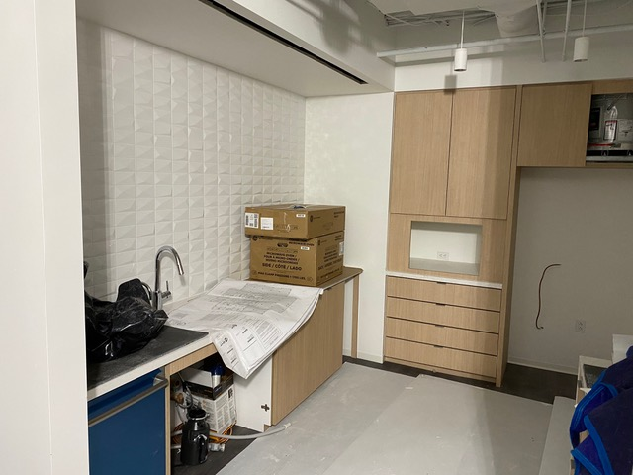
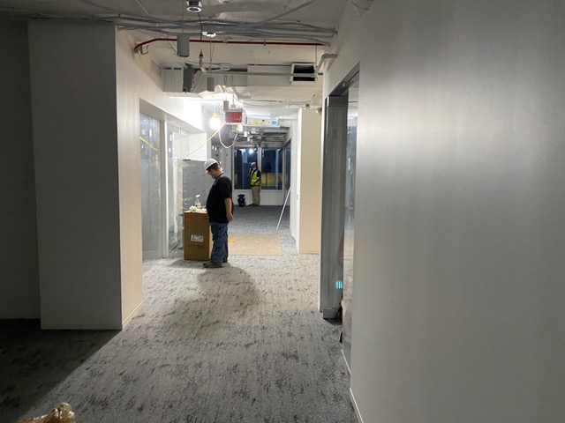
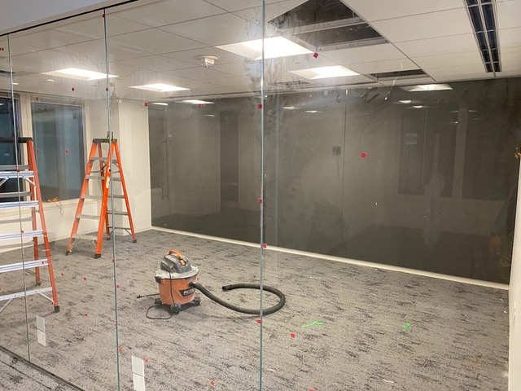
New ASDWA Office
Current lease expires 10/31
Moving 10/24

Slide 12
ASDWA Finances
Finances remain solid – no conference revenue but no state travel reimbursement
Developed a monthly cashflow spreadsheet to provide more granularity
Hoping for In-person conferences & state travel to resume sometime in 2021
Clean report from auditor
PPP loan received and loan forgiveness package submitted
New five-year cycle of EPA cooperative agreement submitted and approved
Package for annual cycle for indirect rate submitted and approved
2021-2025 dues increases – 2021 invoices in November

Slide 13
New ASDWA Members
30 new Administrators since I started in January 2017
Challenges:
Getting to know them – making phone calls
Facilitating state-to-state discussions
Trading tricks and tips
Ensuring new Administrators understand the value of ASDWA
Getting their staff involved with ASDWA

Slide 14
ASDWA COMMITTEES & wORKGROUPS
Background
Committees were established and have continued since ASDWA was created in 1986
Workgroups are created for working on specific topics or projects and may include EPA and/or other partners (e.g., Data Management)
Opportunity for ASDWA members and staff to:
Provide input into ASDWA actions
Stay engaged in national efforts and issues
Learn about other states’ successes and challenges

Slide 15
Committee staff liaisons
DWSRF Committee: Wendi Wilkes
Regulatory Committee: Wendi Wilkes
Committee Workgroups
Consolidation: Deirdre White
CCR: Kevin Letterly
Legionella: Wendi Wilkes
Long-Term Lead and Copper Rule: Wendi Wilkes & Alan Roberson
Perchlorate: Wendi Wilkes & Alan Roberson
PFAS: Deirdre White
Security and Resiliency Committee: Kevin Letterly
Small Systems Committee: Deirdre White
Source Water Committee: Deirdre White
Water Reuse Workgroup: Wendi Wilkes
Data Management (several workgroups): Anthony DeRosa

Slide 16
Officers’ Rotation
2019 President: Mark Mayer
2021 President: Cathy Tucker-Vogel
2021 President-Elect: Lori Mathieu

Slide 17
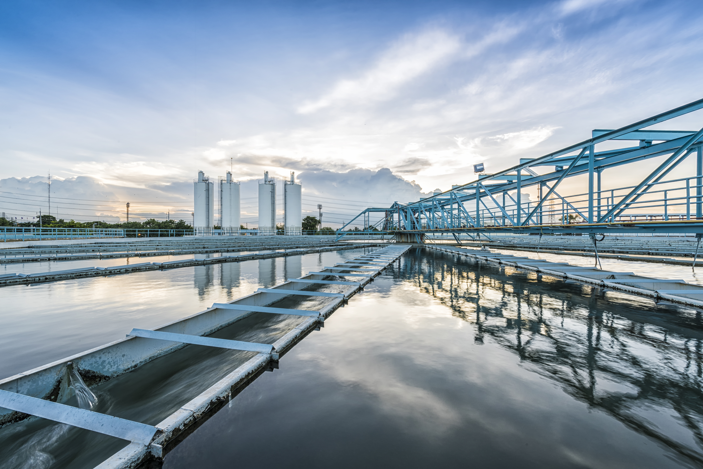
QUESTIONS?
Contact information
aroberson@asdwa.org
Cell phone: (703) 915-4385
social: @AlanTheWaterMan
Also @ASDWAorg

