Slide 1
CMDP & SDWIS Survey Results May 2021

Slide 2
Agenda
1
Survey Overviews
Survey Conclusions
Charts
Next Steps

Slide 3
CMDP & SDWIS Survey Overview
2
3 surveys are included
- SDWIS Community Feedback Survey
- CMDP Production Users Survey
- CMDP Supplemental Survey
Goal
- Gain insights on SDWIS program & identify program priorities
Notes:
SDWIS Overview
- The Association of State Drinking Water Administrators (ASDWA) supports States, Tribes, and Territories with their drinking water programs and provides a forum for these Primacy Agencies to communicate with the EPA. This ASDWA SDWIS Community Feedback Survey collected responses from Primacy Agencies and EPA Regional Fed Coordinators for two weeks from March 19th, 2021 - April 2nd, 2021.
- The focus of this survey was to gain insights on the SDWIS program as a whole to identify areas of improvement and program priorities to better support the Primacy Agencies and Regional Fed Coordinators in performing their job.
CMDP Overview
- This CMDP Production Users Survey collected responses from six Production Users from March 19th, 2021 - April 16th, 2021.
- An additional supplemental survey was conducted consisting of 3 questions asking about the percent burden reduction, percent error reduction, and cost savings/cost avoidance. A total of 11 responses was received.
- The focus of these surveys was to gain insights on the CMDP Adoption process and on the product as a whole to identify areas of improvement and software updates to prioritize to better support the Primacy Agencies and Regional Fed Coordinators in collecting and submitting lab samples.

Slide 4
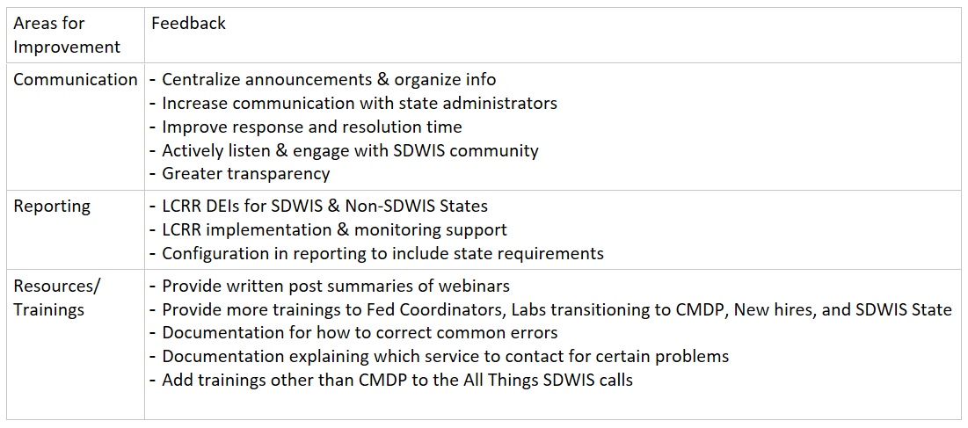
SDWIS Summary
5
Notes:
The SDWIS Program should focus on improving their communication, supporting Primacy Agency reporting efforts, and providing more resources/trainings.

Slide 5
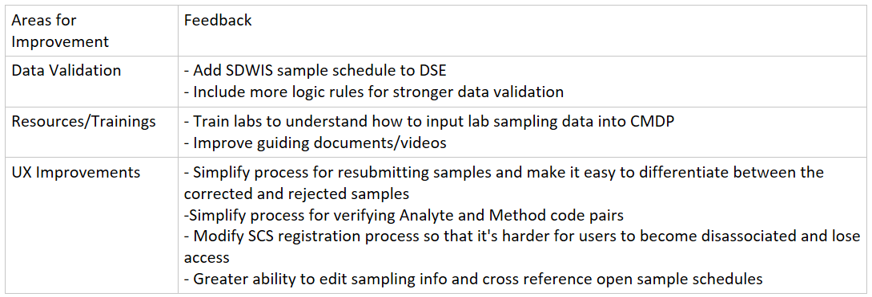
CMDP Summary
6
Key Stats:
Percent Burden Reduction: 8 out of 17 experienced >50%
Percent Error Reduction: 6 out of 17 experienced > 80%
Cost Savings or Cost Avoidance: 10 out of 17 able to hire less or employees were able to allocate time to other tasks
Notes:
Overall people are happy with CMDP & its improvements, and are likely to recommend it to other Primacy Agencies with a score of 4.17
Key Stats:
- Percent Burden Reduction: 15 out of 17 Primacy Agencies experienced some amount of burden reduction, 8 out of 17 experienced >50% burden reduction
- Percent Error Reduction: 12 out of 17 of the Primacy Agencies noticed some amount of error reduction, 6 out of 17 experienced > 80% error reduction
- Any Cost Savings or Cost Avoidance: 10 out of 17 Primacy Agencies noticed cost savings/cost avoidance by hiring less or allocating their time to other tasks
Key Areas for Improvement
Increase data validation, increase resources/trainings & improve user experience (UX)

Slide 6
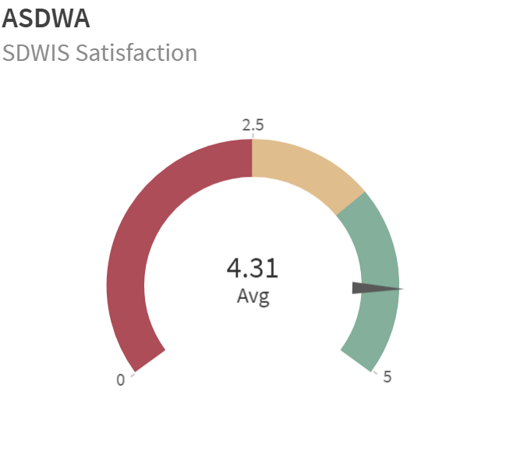
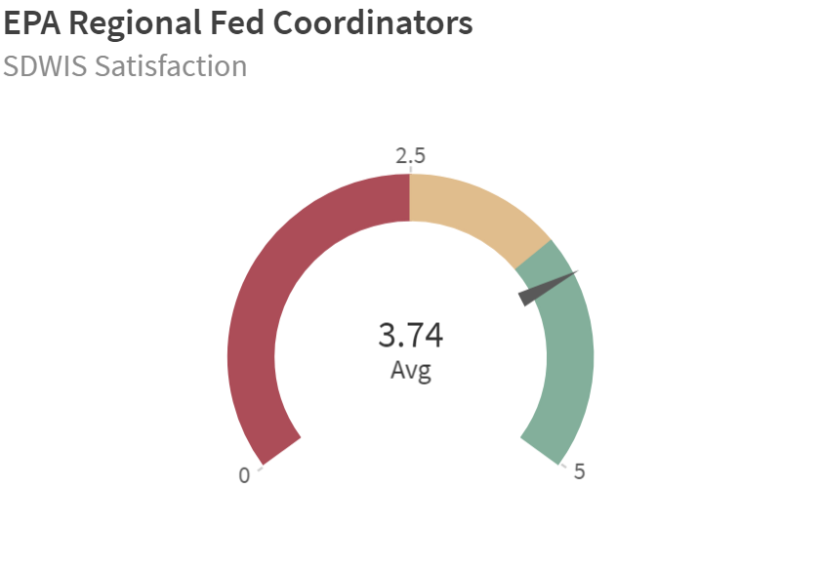
SDWIS Partnerships & Services
7
ASDWA
Areas of Improvement
-Organize info
- Include meeting summaries
-
Doing Well
- Work groups
- Informing and engaging SDWIS community
-Very responsive
EPA Regional Fed Coordinators
Areas of Improvement
- Communication
- Trained & Responsive staff
- Improved SDWIS error documentation
Doing Well
- Responsive
- Strong relationship
- Addressing issues
EPA HQ
Areas of Improvement
- Increase trainings for Fed Coordinators
- Increase SDWIS State Resources
- Communication
- Listening to SDWIS community
Doing Well
- Prompt technical support
- Responsive
Notes:
ASDWA
Areas of Improvement
- Centralize & organize info
- Provide written summaries of all recorded meetings (questions & answers from EPA)
Doing Well
- Work groups
- Informing and engaging SDWIS community
-Very responsive
EPA Regional Fed Coordinators
Areas of Improvement
- Improve Coordination between Fed Coordinators & State Administrators
- Make sure all staff is knowledgeable on SDWIS
- Address issues & improve documentation for SDWIS errors (Ex: Fed Rep errors, syncing problems)
Doing Well
- Responsive
- Strong relationship with some PAs
- Addresses issues with some PAs
EPA HQ
Areas of Improvement
- Be more open to ideas and listen to recommendations from SDWIS community
- Increase trainings for Fed Coordinators
- Increase SDWIS State Resources
Improve Communication
- Clarify who to contact for which problem
- Greater transparency in SDWIS Mod
- Improve responsiveness to emails
Doing Well:
- Prompt technical support
- Responsive with some PAs

Slide 7
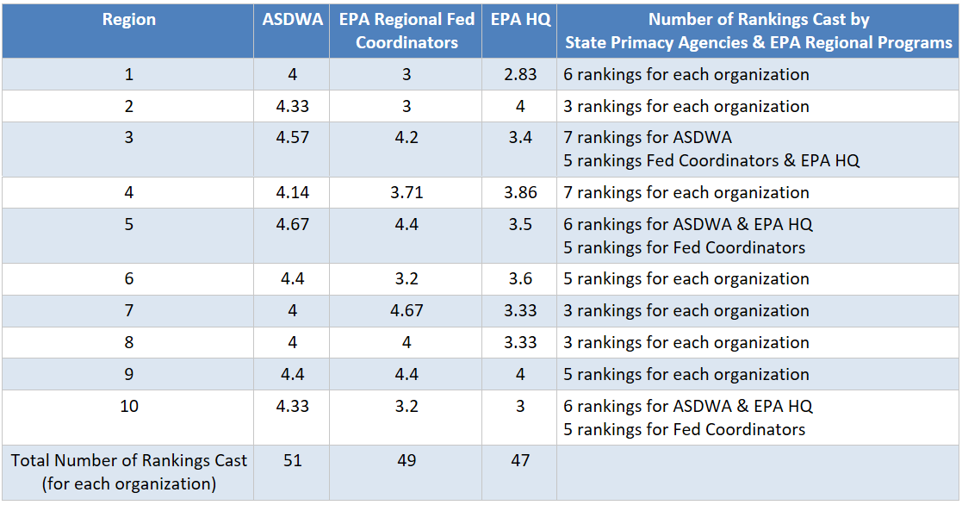
SDWIS Partnerships & Services Breakdown
8

Slide 8
SDWIS Resources
9
All Things SDWIS Calls
Areas of Improvement
- Resources & Trainings
- Communication
Doing Well
- CMDP Demos
- Connecting SDWIS Community
SDWIS Mod Activity Info
Areas of Improvement
- Communication
- Transparency
Doing Well
- Keep sharing updates
SDWIS State 3.4 rollout
Areas of Improvement
- Communication
- Resources & Trainings
- Improve response time
Doing Well
- Excellent installation guide
- Great support
- Responsive
SDWIS State/Fed Helpdesk Support
Areas of Improvement
- Improve response time
- Documentation guidance
Doing Well
-High praise of Dianna Heaberlin
Notes:
All Things SDWIS Calls
Areas of Improvement
- Too CMDP focused, include other trainings, best practices, discussions etc
- Reassess target audience and purpose of calls
-Provide written summary of calls (including Q&A from EPA)
- Explain changes in new updates don't just state the version number of the new update
Doing Well
- CMDP Demos
- Connecting SDWIS Community
SDWIS Mod Activity Info
Areas of Improvement
- Greater transparency: Concerns that info will stop flowing during delays
- More frequent report outs
- Create an updated site for all stakeholders to check project updates
Doing Well
- Keep sharing updates
SDWIS State 3.4 rollout
Areas of Improvement
- Improve response time
- Host a webinar to explain files and what to do to upgrade
- Create documentation of known issues and solutions for 3.4 and older versions
- Notify users of new releases
Doing Well
- Excellent installation guide
- Great support
- Responsive
SDWIS State/Fed Helpdesk Support
Areas of Improvement
- Improve response time
- Answer all questions even if no known solution
- Create documentation on what types of questions the help desk answers
- Create documentation on how to fix errors (FAQs)
Doing Well
-High praise of Dianna Heaberlin, have others meet her standards

Slide 9
10
Top 3 Data Management Risks/Challenges
Actions to Address Reporting Risks/Challenges:
- Clear LCRR Data Entry Instructions
- Tracking and implementing LCRR support
- Add data fields that state users need to perform their state regulations
Notes:
- Primacy Agencies ranked Reporting as the highest #1,#2, and #3 risk/challenge they predict in the next 1-3 years that the SDWIS Program can help avoid or mitigate those
Actions to Address Reporting Risks/Concerns:
- Clear LCRR Data Entry Instructions for SDWIS & non-SDWIS users
- Train the Fed Coordinators to be knowledgeable and prepared to handle questions from Primacy Agencies
- Provide support and guidance for Primacy Agencies in tracking and implementing LCRR
- Add data fields that state users need to perform their state regulations

Slide 10
Category Breakdown
11
Data Clean-Up
- QA/QC
- Fix unresolved issues and errors (Fed Rep ODS)
Implementation & Integration
- Migrating & implementing SDWIS Modernization
- Integrating SDWIS Applications with Primacy Agency system
Provide More Resources/Training
- Provide more Fed Rep reporting tools
- Training & documentation
- New hire onboarding materials
- Diminishing staff and IT personnel
Reporting
- LCRR tracking & implementation, DEIs, Support
- More data entry controls & automation
- Sampling location & management
-Lab transition resistance
Software Development
- Dying/outdated databases (SDWIS State, State databases)
- Security issues
- Upgrades & updates to current SDWIS Applications
UX Improvements
- Monthly Operating Reports (MORs)
- Automate and customize data fields
- Improve ease, transparency & validation of data
Notes:
This slide explains how I grouped the 6 categories based off of responses received.

Slide 11
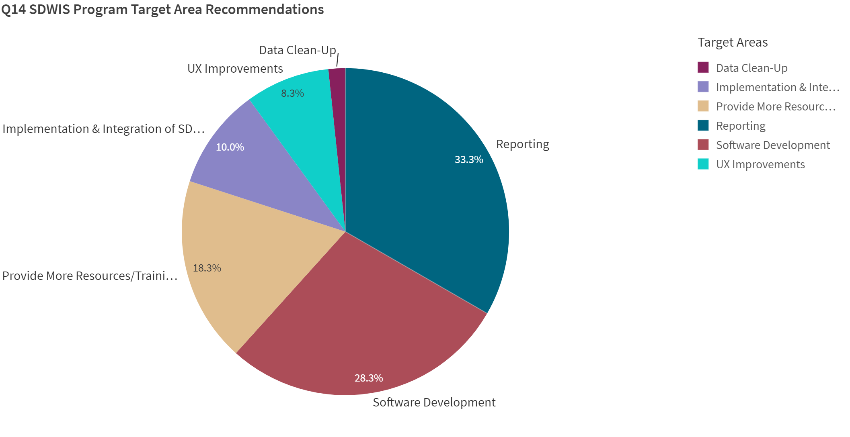
SDWIS Program Target Areas
12
Reporting
- LCRR DEIs, Implementation, Tracking & Monitoring
- Greater Configurability/Automation of Reports
- Paperless solution to MORs
Resources/Training
- SDWIS State & LCRR training
- Lab transition to CMDP training/support
- Updated/More documentation
Software Development
- Updates to current SDWIS Applications (DWW, Lab to State etc)
- Security fixes to ODS and other SDWIS Applications
Notes:
Reporting
- LCRR DEIs, Implementation, Tracking & Monitoring
- Greater Configurability/Automation of Reports
- Paperless solution to MORs
Software Development
- Updates to current SDWIS Applications (DWW, Lab to State etc)
- Security fixes to ODS and other SDWIS Applications
Resources/Training
- SDWIS State & LCRR training
- Lab transition to CMDP training/support
- Updated/More documentation

Slide 12
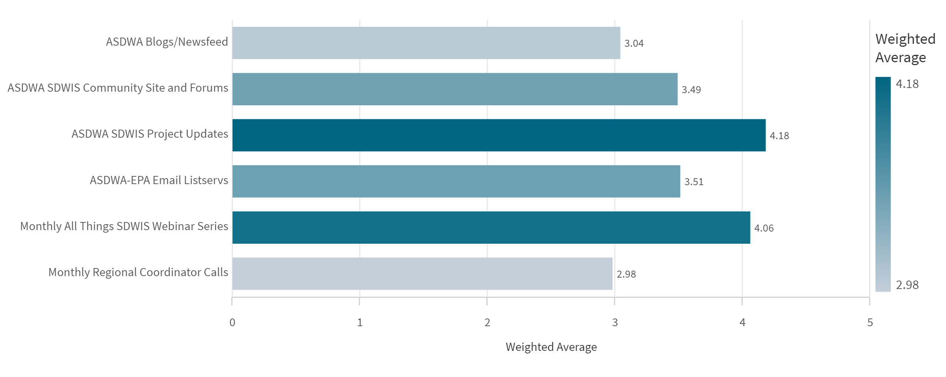
Preferred Methods of Receiving Information
13
Summary
ASDWA SDWIS Project Updates: 4.18
Monthly All Things SDWIS Webinar calls: 4.06
ASDWA –EPA Email Listservs: 3.51
Notes:
Summary (Least Preferred – Most Preferred)
The most important method of receiving information for the SDWIS Community is the ASDWA SDWIS Project Updates closely followed by the Monthly All Things SDWIS Webinar calls.

Slide 13
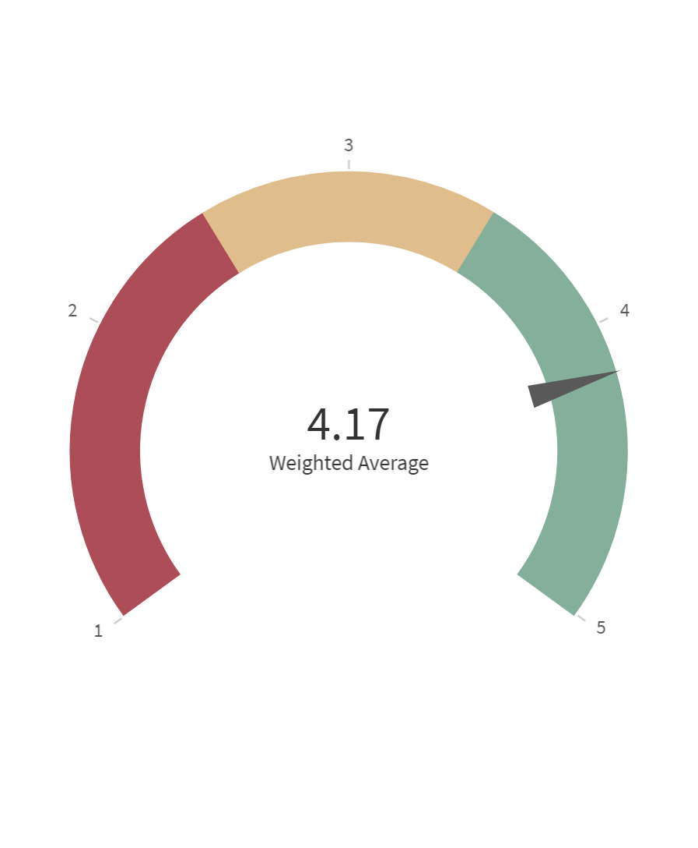
Likelihood of Primacy Agencies Recommending CMDP
14
How to Improve Likelihood
- Improve sampling guidance documents
- Improve the process of tracking rejected samples and re-submitting samples
- Stronger data validation by including more logic rules
- Greater ability to edit & cross reference sampling info
- Quicker response time
Doing Well
- Labs can easily view PWS inventory data
- XML Sampling Business Logic helps improve data quality
Notes:
On a scale of Very Unlikely to Very Likely
Doing Well
- Labs have easy access to view the current PWS inventory data
- XML Sampling Business Logic helps improve data quality
How to Improve Likelihood
- Improve & develop templates & guides to help Primacy Agencies perform their sampling work in CMDP
- Improve the process of tracking rejected samples and re-submitting samples
- Stronger data validation by including more logic rules
- Greater ability to edit sampling info and cross reference open sample schedules
- Quicker response time

Slide 14
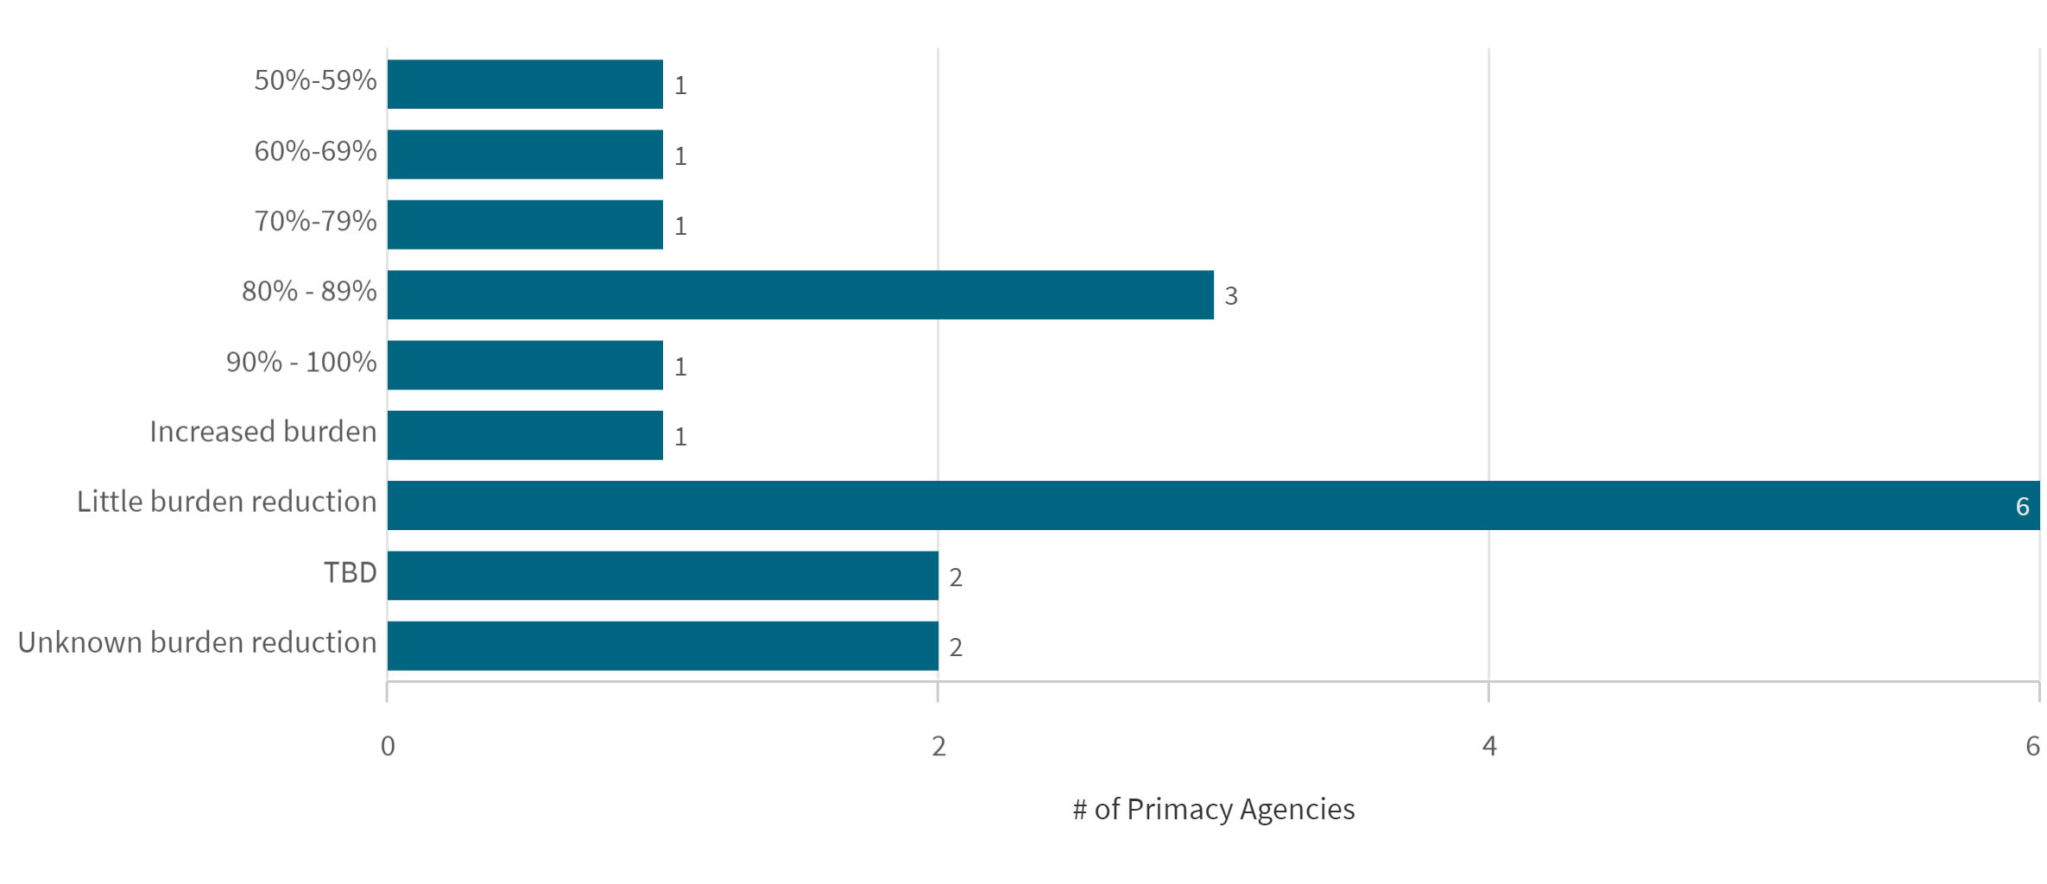
Percent Burden Reduction
15
Summary
- Average 60% burden reduction for those who provided numbers
- Greatest burden reduction experienced is once all labs are fully transitioned
- May be less work for some staff members but an increased work load for other staff members
Notes:
Summary
- CMDP performs stronger data validations than Lab to State
- Once fully transitioned over to CMDP, typically experience burden reduction
- Taking the initial time upfront to train users and provide documentation to labs in the beginning, helps primacy agencies gain greater benefits from CMDP
Reasons for little burden reduction
- Labs still transitioning, have not experienced full benefits of CMDP
- Transitioning from one electronic system to CMDP (Ex: Lab to State, State e-reporting system)
- Not enough IT support to run CMDP
Reason for increased burden reduction
- Increase work for data management staff interacting with labs to correct errors

Slide 15
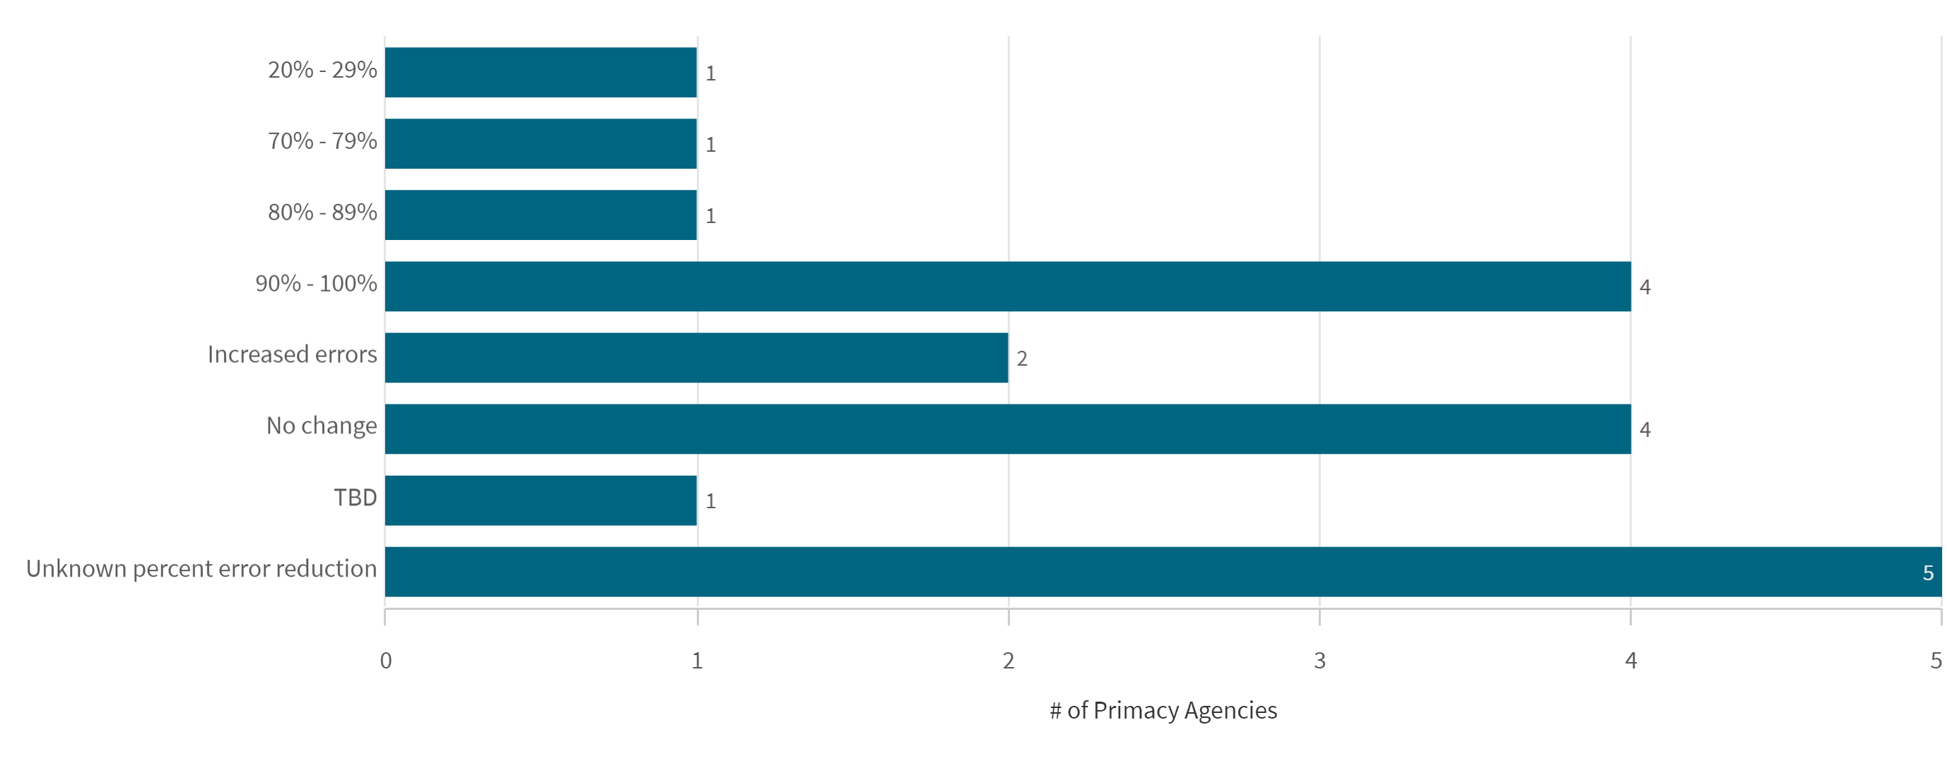
Percent Error Reduction
16
Summary
- Average 80% error reduction for those who provided numbers
-Taking the time up-front to train users & fully transitioning showed greatest results
No change in Errors
- Shift in how errors are resolved (most common error: incorrect dates)
- Labs still transitioning
Notes:
Summary
- Pro: Receiving discrete micro sample data
- Very few errors returned, with users who are well trained using CMDP
Increased errors
- Microbial Sample submissions increased
- Errors with labs using facility/sampling points
No change in Errors
- Shift in how errors are resolved (most common error: incorrect dates)
- Labs still transitioning
Unknown error reduction
- Do not know because did not track number of errors before transitioning

Slide 16
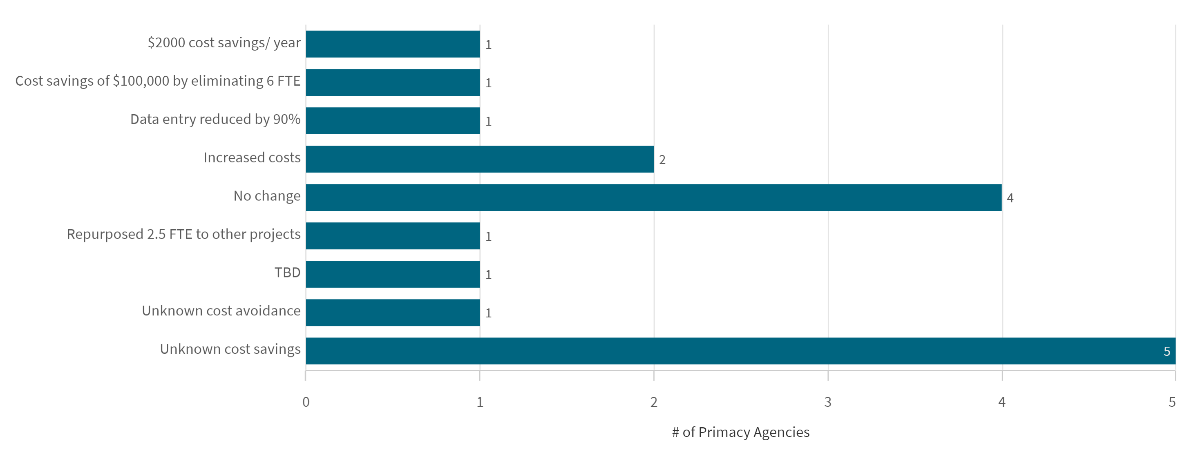
Cost Savings/ Cost Avoidance
17
FTE = Full Time Employee
CMDP has allowed Primacy Agencies to save in costs indirectly by freeing up employee's time to allow them to focus on other pertinent work or by no longer needing to hire an employee exclusively for data entry tasks.

Slide 17
How to Improve CMDP Adoption Process
18
Summary
- Improve training, data validation, and SCS functionality
Notes:
The 4 columns from left to right say:
- Add SDWIS Sample Schedule to DSE
- Greater Lab Support & Trainings
- Increase & Update CMDP Trainings
- SCS Registration & Permissions
Summary
- Improve training, data validation, and SCS functionality
- Greater trainings and documentations to help new users transitioning to CMDP
- Add SDWIS Sample Schedule to DSE
SCS Registration & Permissions:
- Streamline SCS registration process
- Users should have to enter unique CMDP external organization ID to select organization info
- Do not allow users to modify organization info after account has been created

Slide 18
Next Steps: SDWIS Modernization
19
Based on the survey results, many respondents indicated communications as a top priority and staying informed about decisions and project milestones. Individual follow-ups with be scheduled to address specific comments/questions.
Current channels of communications that stakeholders should leverage:
State primacy agencies: (some resources may require ASDWA website login)
Monthly All Things SDWIS Call - calls and presentation materials are recorded and archived on the ASDWA website: SDWIS Community Videos
SDWIS User Community Resource Page on the ASDWA website
SDWIS User Community Discussion Forums on the ASDWA website
Program updates sent by ASDWA to State Administrators and DW program managers
EPA Regions/Fed Coordinators (EPA Only):
All of the above
Participate in monthly HQ/Regional coordinator calls - POC: Justin Wright
Utilize the Regional SDWIS Operations Support Team (Teams site)
Reach out directly to HQ program staff

Slide 19
Next Steps: SDWIS Modernization
20
Moving forward with SDWIS Modernization, EPA is working towards developing a centralized communications "portal" to support self-help and knowledge management on SDWIS Modernization. The goal is to allow anyone interested about project activities and milestones to be able to access that information easily and quickly.
Objectives include:
Allowing all stakeholder tiers to self-help (answer questions about the project without intervention by Project Manager or Product Owner)
Supporting real-time notifications
Centralized platform for supporting accessing all project information, with defined views for specific groups/roles
Centralized platform to support collaboration on project activities
Allows real-time access to development activities and schedules
What's been completed?
What is left to do, and when?
What's on the backlog and prioritization?
Ensures full and open transparency on project activities to all stakeholder tiers

Slide 20
Next Steps: SDWIS State
21
- Currently planning training for Fed Coordinators – Coordinators submitted a business needs document and HQ will be using contract funding to provide the requested training.
- Conduct additional webinar(s) for 3.4 explaining what the files are and how to install them.
- Sharing explanations of common reporting errors on regular workgroup calls (Fed Coordinator calls & DMAC), recording the discussions and sharing with the Fed Coordinators & SDWIS Community.
New help desk email: SDWISHelpDesk@epa.gov
New help desk address: https://sdwishelpdesk.zendesk.com/hc/en-us

Slide 21
Next Steps: CMDP
22
- Primacy agency adoption guidance documentation available through ASDWA from Production PAs
- Lab training support:
- DWPD Support Contract – Services for training are available
- Email: howard.roger@epa.gov
- All training materials will be available in one central repository
- Grants available for CMDP adoption support, including lab training
- Exchange Network Grants:
https://www.epa.gov/exchangenetwork/exchange-network-grant-program
- Drinking Water State Revolving Fund (SRF):
https://www.epa.gov/dwsrf/how-drinking-water-state-revolving-fund-works
- Public Water System Supervision (PWSS) Grant:
https://www.epa.gov/dwreginfo/public-water-system-supervision-pwss-grant-program
-Sample submission examples provided (may be available via PA adoption material)

