Slide 1
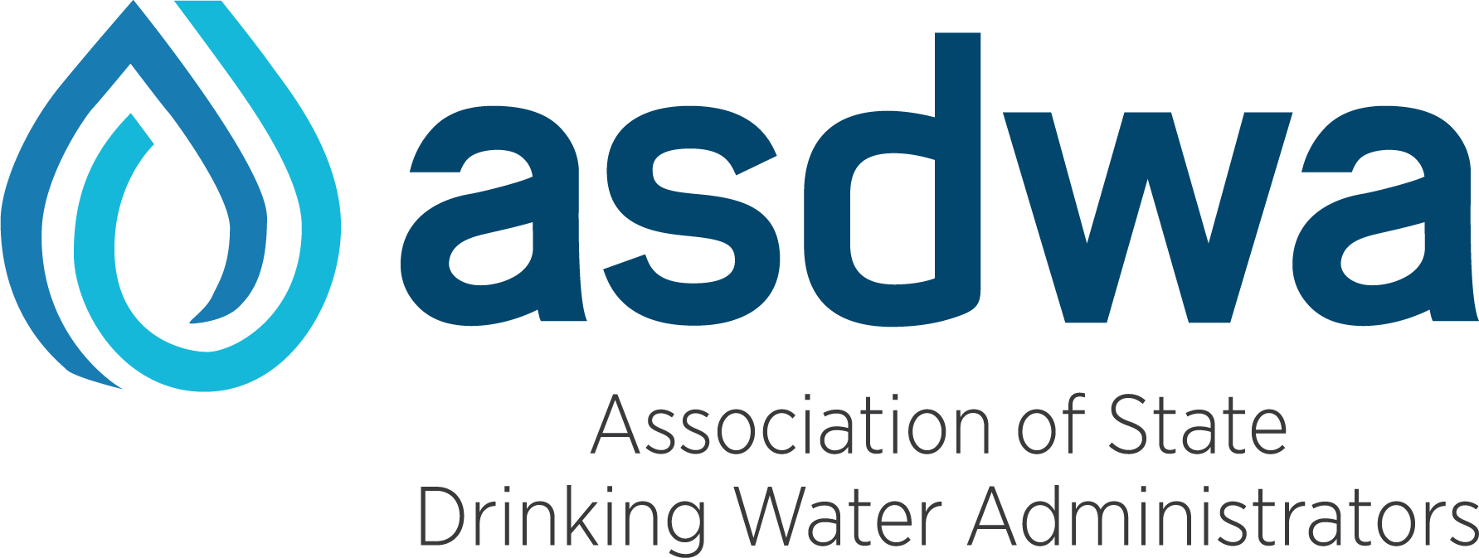
AWOP New States and Staff Meeting
Status
Targeted Performance Improvement
Maintenance
July 19

Slide 2
Introductions
Please describe your interest in AWOP and why you are attending this session

Slide 3
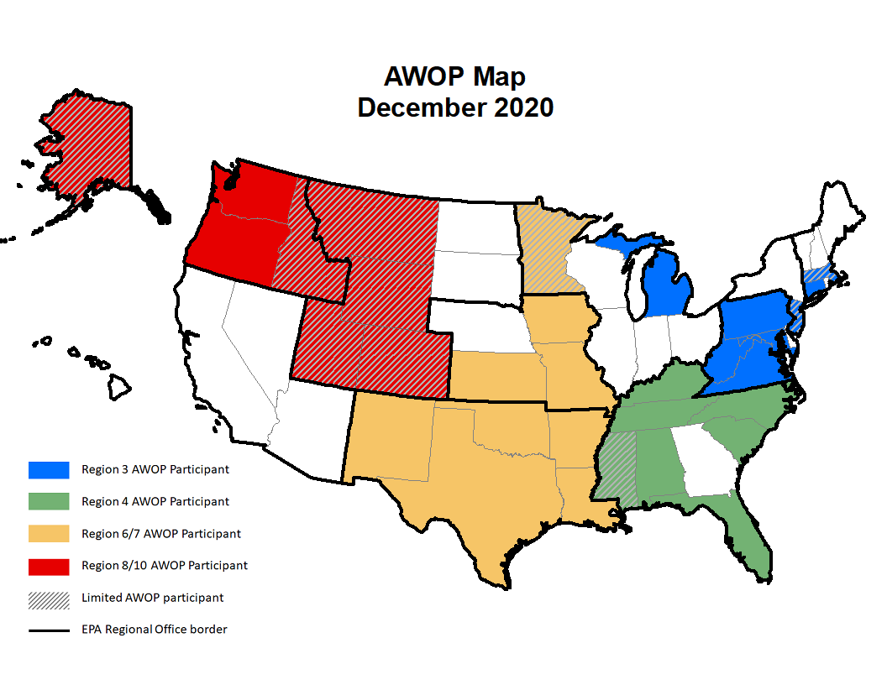
Notes:
I’m going to kick this off by distinguishing between:
Participation in the national AWOP network
Implementing an individual AWOP by a DW agency (state, territory, EPA Regl DI)
Map: visual representation of the current national AWOP network. No change since last December (although NV participated in the R10 AWOP mtg last week). Geographic EPA Regional Office boundaries are delineated and the coloration shows the four existing multi-state AWOP groups transcend those boundaries. Not depicted on the map is the full reach of AWOP over time, as “optimization tools” have been introduced and often implemented in nearly every state, Puerto Rico and internationally. The coloration on the map recognizes the states that are routinely participating in AWOP events. I’ll discuss the difference between limited participation and full participant in a moment.
National program Implementation is currently through 4 existing multistate groups:
Implementation is a collaborative approach where the participants are facilitated through an ongoing strategic implementation process by members of the NOLT (TSC, ASDWA, PAI, EPA Regnl DW Programs)
Meetings and workshops are facilitated by the NOLT. Historically conducted in-person but virtually during the pandemic. Considering future hybrid approaches.
Participants share individual DW program AWOP implementation status and experiences. NOLT demonstrates technical “tools”. The Nominal Group Process is used to identify relevant discussion topics. An “approach” is identified for each topic resulting in the development of action items.
AWOP events are open for participation by all drinking water agencies, even if they have not committed to implementation of AWOP (mention hash marks on map).

Slide 4
AWOP
MODEL
STATUS
Track
Assess
Prioritize
TPI
(Targeted Performance Improvement)
Evaluation & Training Tools
MAINTENANCE
Sustain
Integrate
Enhance
Notes:
Individual AWOP implementation is described by this model.
An AWOP agency (solid colors on map) has committed to AWOP implementation. Implementation begins with a state drinking water administrator & staff adopting some or all of the optimized performance goals and emphasizing to water system personnel the importance of meeting those goals.
AWOP Commitment
Nationally, participate in the AWOP network events
Individually, adopt AWOP goals and strive to implement this model
Encourage a review of the 2021 AWOP background documents on the ASDWA AWOP national meeting event page that some of our AWOP states have provided. These documents include some staff resource commitments and information regarding implementation of this model.
I anticipate more discussion about the AWOP commitment during the Q&A session later in this meeting.
For now, we will provide information about accessing more AWOP resources on EPA and ASDWA websites

Slide 5
AWOP SharePoint Site

Slide 6
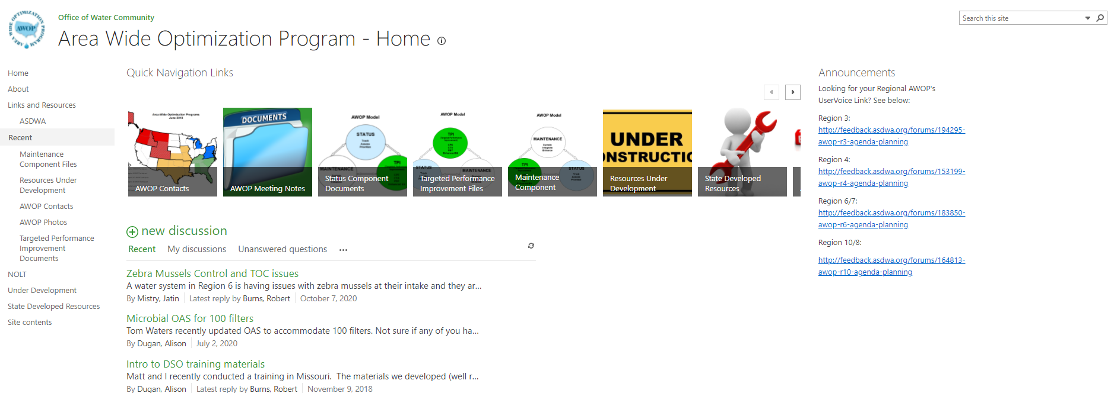
Home Page
Platform for the AWOP Network to post documents and share ideas, which are only accessible to members
Has grown “organically” – and is still under development!
Notes:
This is the Platform we use for the AWOP network to post documents and share ideas, which are only accessible to members.
The site has grown organically, so there are many aspects that are still under development – I’m the lead in TSC and built the site with support from a SharePoint expert in R6. Anything you’d like to see – let us know. ☺
A lot going on with this slide:
Eight main areas of the site
A discussion forum and announcements
Can navigate by clicking on the areas to the left or on one of these boxes for the desired area

Slide 7
Meeting Files
Organized by Regional AWOP
Includes meeting summaries and training topics
Some of the more recent training topics have been recorded
Includes National Meeting Files from 2017 and 2019
Includes recorded content!
Notes:
Probably the most-accessed area is called “AWOP Meeting Notes” which houses all the AWOP Regional and National Meeting notes.
Explain….
Since Covid began, all of our meetings are virtual. Miss out on the inperson, it has encouraged, or empowered recording of the training topics during our regional AWOP meetings
Some topics include: HABs, Manganese optimization, Tank Management, AWOP Back-to-Basics, Disinfection Data Integrity, Chlorine Dioxide, and Wildfire Impacts on water quality - just to name a few.

Slide 8
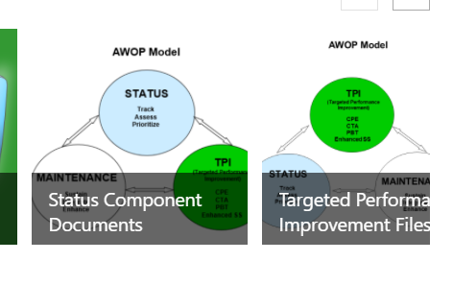
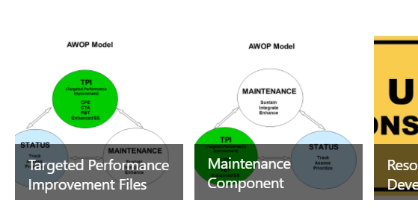
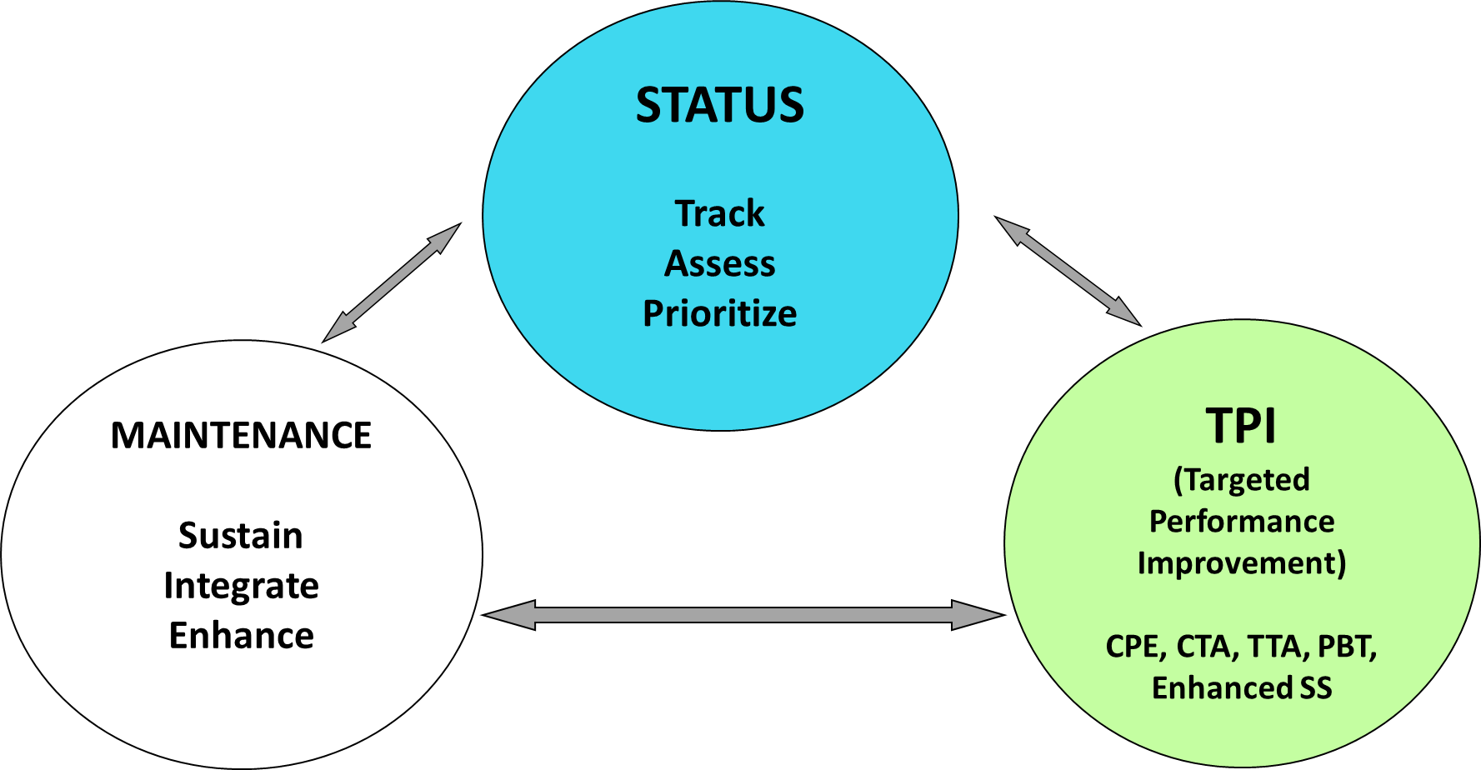
AWOP Tools
The “tools” within the AWOP SharePoint site are organized by components
Notes:
Rick showed this concept earlier, and I’m simply showing to emphasize that the information within the AWOP SharePoint site is organized by AWOP components
Explain:
Status: AWOP Goals, example status component and data integrity resources
TPI: Evaluation and special study protocols and training agendas.
Maintenance: groundhog presentations, awards program examples, and other resources
Hover over each box to see this.
Best to learn by exploring.

Slide 9
Resources under Development
Optimization areas that are (generally) newer and still under development
Includes contact absorption clarifiers, harmful algal blooms, membranes and slow sand filtration
Notes:
We do have one area of the site where we house “resources under development”
Includes any optimization approaches that have been developed in the areas of
Contact adsorption clarifies
Harmful Algal Blooms
Membranes
Slow Sand Filtration
Area is a little fuzzy as to what is considered under development vs. developed – in general these are areas that we would like to get more field experience with or are working to formalize, so they are resources that we can share but with that caveat.

Slide 10
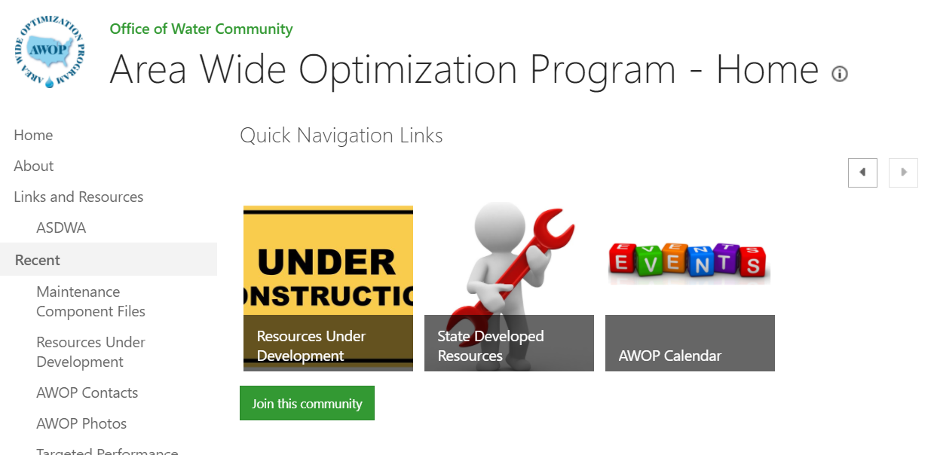
State Developed Resources and AWOP Calendar
Optimization related resources developed by states within the AWOP network to support drinking water optimization efforts
AWOP Events Calendar
Both areas still a work in progress…
Notes:
Two other areas to mention…

Slide 11
Summary
A unique link is needed to access the site
Please email dugan.alison@epa.gov so I can connect you!
Notes:
Unique link: If you don’t have access to the SharePoint site, just send me an email and I can send you one.
Earlier in the use of SharePoint we had trouble with some states not allowing access and we sometimes had to send links to personal email addresses, but I’m pretty sure that is no longer an issue for most of our users.
All users are admitted to the site as “contribute, no delete” which means should be able to download files, upload files – but not delete content from the site

Slide 12
Who is Asdwa?
The Association of State Drinking Water Administrators (ASDWA) is the professional Association serving state drinking water programs. Formed in 1984 to address a growing need for state administrators to have national representation.
ASDWA members are the drinking water program administrators in the 50 states, the five territories, the Navajo Nation, and the District of Columbia. (15 of the 50 state drinking water programs are located in state departments of health, 32 are located in state departments of the environment or natural resources, and 3 are in mixed departments of health and environment.)

Slide 13
ASDWA Resources
ASDWA AWOP Webpage (https://www.asdwa.org/awop/)
ASDWA AWOP UserVoice (http://feedback.asdwa.org/)

Slide 14
New State Training Option
PAI

Slide 15
Louisiana AWOP Revitalization
Alicia Martinez, P.E.
LDH District Engineer, District 1 and LDH AWOP Lead
alicia.martinez@la.gov
Julie Z. LeBlanc, P.E.
LDH AWOP Contractor
julie.z.leblanc@gmail.com
Notes:
Introduce ourselves:
Alicia Martinez. LDH District Engineer. With LDH for approximately 4 years, named LDH AWOP core lead in early 2018. Co-facilitates LA’s AWOP revitalization with Julie (it helps that we get along well).
Julie LeBlanc. LDH AWOP Contractor. Initially started in the EPA AWOP in 1993 (CPE training), participated with state of Louisiana as a Corps employee (state-Corps partnership) 1995 - 2003, participated in “AWOP Commitment” discussion at first EPA Region 6 meeting (deal/no deal) in 1999 (LA had already completed 17 CPEs). After state-Corps partnership dissolved in 2003, I was asked to participate as a contractor to LDH to facilitate AWOP efforts. Have served in a contractor capacity since 2005 (working under my 6th three (3)-year contract). My AWOP involvement has spanned 28 years.

Slide 16
AWOP in Louisiana – “Take 1”
Sep 1995: LA completed 3 training CPEs (EPA TSC, PAI and University of Cincinnati)
Apr 1999: EPA Region 6 AWOP kicked off in OKC, OK (LA had conducted 17 CPEs within the state)
Jan 2000: LA formally adopted optimized performance goals (letters sent to all SWTPs) and started to rank plants yearly against the AWOP prioritization criteria
Between 1995-2006: completed 36 Comprehensive Performance Evaluations (CPEs) and 9 stand-alone Filter Assessments
Between 2002 – 2006: Completed 4 turbidity-based Performance-Based Training (PBTs) series with total of 20 plants completing
May 2011: Completed 13th year of prioritization of all SWTPs based upon risk to public health, this yearly ranking was used to focus AWOP activities
Nov 2014: Distribution system sampling exercise (EPA/LA)
2014-2017: Participation in Region 6/7 AWOP activities (no real team)
Notes:
Julie to cover TAKE 1. HIT HIGLIGHTS only.
From 1995 – 2003 had a well-organized and successful state AWOP. We had established strategies and implemented the strategies for each of the FOUR AWOP Components (Status, Evaluation, Follow-up, and Maintenance). The 3-component model combines Evaluation and Follow-Up into Targeted Performance Improvement (TPI) component.
Our core team met quarterly, usually in person. Sometimes multiple days (at least once a year).
We head a well-functioning, highly motivated, and successful AWOP team.
LDH Management waned… went to “limited” AWOP activities…. LDH staff retired or left the state. Experience no longer existed.

Slide 17
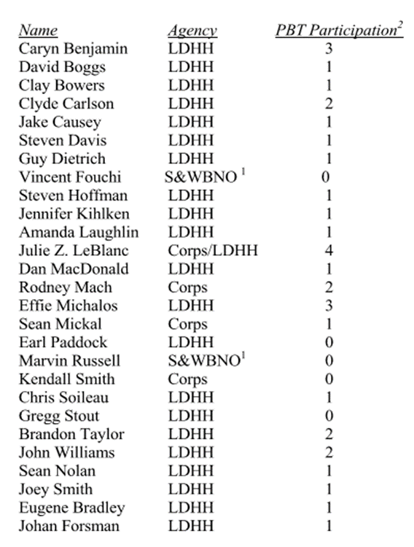
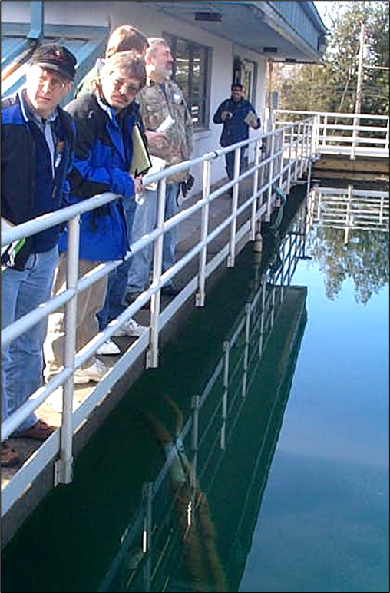
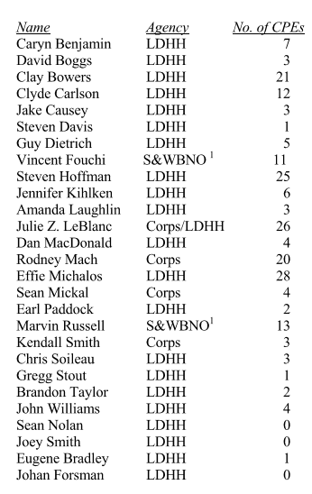
AWOP in Louisiana – “Take 1”
PBTs
CPEs
“Take 1” was primarily
focused on surface water
and turbidity
Notes:
Key point on this slide is the size of the “team”. There was a “Core Team: and then there were those that participated in AWOP activities (like CPEs/PBTs) and formed a larger group of LDH staff from Central office and district/regional offices.
Smaller subgroup (Core team) lead overall AWOP activities, planned future events, and engaged other staff as participants.

Slide 18
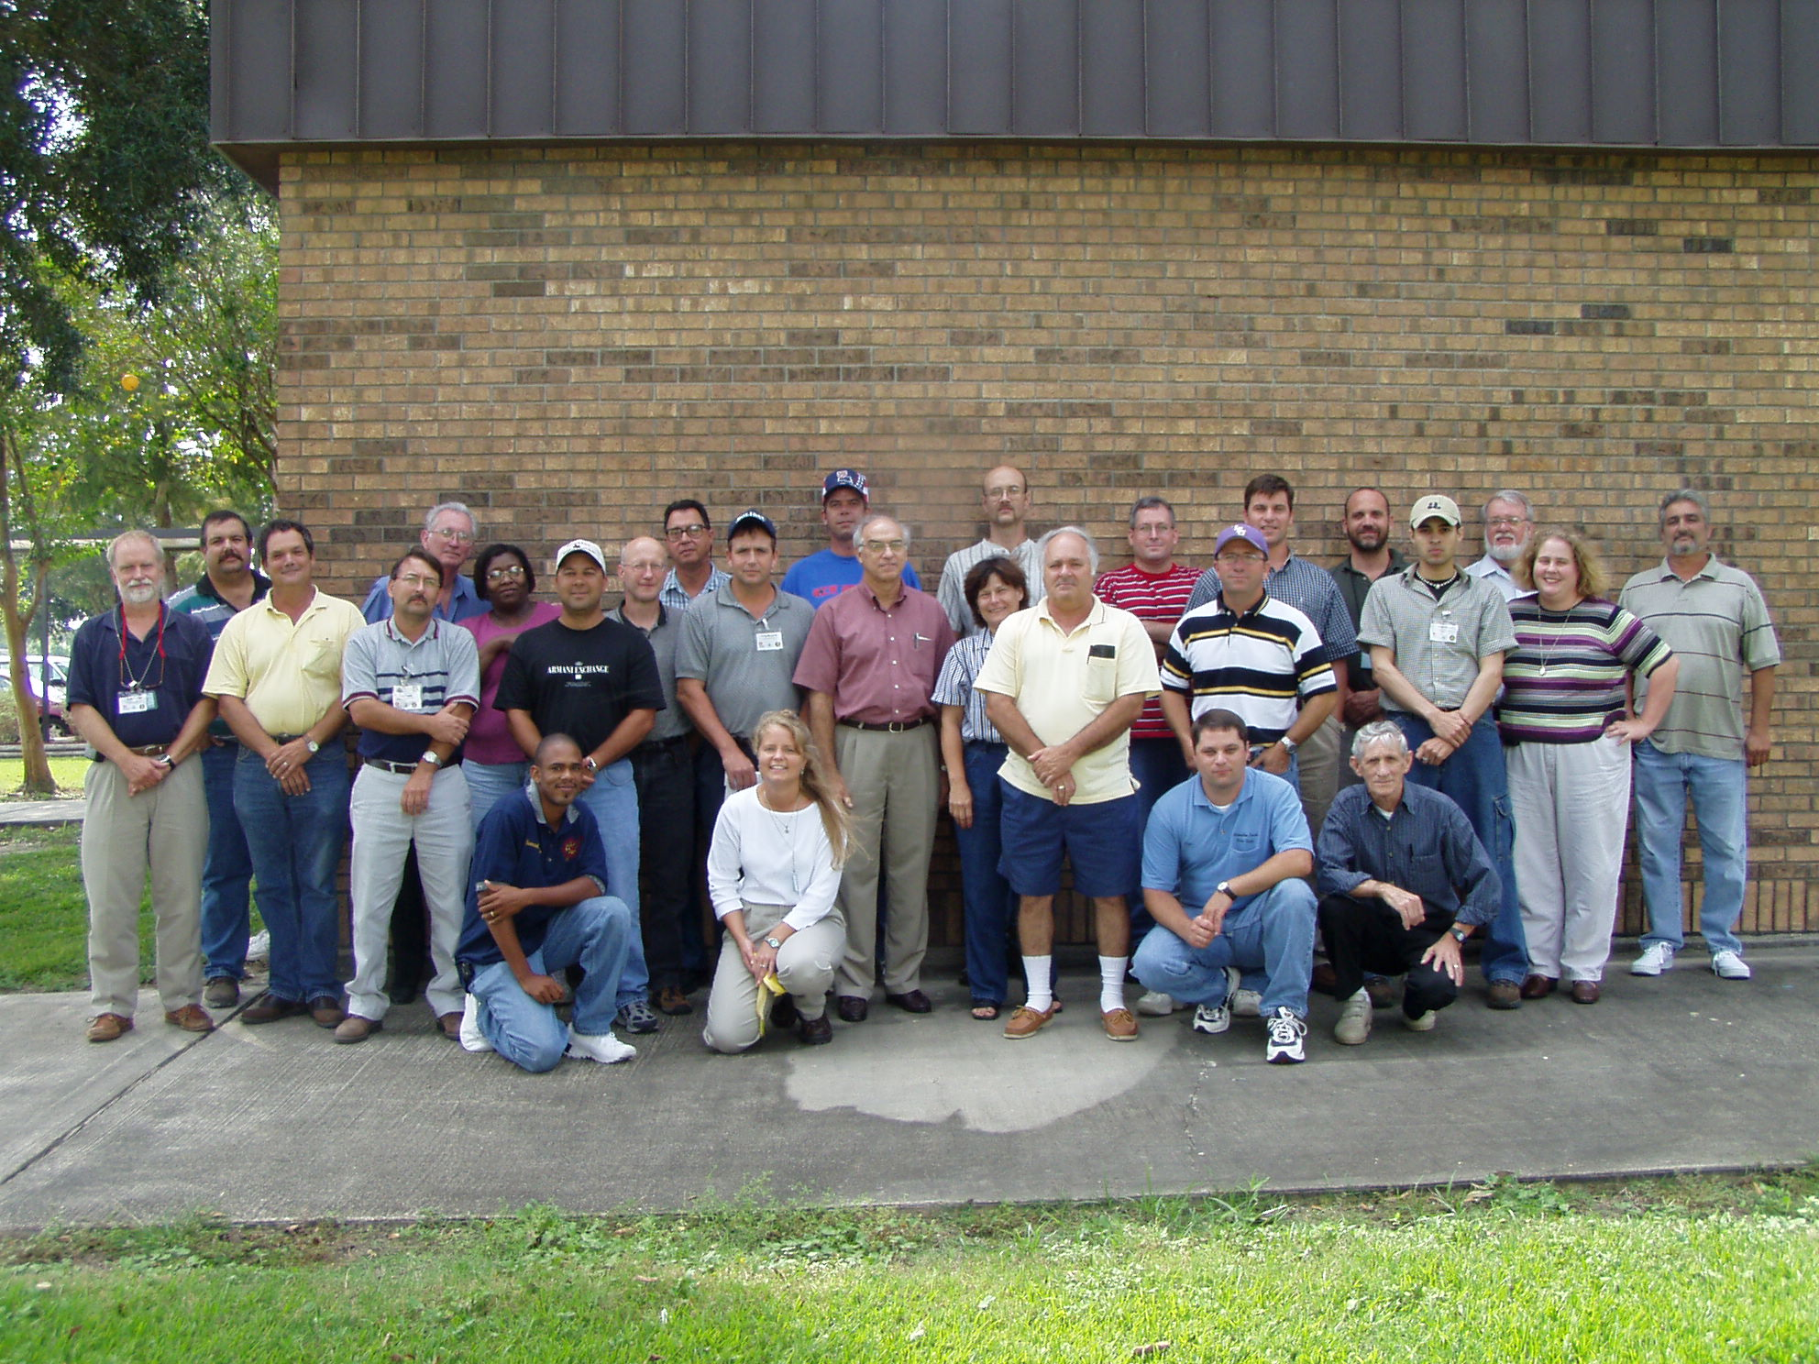
PBT #1
April 2001 – April 2002
6 plants
PBT #2
August 2002 - Sept 2003
8 plants
PBT #3
October 2004 – June 2006
3 plants
Notes:
Fly by this one, just PBT session participants (LDH staff and plants)

Slide 19
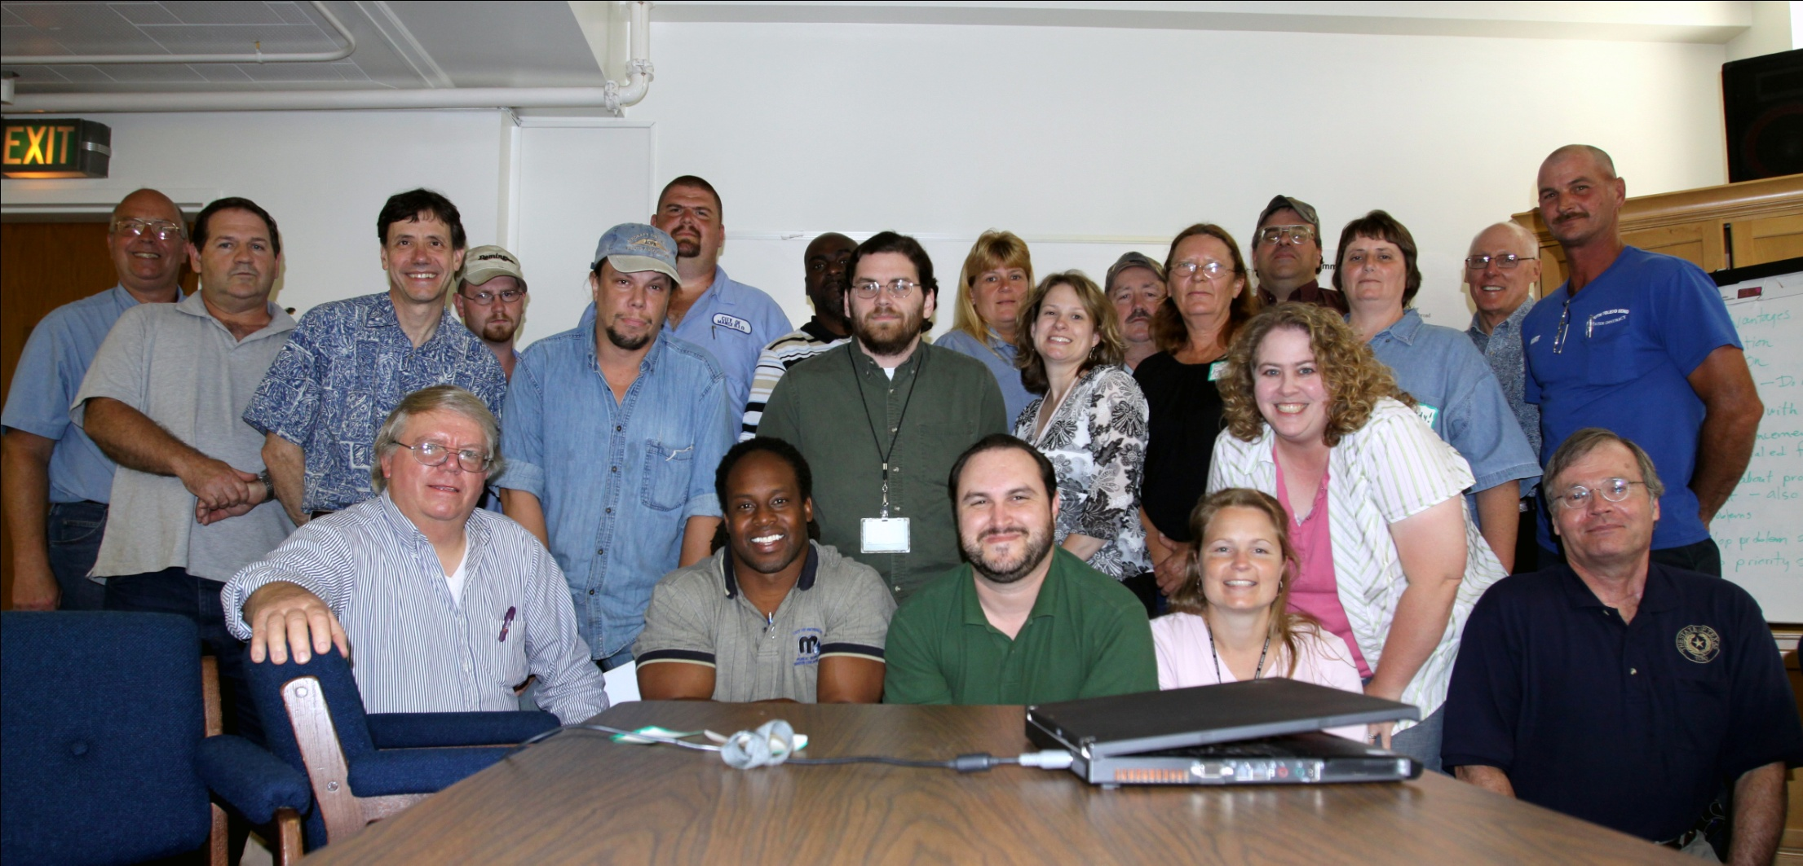
PBT #4
March 2008 – May 2009
6 plants
Notes:
Fly by this one, just PBT session participants (LDH staff and plants)

Slide 20
Current Status/Path Forward in LA – “Take 2”
Oct 2017, LDH hosted R6/R7 AWOP quarterly meeting
Early 2018, Alicia Martinez named AWOP lead
Goal is to reinvigorate/rebuild the AWOP program, and expand focus beyond surface water/turbidity and include groundwater, distribution systems, DBPs
Program is supported by LDH Management (many were engaged in “Take 1” of AWOP)
Central Office and District leadership and staff involvement
“New state” training over last 3 years with Process Applications Inc (PAI), starting in 2018 and continuing today
Just recently (Feb 2021) established and held our first LDH AWOP core team meeting
Notes:
Alicia to cover TAKE 2.

Slide 21
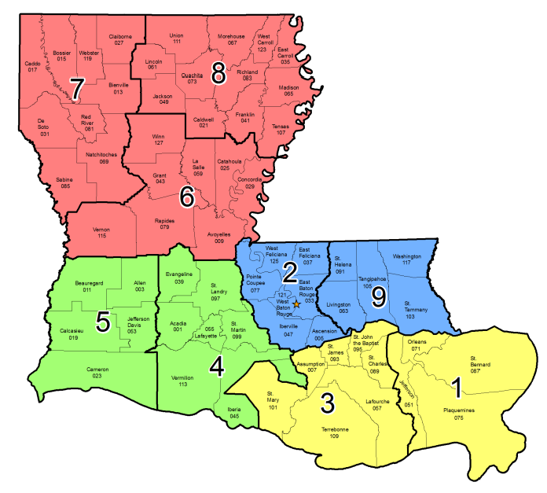
Email – Safe.Water@la.gov
Region 6, 7 & 8
District Engineer:
Barbara.Featherston@la.gov
318-676-7477
Region 2 & 9
District Engineer:
Jacob.Haffner@la.gov
225-342-7368
Region 4 & 5
District Engineer:
Steven.Joubert@la.gov
337-475-3214
Region 1 & 3
District Engineer:
Alicia.Martinez@la.gov
504-599-1564
State Office
Websites:
Engineering Services: www.ldh.la.gov/engineering
Safe Drinking Water Program: www.ldh.la.gov/SafeDrinkingWater
Drinking Water Watch: www.ldh.la.gov/drinkingwaterwatch
Notes:
All districts and regions are engaged in AWOP.
Focus has shifted from primarily SWTP-focused to be focused on GW as well as surface water, and includes DSO and DBP focus too.
Engagement and involvement from the two Deputy Chiefs (John Williams, Deputy Chief for D1/2 and Jennifer Kihlken, Deputy Chief for D3/4).

Slide 22
October 2017 to Present – “Take 2”
Almost 4 years into “reinvigoration” of LDH AWOP
PAI “New State” Training (2018 – present):
Year 1 – Intro to AWOP & optimization, 3 turbidity CPEs
Year 2 – Distribution System optimization, 3 DSO CPEs (COVID interrupted, held 2 CPEs & 2 Zoom virtual sessions with LDH staff)
Year 3 – Disinfection optimization, 2 planned GW DBP CPEs
LDH hosted operator Zoom sessions in Nov & Dec 2020
Inaugural Core Team meeting held 25 Feb 2021
Core Team formed sub-groups (VOTS, SCS)
Core Team meets monthly (1 hour)
Don’t get discouraged: building an AWOP takes time, focus, commitment, and lots of Action Item lists
Notes:
Alicia to cover TAKE 2.

Slide 23
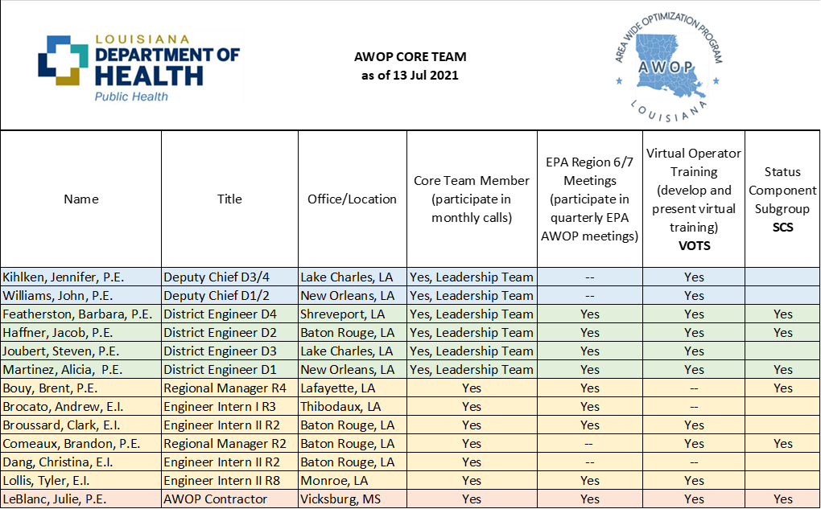
LDH AWOP Core Team – “Take 2”
Notes:
Alicia to cover TAKE 2.

Slide 24
Perspectives and Lessons Learned
Build program in a slow and deliberate manner (“new state“ training is a great place to start)
One size does not fit all (what works for LA may not work for another state)
Don’t reinvent the wheel (reach out to other states for examples and ideas), AWOP people love to talk AWOP
Don’t bite off more than the team can chew (start small)
Be/find a “champion” and be tenacious and persistent
Find a way to maintain management support for this “voluntary program”, it will pay dividends in your “mandatory program”
Notes:
Julie and Alicia jointly go over these bullet points.

Slide 25
Louisiana AWOP Revitalization - Questions?
Alicia Martinez, P.E.
LDH District Engineer, District 1 and LDH AWOP Lead
alicia.martinez@la.gov
Julie Z. LeBlanc, P.E.
LDH AWOP Contractor
julie.z.leblanc@gmail.com
Notes:
Open to questions from new states

Slide 26
Questions and Discussion

