Slide 1

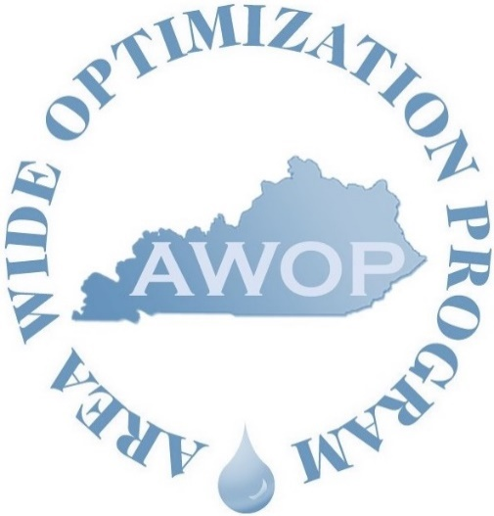

Pandemic Lessons Learned
Jackie Logsdon
9th Biennial AWOP National Meeting
July 21, 2021

Slide 2

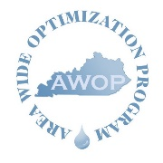
Overview
Transition to a virtual platform for Performance Based Training (PBT)
Development of the KY AWOP Story Map

Slide 3
Performance Based Training
(PBT)

Slide 4
PBT
A uniquely tailored, hands-on training approach
  Series of six sequential trainings spread out over the course of several months (~18 months)
  Comprised of classroom, field, and facilitation training components
  Special studies “homework” assigned between sessions
  Targets a small group of systems; regionally located
  Instills strategic knowledge
  Bridges the “knowing-doing” gap
  Promotes problem solving skills
  Site-specific implementation
  Provides an environment for positive peer interaction

Slide 5
PBT During a Pandemic
KY-TN D/DBP PBT
  Teamed up with TDEC and USEPA TSC
  Began with four systems and ended with three (invited six-eight)
    Three systems produce 0.8-2.5 MGD and serve <15,000
    One system produces ~9 MGD and serves ~30,000

Slide 6
PBT During a Pandemic
  Timeline of Events
    June 19, 2019—Session 1
    September 5, 2019—Session 2
    December 12, 2019—Session 3; Session 4 scheduled for April 2020
    March 2020—DUN, DUN, DUNNNNNN…COVID-19; Session 4 cancelled until further notice
    November 5, 2020—Session 4 was held via Microsoft Teams
    April 21, 2021—Session 5 was a two-hour meeting via Microsoft Teams to closeout the series

Slide 7
PBT During a Pandemic—Lessons Learned
We allowed too much time to pass between sessions.
  Held off in hopes of hosting in-person
  Lost momentum & interest
Systems were experiencing staffing issues and heavy workloads as result of the virus.
The PBT is designed to be hands-on—that is one reason it is so effective.
  Lost the synergy created when gathered as a group working together
  This training structure is not suitable for a virtual platform—especially with smaller systems.
Systems that completed the series demonstrated improved performance and lowered DBP levels—Success!

Slide 8
AWOP
Story Map

Slide 9
AWOP
Story Map
Began discussing the idea of development in the fall of 2019
When site visits came to a screeching halt, we decided to visit some “back-burner” items
  AWOP Story Map!
Started working with the GIS & Data Analysis Section on March 18, 2020
The KY AWOP Story Map went live on June 18, 2020

Slide 10
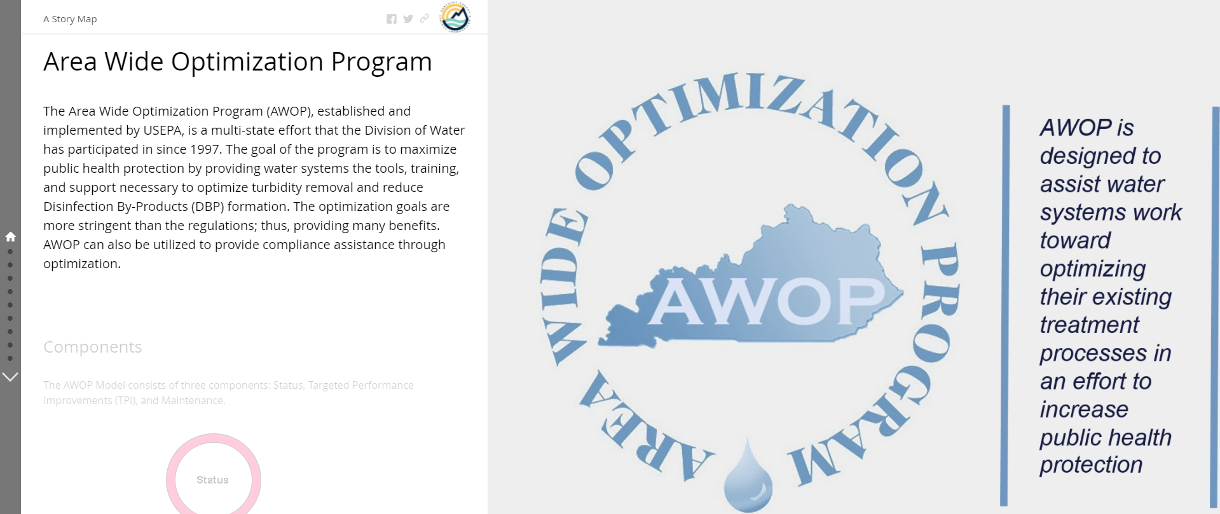
AWOP
Story Map
AWOP Story Map
https://tinyurl.com/KYAWOP

Slide 11
AWOP
Story Map—Lessons Learned
Duties shifted allowing more time to dedicate to this project
Excellent resource to spread the word, highlight successes, and increase water system participation in AWOP!

Slide 12
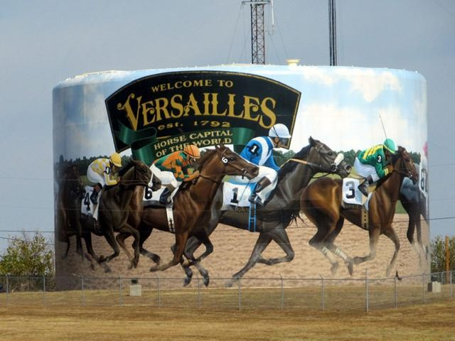
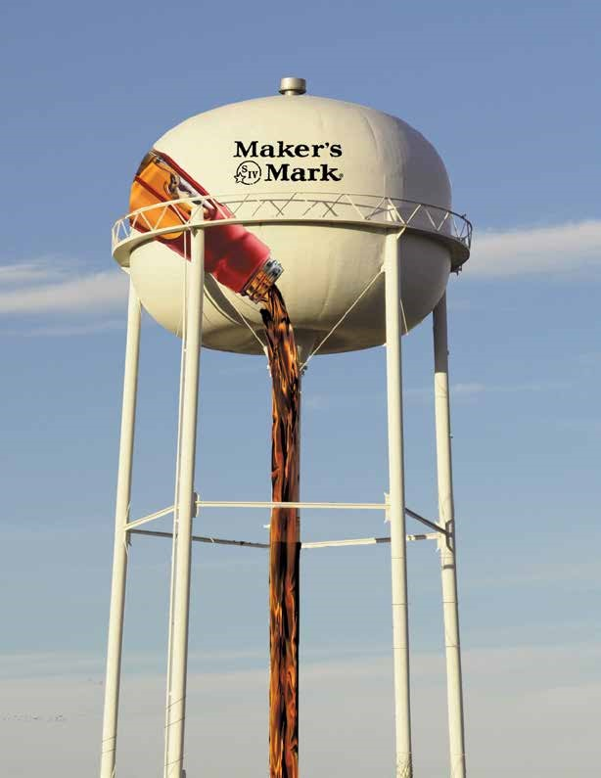
Jackie Logsdon
Drinking Water Technical Assistance
Division of Water
Kentucky Department for Environmental Protection
270-825-7513
jackie.logsdon@ky.gov
https://tinyurl.com/KYAWOP

Slide 13


Pandemic Lessons Learned (Louisiana)
Alicia Martinez, P.E.
LDH District Engineer, District 1 and LDH AWOP Lead
alicia.martinez@la.gov
Julie Z. LeBlanc, P.E.
LDH AWOP Contractor
julie.z.leblanc@gmail.com
Notes:
Introduce ourselves

Slide 14


Background
LDH began “reinvigoration” of our AWOP in 2017
PAI “New State” Training (2018 – present):
Year 1 – Intro to AWOP & optimization, 3 turbidity CPEs
Year 2 – DSO focus, 3 DSO CPEs planned (COVID interrupted, held 2 CPEs), moved to virtual (Zoom) sessions for LDH staff
Year 3 – DBP focus, virtual sessions again followed by 2 planned GW DBP CPEs
COVID yielded Year 2 PAI virtual training events: Intro to GW Optimization (May 2020) and Chloramine Optimization (June 2020)

Slide 15
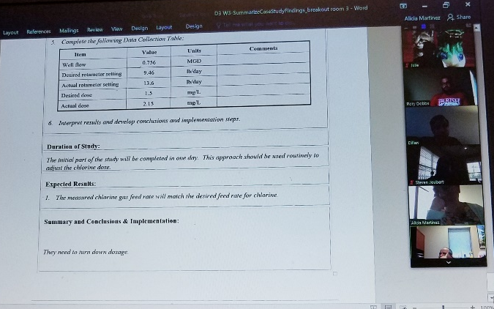
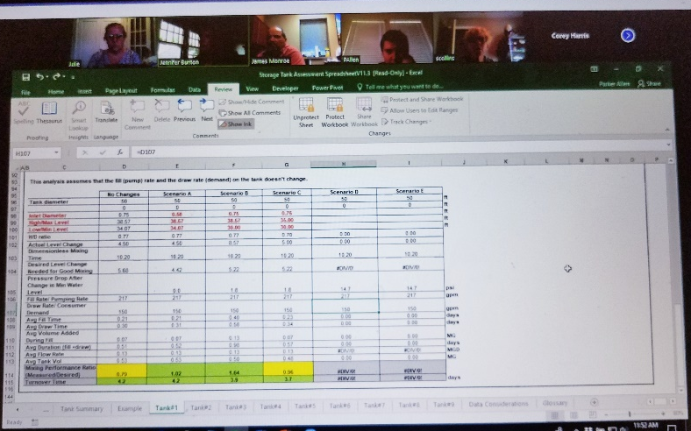
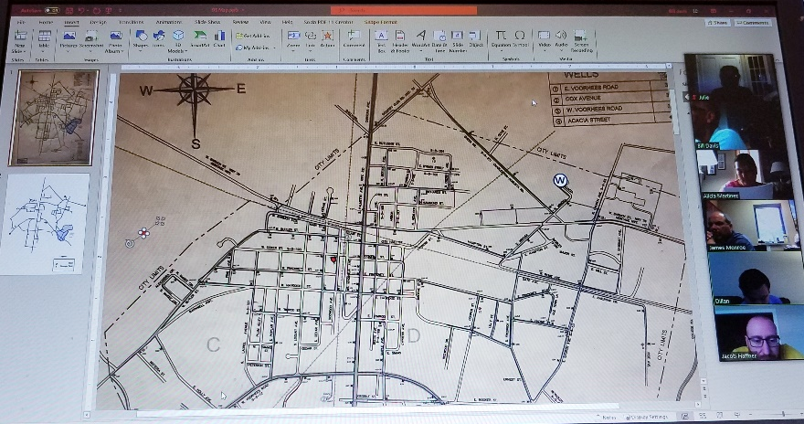
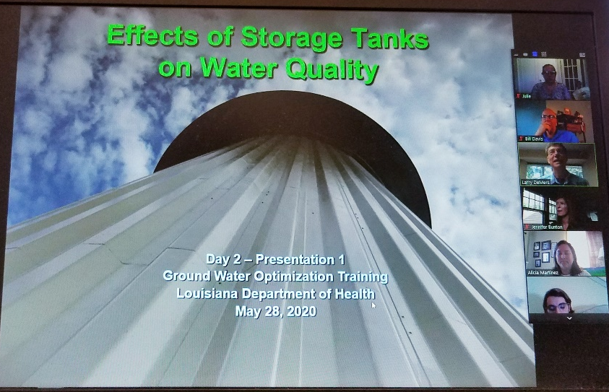
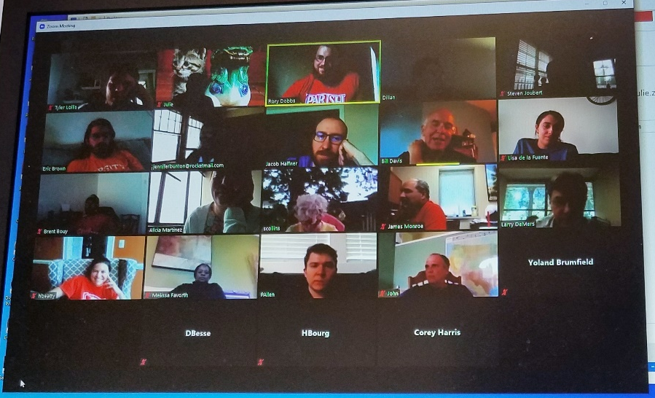
PAI-facilitated Virtual Training – Series #1
Groundwater Optimization
Held 27-29 May 2020
3 PAI trainers
20 LDH participants
Presentations
Small group workshops

Slide 16
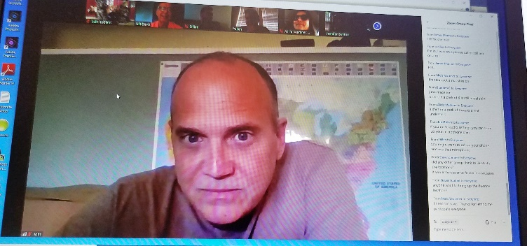
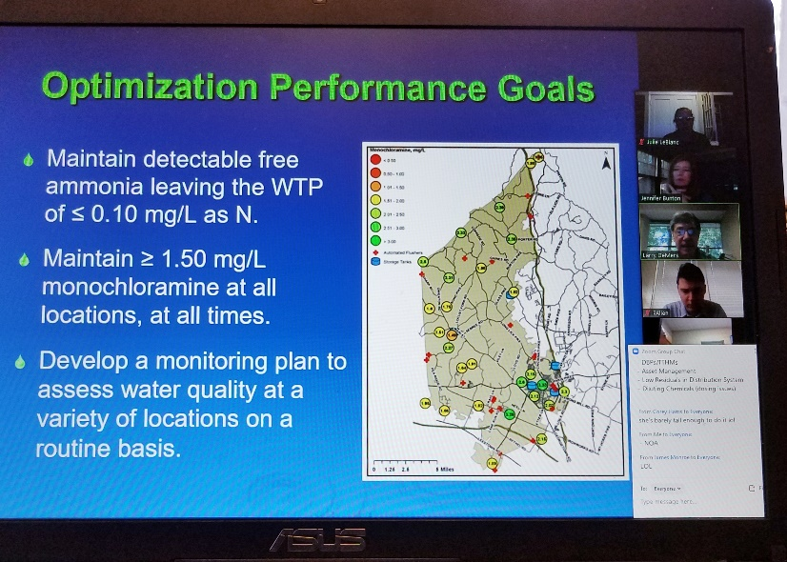
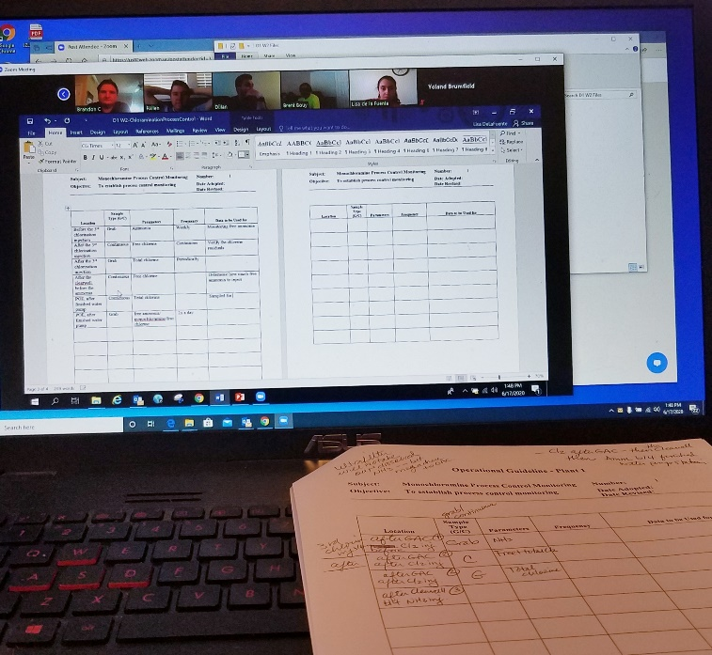
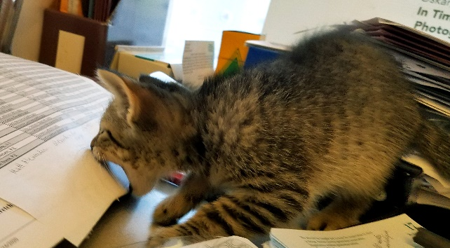
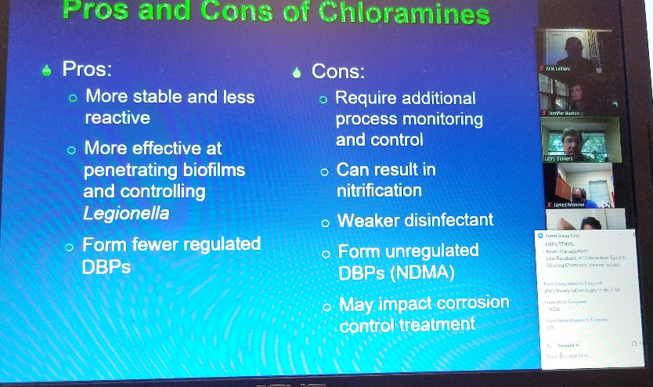
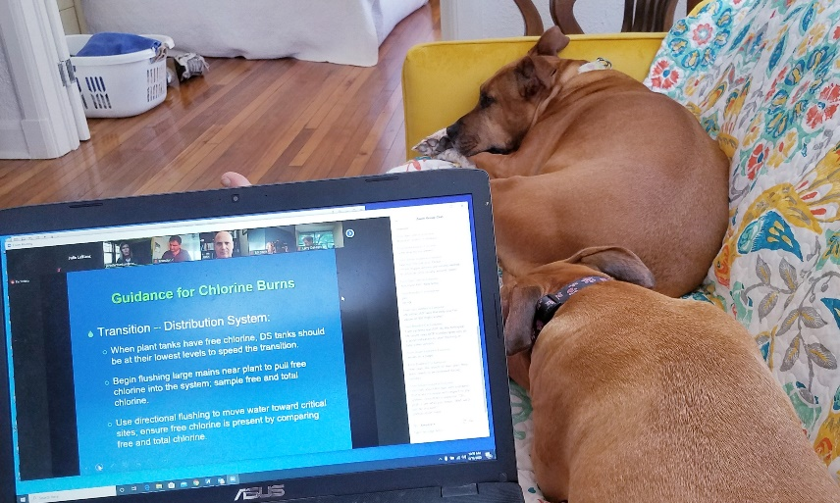
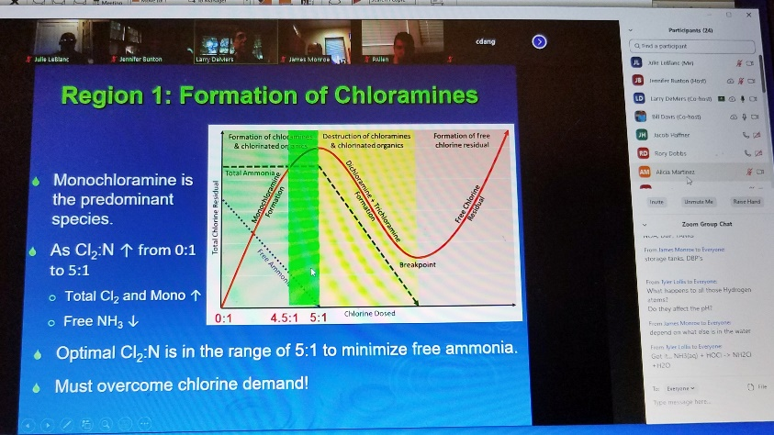
PAI Virtual Training – Series #2
Chloramine Optimization Concepts
Held 17-19 Jun 2020
3 PAI trainers
21 LDH participants
+ Matt Alexander, TSC
Presentations
Small group workshops

Slide 17
PAI-Developed Follow Up Workshops
Integrating Lessons Learned
LDH facilitated PAI-developed follow-up workshops with LDH staff entitled Integrating Lessons Learned
Purpose of workshop: LDH staff to brainstorm on approaches to utilize the skills learned during the virtual training event to solve issues seen in plants
GW Optimization workshop (held 12 Jun 2020) – 15 LDH staff
Chloramine Optimization workshop (held 30 Jun 2020) – 17 LDH staff
Step 1. Brainstorm and list issues that systems with chloramines or naturally occurring ammonia may face
Step 2. Select 2-3 issues and: (a) describe the problem, (b) develop approach and select tools to solve each issue and (c) develop strategy to engage operators
Step 3. Document workshop discussion. Go out and do good things!

Slide 18
Notes:
From the LDH-facilitated Follow-On Workshop (shared to show what the documentation looked like). NOT a slide to read…

Slide 19

LDH-hosted Virtual Operator Training:
Chloramine Optimization Concepts
Built from the PAI series 2 (Chloramine-focused), LDH developed a 5-hour virtual operator training session
Small group of ~6 LDH staff worked to develop training
Targeted surface and ground water operators
Operators earn continuing education credit
Interactive Zoom platform was used, with use of polls to encourage operator participation
Session covered: Naturally-occurring ammonia, guide to breakpoint chlorination, chloramine disinfection overview, LA nitrification plan requirements, interactive case studies, Davidson Pie Wheel
Run-thru was held with LDH staff on 16 Oct 2020
First virtual operator training session was held 19 Nov 2020 (11 operators)
Second virtual operator training session was held 16 Dec 2020 (37 operators)
A video of the Zoom training is available for operators to view and earn hours, operators have to sign a certification testifying that they watched the video, 100+ operators have submitted certificates

Slide 20
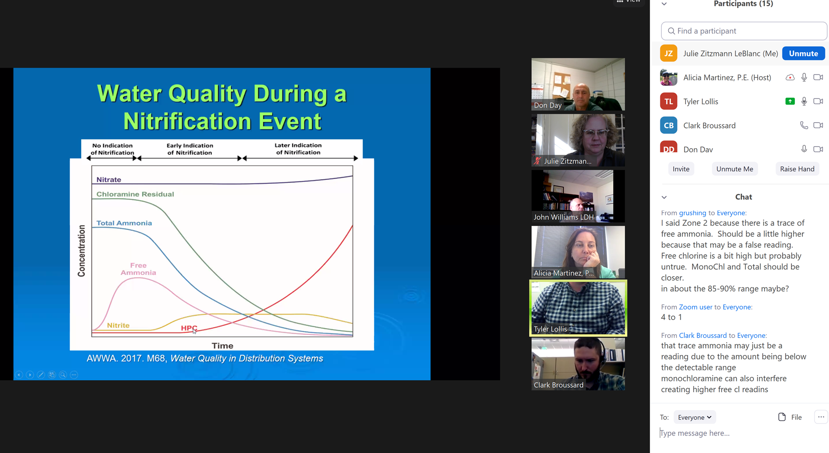
Virtual Operator Training – Nov 2020
First virtual operator training session was held 19 Nov 2020
Pilot with smaller group of operators (total of 11 operators)

Slide 21
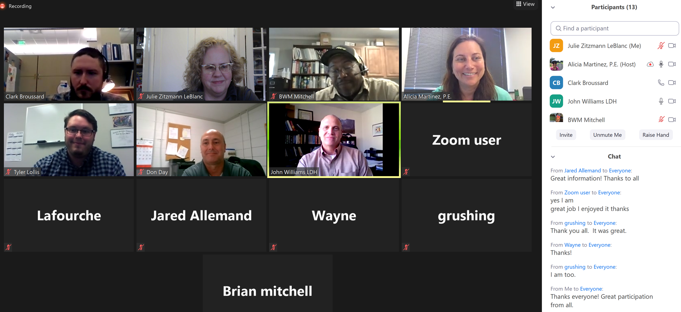
Virtual Operator Training – Nov 2020
First virtual operator training session was held 19 Nov 2020
Pilot with smaller group of operators (total of 11 operators)

Slide 22
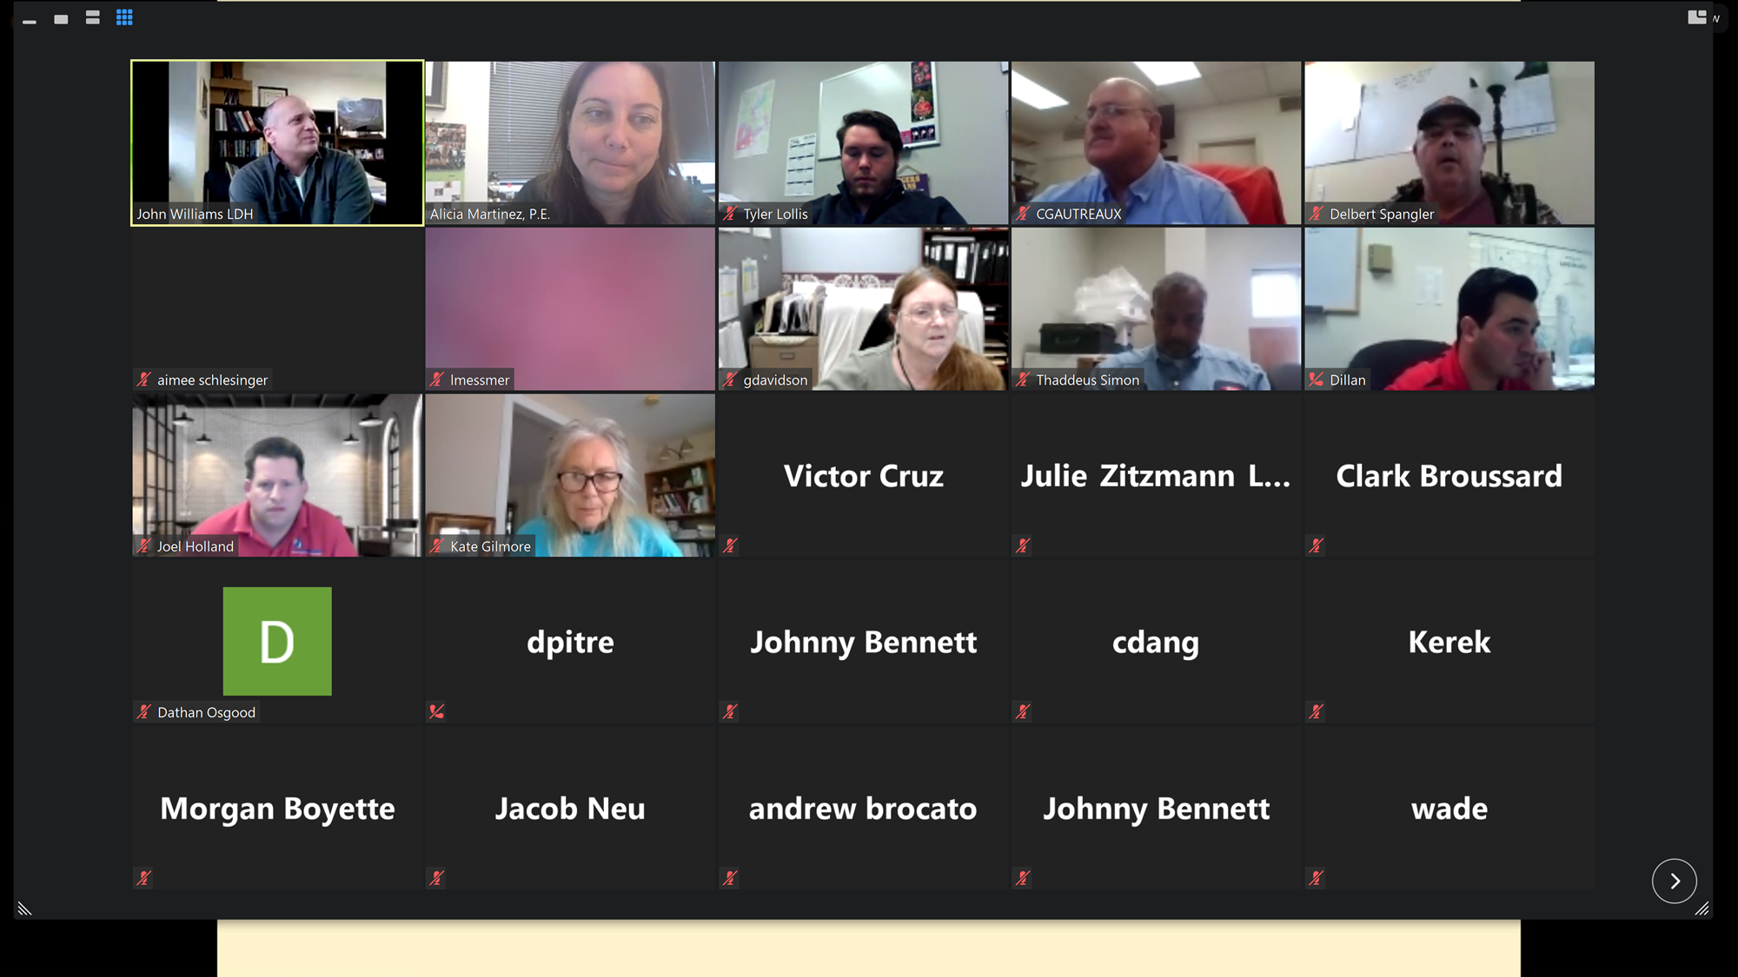
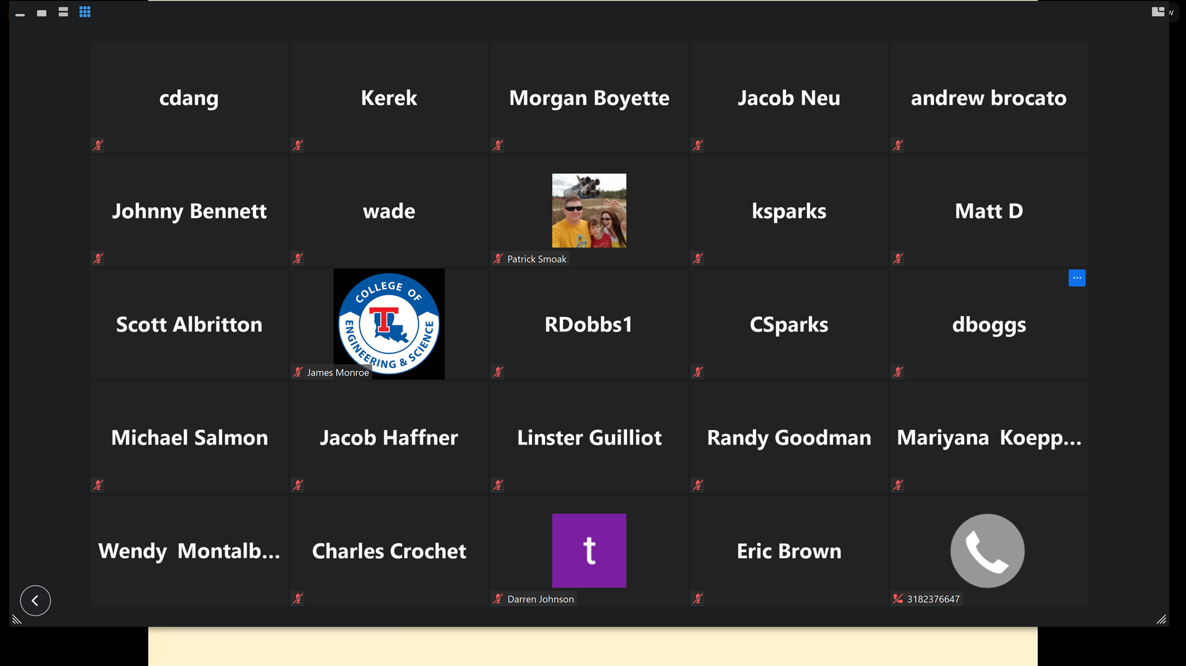
Virtual Operator Training – Dec 2020
Second virtual operator training session was held 16 Dec 2020
27 Operators and 10 LDH staff participated as trainees (37 trainees)

Slide 23
AWOP Core Team
Virtual Operator Training Subgroup (VOTS)
LDH’s Virtual Operator Training Subgroup (VOTS) held meetings on 30 Mar, 15 Apr, 6 May, 22 Jun 2021. Next meeting 27 Jul 2021.
Purpose of VOTS is to develop and hold virtual operator training on topics of interest to water treatment operators (GW and SW) in LA
Operators will earn required training credit (currently in a virtual setting, plan to also offer in-person training when possible)
Following on the heels of successful of Chloramine virtual operator training in Nov and Dec 2020
A smaller subgroup from the LDH AWOP core team work together
  During first meeting, brainstormed on ideas of areas where operators could benefit from additional training on
  Decided to focus on back-to-basics as a focus area
  Continue to meet often to develop and refine agenda/presentations

Slide 24
UPCOMING LDH-hosted VOT:
Back-to-Basics Concepts
Interactive Zoom platform will again be used, with use of polls to encourage operator participation
Decided upon 1-day format, 4-5 hours (and will record individual presentations for future viewing (to earn operator hours)
Back-to-Basics Presentations
  What is AWOP (short 10-15 minutes)
  Sampling and Data Integrity
  Dosing of Chlorine and Determining Demand on Source Water
  What are DBPs
  Strategies for Mitigating DBP Issues

Slide 25
Pandemic Lessons Learned (Louisiana)
QUESTIONS?
Alicia Martinez, P.E.
LDH District Engineer, District 1 and LDH AWOP Lead
alicia.martinez@la.gov
Julie Z. LeBlanc, P.E.
LDH AWOP Contractor
julie.z.leblanc@gmail.com

Slide 26
PANDEMIC LESSONS LEARNED:
REMOTE SANITARY SURVEYS
AWOP NATIONAL MEETING 2021
(July 21, 2021)
Tom Chyra, P.E., Supervising Sanitary Engineer

Slide 27
Presentation Outline
Drinking Water Section (DWS) Background
Pandemic in 2020 and Sanitary Surveys
Remote Sanitary Survey Process
Challenges of Remote Sanitary Surveys
Benefits of Remote Sanitary Surveys
Lessons Learned in CT

Slide 28
DWS Background
Regulates approximately 2,500 public water systems (PWS)
Responsible for completing approximately 500 sanitary surveys each year (C, NTNC, and TNC)
4 staff responsible for completing large PWS sanitary surveys including subpart H PWS
6 staff responsible for completing small PWS sanitary surveys
Prior to the pandemic all sanitary surveys were conducted in person
DWS started using SWIFT a few years ago to conduct sanitary surveys and generate sanitary survey reports

Slide 29
Pandemic in 2020 and Sanitary Surveys
In the beginning of 2020 sanitary survey staff got a head start on sanitary surveys due to a very mild winter and no snow cover
Staff were actually on pace to complete their sanitary surveys ahead of schedule for the year
In mid-March 2020 state employees were instructed to begin teleworking as the pandemic began ramping up
Governor Lamont’s “Stay Safe, Stay at Home” executive order
No field work directive

Slide 30
Pandemic in 2020 and Sanitary Surveys
Operators for the most part were still conducting their normal on-site visits to PWS to ensure continuity of PWS operations
Large PWS were very sensitive in keeping their treatment plant operators isolated and safe, did not want anyone else coming into their treatment plants including sanitary survey staff
What to do about sanitary surveys which historically always have been done in person on-site?
EPA Region 1 minimum expectation that States reach out to all PWS that were scheduled for sanitary surveys in 2020
Monthly EPA Region 1 meetings to discuss sanitary surveys and how to complete them remotely, lots of great input from States

Slide 31
Remote Sanitary Surveys
A decision was made internally that all remaining sanitary surveys would be done remotely and that ALL remaining sanitary surveys would still be completed by the end of 2020
Two teams of supervisors and staff mobilized to develop workgroups to develop remote sanitary survey processes for large and small PWS as both sets of PWS had different challenges and complexity
Solicited input from a small group of certified PWS operators
End result was the development of a 4-page condensed sanitary survey form to be used during the pandemic

Slide 32
Remote Sanitary Surveys
First page was pre-filled by sanitary survey staff based on file reviews and compliance history
Remaining 3 pages consisted of yes/no questions and were completed by staff during the remote survey
PWS were given the form ahead of time so they knew what to expect and had time to prepare
Staff already had state-issued laptops with cameras prior to the pandemic with MS Teams installed
At the onset of the pandemic staff also received state-issued iPhones and VPN credentials in order to remotely access SDWIS and internal electronic filing and database systems

Slide 33
Remote Sanitary Surveys
“Live” remote sanitary surveys were conducted via MS Teams, Skype, or FaceTime. Instructions were developed for PWS on how to install and use MS Teams and Skype on their smartphones
Focus was on critical components such as sources of supplies and treatment
Relied on digital photos for other components such as pump stations, storage tanks, meter vaults, etc.
Also relied heavily on regulatory mandated storage tank inspection reports to assess storage tanks
Used desktop version of SWIFT to generate reports
All required sanitary surveys were completed for 2020!!

Slide 34
Challenges of Remote Sanitary Surveys
Cell phone service coverage in rural areas or inside buildings
Technology knowledge and comfort (some smaller PWS personnel did not have smartphones – flip phones still exist!)
Some operators insisted on DWS staff doing in person sanitary surveys
Took some time for staff to get used to doing sanitary surveys remotely
Cannot see everything like you would normally see in person (i.e. sources of pollution)
Video was sometimes choppy or unclear

Slide 35
Benefits of Remote Sanitary Surveys
Staff spent more time on file reviews and PWS compliance history and inventory verification during their prep work
More consistency with prep work and file review
Did not have to spend significant amount of time driving to get to the sanitary survey locations, more flexibility
Operators were better prepared to have information requested ready for us before the sanitary survey
Administrative portion of the sanitary survey became more efficient
Led to ancillary benefits such as conducting all or portions of final project inspections remotely resulting in significant time savings

Slide 36
Lessons Learned in CT
The “new normal” of conducting sanitary surveys is here to stay
Technology plays an important role in conducting remote sanitary surveys – need laptops, smartphones, and VPN
Certain components of a sanitary survey can be completed remotely so that field time is efficient and focused on critical components
For some large PWS sanitary surveys that may mean saving a day or two of driving and field time
Renewed focus on consistent sanitary survey prep and file reviews
Some very small PWS may be conducive to having their sanitary surveys done entirely remotely
Reaching out to other States was very beneficial, networking is key

Slide 37
Thank You
For questions please contact:
thomas.chyra@ct.gov
860-936-0742

