Slide 1
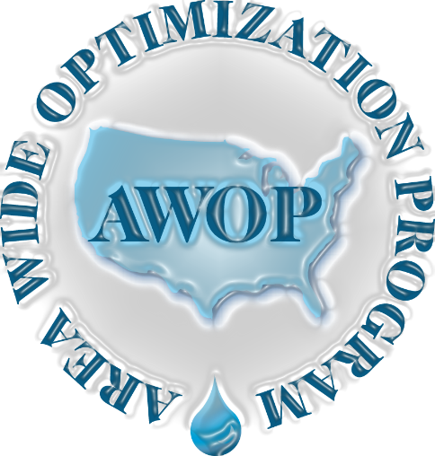
Region 10/8 AWOP Program Reports
“Sustaining AWOP in Times of Change”
2021 AWOP National Meeting
July 21, 2021

Slide 2
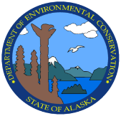
Alaska AWOP Update
9th Biennial AWOP National Meeting July 19-21
Johnny Mendez, P.E.
Northern Area Engineering Coordinator
Alaska Department of Environmental Conservation
Drinking Water Program

Slide 3
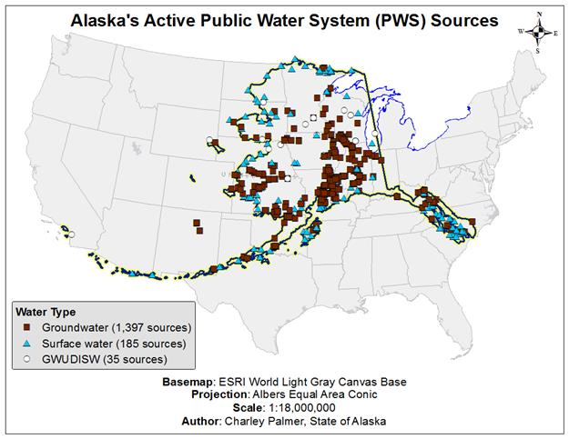
Public Water Systems in AK
1368 PWS in AK

Slide 4
Alaska DEC-DW Engineering Group Mission
The Drinking Water Program engineers protect public health by overseeing the design, construction, and operation of public water systems. We strive to efficiently implement regulatory requirements with predictability, thoughtfulness, and clarity, while allowing for site specific accommodations when possible.
AWOP Vision
To promote adoption of optimization treatment goals & concepts in order to improve public health protection. Participate in AWOP activities when possible to maintain proficiency, support staff training and professional growth to help provide better technical assistance and technology transfer to our public water systems.

Slide 5
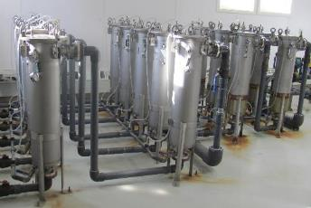
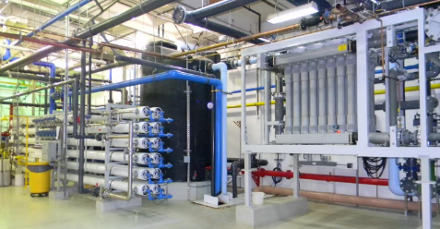
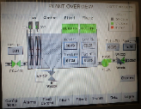
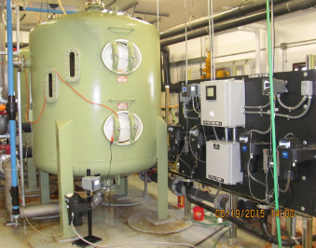
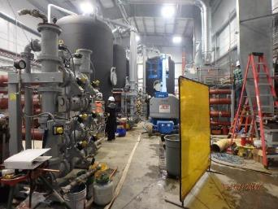
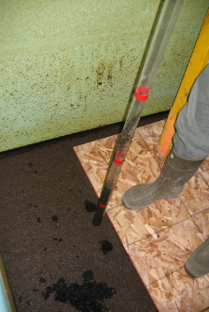
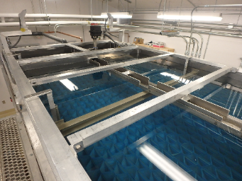
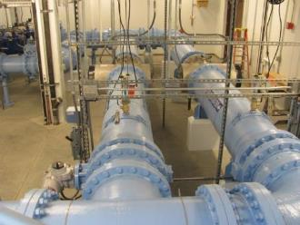
Water Treatment Sampler-AK
SCADA
Bag Filters
GAC Treatment
Membrane filtration
Coring a Gravity Filter
Direct Filtration
Conventional Filtration
UV Reactors

Slide 6
AWOP Importance
Challenges
Alaska historically has opted not to add additional regulatory burden (beyond Federal) to PWSs (“no more stringent” state).
New Federal rules require increased scrutiny of water system components and system operations (DBP Rules, LT1, LT2, Groundwater Rule).
Less funding available for water system improvements or replacements.
Increased complexity of water systems requires hands-on knowledge by DEC engineering staff and more responsibilities for PWS operators.
Alaska’s resources for providing capacity development and technical assistance services is limited.
Participation in AWOP can/has:
Increase expertise of our staff by collaborating, exchanging ideas and “lessons-learned” with other state counterparts.
Improve our staff’s capacity to provide technical assistance to PWSs and help reduce public health risks.
Improve ability to more effectively implement primacy related engineering oversight.
Focus on optimization encourages PWSs to make the most of current resources. Voluntary nature of concepts matches State’s regulatory vision

Slide 7
Past Achievements
Several SW Treatment CPE training in the State. At height of Program doing 2 CPEs per year to help train up staff (early 2000’s)
Conducted Status Component Inspections of SW systems in State (>2/3 inspected from 2010 to 2018). Data helped update State information of treatment system processes and operational capabilities. Also helped document capacity of systems to meet treatment requirements and where to target future technical assistance.
Current Status & Future Plans
Alaska’s AWOP program has been significantly reduced due to budget limitations, staffing turnover, retirements, etc. (limited informal participation).
COVID-19 hampered travel, harder to keep up with SCIs
Trying to maintain optimization concepts and keep lessons learned active to be ready to reestablish program when conditions allow
Future Goals: Train up staff in CPEs, improve monitoring data collection, keep up with SCIs

Slide 8
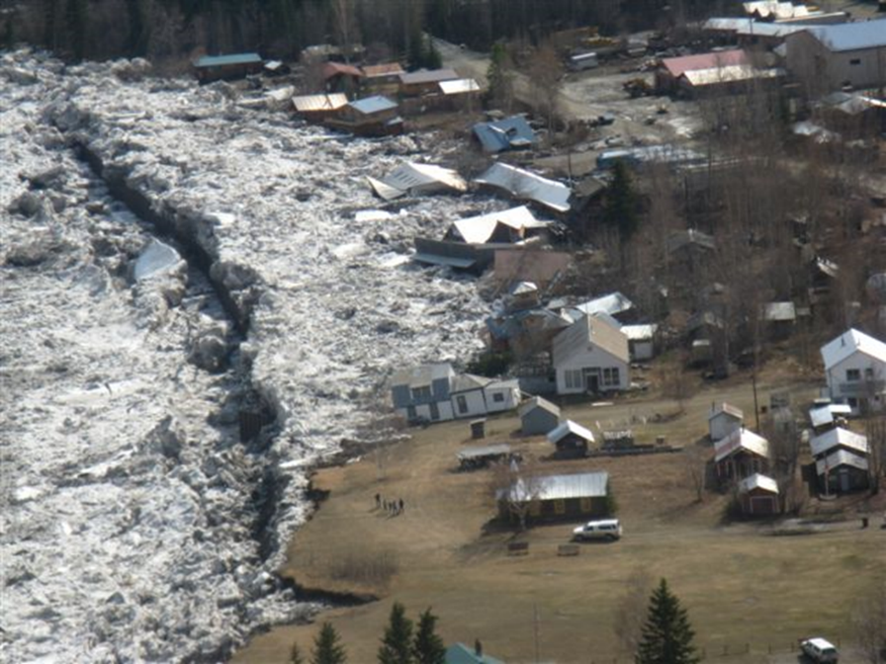
Questions?

Slide 9
OREGON
Area Wide Optimization Program
(AWOP)
AWOP National Meeting
July 19 - 21, 2021
(Virtual via Microsoft Teams)

Slide 10
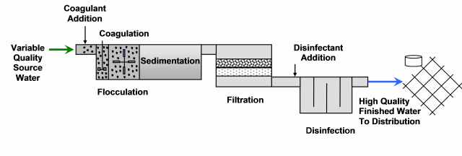
Oregon’s AWOP
The objective of Oregon’s Area Wide Optimization Program is to educate water system operators in optimizing principles with the ultimate goal of improving public health protection.

Slide 11
Core AWOP Team
AWOP Core Team Member | AWOP Core Team Member | # of Counties
Phebe Howe (Debra Lambeth is now focused on SRF and Environmental Review) | Capacity Development Coordinator | 1 (also responsible for county/ag contract oversight, training, and liaison)
Evan Hofeld | Coordinator | 2
Vacant (James Nusrala retired 7/16/21) | Region 1 | 3
Jay MacPherson | Region 2 | 1 (also R2 Plan Review Coordinator)
Rebecca Templin | Region 2 | 1 (Extra PR as needed)

Slide 12
Outreach Activities
Conference presentations Direct mailings Updating and maintaining website www.healthoregon.org/swt Articles in electronic newsletter (The Pipeline) CPE, PBT, On-site assistance (treatment plant, data integrity, CT evaluations) Operator trainings

Slide 13
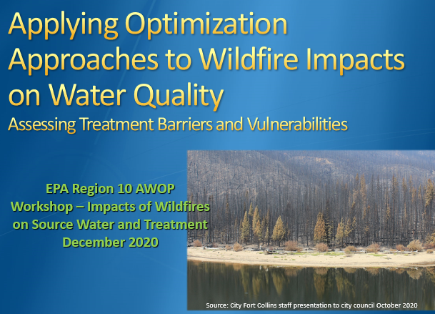
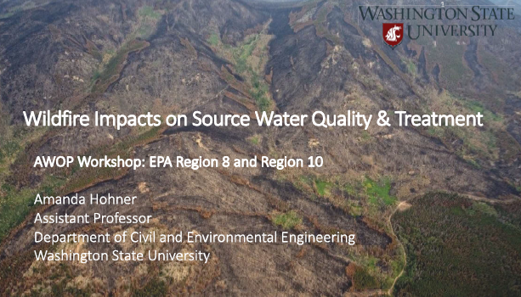
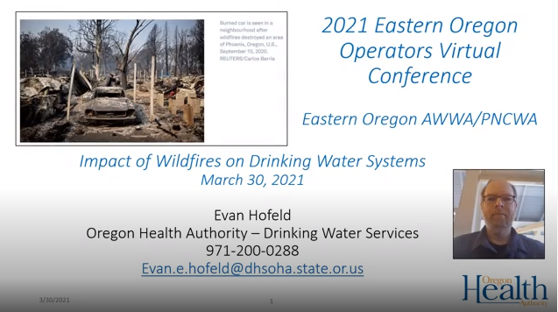
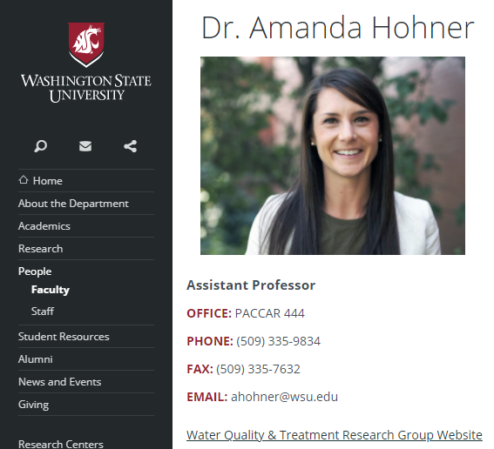
Gaining knowledge and experience through quarterly Region 10/8 AWOP Meetings
Use knowledge gained to:
Train other staff
Train operators
https://ce.wsu.edu/faculty/dr-amanda-hohner/
https://youtu.be/hURV4boSaPI

Slide 14
Using knowledge to adapt to new priorities
Cyanotoxins
Developed guidance for cyanotoxins | Optimizing Treatment for Cyanotoxin Removal - May 2019
Wildfires
Developed guidance for treating waters impacted by wildfire | Optimizing Filtration After a Wildfire - February 2021
Assisted with post-wildfire response and development of Erosion Threat Assessment and Response Team report | ETART Water Quality/Drinking Water Supply Resource Report (Summary)
3 conference/workshop presentations on wildfire impacts and guidance | https://youtu.be/hURV4boSaPI
Membrane Filtration (Addressing MF/UF Module Replacements)
LRV as an Upper Control Limit (UCL) | Developed plan review process for incorporating LRVambient as a UCL when modules are replaced.

Slide 15
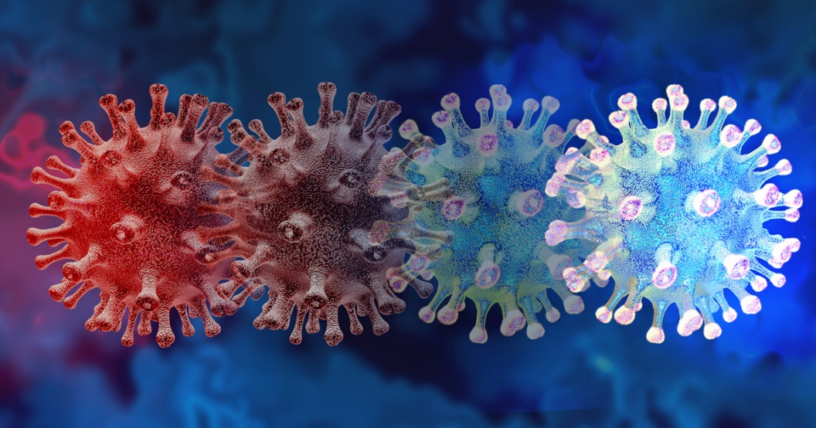
Adapting to COVID-19 (SARS-CoV-2 and variants)
https://www.beckmancoulter.com/en/blog/diagnostics/sars-cov-2-variants-and-the-impact-on-diagnostic-tests
COVID-19 had a chilling effect on Oregon AWOP, but didn’t kill it…
Postponed all on-site activities – efforts went to wildfire response.
Postponed in-person R10/8 AWOP meetings/training workshops - Still held virtual meetings.
Reduced in-person operator training – adapted to on-line class.
Furthered progress on LRVambient for membranes via plan review process

Slide 16
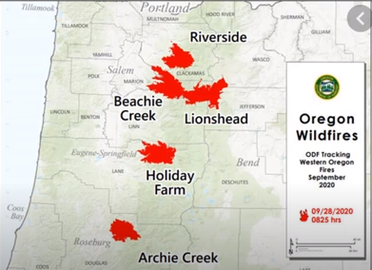
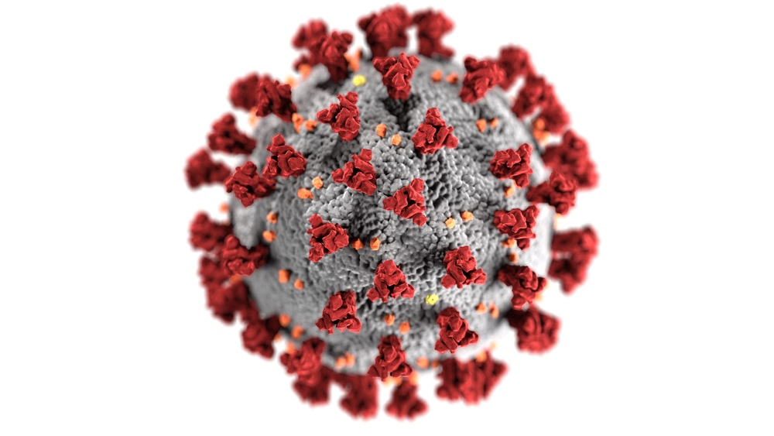
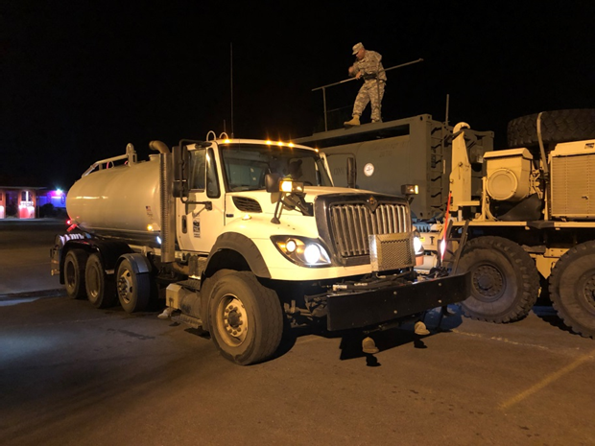
Questions?
Evan Hofeld, PE
Regional Engineer
Oregon Drinking Water Services
Evan.e.hofeld@dhsoha.state.or.us
971-200-0288
2020 Oregon megafires over 100,000 acres in size (image from 9/28/20)
Oregon National Guard distributing drinking water to Salem residents due to cyanotoxins in 2018

Slide 17
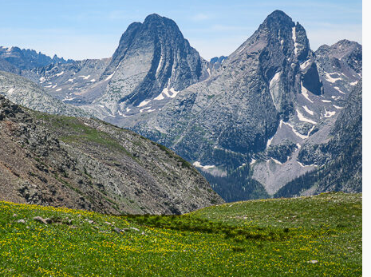
Region 8 States:
Colorado (picture)
Utah
Montana
Wyoming
North Dakota
South Dakota
EPA directly
Implements:
Wyoming
Tribal lands
in all
states

Slide 18
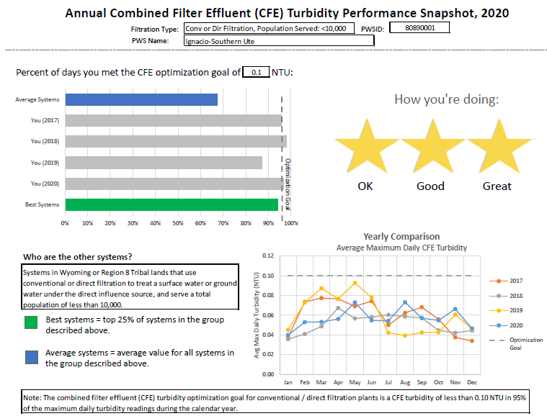

Slide 19
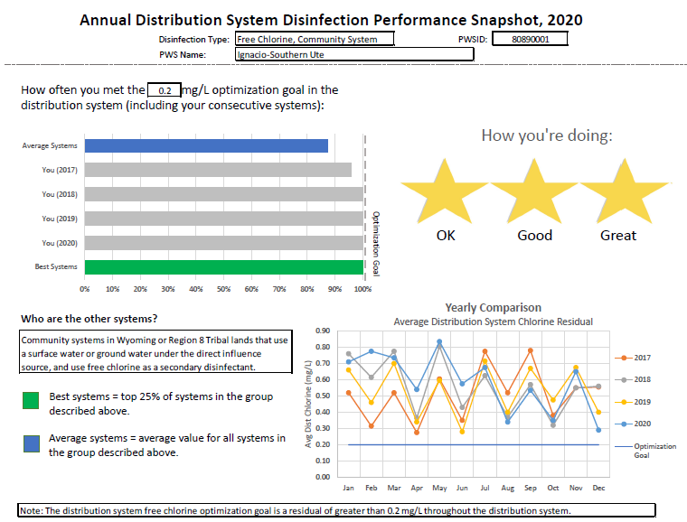

Slide 20
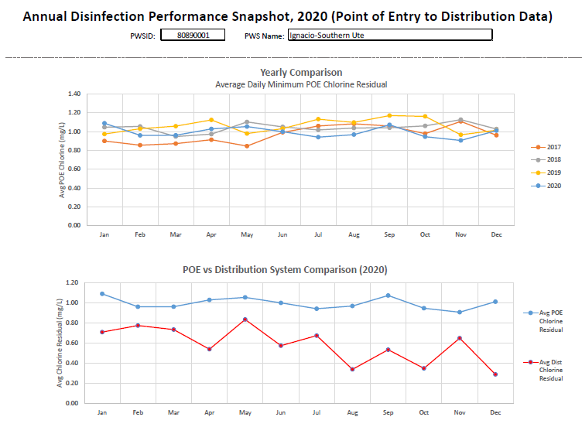

Slide 21
EPA Region 10
Direct Implementation Program Update
2021 AWOP National Meeting
July 21, 2021

Slide 22

Program Strategy
Current Approach – Focus outreach and TA on:
PWSs with health-based violation of optimizable treatment.
PWSs with potential for health-based violation of optimizable treatment.
Distribution system optimization of free chlorine residual at PWSs with history of low reported residuals.
Bonus goal: conduct a voluntary CPE at each surface water system.

Slide 23
Optimization Activities - Adaptation
Personnel updates
  Sam Perry joined EPA Region 10 and the AWOP team
Direct Implementation Program Optimization Activities:
  Two remote trainings conducted January 2021 for staff and TA Providers:
    Surface Water Optimization
    Groundwater Optimization
  Remote activities:
    Arsenic treatment optimization assistance with Lummi Nation
    DBP optimization with Metlakatla Indian Community; Yakama Nation; Tulalip Tribes
Future Activities:
  On-site and remote TA; training
  Increase focus on DSO/free chlorine residual

Slide 24
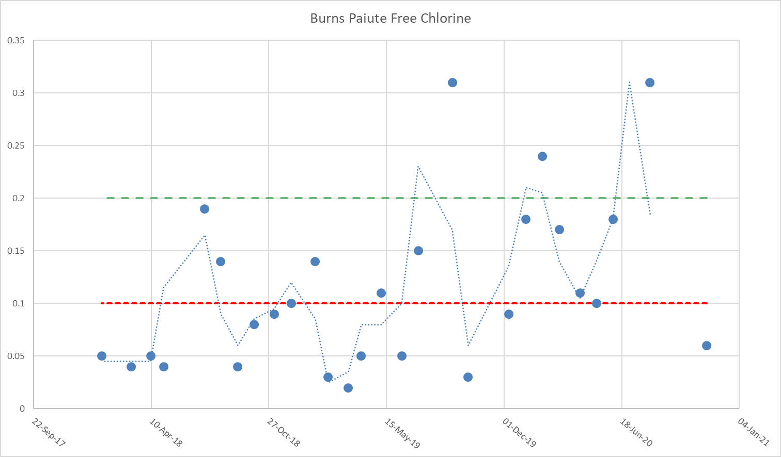
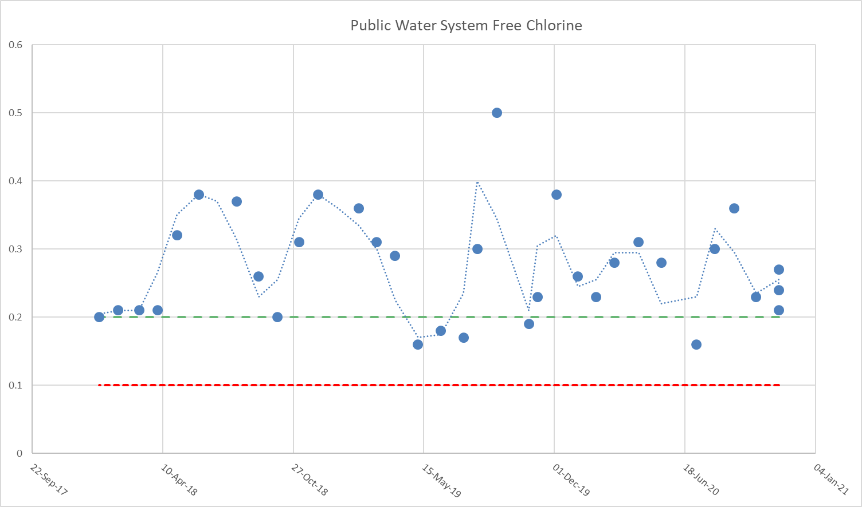
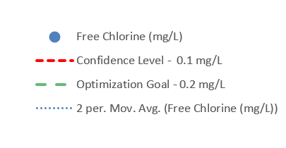
Focus Area: Distribution System Optimization
PWS #1 Free Chlorine Residual in Distribution
Some PWSs consistently reporting low residuals.
Starting with focus on ~30 PWSs.
Outreach and training ongoing.
PWS #2 Free Chlorine Residual in Distribution

Slide 25
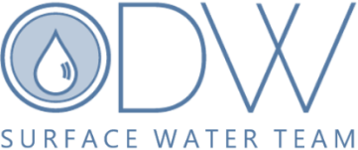
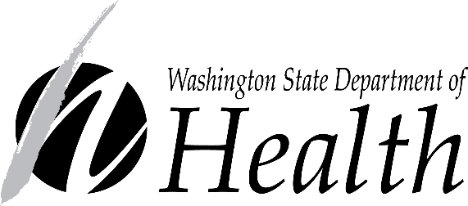
Focus Areas:
Rapid Rate Filtration Treatment Optimization (TOP)
Arsenic Treatment Optimization (ATOP)
Slow Sand Operational Guidelines
DE Operational Guidelines
Distribution System
135 surface water systems
WASHINGTON UPDATE
REGION 10 AWOP- Jul 2021

Slide 26
Turbidity Performance by Population-Rapid Rate Filtration Plants

Slide 27
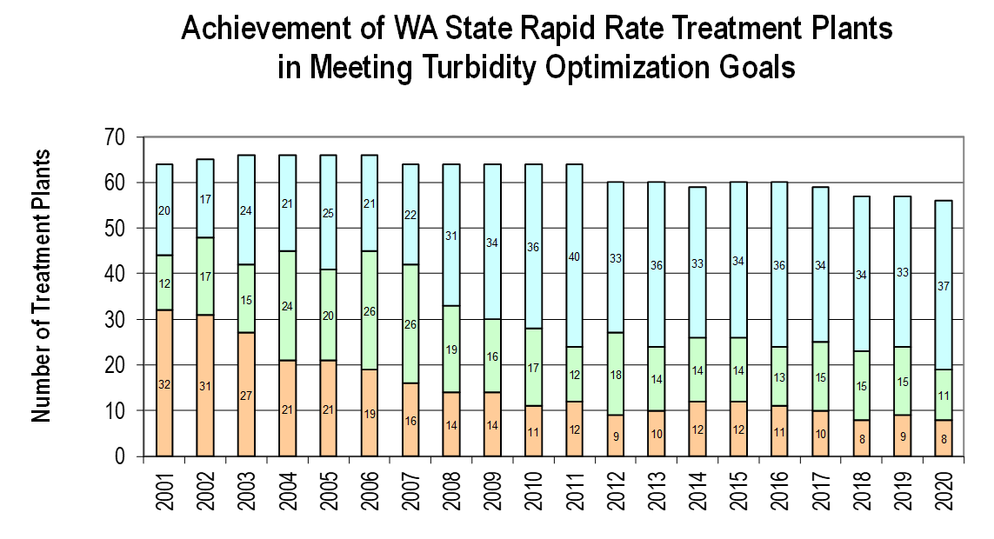
Cat | 95th % CFE |  | Max CFE
1 | ≤0.10 | & | ≤0.30
2 | ≤0.10 | & | 0.31 – 0.80
2 | 0.11-0.20 | & | ≤0.80
3 | >0.20 | or | >0.80

