Slide 1
Disinfection Requirements Rule
Operator Training
2019
Notes:
Welcome to the Disinfection Requirements rule training.
Introduce instructors

Slide 2
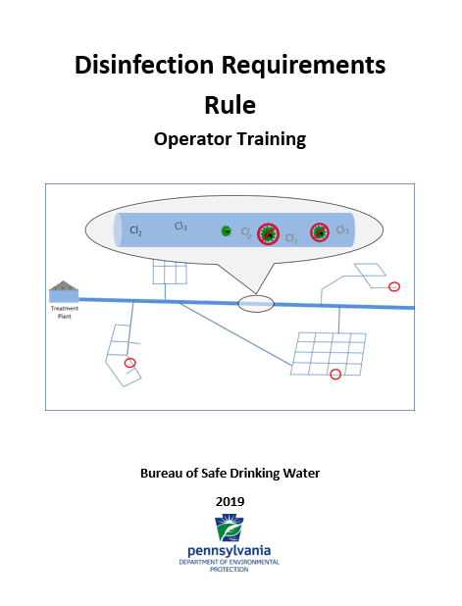
Introduction
Workbook
Not just a copy of slides
More information/complete sentences for your reference later
PowerPoint references workbook page number in lower left
Activities throughout course:
Apply what you learn
Check for comprehension
Credit for operators
WB 1-1
Notes:
First, I want talk about the workbook you have in front of you. This is not just a copy of the slides. There is typically more information in the workbook, so you will have a full reference for use after the training.
The PowerPoint slides reference the workbook page number in the lower left, just like this (see lower left of the current screen), so you can always follow along in the workbook.
The tabs are appendices that we will refer to during the class.
Advance Slide:
Many lessons have activities built-in to allow you to apply what you are learning. This also serves as a check for comprehension to see if we need to revisit any topics. In addition, for all of you that are certified operators, this serves as the assessment method so we can determine successful completion and get you credit.
Therefore, it is imperative that you actively participate in this course and complete all of the in-class activities, to earn your continuing education credits.

Slide 3
Operator Training Agenda
Lesson 1: Background
Lesson 2: Monitoring and Reporting
Lesson 3: Compliance
Lesson 4: Distribution System Investigations
Lesson 5: Overview of Best Management Practices
Lesson 6: PN/CCR
Lesson 7: Other Provisions
Notes:
Here are the lessons that we will cover in this course. These are listed in the Table of Contents in the front of the book.

Slide 4
Disinfection Requirements Rule
Lesson 1:
Background
Operator Training
2019
Notes:
Let’s start the first lesson now, which is background and introduction to the rule.

Slide 5
This lesson will cover…
Why the disinfectant residual requirements are changing
The basis for the new requirements
Rule basics
WB 1-1
Notes:
In this lesson, we will cover:
Why the disinfectant residual requirements are changing
The basis for the new requirements
Some rule basics

Slide 6
Who is affected?
DRR applies to:
All Community Water Systems
All Non-Transient Noncommunity Water Systems using chlorine disinfectant
Transient Noncommunity Water Systems with:
Filtration of a surface water source
Filtration of a GUDI (Groundwater Under the Influence of Surface Water) source
4-Log disinfection of a groundwater source
WB 1-1
Notes:
First, who is affected by the DRR? The DRR applies to:
All Community Water Systems
Advance Slide:
All Non-Transient Noncommunity Water Systems using chlorine disinfectant
This includes all NTNC systems with chlorine, regardless of whether it is 4-log treatment or not; if they use a chlorine disinfectant they have to comply with the rule.
Advance Slide:
Transient Noncommunity Water Systems with:
Filtration of a surface water source
Filtration of a GUDI (Groundwater Under the Influence of Surface Water) source
4-Log disinfection of a groundwater source

Slide 7
Background: Distribution Disinfectant Residual
Beginning April 29, 2019:
Minimum required distribution residual level will increase from 0.02 to 0.2 mg/L
Free or total chlorine depending on the type of disinfectant
Treatment
Plant
WB 1-1
Notes:
The primary element of the rule that we’ll discuss in this course is the change in distribution residual requirements.
Beginning April 29, 2019, the minimum required distribution residual level will increase from 0.02 mg/L to 0.2 mg/L free or total chlorine, depending on the type of disinfectant used, which we’ll explain later in the course.

Slide 8
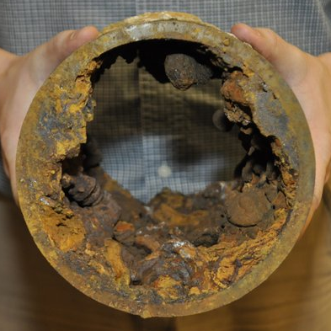
Background: Distribution System
The distribution system presents many challenges:
Finished water can undergo substantial changes due to physical, chemical, and biological reactions in the distribution system
To make matters worse, as distribution systems age, deterioration can occur allowing contamination:
Corrosion
Erosion of pipe materials
Eventual water main breaks
Other areas of intrusion create pathways of contamination
WB 1-1
Notes:
Let’s take a step back and look at the basis for maintaining a disinfectant residual.
First, the distribution system presents many challenges:
Finished water can undergo substantial changes due to physical, chemical, and biological reactions in the distribution system.
Advance slide;
Further, as distribution systems age, deterioration of pipe materials can occur allowing for pathways of contamination.

Slide 9
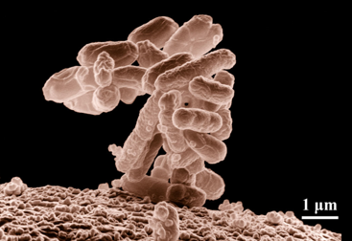
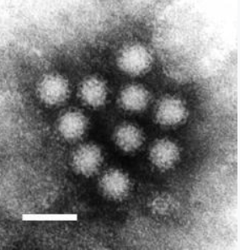
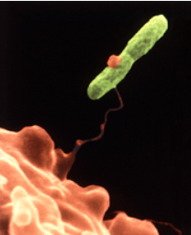
Background: Distribution System
Many different microbes can survive in the distribution system:
Bacteria
Viruses
Protozoa
Amoeba
Cluster of E. Coli bacteria (magnified 10,000 x)
A Legionella pneumophilia bacterium (green) caught by an amoeba (orange)
Norwalk Virus
WB 1-1 and 1-2
Notes:
Many different microbes can survive in the distribution system, including:
Bacteria
Viruses
Protozoa
Amoeba

Slide 10
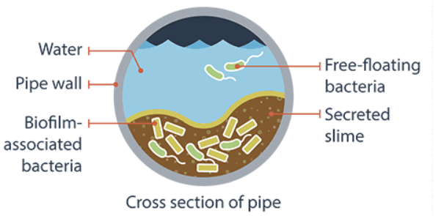
Distribution System: Biofilms
Some microbes produce biofilms in the distribution system:
Biofilms can trap other material, organisms and contaminants
Under various circumstances, biofilms can release trapped contaminants (slow release mechanism)
WB 1-2
Notes:
Some microbes produce biofilms in the distribution system:
Advance Slide:
Biofilms can trap other material, organisms and contaminants
Advance Slide:
Under various circumstances, biofilms can release trapped contaminants through a slow release mechanism

Slide 11
Background: Distribution System
Factors that influence pathogen survival and growth in the distribution system include:
Water chemistry (temperature, pH, etc)
Presence of nutrients
System hydraulics
Sediment accumulation
Presence (or absence) of disinfectant residual
WB 1-2
Notes:
There are several factors that that influence pathogen survival and growth in the distribution system, including:
(Advance Slide for each bullet)
Water chemistry (temperature, pH, etc)
Presence of nutrients
System hydraulics
Sediment accumulation
and the Presence (or absence) of disinfectant residual…
…which can be controlled and is the basis for the DRR.

Slide 12
Background: Distribution System
Maintenance of an adequate residual:
Prevents or limits regrowth of microorganisms in the distribution system
Inactivates microorganisms that may enter the system through:
cross-connections
main breaks
zero or negative pressure situations
Cl₂
Cl₂
Cl₂
Cl₂
Cl₂
Cl₂
WB 1-2
Notes:
So with this information on distribution systems in mind, we know that the maintenance of an adequate residual:
1. Prevents or limits regrowth of microorganisms in the distribution system
Advance Slide:
2. And it inactivates microorganisms that may enter the system through:
cross-connections
main breaks
zero or negative pressure situations

Slide 13
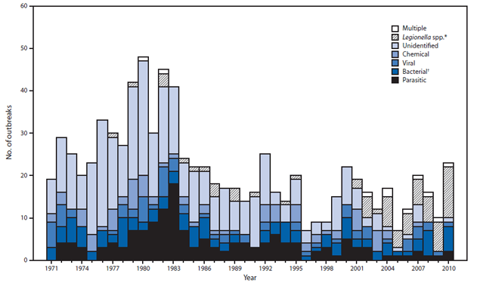
Still a Problem…
Despite advances in water treatment and management, waterborne disease outbreaks continue to occur in the United States.
2009-10 study: CDC determined that the large proportion (78%) of illnesses observed in outbreaks involved distribution system deficiencies.
#
OUTBREAKS
WB 1-3
Notes:
Despite advances in water treatment and management, waterborne disease outbreaks continue to occur in the United States.
This graph, created by the Center for Disease Control and Prevention (CDC), shows waterborne outbreaks in the US and what they are attributed to.
Advance Slide:
The diagonal line shading that is circled here in red represents legionella cases in 2010, showing that Legionella is highly prevalent, which is a distribution system problem.
Advance Slide:
In an ’09-’10 study, CDC also determined that the large proportion (78%) of illnesses observed in outbreaks involved distribution system deficiencies.

Slide 14
Still a Problem…
Pennsylvania:
Nearly all outbreaks since 2010 have been associated with distribution system deficiencies and Legionella
In 2017, there were 90 E. Coli MCL violations at 79 different public water systems
The distribution system is the remaining component yet to be adequately addressed in efforts eliminate waterborne disease outbreaks.
WB 1-3
Notes:
Pennsylvania follows a similar trend to the national numbers.
Nearly all outbreaks since 2010 have been associated with distribution system deficiencies and Legionella
In 2017, there were 90 E. Coli MCL violations at 79 different public water systems. E. coli is largely a distribution system issue.
Advance Slide:
So, the distribution system is the remaining component of public water systems yet to be adequately addressed in efforts eliminate waterborne disease outbreaks

Slide 15
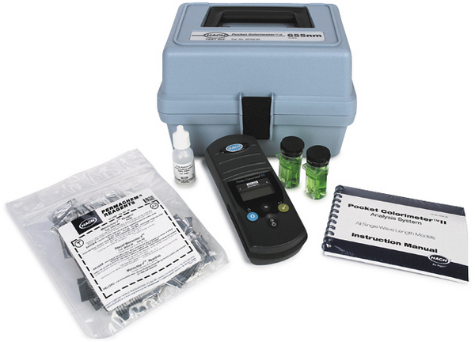
Establishing a New Residual Requirement
PA sought to establish a distribution residual requirement that is both truly detectable and controls microbial growth
First: What is a true detectable residual?
It was determined that the previous 0.02 mg/L was not truly detectable
Analyzers cannot accurately read that low
WB 1-4
Notes:
In an attempt to address this problem, Pennsylvania sought to establish a distribution residual requirement that is both truly detectable and controls microbial growth.
Advance Slide:
First of all…What is a true detectable residual?
It was determined that the previous 0.02 mg/L was not truly detectable
In other words, analyzers cannot accurately read that low

Slide 16
True Detectable Residual
DEP reviewed several studies to determine the true lower detection limit
Example: Colorado Dept of Health and Env:
Analyzed data from 450 samples
Detection limit determined to be 0.09 mg/L
WB 1-4
Notes:
DEP reviewed several studies to determine the true lower detection limit…
(We will briefly look at some of this information; you can review it in more detail later.)
Advance Slide:
…for example, in a Colorado Dept of Health and Environment study that was reviewed:
Data was analyzed from 450 samples
Detection limit was determined to be 0.09 mg/L (which is higher than the previously established minimum in PA of 0.02 mg/L)

Slide 17
True Detectable Residual
What is a true detectable residual?
EPA established a practical quantitation limit of 0.1 mg/L for the approval of free chlorine residual methods (lowest quantifiable limit)
Also, all chlorine residual test methods are subject to interference from iron, manganese, and DBPs
Based on all this information, a true detectable residual is likely somewhere between 0.1 and 0.2 mg/L
WB 1-4
Notes:
Continuing with determining what is a true detectable residual?
EPA established a practical quantitation limit of 0.1 mg/L for the approval of free chlorine residual methods. Again, this is much higher than the previous 0.02 mg/L detection level.
Advance Slide:
Also, all chlorine residual test methods are subject to false positives due to interference from iron, manganese, and DBPs (Hach 2013)
Advance Slide:
So, based on all this information, DEP concluded that a true detectable residual is likely somewhere between 0.1 and 0.2 mg/L
But the story doesn’t end there….

Slide 18
Establishing 0.2 mg/L Level
DEP’s next step: Established a residual that is not only detectable, but also controls microbial growth
DEP reviewed and considered:
Numerous studies
Other states’ disinfection residual requirements
Industry standards
WB 1-4
Notes:
The next step was to establish a distribution residual that is not only detectable, but also controls microbial growth.
Advance Slide:
To achieve this, DEP reviewed and considered:
Numerous studies
Industry standards
Other states’ disinfection residual requirements
Let’s look at these…

Slide 19
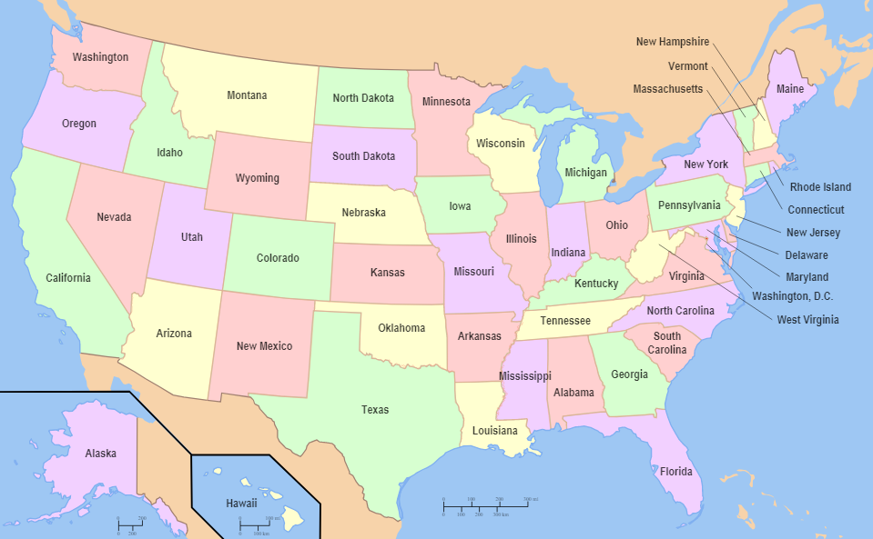
Establishing 0.2 mg/L
Three studies highlighted in your workbook
Studies found substantially more coliform and E. coli positives when residuals were <0.2 mg/L
Review of other states’ residual requirements:
19 states have requirements that are >0.2 mg/L
WB 1-5
Notes:
First, there are three studies highlighted in your workbook on page 1-5. If interested, you can read through them in more detail later.
But ultimately, the key takeaway is that the studies found substantially more coliform and E. coli positive samples when residuals were <0.2 mg/L.
Advance Slide:
DEP also found that 19 states have requirements that are >0.2 mg/L.

Slide 20
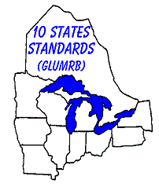
Establishing 0.2 mg/L
Industry Standards:
“Ten State Standards” specifies a minimum free chlorine distribution residual of 0.2 mg/L
Widely accepted standards created by the Greater Lakes-Upper Mississippi River Board of State and Provincial Public Health and Environmental Managers
WB 1-6
Notes:
DEP also considered various industry standards …
Advance Slide:
The 2012 edition of Ten States Standards specifies a minimum free chlorine residual of 0.2 mg/L
Advance Slide:
The Ten State Standards are widely accepted standards created by the Greater Lakes-Upper Mississippi River Board of State and Provincial Public Health and Environmental Managers.
The standards created by this Board are accepted nationwide. Pennsylvania is one of the 10 states.

Slide 21
Establishing 0.2 mg/L
Industry Standards:
Water Research Foundation (WRF) recommends a free chlorine distribution residual of 0.20 mg/L for optimized distribution
EPA’s Area Wide Optimization Program for Distribution Systems recommends maintenance of >0.20 mg/L free chlorine at all times in the distribution
WB 1-6
Notes:
Another industry standard reviewed comes from the Water Research Foundation (WRF), which recommends a free chlorine distribution residual of 0.20 mg/L for optimized distribution.
Advance Slide:
Also, EPA’s Area Wide Optimization Program for Distribution Systems recommends maintenance of >0.20 mg/L free chlorine at all times in the distribution.

Slide 22
Establishing 0.2 mg/L
Based on all this information and industry input, PA established a minimum distribution residual requirement of 0.2 mg/L
Treatment
Plant
WB 1-6
Notes:
After reviewing all this information and obtaining industry input, PA established a minimum distribution residual requirement of 0.2 mg/L

Slide 23
Overview
The DRR establishes:
Sample siting plan requirement
Minimum distribution disinfection residual level of 0.2 mg/L beginning 4/29/19
Weekly monitoring
Revised reporting requirements
Distribution system investigation
Note: For groundwater systems, the 4-log Entry Point requirement of >0.40 mg/L (or permitted level) DID NOT CHANGE.
WB 1-7
Notes:
So now you know the basis for the minimum residual requirement.
Next, let’s review some rule basics that we’ll dive deeper into during this course.
The DRR establishes:
Sample siting plan requirement; these were due to DEP last fall (by October 29, 2018)
Minimum distribution disinfection residual level of 0.2 mg/L, beginning when? (Instructor Note: Wait for response)
Advance Slide: 4/29/19
Weekly monitoring for distribution disinfectant residuals
Revised reporting requirements
Distribution system investigations
Advance Slide:
Note: For groundwater systems, the 4-log Entry Point requirement of > 0.40 mg/L (or permitted level) DID NOT CHANGE. We just didn’t want any confusion as we cover the 0.2 mg/L distribution requirement.

Slide 24
Overview
The DRR also revises some requirements for surface systems:
Requires filter plants to maintain > 0.20 mg/L residual at the entry point.
Requires filter plants to calculate Giardia log inactivation at least once/day and report this value to DEP
WB 1-7
Notes:
There are some other requirements in the DRR that we will not cover in detail.
For surface systems…
Advance Slide:
DRR requires filter plants to maintain greater than or equal to 0.20 mg/L residual at the entry point.
Note that this is a change from 0.2 mg/L; a significant digit was added making it 0.20 mg/L.
We will cover the Public Notification requirements for this in the PN lesson.
Advance Slide:
Also, DRR requires filter plants to calculate Giardia log inactivation at least once/day during the time of expected peak hourly flow, and report this value to DEP.
DEP will be holding separate focus sessions for this requirement.

Slide 25
Overview
Other provisions:
DRR requires systems that provide chloraminated water to develop and implement a nitrification control plan.
Covered in last lesson in course
WB 1-7
Notes:
DRR also requires systems that provide chloraminated water to develop and implement a nitrification control plan.
This will be covered in last lesson

Slide 26
Key Points
The minimum required distribution disinfection level is changing from 0.02 mg/L to 0.2 mg/L to be:
A truly detectable level
A residual that controls microbial growth
Complying with the new rule will be covered in this course
WB 1-7
Notes:
Let’s review the key points from this lesson.
The required distribution disinfection level is changing from 0.02 mg/L to ? Instructor Note: Wait for response (advance slide after response) 0.2 mg/L to be:
A truly detectable level
A residual that controls microbial growth
Complying with the new rule will be covered in this course.

