Slide 1
Pennsylvania’s
Disinfection Requirements Rule (DRR)
National AWOP Meeting
July 19-21, 2021

Slide 2
Background: Distribution Disinfectant Residual
Prior to April 29, 2019:
Minimum required distribution residual level was 0.02 mg/L
Treatment
Plant
Notes:
The primary element of the rule that we’ll discuss in this course is the change in distribution residual requirements.
Beginning April 29, 2019, the minimum required distribution residual level will increase from 0.02 mg/L to 0.2 mg/L free or total chlorine, depending on the type of disinfectant used, which we’ll explain later in the course.

Slide 3
Background: Distribution Disinfectant Residual
PA was concerned that 0.02 mg/L was:
Not truly detectable
Inadequate to control microbial pathogens
PA sought to establish a new distribution residual requirement that was both truly detectable and controlled microbial pathogens
Notes:
The primary element of the rule that we’ll discuss in this course is the change in distribution residual requirements.
Beginning April 29, 2019, the minimum required distribution residual level will increase from 0.02 mg/L to 0.2 mg/L free or total chlorine, depending on the type of disinfectant used, which we’ll explain later in the course.

Slide 4
True Detectable Residual
DEP reviewed several studies to determine the true lower detection limit
Example: Colorado Dept of Health and Env:
Analyzed data from 450 samples
Detection limit determined to be 0.09 mg/L
Notes:
DEP reviewed several studies to determine the true lower detection limit…
(We will briefly look at some of this information; you can review it in more detail later.)
Advance Slide:
…for example, in a Colorado Dept of Health and Environment study that was reviewed:
Data was analyzed from 450 samples
Detection limit was determined to be 0.09 mg/L (which is higher than the previously established minimum in PA of 0.02 mg/L)

Slide 5
True Detectable Residual
EPA established a practical quantitation limit of 0.1 mg/L for the approval of free chlorine residual methods (lowest quantifiable limit)
Also, all chlorine residual test methods are subject to interference from iron, manganese, and DBPs
Notes:
Continuing with determining what is a true detectable residual?
EPA established a practical quantitation limit of 0.1 mg/L for the approval of free chlorine residual methods. Again, this is much higher than the previous 0.02 mg/L detection level.
Advance Slide:
Also, all chlorine residual test methods are subject to false positives due to interference from iron, manganese, and DBPs (Hach 2013)
Advance Slide:
So, based on all this information, DEP concluded that a true detectable residual is likely somewhere between 0.1 and 0.2 mg/L
But the story doesn’t end there….

Slide 6
True Detectable Residual
What is a true detectable residual?
Learned that 0.02 mg/L was not a true detectable residual.
Analyzers cannot accurately read that low
Based on all this information, a true detectable residual is likely somewhere between 0.1 and 0.2 mg/L
Notes:
Continuing with determining what is a true detectable residual?
EPA established a practical quantitation limit of 0.1 mg/L for the approval of free chlorine residual methods. Again, this is much higher than the previous 0.02 mg/L detection level.
Advance Slide:
Also, all chlorine residual test methods are subject to false positives due to interference from iron, manganese, and DBPs (Hach 2013)
Advance Slide:
So, based on all this information, DEP concluded that a true detectable residual is likely somewhere between 0.1 and 0.2 mg/L
But the story doesn’t end there….

Slide 7
Microbial Control
DEP’s next step: Establish a residual that controls microbial pathogens
Notes:
The next step was to establish a distribution residual that is not only detectable, but also controls microbial growth.
Advance Slide:
To achieve this, DEP reviewed and considered:
Numerous studies
Industry standards
Other states’ disinfection residual requirements
Let’s look at these…

Slide 8
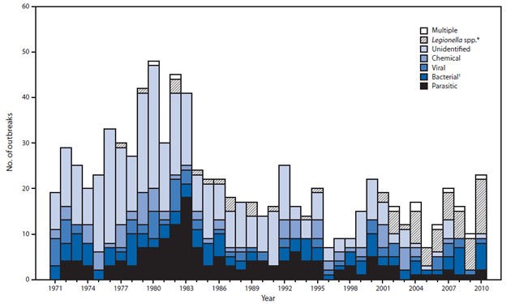
Still a Problem…
Despite advances in water treatment and management, waterborne disease outbreaks continue to occur in the United States.
2009-10 study: CDC determined that the large proportion (78%) of illnesses observed in outbreaks involved distribution system deficiencies.
#
OUTBREAKS
Notes:
Despite advances in water treatment and management, waterborne disease outbreaks continue to occur in the United States.
This graph, created by the Center for Disease Control and Prevention (CDC), shows waterborne outbreaks in the US and what they are attributed to.
Advance Slide:
The diagonal line shading that is circled here in red represents legionella cases in 2010, showing that Legionella is highly prevalent, which is a distribution system problem.
Advance Slide:
In an ’09-’10 study, CDC also determined that the large proportion (78%) of illnesses observed in outbreaks involved distribution system deficiencies.

Slide 9
Still a Problem…
Pennsylvania:
Nearly all outbreaks since 2010 have been associated with distribution system deficiencies and Legionella
In 2017, there were 90 E. Coli MCL violations at 79 different public water systems
The distribution system is the remaining component yet to be adequately addressed in efforts eliminate waterborne disease outbreaks.
Notes:
Pennsylvania follows a similar trend to the national numbers.
Nearly all outbreaks since 2010 have been associated with distribution system deficiencies and Legionella
In 2017, there were 90 E. Coli MCL violations at 79 different public water systems. E. coli is largely a distribution system issue.
Advance Slide:
So, the distribution system is the remaining component of public water systems yet to be adequately addressed in efforts eliminate waterborne disease outbreaks

Slide 10
Microbial Control
DEP reviewed and considered:
Numerous studies
Other states’ disinfection residual requirements
Industry standards
Notes:
The next step was to establish a distribution residual that is not only detectable, but also controls microbial growth.
Advance Slide:
To achieve this, DEP reviewed and considered:
Numerous studies
Industry standards
Other states’ disinfection residual requirements
Let’s look at these…

Slide 11
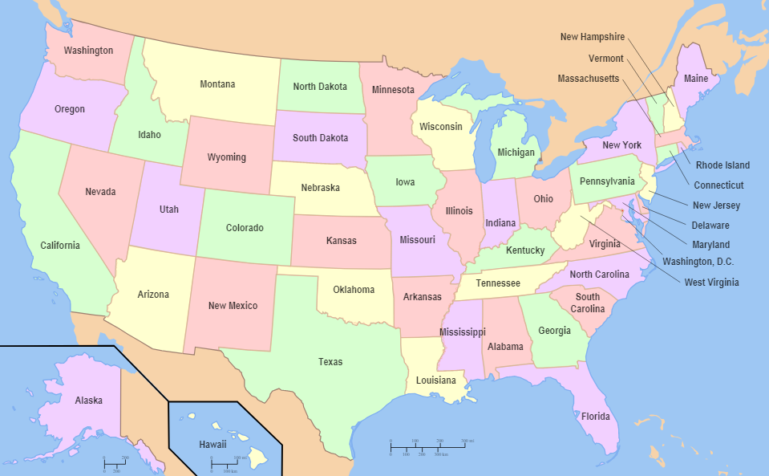
Establishing 0.2 mg/L
Three studies
Found substantially more coliform and E. coli positives when residuals were <0.2 mg/L
Review of other states’ residual requirements:
19 states have requirements that are >0.2 mg/L
Notes:
But ultimately, the key takeaway is that the studies found substantially more coliform and E. coli positive samples when residuals were <0.2 mg/L.
Advance Slide:
DEP also found that 19 states have requirements that are >0.2 mg/L.

Slide 12
Comparison to Other States
State | Minimum Residual | State | Minimum Residual | State | Minimum Residual | State | Minimum Residual
Alabama* | 0.2 (F) 0.5 (T) | Indiana | 0.2 (F) 0.5 (T) | Missouri | 0.2 (T) | Oklahoma | 0.2 (F) 1.0 (T)
Colorado* | 0.2 | Iowa | 0.3 (F) 1.5 (T) | Nebraska | SW-0.2 (F) SW-0.25-0.5 (T) GW-0.1 (F) | Pennsylvania* | 0.2
Delaware | 0.3 (F) | Kansas* | 0.2 (F) 1.0 (T) | Nevada | 0.05 | Tennessee* | 0.2 (F)
Florida* | 0.2 (F) 0.6 (T) | Kentucky* | 0.2 (F) 0.5 (T) | New Jersey* | 0.05 | Texas* | 0.2 (F) 0.5 (T)
Georgia | 0.2 (F) | Louisiana* | 0.5 | North Carolina* | 0.2 (F) 1.0 (T) | Vermont | 0.1 (F)
Illinois* | 0.2 (F) 0.5 (T) | Minnesota | 0.1 | Ohio* | 0.2 (F) 1.0 (T) | West Virginia* | 0.2 (T)
* States with mandatory disinfection

Slide 13
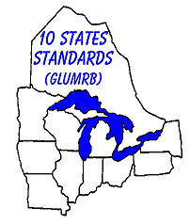
Establishing 0.2 mg/L
Industry Standards:
“Ten State Standards” specifies a minimum free chlorine distribution residual of 0.2 mg/L
Widely accepted standards created by the Greater Lakes-Upper Mississippi River Board of State and Provincial Public Health and Environmental Managers
Notes:
DEP also considered various industry standards …
Advance Slide:
The 2012 edition of Ten States Standards specifies a minimum free chlorine residual of 0.2 mg/L
Advance Slide:
The Ten State Standards are widely accepted standards created by the Greater Lakes-Upper Mississippi River Board of State and Provincial Public Health and Environmental Managers.
The standards created by this Board are accepted nationwide. Pennsylvania is one of the 10 states.

Slide 14
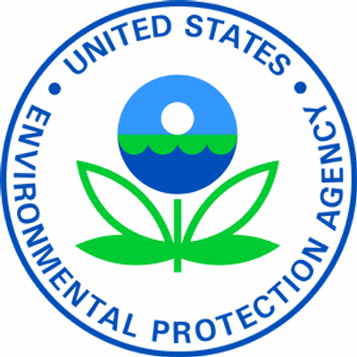
Establishing 0.2 mg/L
Industry Standards:
Water Research Foundation (WRF) recommends a free chlorine distribution residual of 0.20 mg/L for optimized distribution
EPA’s Area Wide Optimization Program for Distribution Systems recommends maintenance of >0.20 mg/L free chlorine at all times in the distribution
Notes:
Another industry standard reviewed comes from the Water Research Foundation (WRF), which recommends a free chlorine distribution residual of 0.20 mg/L for optimized distribution.
Advance Slide:
Also, EPA’s Area Wide Optimization Program for Distribution Systems recommends maintenance of >0.20 mg/L free chlorine at all times in the distribution.

Slide 15
Establishing 0.2 mg/L
Based on all this information and industry input, PA established a minimum distribution residual requirement of 0.2 mg/L
Treatment
Plant
Notes:
After reviewing all this information and obtaining industry input, PA established a minimum distribution residual requirement of 0.2 mg/L

Slide 16
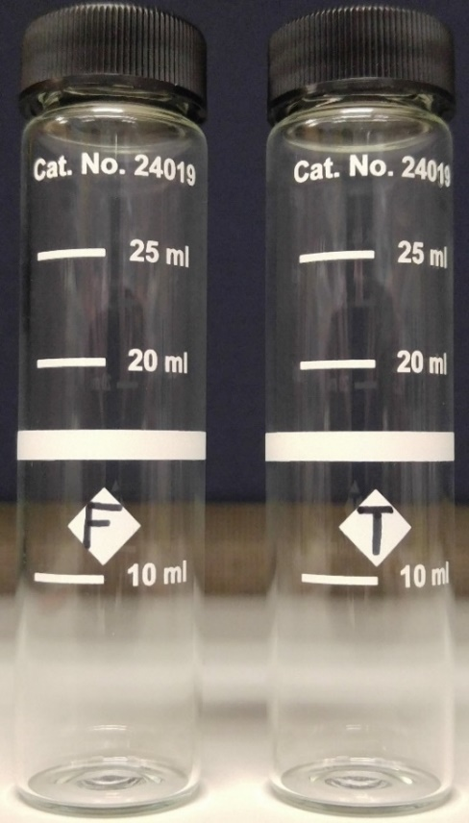
Type of monitoring
What type of monitoring is required?
Free chlorine for systems using chlorine
Total chlorine for systems using chloramines
Both free and total chlorine for mixing zones (identified in SSP)
Both free and total chlorine during a free chlorine burn (for systems using chloramine)
Notes:
109.710 lists the type of monitoring required:
Systems using chlorine should monitor for free chlorine.
Systems using chloramines should monitor for total chlorine.
ADVANCE
Systems with any mixing zones should monitoring for both free and total chlorine. Mixing zones should be identified in the SSP.
ADVANCE
Systems that use chloramines should monitor for both free and total chlorine during a free chlorine burn.
Instructor note: If asked, What is a free chlorine burn?
Water systems that use chloramine disinfection in their distribution systems may choose to periodically conduct a free chlorine burn. This process involves a temporary switch from chloramine to free chlorine disinfection. The purpose of a free chlorine burn is to minimize biofilms and bacterial regrowth in distribution pipes, inactivate nitrifying bacteria, and restore water quality. Free chlorine burns are typically short lived and may last for a few weeks. There can be many operational challenges associated with conducting a free chlorine burn, including simultaneous compliance issues with corrosion control, taste and odor complaints, and increased color and turbidity.

Slide 17
Effective Date
When did the distribution residual monitoring requirements of the DRR go into effect?
April 29, 2019
APRIL 2019
Sun | Mon | Tues | Wed | Thurs | Fri | Sat
 | 1 | 2 | 3 | 4 | 5 | 6
7 | 8 | 9 | 10 | 11 | 12 | 13
14 | 15 | 16 | 17 | 18 | 19 | 20
21 | 22 | 23 | 24 | 25 | 26 | 27
28 | 29 | 30
DRR
Notes:
Also to review from lesson 1, The distribution residual monitoring requirements that will be covered in this lesson have an effective date of 1-year after the DRR was published. That makes the monitoring requirements effective date April 29, 2019.
Beginning on that date, all water systems noted on the previous slide are required to begin compliance monitoring according to the provisions of DRR.

Slide 18
Early Findings/Impacts
High percentage of CWSs met DRR TT = 99.7%
Improved water quality and public health protection
Did not result in an increase in DBPR MCL violations
Did result in fewer RTCR MCL violations
Did not result in a substantial increase in permit applications or infrastructure costs

Slide 19
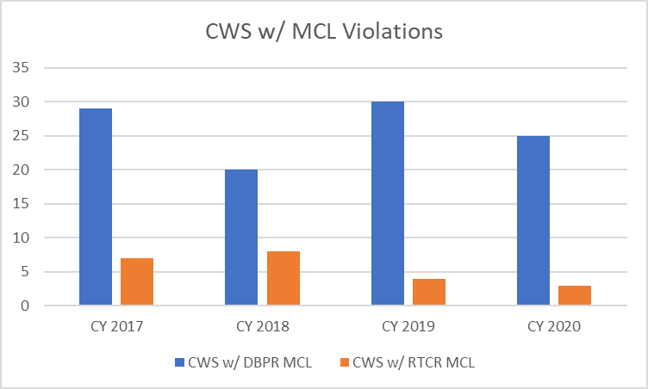
DBPR & RTCR Compliance
Notes:
DRR distribution system disinfectant residual effective 4/29/2019

Slide 20
Key Points
The minimum required distribution disinfection level is changed from 0.02 mg/L to 0.2 mg/L to be:
A truly detectable level
A residual that controls microbial pathogens
Notes:
Let’s review the key points from this lesson.
The required distribution disinfection level is changing from 0.02 mg/L to ? Instructor Note: Wait for response (advance slide after response) 0.2 mg/L to be:
A truly detectable level
A residual that controls microbial growth

