Slide 1


Welcome to the Association of State Drinking Water Administrator’s
Lead Service Line Inventory Symposium

Slide 2
Lead Service Line Inventory Symposium
Session 2 - Notes from The Field: State and Utility Experiences with Existing LSL Inventory Rules
Stephanie Schlea
Senior Water Policy Advisor

Slide 3
Session 2 speakers
Jessica Sibriski, Massachusetts Department of Environmental Protection
Robert Orthman, Boston Water and Sewer Commission
Ann Hirekatur, Wisconsin Department of Natural Resources
Mike Mahloch, Allouez Waterworks
Hayden King, Indiana Department of Environmental Management
Tyler Steury, Vic Kelson and James Hall, City of Bloomington

Slide 4

Massachusetts Department of Environmental Protection
Jessica Sibriski

Slide 5
LEAD AND COPPER RULE REVISIONS
LEAD SERVICE LINE INVENTORIES
DRINKING WATER PROGRAM

Slide 6
Lead Service Lines in MA
Estimated 220,000 LSL in Massachusetts
2016 MassDEP’s Lead and Copper Rule Lead Service Line Survey:
782 PWS subject to the LCR in Massachusetts, including 523 Community and 259 Non-Transient Non-Community PWS
547 PWS participated from the survey
MassDEP’s LSL Survey follow-up in 2018-2019.

Slide 7
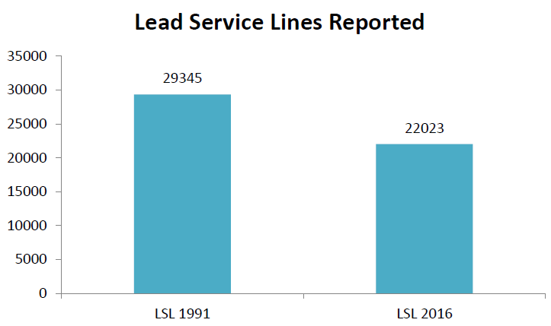
Lead & Copper Rule Survey

Slide 8
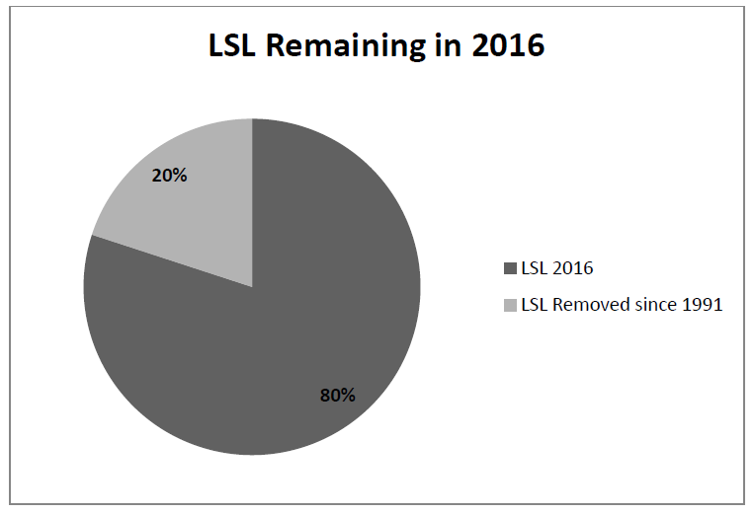
Lead & Copper Rule Survey

Slide 9
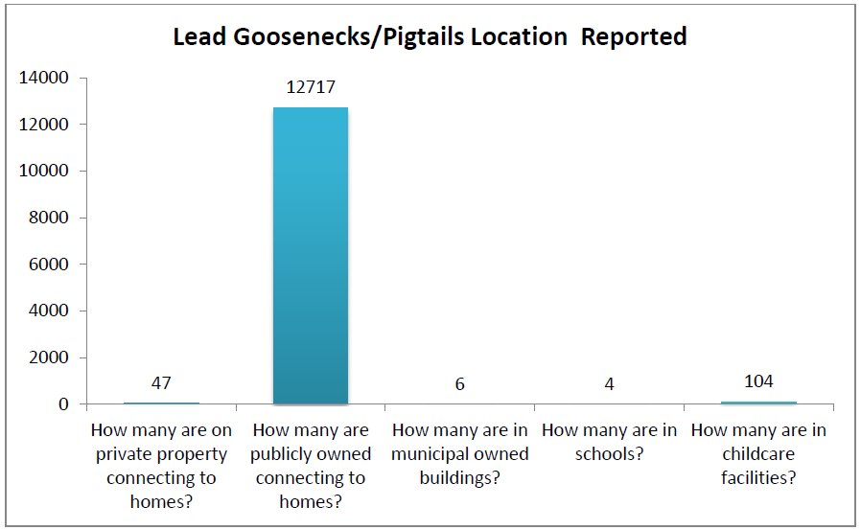
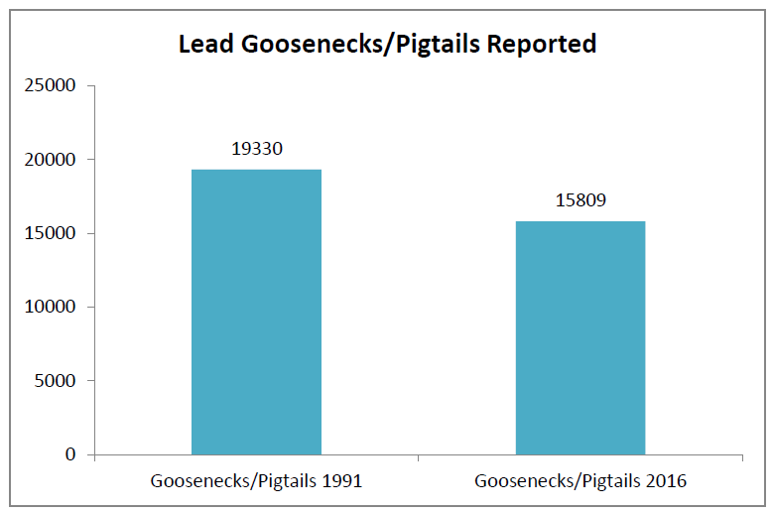
Lead & Copper Rule Survey
Goosenecks/Pigtails location No classified: 2,931

Slide 10
Lead & Copper Rule Survey

Slide 11
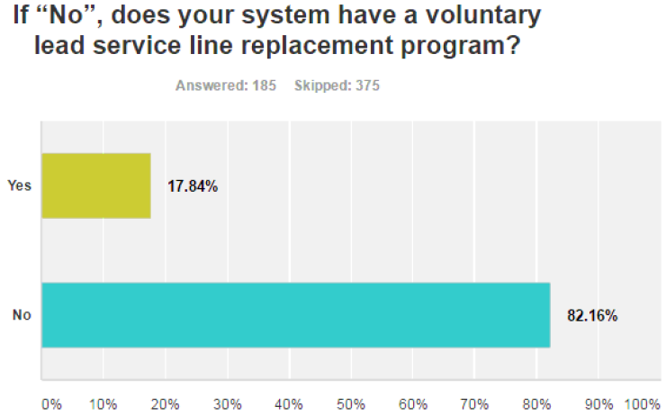
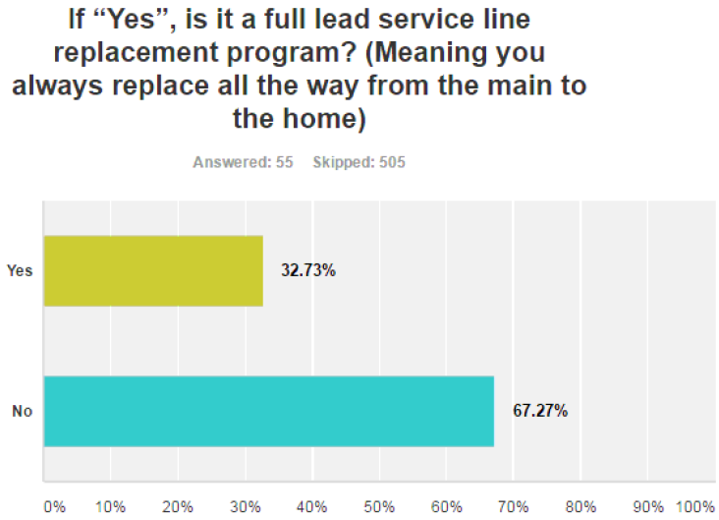
Lead & Copper Rule Survey

Slide 12
MATERIALS SURVEY WORKSHEET (MSWS)

Slide 13

Materials Survey Worksheet (MSWS)
All public water suppliers must complete a MSWS of their system to identify their pool of sample sites
MSWS must be completed before sampling for lead and copper- start early!
Every PWS must fill out a MSWS, but only need to submit it with the Sampling Plan when the sampling plan has sites other than Tier 1 sites
MSWS should be constantly updated (every sampling round) to ensure that the highest tier sites are included in the sampling plan
Keep track of MSWS changes over time; assign someone to this task
https://www.mass.gov/doc/identifying-sites-for-lead-and-copper-sampling-and-preparing-a-sampling-plan-and-materials
Slide provided by MassDEP LCR workgroup – Catherine Wanat, WERO

Slide 14

Gathering Information for MSWS
PWSs should survey all records documenting the materials used to construct and repair the distribution system and buildings connected to the distribution system
Service Line Tie-cards
Building Permits
Plumbing Codes and Permits
Distribution Maps and Drawings
Inspection and Maintenance Records
Meter Installation Records
Permit Files
Interviews with Senior Personnel, Building Inspectors, and Retirees
Slide provided by MassDEP LCR workgroup – Catherine Wanat, WERO

Slide 15
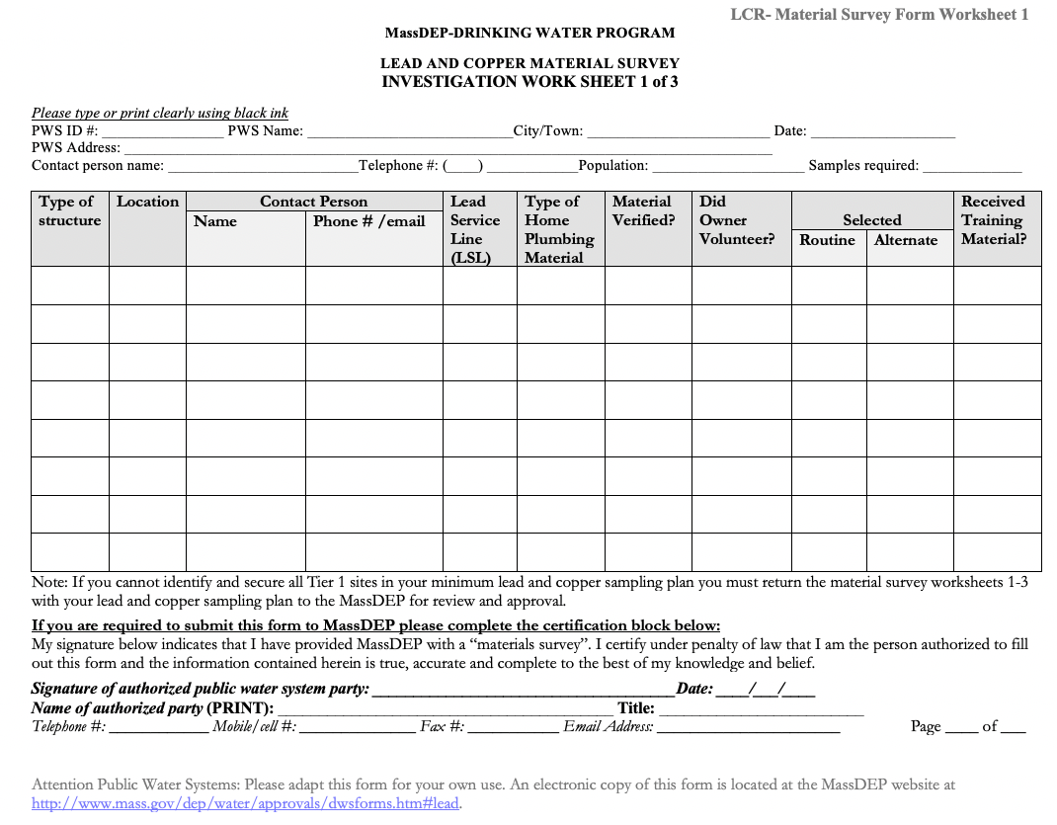
Slide provided by MassDEP LCR workgroup – Catherine Wanat, WERO

Slide 16
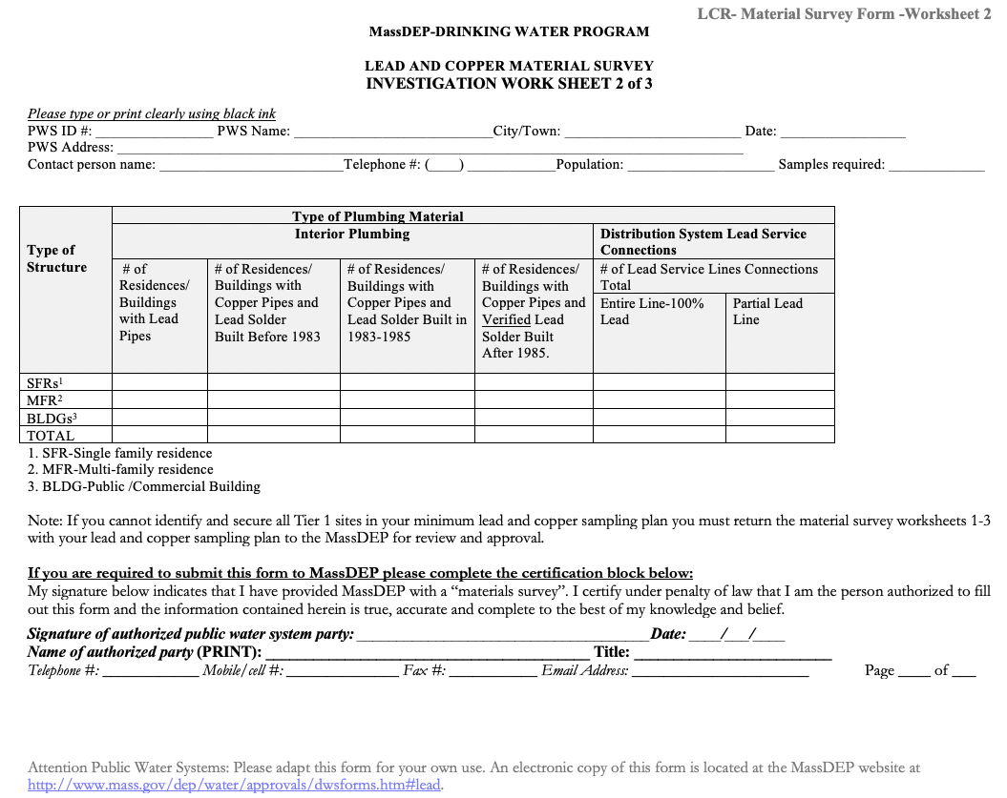
Slide provided by MassDEP LCR workgroup – Catherine Wanat, WERO

Slide 17
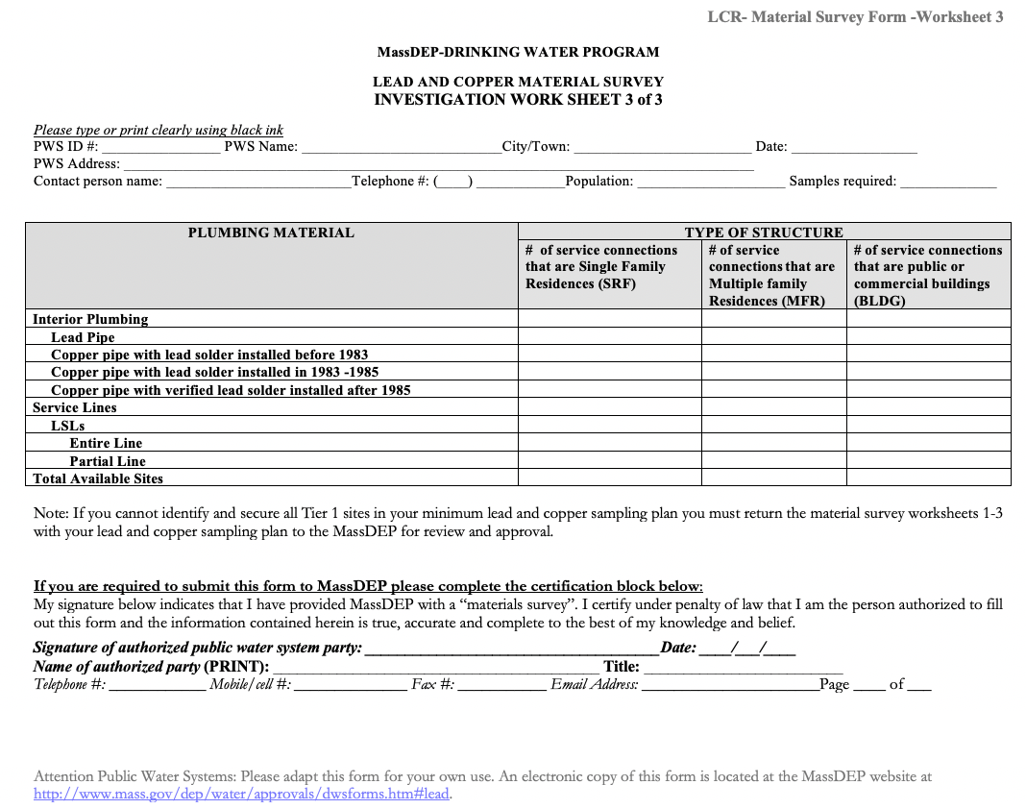
Slide provided by MassDEP LCR workgroup – Catherine Wanat, WERO

Slide 18



Common Mistakes Made on MSWS
TOTAL NUMBER OF SITES EQUAL TO THE NUMBER OF SAMPLES REQUIRED, RATHER THAN THE NUMBER OF SERVICE CONNECTIONS IN THE PWS DISTRIBUTION
putting all service connections on worksheet 1
no signature
Slide provided by MassDEP LCR workgroup – Catherine Wanat, WERO

Slide 19
PREPARING FOR THE
LCRR LSL INVENTORY
DATA COLLECTION

Slide 20
PWSs Meetings Results
PHASE 01
Customer LSL verification is the greatest barrier to develop LSL inventories

Slide 21
What Information Should be Included in the Inventory?
Site Id | Locational Identifier | Connector (Gooseneck / Pigtail) Material | Connector (Gooseneck / Pigtail) Currently Present? | Current Public Service Line Material | Was Public Service Line Material Ever Previously Lead? | Public Service Line Size (length/ diameter) | Public Service Line Install Date | Current Private Service Line Material | Private Service Line Size (length/ diameter) | Private Service Line Install Date | Building Type | Point-of-entry Or Point-of-use Treatment Present? | Building Plumbing Material 1 | Building Plumbing Material 2 | Building Plumbing Material Install Date | Part of LCR Sampling Plan?
LC00XX Used for LCR Sampling Plan | ADDRESS/BLOCK | L LEAD C COPPER B BRASS S STEAL P PLASTIC O OTHER - DOES NOT CONTAIN LEAD OR LEAD SOLDER UNK UNKNOWN | YES - KNOWN WITH CERTAINTY NO - KNOWN WITH CERTAINTY UNK - NOT KNOWN WITH CERTAINTY | L CONFIRMED LEAD C CONFIRMED COPPER G CONFIRMED GALVANIZED P PLASTIC DI DUCTILE IRON CI- L LINED CAST IRON CI-U UNLINED CAST IRON UNK-LG UNKNOWN - MAY CONTAIN LEAD AND/OR GALVANIZED UNK-NOLG UNKNOWN - DEFINITELY DOES NOT CONTAIN LEAD OR GALVANIZED | YES NO UNK |  | YYYY | L C G P DI CI-L CI-U UNK-LG UNK-NOLG |  | YYYY | SF SINGLE-FAMILY MF MULTI-FAMILY SCH/CC SCHOOL/CHILD CARE RES/CC RESIDENTIAL & IN-HOME CHILD CARE NONRES NONRESIDENTIAL, NON-SCHOOL, NON-CHILD CARE MIX MIXED RESIDENTIAL & NONRESIDENTIAL O OTHER | YES NO UNK | L LEAD C COPPER CLS COPPER W/LEAD SOLDER O OTHER - DOES NOT CONTAIN LEAD OR LEAD SOLDER UNK UNKNOWN | L C CLS O UNK | YYYY | ROUTINE ALTERNATE N/A NOT APPLICABLE
3/8”
1/2"
5/8"
3/4"
1"
1 1/4"
1 1/2"
1 3/4"
2"
3"
4"
6"
8"
10"
12"
14"
16"
O=Other
3/8”
1/2"
5/8"
3/4"
1"
1 1/4"
1 1/2"
1 3/4"
2"
3"
4"
6"
8"
10"
12"
14"
16"
O=Other

Slide 22
Proposed Solution to accelerate LSL inventories
Allow consumers to report their service line materials for PWS follow up verification
How?
Develop an application for consumer reporting and launch social media outreach and education campaign

Slide 23
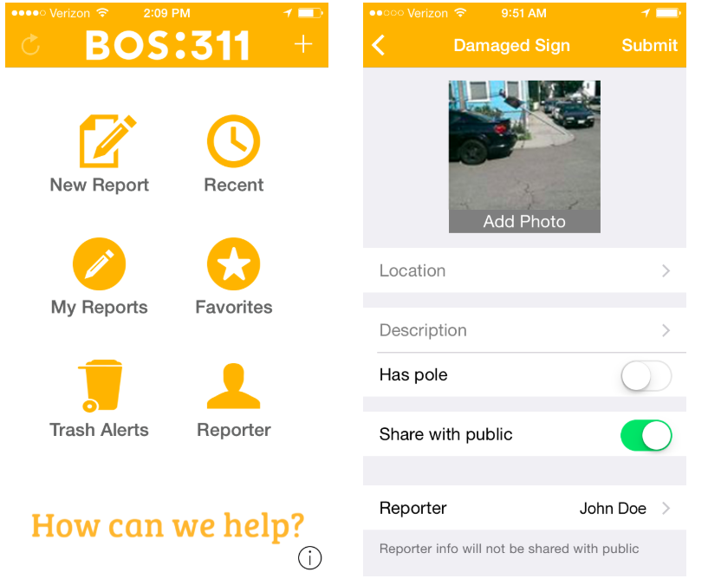
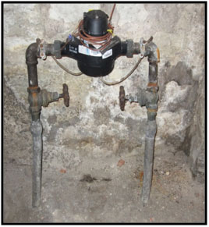






Propose Solution Development
LEAD BE GONE
Water Service Line Material
Learn to identify lead service lines
Report service line material
Add photo
Location
Favorites
Select your Public Water Supplier
My Reports
Description
Questions?
Reporter
Links of interest
My contacts
SUBMIT

Slide 24
GRANTS…

Slide 25
Boston Water and Sewer Commission
Robert Orthman

Slide 26
BWSC Lead Inventory Steps (Short Version)
Key Steps
  Created Lead Team of relevant internal department leaders
  Reviewed all available data BWSC already had
    Customer service records
    Site plan and permitting
    Meter replacements or repairs
    Departmental construction and operations records
    Historical records, cards, plans, etc
  Determined needs in field
    Trained personnel to conduct scratch tests in homes
    Put out new contracts for investigations in public way
Overall Takeaway – very time-intensive process; requires good coordination across departments, BEGIN EARLY!

Slide 27
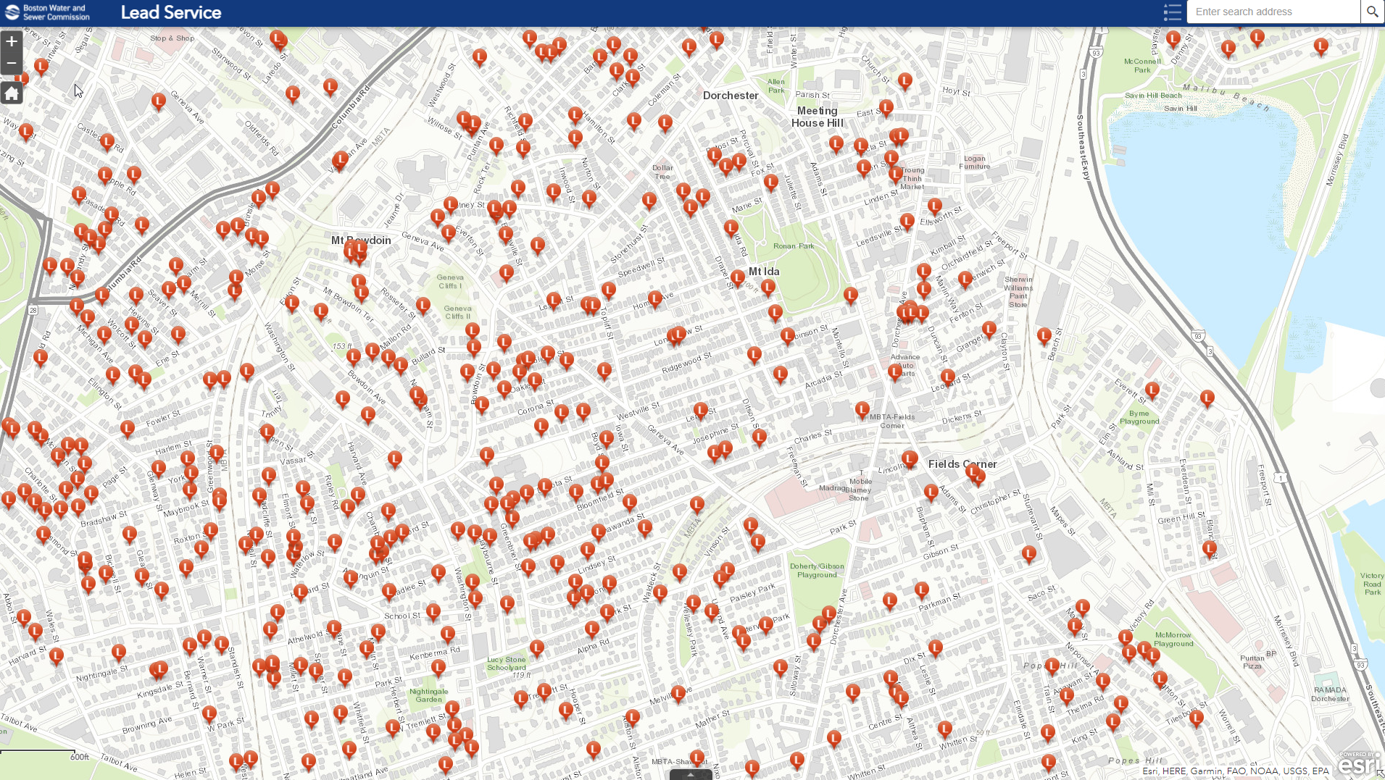

Slide 28
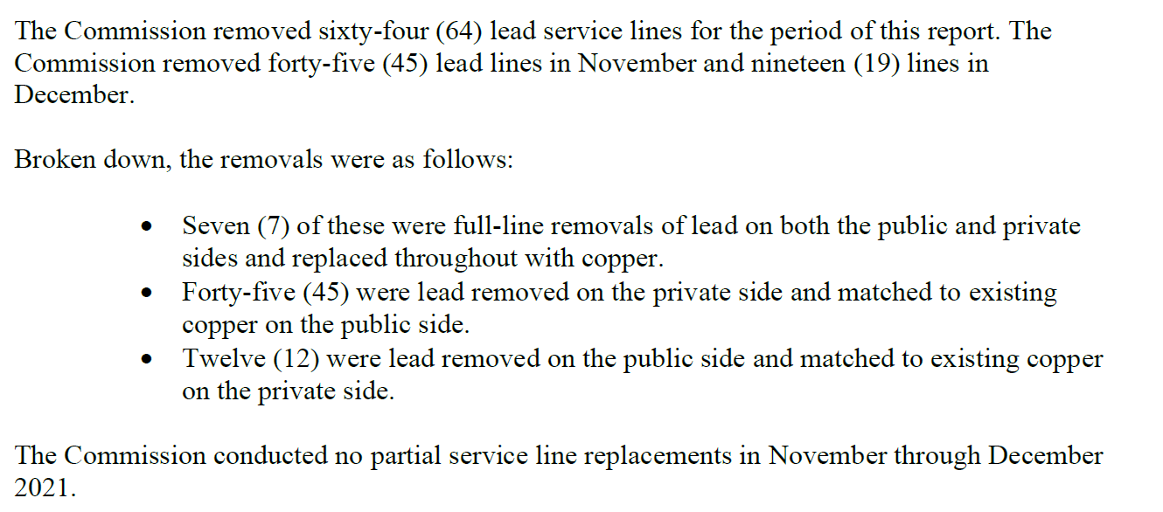
Example of Reporting to State Regulator (MassDEP)

Slide 29
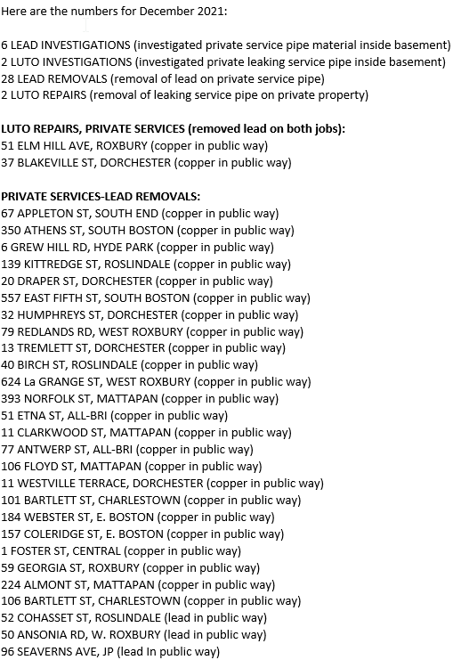
Monthly Internal Updates Emails to All
Relevant Departments and Staff

Slide 31
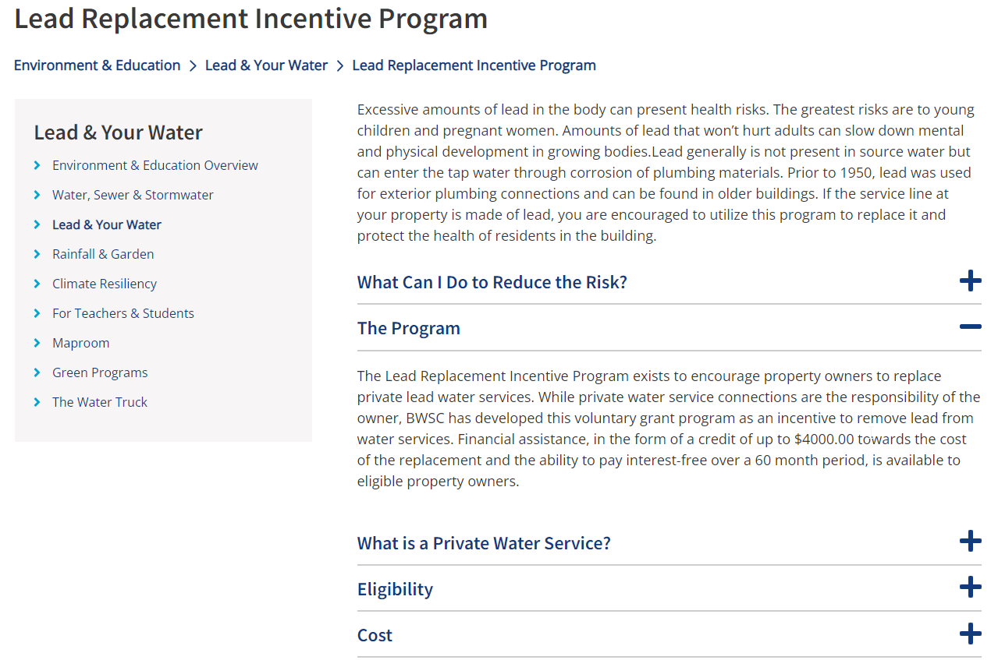

Slide 32
Robert Orthman
Senior Assistant General Counsel
orthmanr@bwsc.org
www.bwsc.org

Slide 33

Wisconsin Department of Natural Resources
Ann Hirekatur

Slide 34
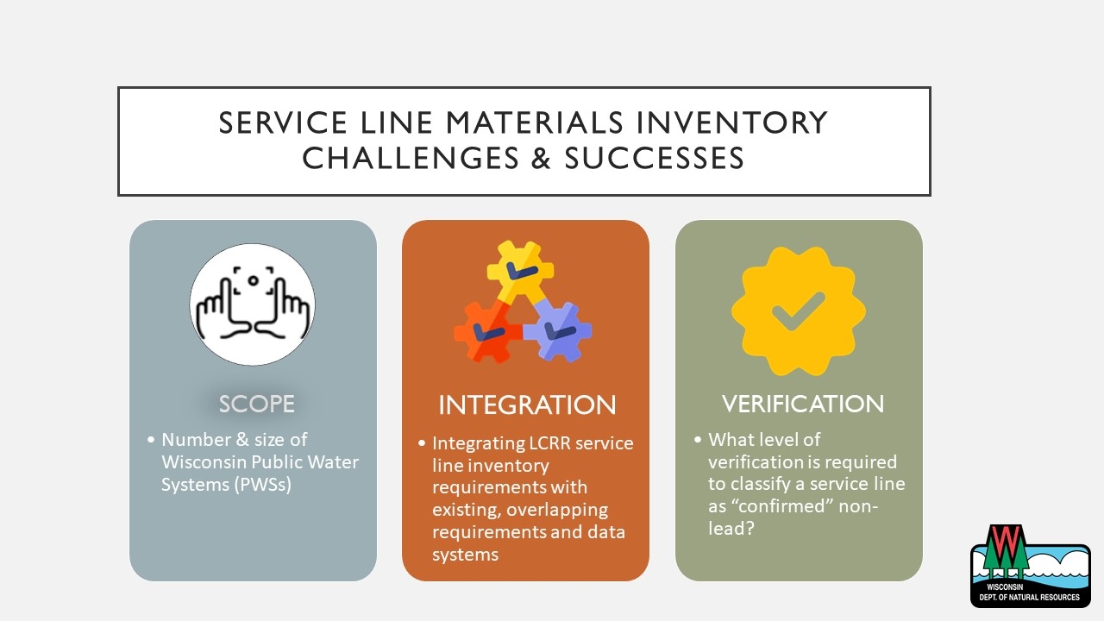

Slide 35
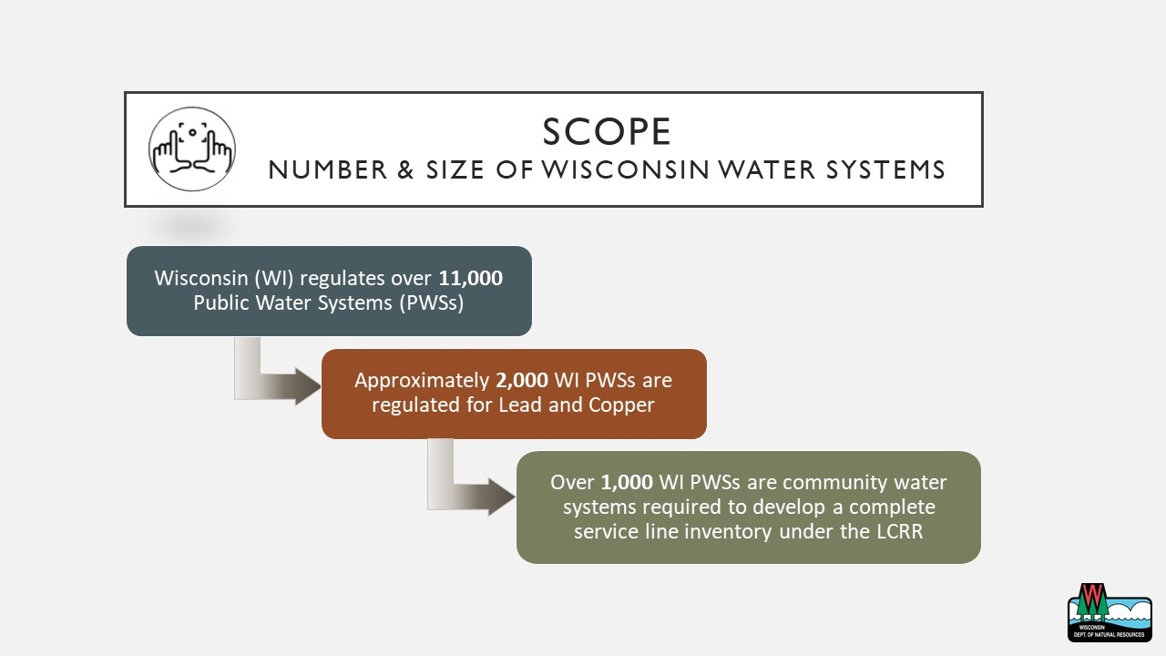

Slide 36
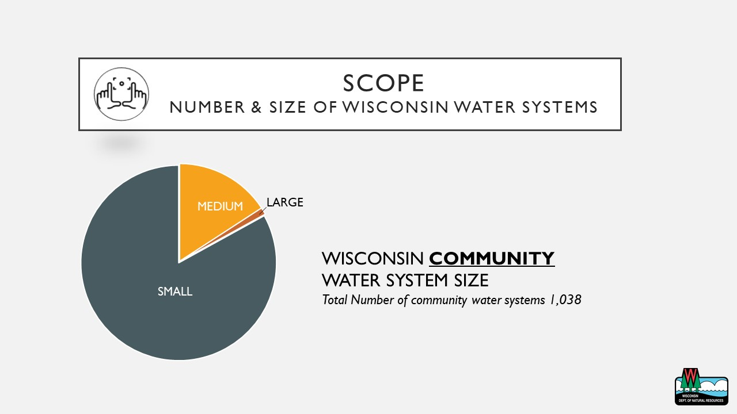

Slide 37
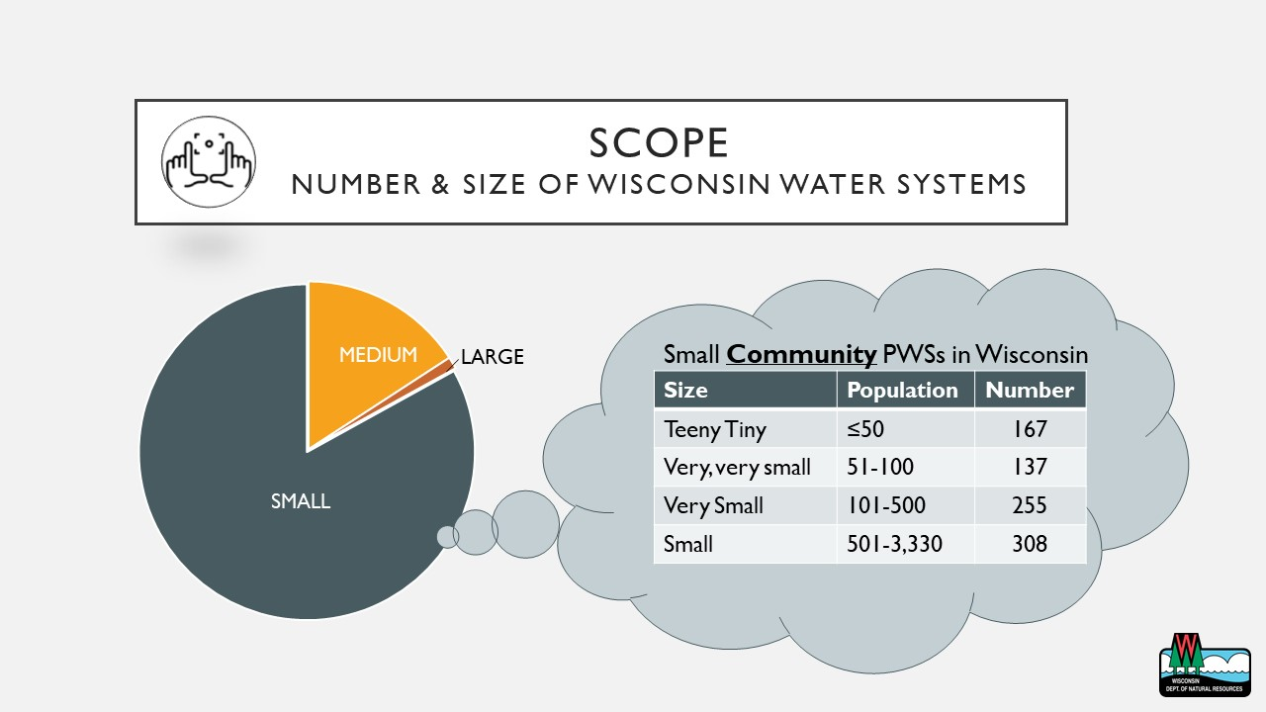

Slide 38


Slide 39
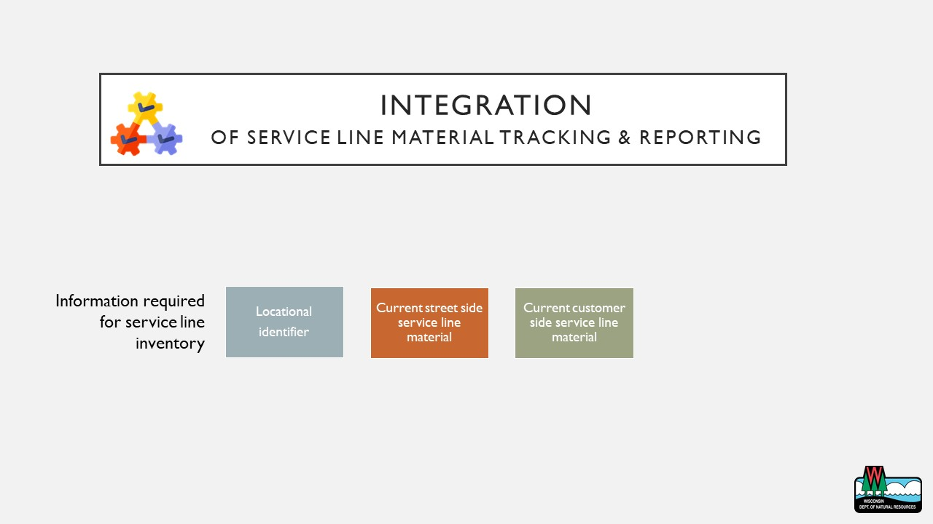

Slide 40
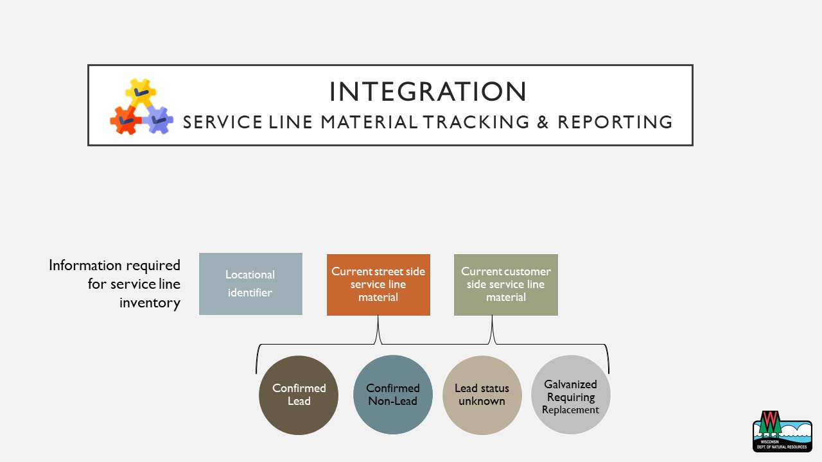

Slide 41
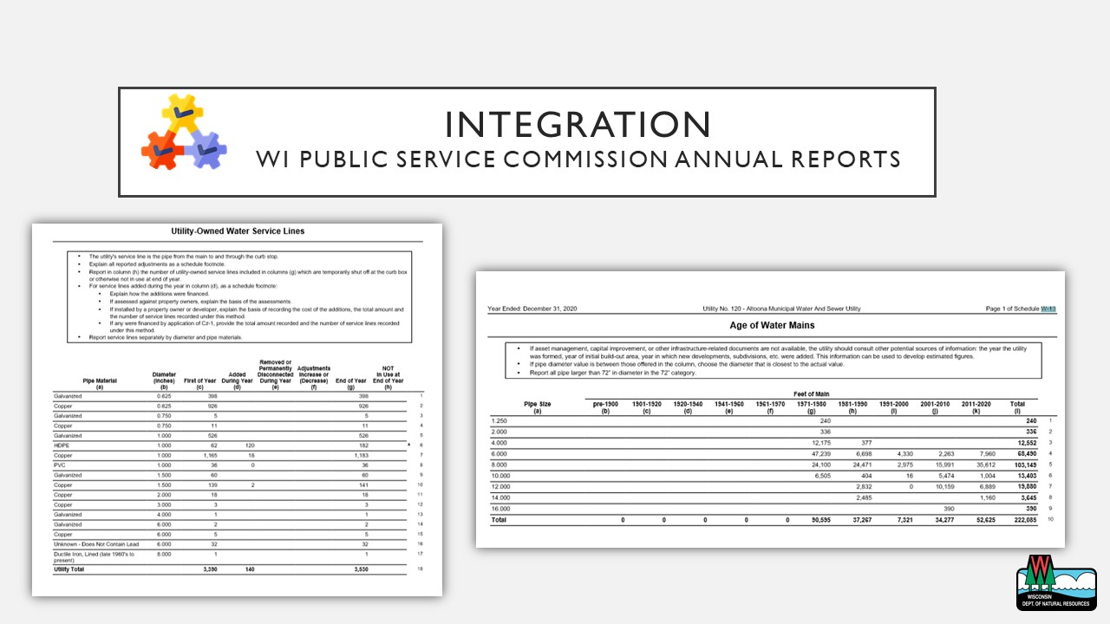

Slide 42
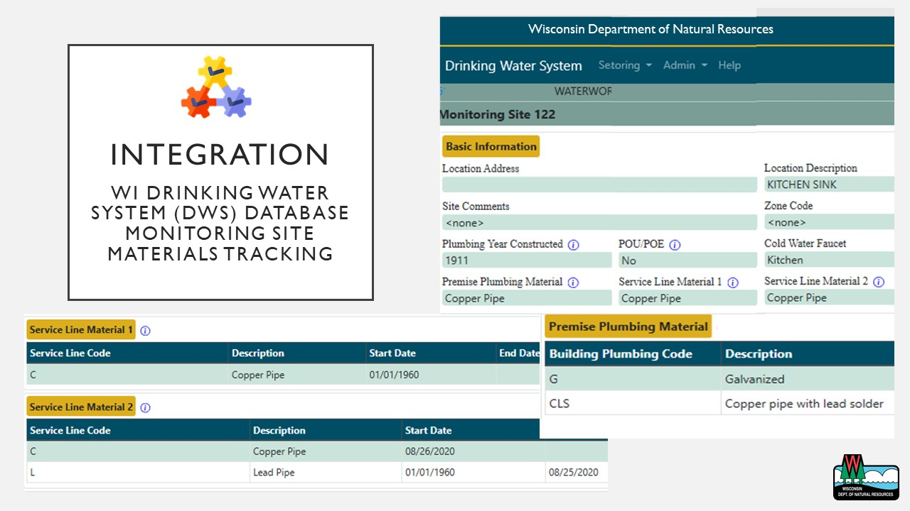

Slide 43
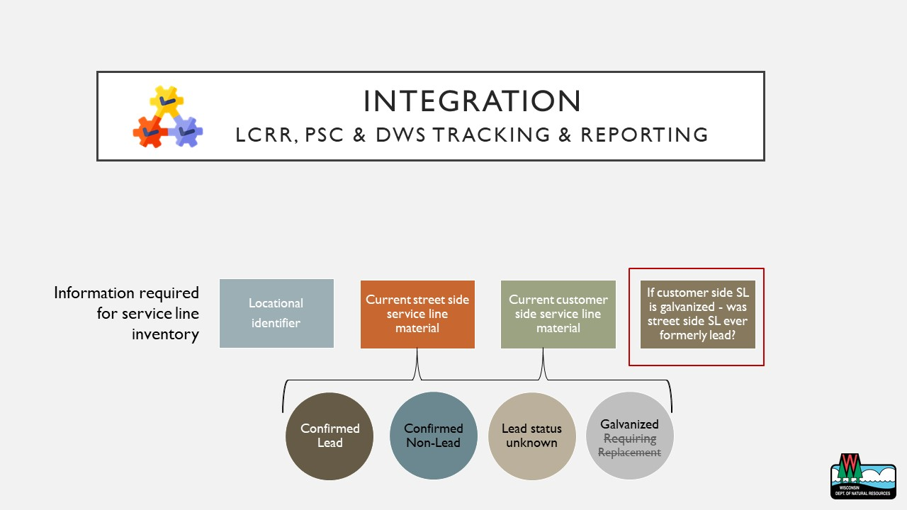

Slide 44
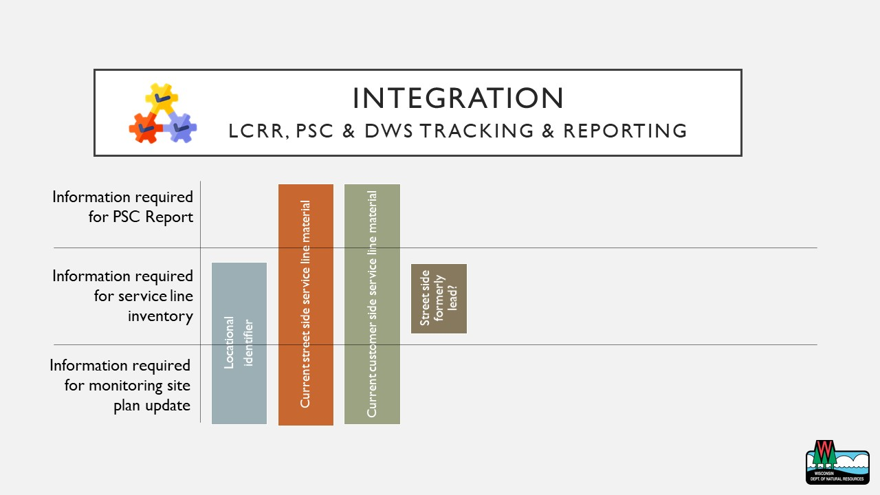

Slide 45
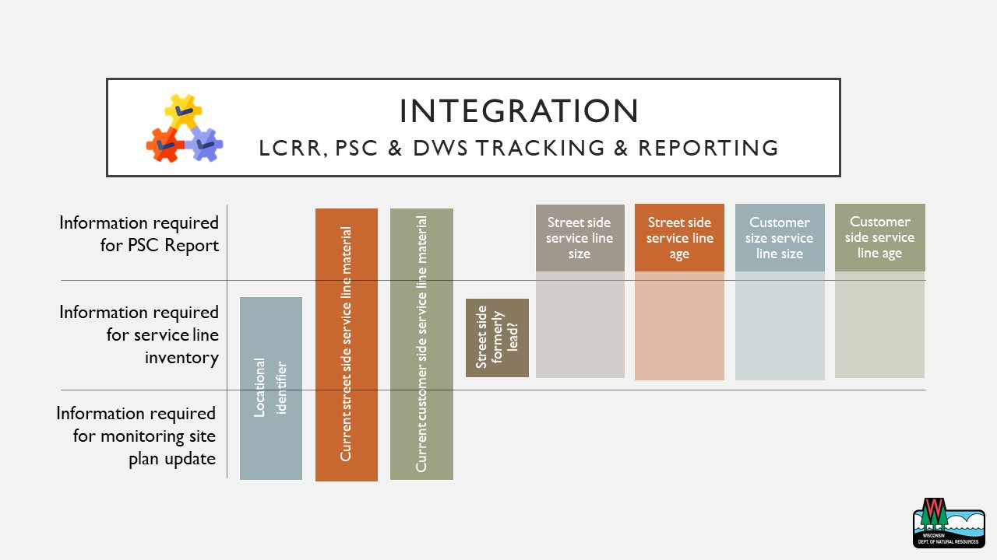

Slide 46
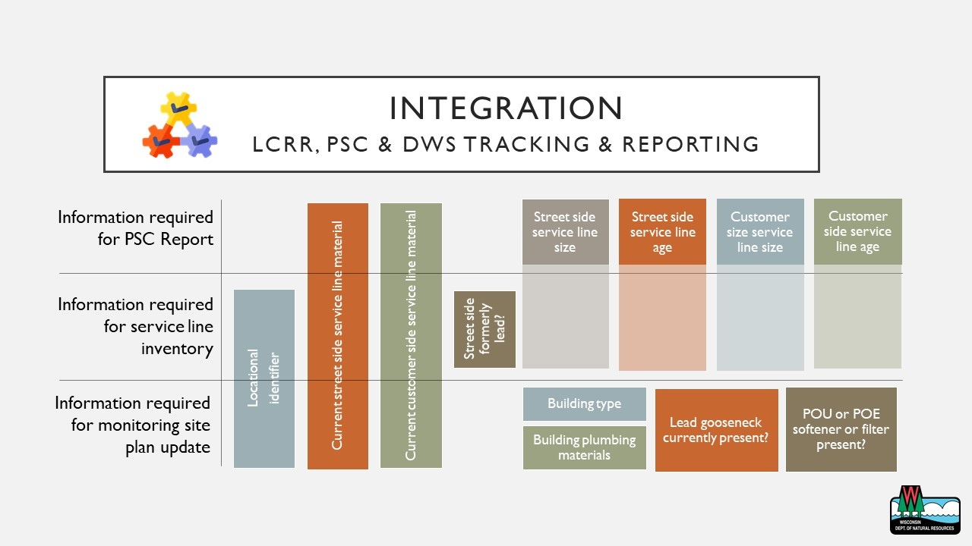

Slide 47
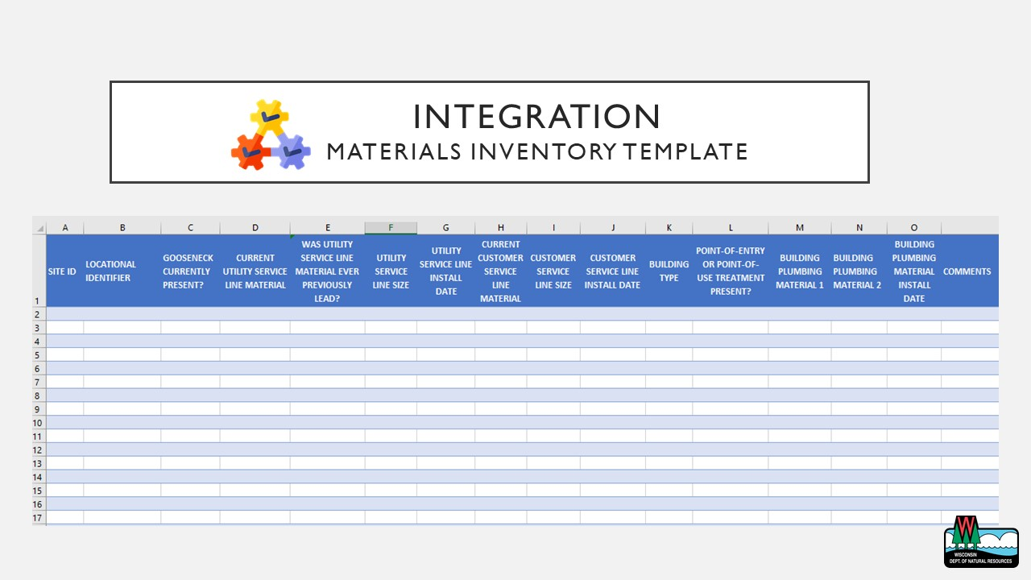

Slide 48
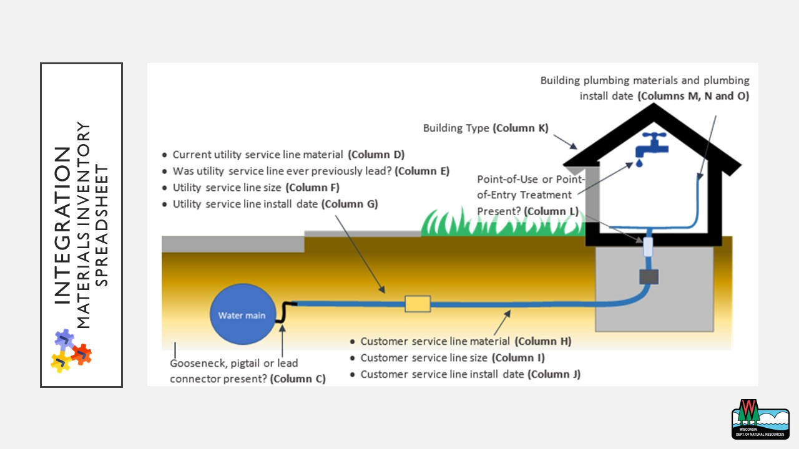

Slide 49
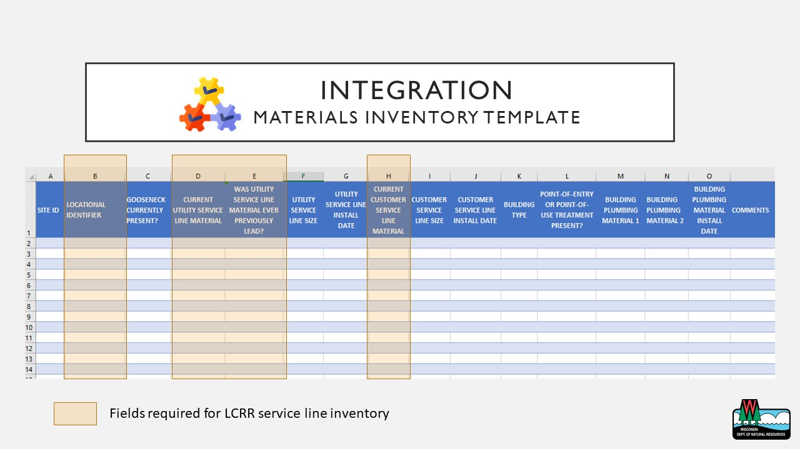

Slide 50
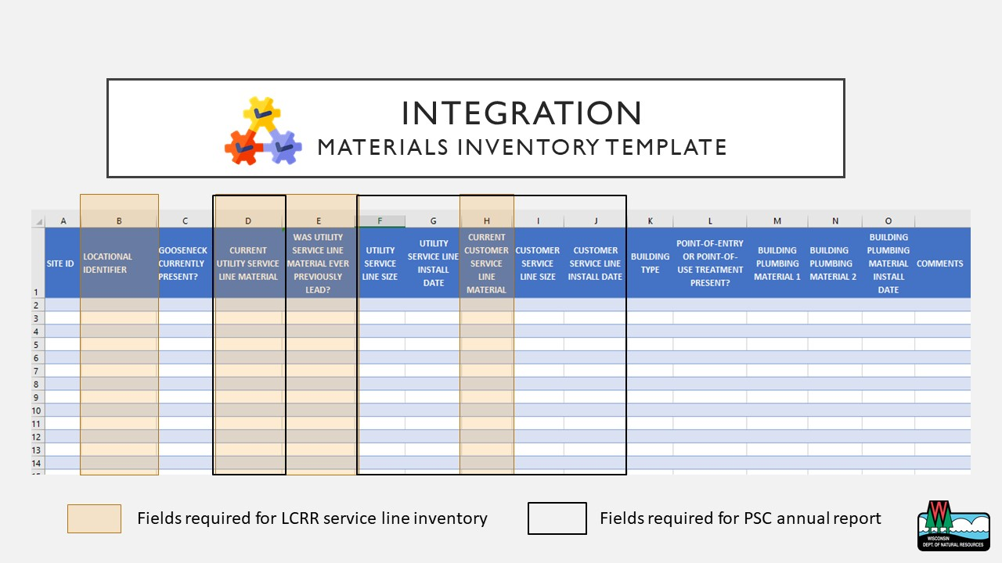

Slide 51
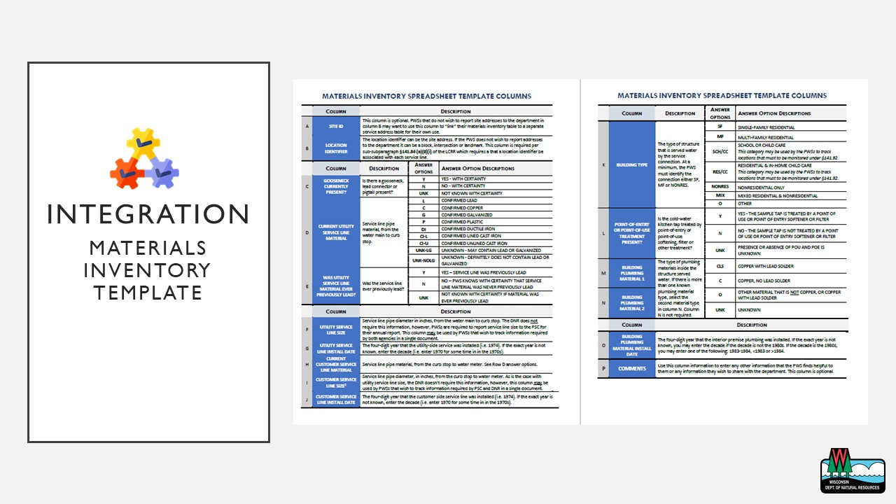

Slide 52
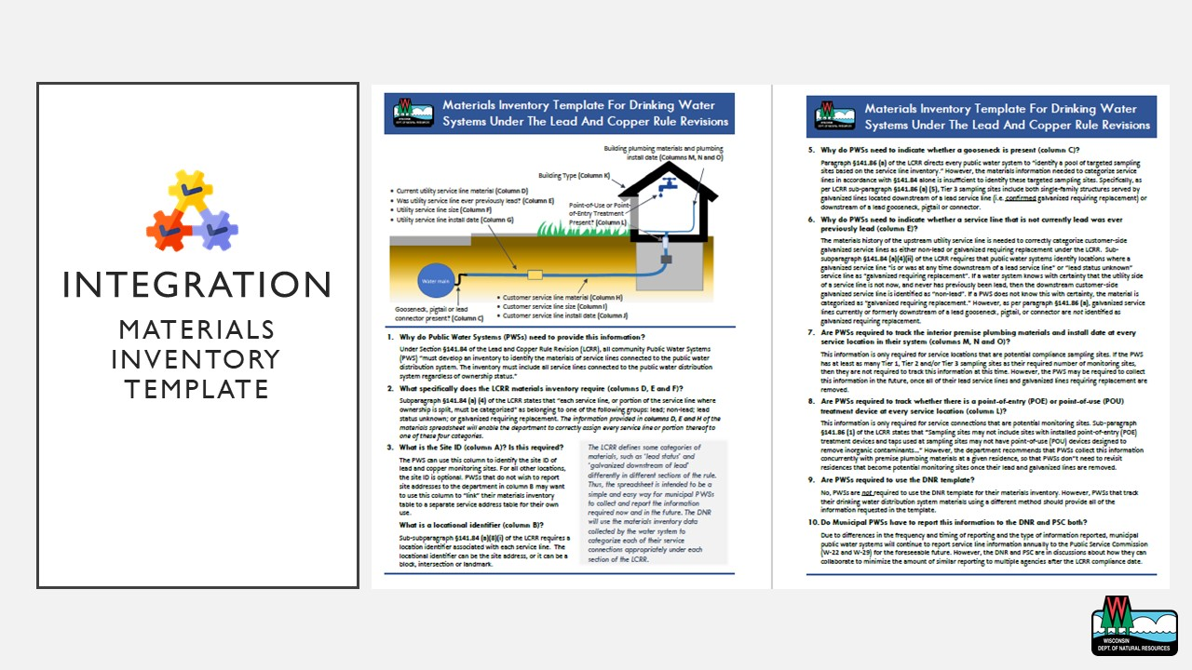

Slide 53
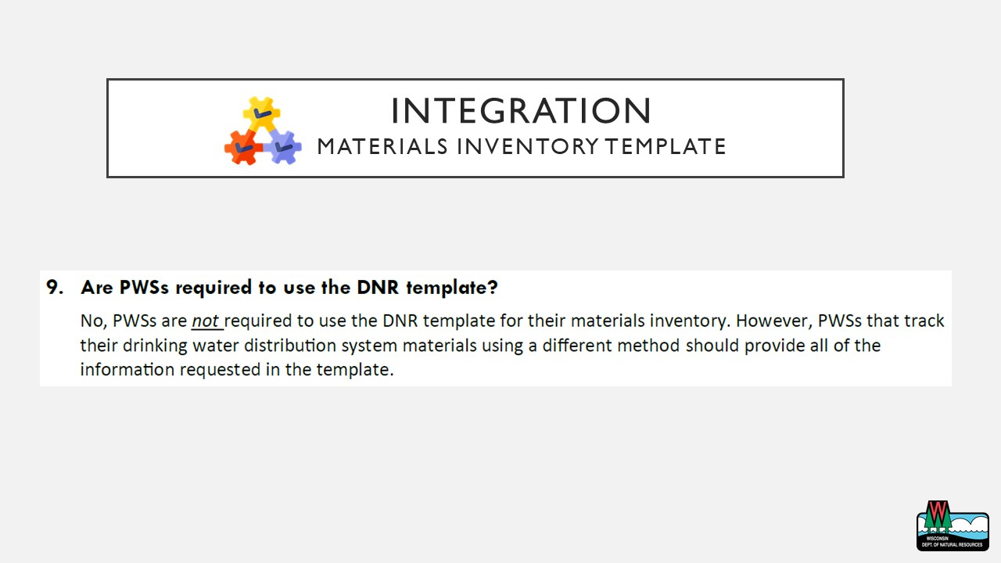

Slide 55
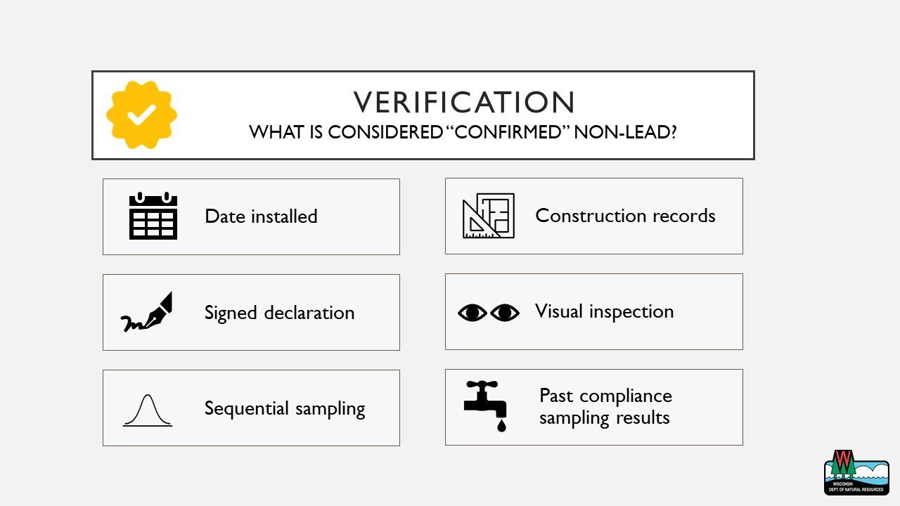

Slide 56

Allouez Waterworks
Mike Mahloch

Slide 57

Indiana Department of Environmental Management
Hayden King

Slide 58

City of Bloomington
Tyler Steury and Vic Kelson
James Hall (Q&A)

Slide 60
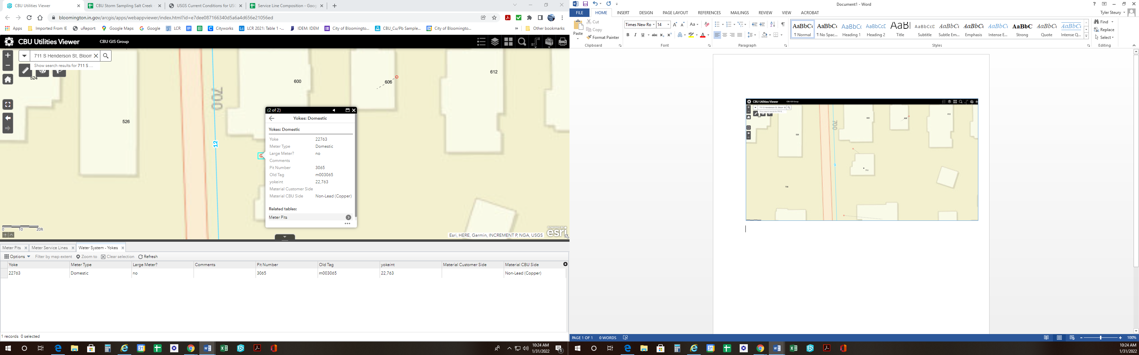

Slide 61
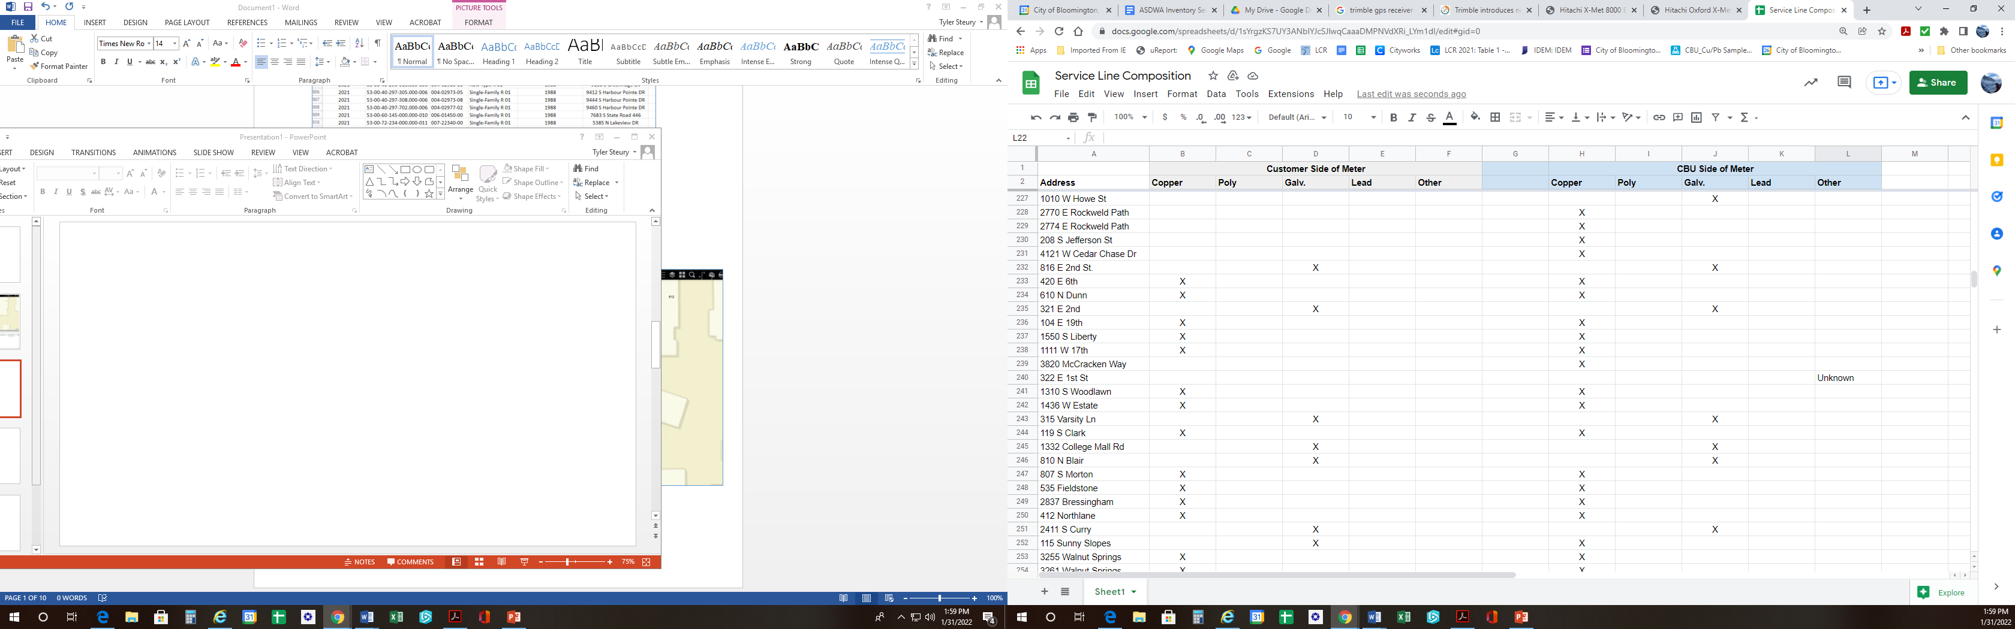

Slide 62
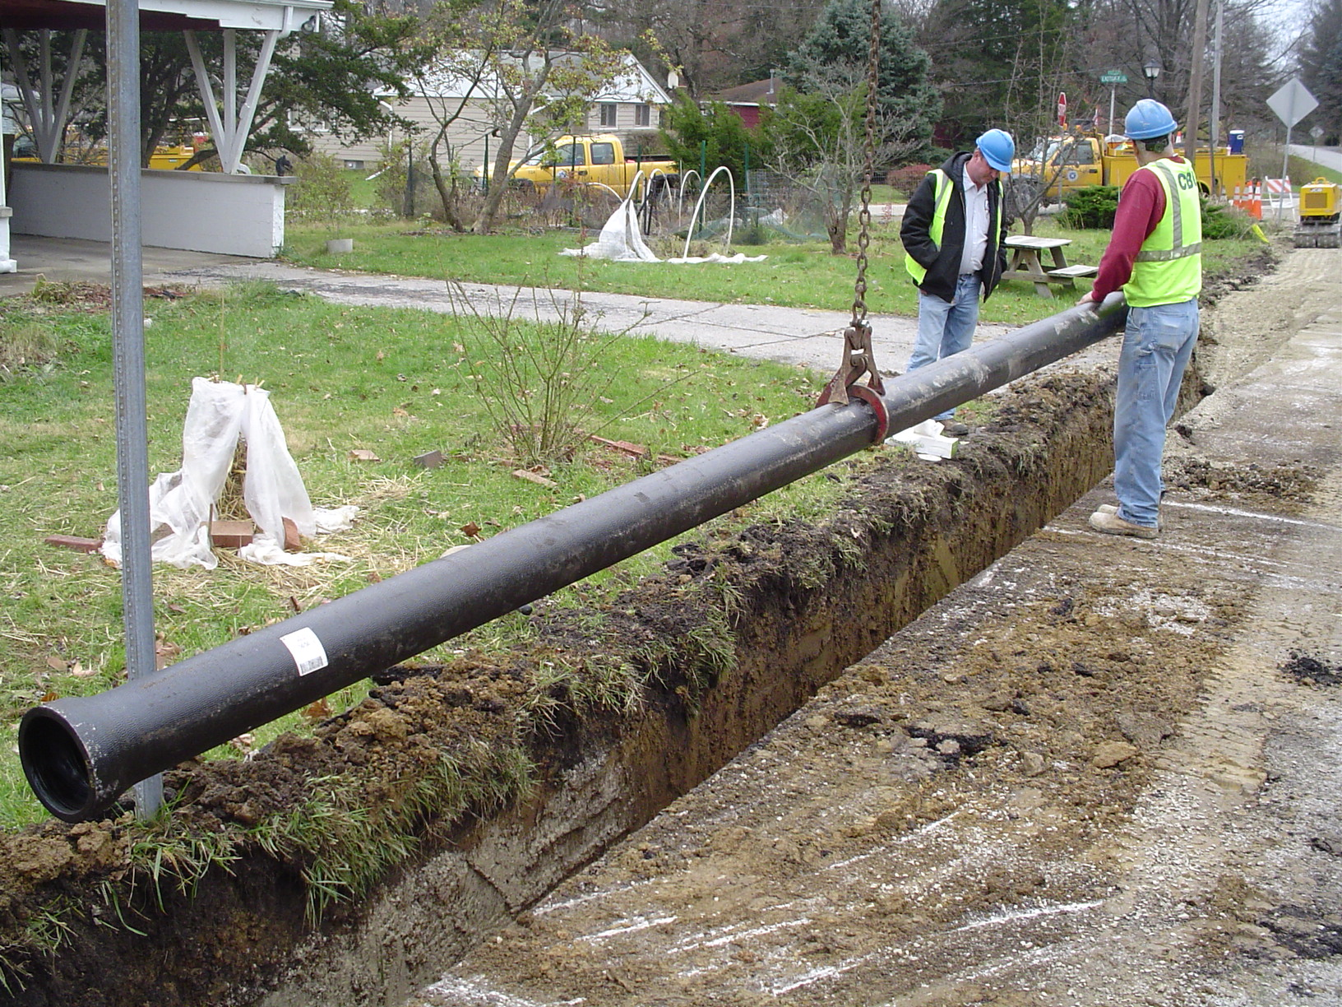

Slide 63
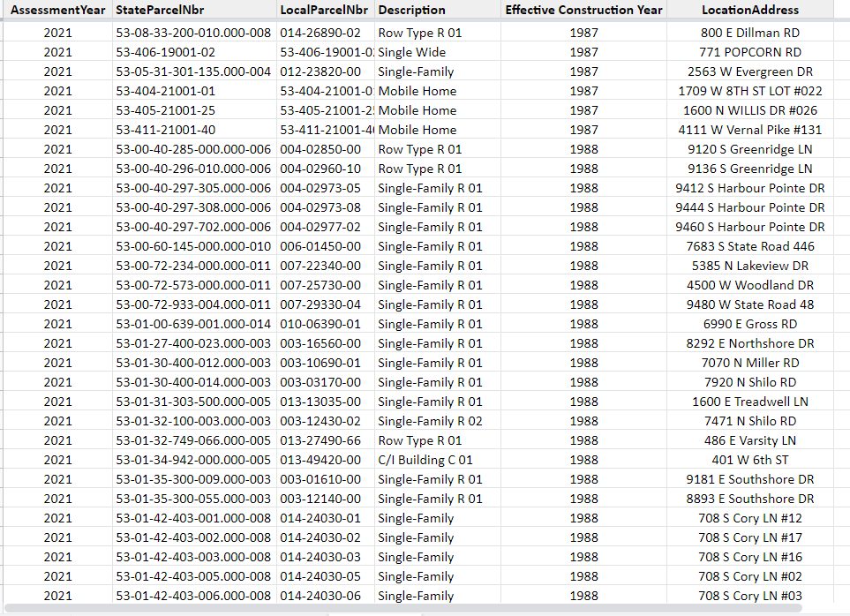

Slide 64
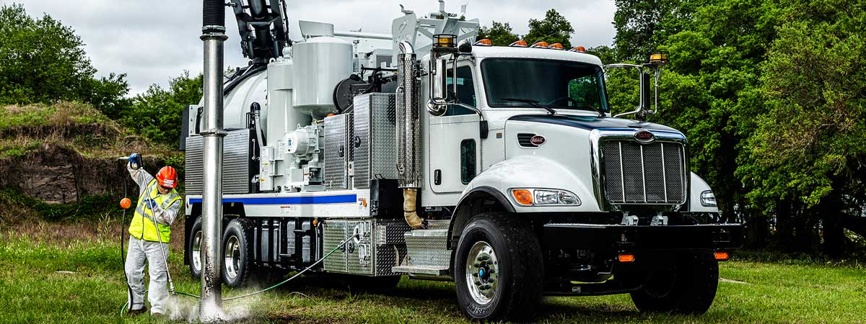

Slide 65
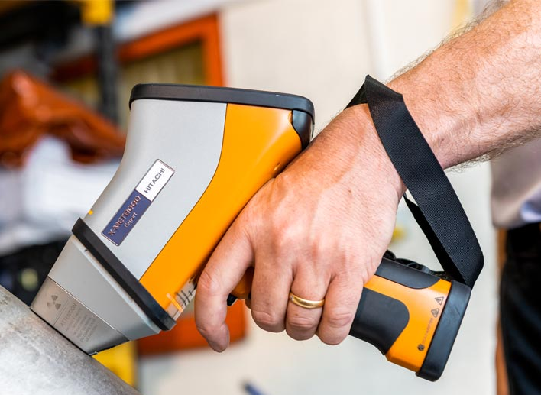


Slide 66

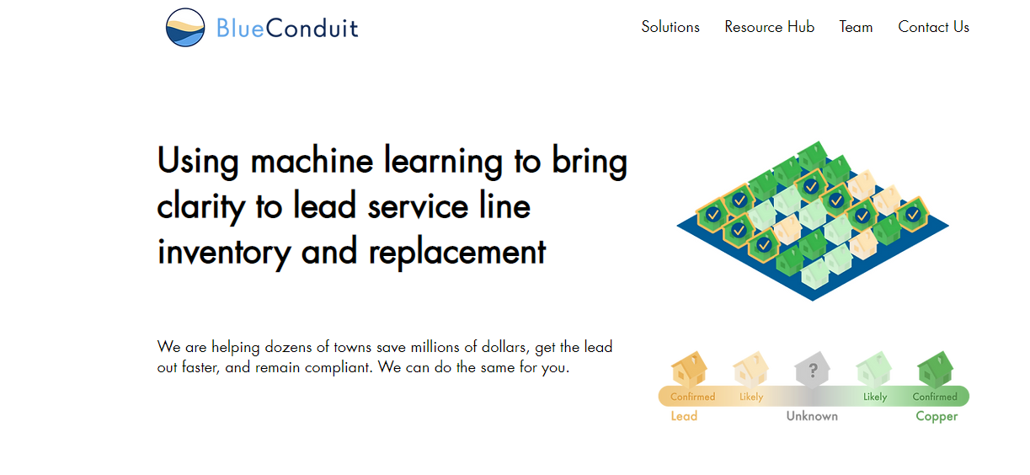

Slide 67

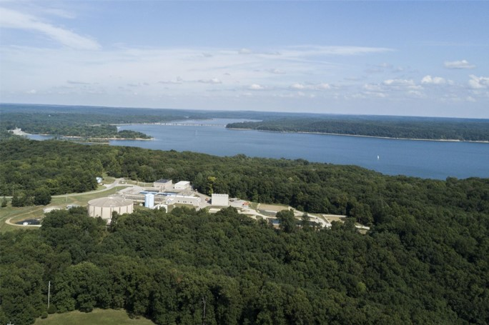

Slide 68

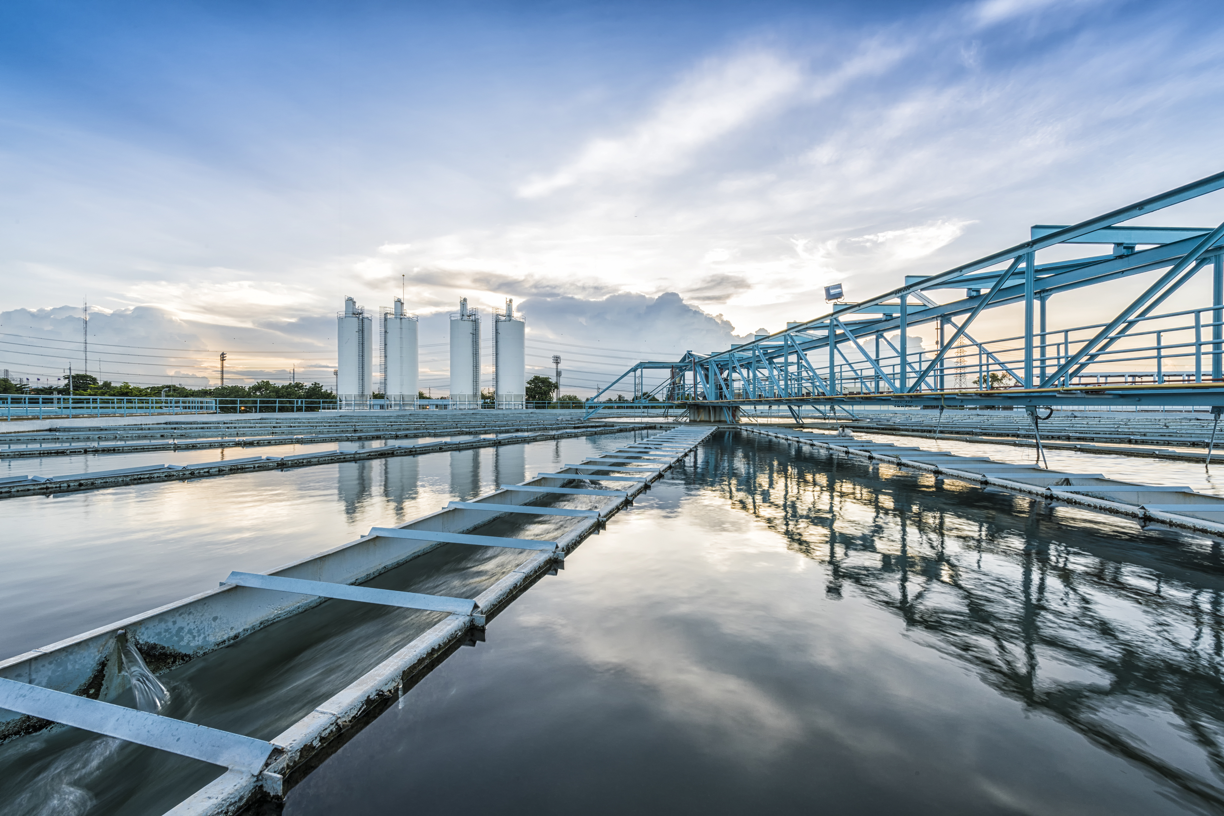

QUESTIONS?

Slide 69
Join us for our next session!
Morning Webinars
11:00 AM-12:30 PM EST
Afternoon Webinars
3:00 PM-4:30 PM EST
All Webinars Will Be
Archived on ASDWA’s
Website
Wednesday, February 2
Wednesday, February 9
Wednesday, February 16
Session 1: Overview of LCRR
Session 2: Notes from the Field: State and Utility Experiences with Existing LSL Inventory Rules
Session 3: Capitalizing in Innovations for LSL Inventories
Session 4: Small Systems, Big Challenges: Implementing LSL Inventories and Replacements at Small Systems
Session 5: Water System Inventory Case Studies
Session 6: Show Me the Money: Funding for LSL Inventories and Replacement
Wednesday, February 23
Session 7: The Other Side of the Meter: Practical Tools for Collecting Private-Side Service Line Material
Session 8: Tell Me About It: Mapping and Communicating your LSL Inventory and Replacements
Wednesday, March 2
States-only debrief (3:00-4:30 EST)

