Slide 1
Welcome to the Association of State Drinking Water Administrator’s Lead Service Line Inventory Symposium

Slide 2
Lead Service Line Inventory Symposium Session 4 – Small Systems, Big Challenges: Implementing LSL Inventories and Replacements at Small Systems
Stephanie Schlea
Senior Water Policy Advisor

Slide 3
Housekeeping Items
Please note that ASDWA is unable to offer CEUs or completion certificates for this symposium.
ASDWA will not be able to provide technical support for GoToWebinar during the session. If you have issues with a lagging video or sound, please check your broadband connection. We recommend closing all other applications to maximize your bandwidth.
All sessions will be recorded and will be available later on ASDWA’s website should you have connection issues or if you miss a session.
Each session will include at least 30 minutes for question and answers, so please type your questions into the chat box and we will bring those up in the discussion portion.

Slide 4
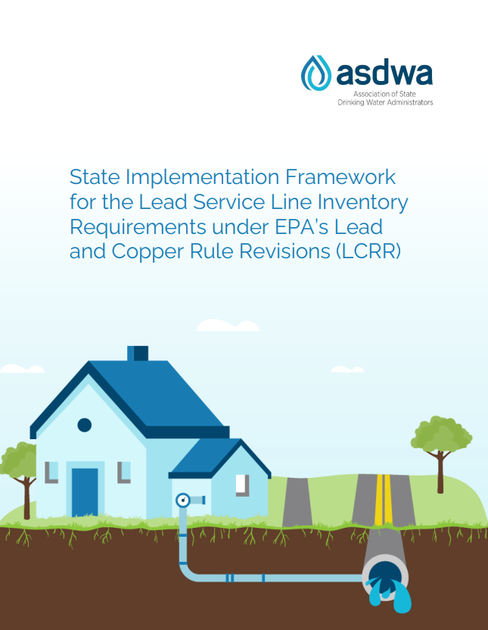
Now available for download on our website:
ASDWA’s LSL Inventory Framework
LSL Inventory Template
www.asdwa.org/lead-and-copper-rule-lcr/

Slide 5
SYMPOSIUM OVERVIEW Morning Webinars 11:00 AM-12:30 PM EST Afternoon Webinars 3:00 PM-4:30 PM EST Recordings and slide decks will be available on the event page: www.asdwa.org/event/lead-service-line-inventory-symposium/
Wednesday, February 2
Wednesday, February 9
Wednesday, February 16
Session 1: Overview of LCRR
Session 2: Notes from the Field: State and Utility Experiences with Existing LSL Inventory Rules
Session 3: Capitalizing in Innovations for LSL Inventories
Session 4: Small Systems, Big Challenges: Implementing LSL Inventories and Replacements at Small Systems
Session 5: Water System Inventory Case Studies
Session 6: Show Me the Money: Funding for LSL Inventories and Replacement
Wednesday, February 23
Session 7: The Other Side of the Meter: Practical Tools for Collecting Private-Side Service Line Material
Session 8: Tell Me About It: Mapping and Communicating your LSL Inventory and Replacements
Wednesday, March 2
States-only debrief (3:00-4:30 EST)

Slide 6
WHAT THIS SYMPOSIUM…
IS
IS NOT
A starting point for the drinking water community to begin developing inventories
An introduction to adaptive management
Shared experiences from states and water systems
Discover opportunities to further the discussion on inventories
About EPA’s inventory guidance
The final word on inventories or specific inventory requirements
Questions will remain for how states should/will implement rule
A forum for answering every possible question about inventories
Not planning to develop a set of FAQS
Not planning to answer state-specific questions
A forum to debate LCRR or LCRI

Slide 7
Session 4 Speakers
Jeff Oxenford, Rural Community Assistance Partnership
Ted Stiger, Rural Community Assistance Partnership
Matt Holmes, National Rural Water Association
Tim Neumann, Michigan Rural Water Association
Mark Stasyszen, Oklahoma Department of Environmental Quality
Cathy Tucker-Vogel, Kansas Department of Health and Environment

Slide 8
Guiding rural communities to get the lead out
Jeff Oxenford
Director of Training and Technical Services
joxenford@rcap.org

Slide 10
Who we serve (FY 2020)
$3.4 M rural residents
1.1 M people of color
300,000 tribal members
40% of persistent poverty counties
Average population of communities served
Average Median Household Income of communities served

Slide 11
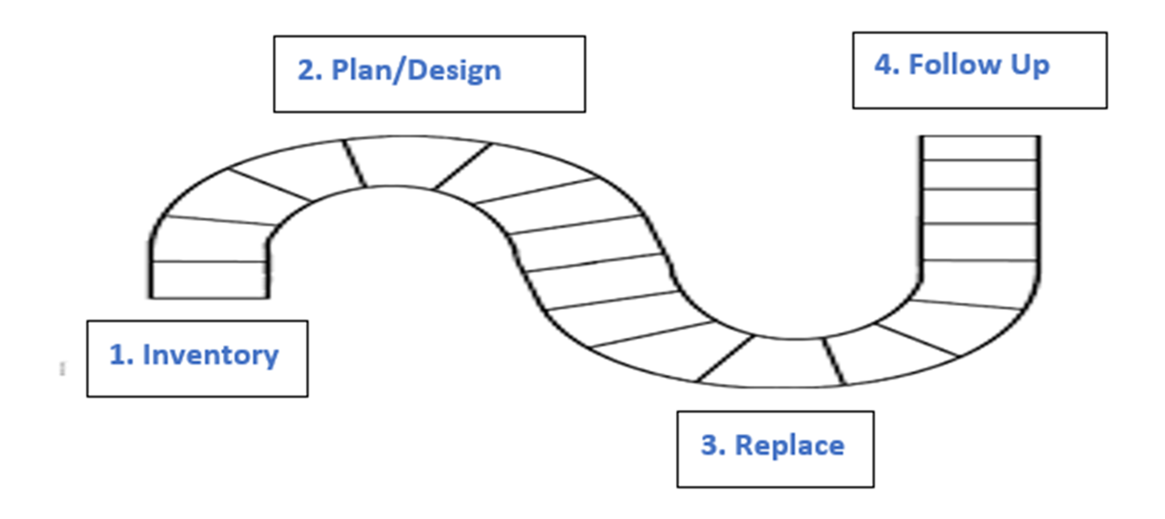

Slide 12
Getting ready
Roadmap
Communication
Funding
Long-term

Slide 13
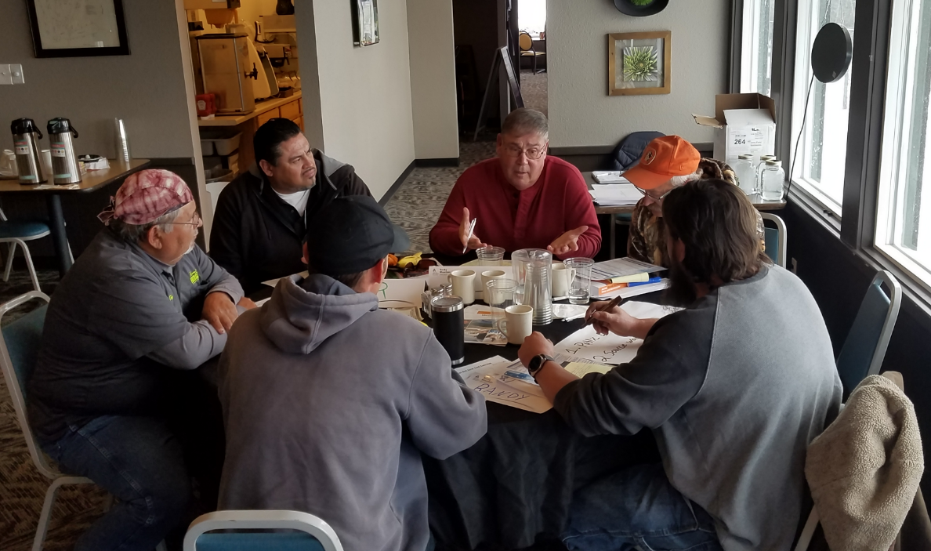
Getting Ready
Developing the roadmap
Training – System and Boards
Facilitate kick-off meetings
Obtain funding
Access funding, completing loan/grant applications
Communications/ engagement
Communication to the public and elected/appointed officials
Liaison between the utility, community, primacy, funders

Slide 14
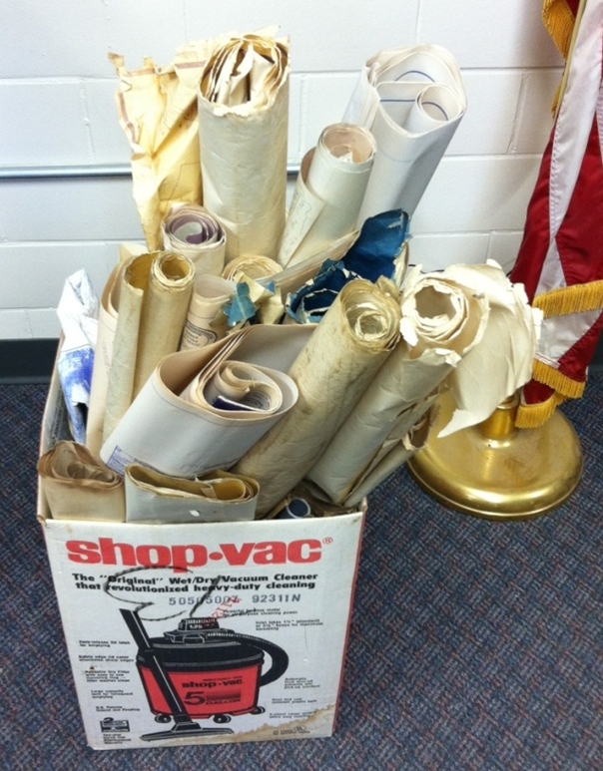
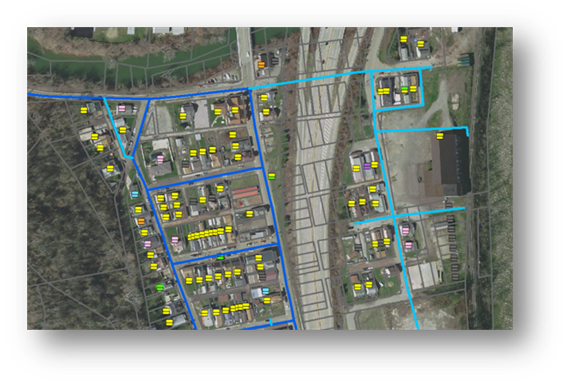
Inventory
Inventory
Guide communities through the inventory process
Finding records and other data
Field inspections, etc.
GIS mapping of service lines

Slide 15
Replacement Planning
Develop lead replacement plans
Communicate the plan
Training to officials on the life cycle of a project & project management
Getting residents and businesses ready for replacement stage
Policies/procedures
Bid specifications/ Supporting procurement
Passing needed ordinances and policy changes
Addressing liability issues
Regionalization options?

Slide 16
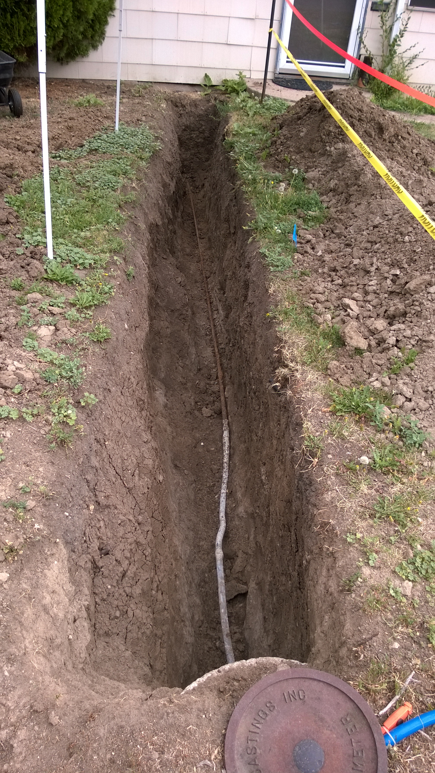
Replacement
Access funding for replacement
Communication - What to expect during and after replacement
Working with contractors
Project management
Identifying qualified contractors
Construction oversight & post-construction inspection
Keeping costs under control
Post replacement procedures
Reporting
Primacy, funders, community

Slide 17
Follow-up
Design post-replacement sampling plans
Design filter maintenance programs
Coordinating with and reporting to primacy agencies
Working with homeowners and businesses that refuse replacement

Slide 18
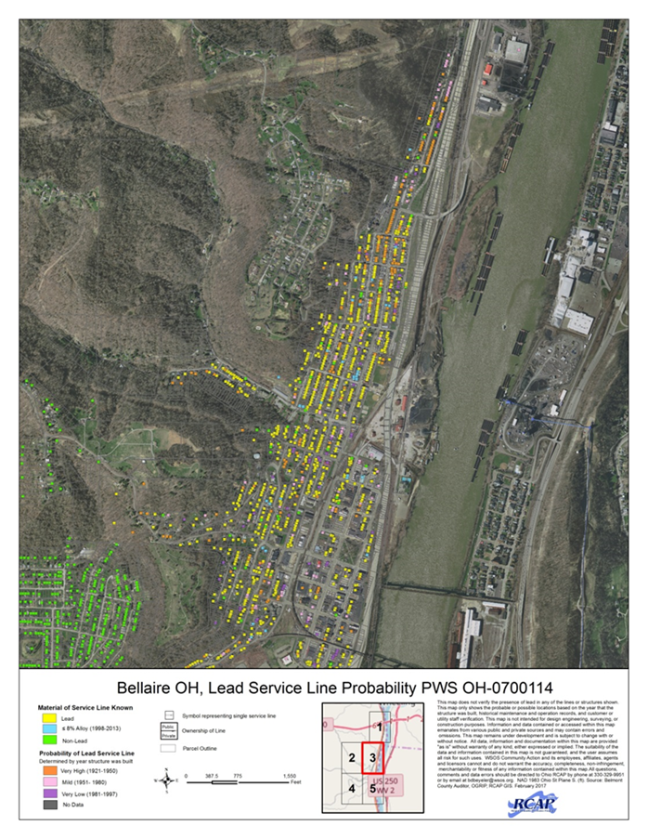
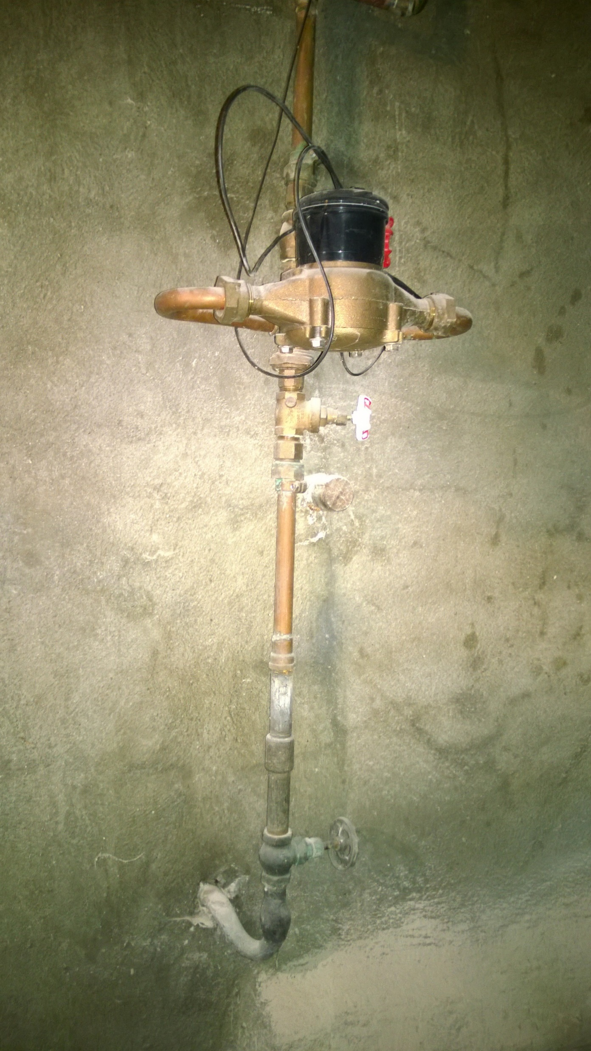
Post-lead- What are we leaving communities with? What are the opportunities?
With inventories
Maps (asset management, disaster recovery)
Records/ data management
With replacement
Meter replacement
Main replacement
Other
Building relationships - Customer, boards, etc.

Slide 19
Summary
Small/rural communities can benefit by having support throughout the process
Don’t overlook other opportunities to build a resilient and sustainable utility

Slide 20
Matt Holmes,
National Rural Water Association
Tim Neumann, Michigan Rural Water Association

Slide 21
Mark Stasyszen,
Oklahoma Department of Environmental Quality

Slide 22
ASDWA Lead Service Line Symposium
Developing LSL Inventories
February 9, 2022

Slide 23
Lead Service Line Inventories
LCRR - Developing LSL Inventory
Previous Efforts
Lessons Learned
PWS Concerns
E-Reporting Tool Demo
To protect and improve the health and environment of all Kansans

Slide 24
Lead Service Line Inventories
System Maps
Structure Type
BLDG – Building
MFR – Multi-family Residence
SFR – Single-family Residence
Lead Service Line
F – Full Lead Service Line
P – Partial Lead Service Line
G – Gooseneck or Pigtail
Interior Plumbing Material
LP – Lead Pipe
CLS82 – Copper Pipe w/Lead Solder after 1982, before 1989
CLS83 – Copper Pipe with Lead Solder before 1983
To protect and improve the health and environment of all Kansans

Slide 25
Lead Service Line Inventories
PWS Feedback
The Good
Improved PWS knowledge
Groundwork for LCRR implementation
Distribution system materials
More suitable sample sites
Improved communication with KDHE
The Bad & The Ugly
Very time consuming
Lack customer cooperation
Impossible to know all materials
To protect and improve the health and environment of all Kansans

Slide 26
Lead Service Line Inventories
KDHE Lessons Learned
Need a data system
Need E-Reporting Tool
Need updated forms & guidance
Review & acceptance takes time
Effort requires significant follow-up
Small systems are challenged
To protect and improve the health and environment of all Kansans

Slide 27
Lead Service Line Inventories
What Does The Future Hold??
Implement E-Reporting Tool
Develop Guidance Documents
Complete LSL Inventories
Public & Private
Include Galvanized Lines
Include Goosenecks, Pigtails
Develop Assistance Program
Non-PWS owned LSL data collection will be challenging
To protect and improve the health and environment of all Kansans

Slide 28
Lead Service Line Inventories
Spreadsheet Demo
https://www.kdhe.ks.gov/547/Lead-Copper-Rule
Contact:
Rob Gavin
rob.gavin@ks.gov
To protect and improve the health and environment of all Kansans

Slide 29
Cathy Tucker-Vogel
cathy.tucker-vogel@ks.gov
785-368-7130
kdheks.gov/water
KDHE Bureau of Water
Public Water Supply Section
February 9, 2022

Slide 30
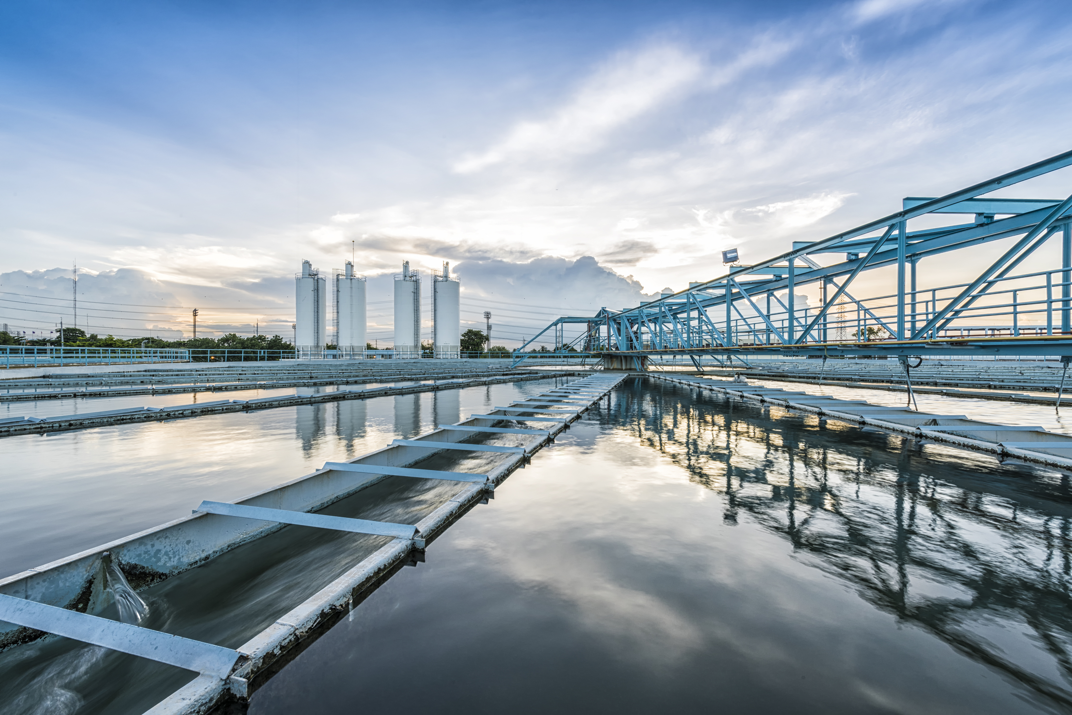
QUESTIONS?

Slide 31
Join us for our next session! Morning Webinars 11:00 AM-12:30 PM EST Afternoon Webinars 3:00 PM-4:30 PM EST Recordings and slide decks will be available on the event page: www.asdwa.org/event/lead-service-line-inventory-symposium/
Wednesday, February 2
Wednesday, February 9
Wednesday, February 16
Session 1: Overview of LCRR
Session 2: Notes from the Field: State and Utility Experiences with Existing LSL Inventory Rules
Session 3: Capitalizing in Innovations for LSL Inventories
Session 4: Small Systems, Big Challenges: Implementing LSL Inventories and Replacements at Small Systems
Session 5: Water System Inventory Case Studies
Session 6: Show Me the Money: Funding for LSL Inventories and Replacement
Wednesday, February 23
Session 7: The Other Side of the Meter: Practical Tools for Collecting Private-Side Service Line Material
Session 8: Tell Me About It: Mapping and Communicating your LSL Inventory and Replacements
Wednesday, March 2
States-only debrief (3:00-4:30 EST)

