Slide 1
2023 ASDWA Presentation Millstone River HAB
Rob Newby, Ph.D.
Microbiologist
NJDEP Division of Science and Research

Slide 2
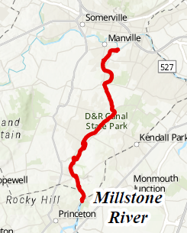
2022 Millstone HAB Summary
On 07/21/22, a HAB was discovered at Rt. 518 during routine water quality monitoring.
The HAB event was tracked and eventually found to traverse the full extent of the Millstone River to the confluence of the Raritan River ~ 9 Miles.
At the confluent point there is a drinking water intake which serves ~800,000 people.
Blooms on flowing waters are considered to be rare but may be under reported or under characterized.

Slide 3
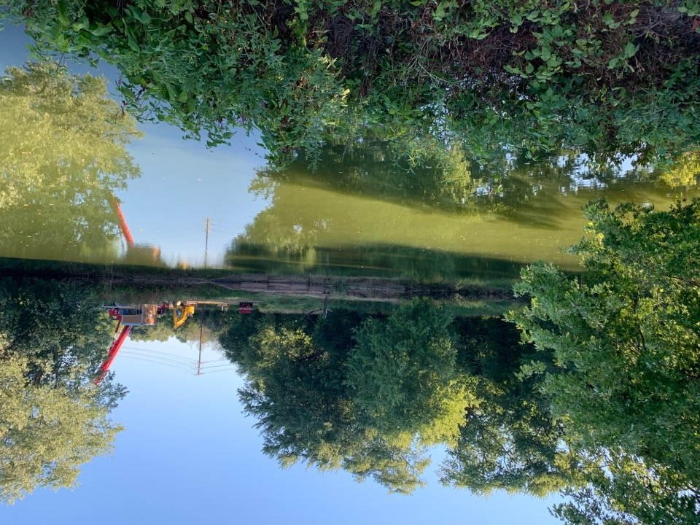
Driving Forces of Blooms
Key Nutrients
Phosphorus
Nitrate
Iron, Zinc
Physical Properties
Temperature
Water “stillness”
Wind activity
Predation
Rainfall

Slide 4
Nutrients and Blooms
Largest driving force of cyanobacteria growth (besides sunlight and warmth) is the availability of nitrogen and phosphorous (N/P)
Some species of cyanobacteria can take atmospheric nitrogen (inert) and make it into a biologically available form
For most blooms in NJ, N is not the limiting factor; P is.
The biological state of N seems to play a role in toxin production.
Phosphate can be carried over several generations; so cyanobacteria can source the P from one location in a waterbody and then be moved away without any immediate impact to their growth
Cyanobacteria are also adept at getting P out of the water; by altering the water chemistry and other factors

Slide 5
Bloom Investigation
Flows on the Millstone were at historic lows. Portions of the River were characterized as “lake-like.”
Phycological analysis revealed that the bloom was not the same throughout the 9-mile stretch
This was our first indicator that this wasn’t a flowing event from Carnegie Lake and just riding the currents through the Millstone. We had entire cell population differences as we got closer to the confluence.
The bloom was producing toxins, but not in a way which was initially intuitive.
The science behind why blooms make toxins is still very much emerging – likely factors are the limiting factors such as N & P, but the biological state these factors are in – such as nitrate or nitrite for N.

Slide 6
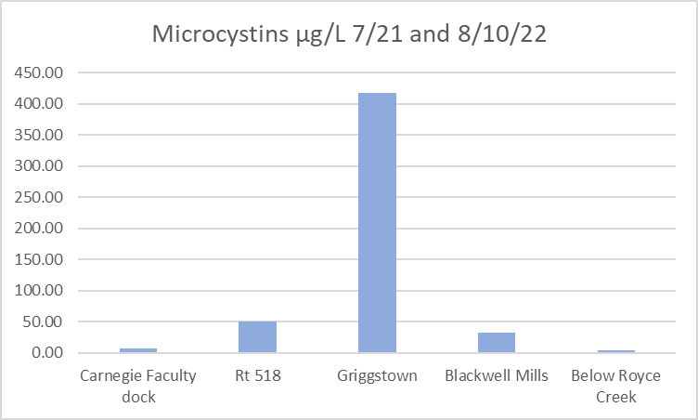
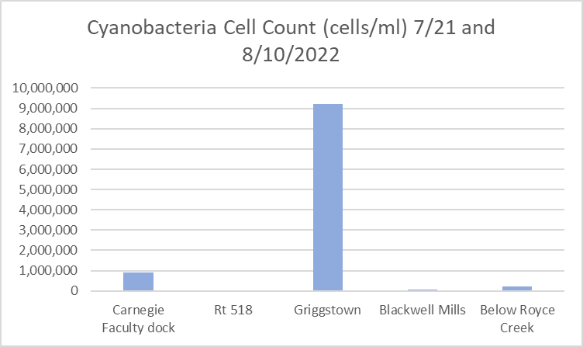
Initial Results: 7/21/2022
12th highest toxins
8th highest cell count
on record
Site Location | Microcystins (µg/l) | Cell count (cells/ml)
Carnegie Faculty dock | 6.64* | 900,250
Rt 518 | 50.20** | Present; below quantification
Griggstown | 417.00** | 9,210,000
Blackwell Mills | 32.98** | 73,750
Below Royce Creek (8/10) | 4.89* | 226,500
*Above Advisory Alert 2.0 ug/L microcystin & 80,000 cells/mL
**Above Warning Alert 20-2000 ug/L microcystin

Slide 7
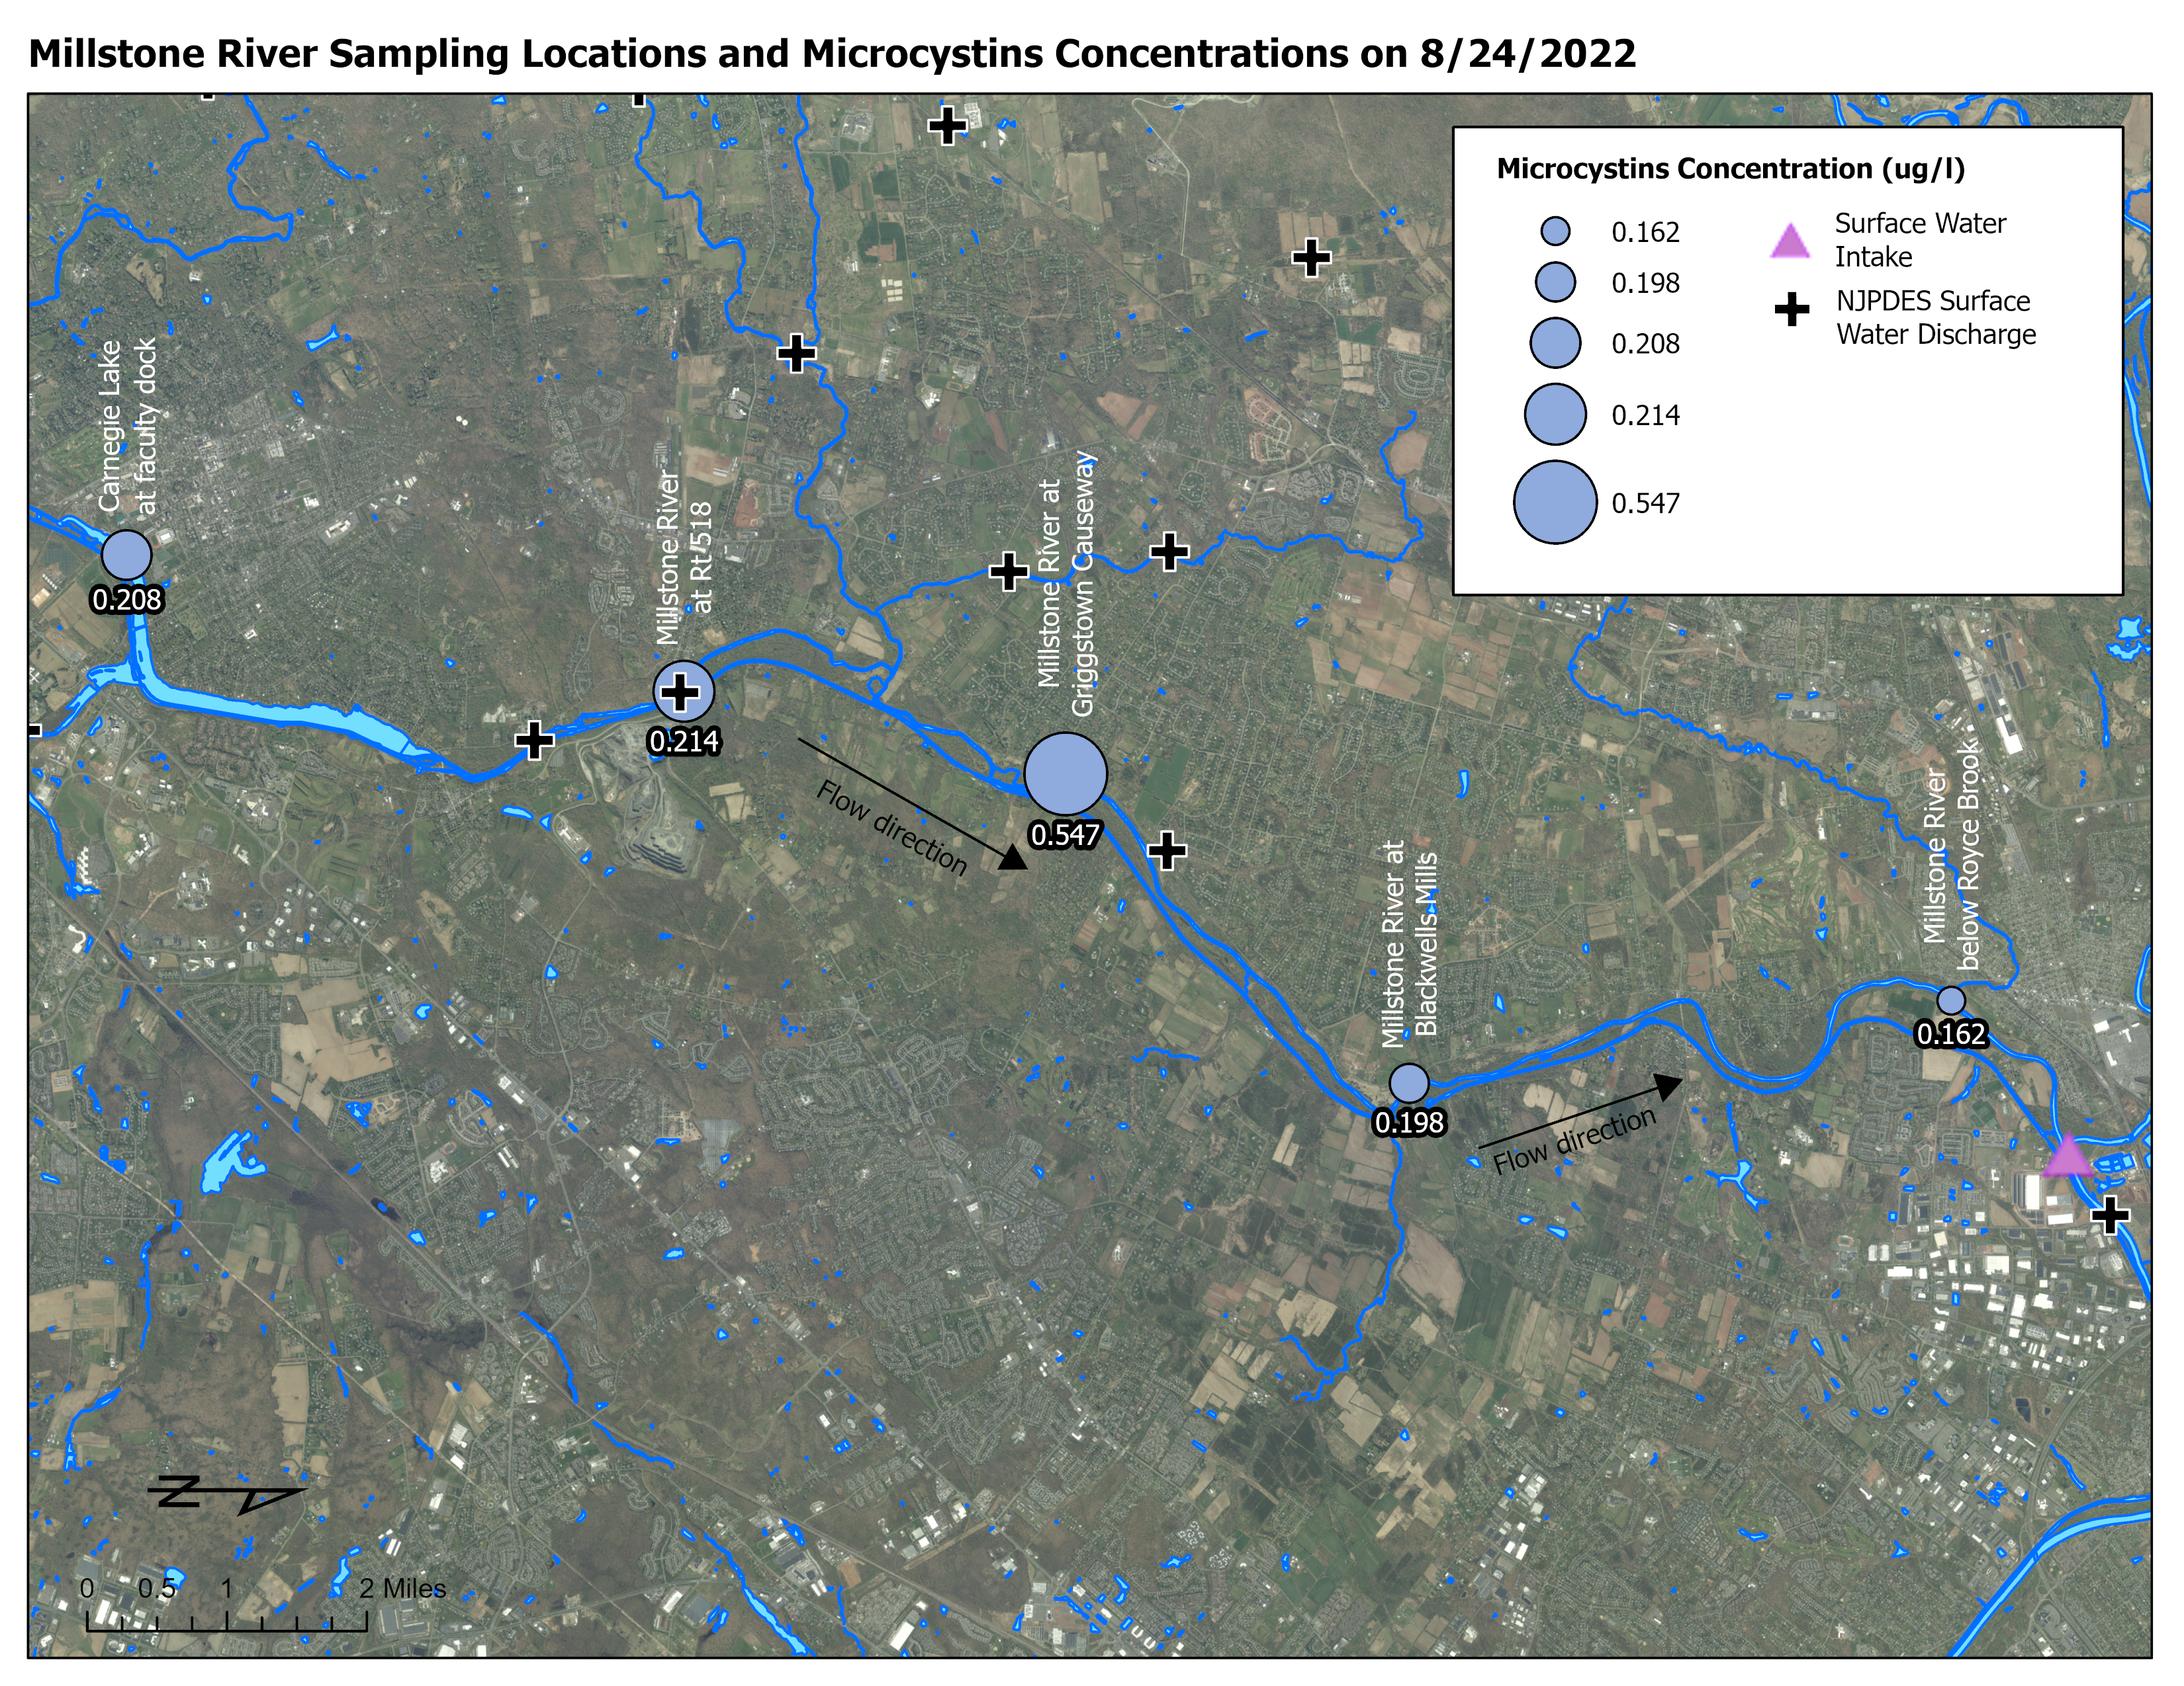
Bloom Investigation

Slide 8
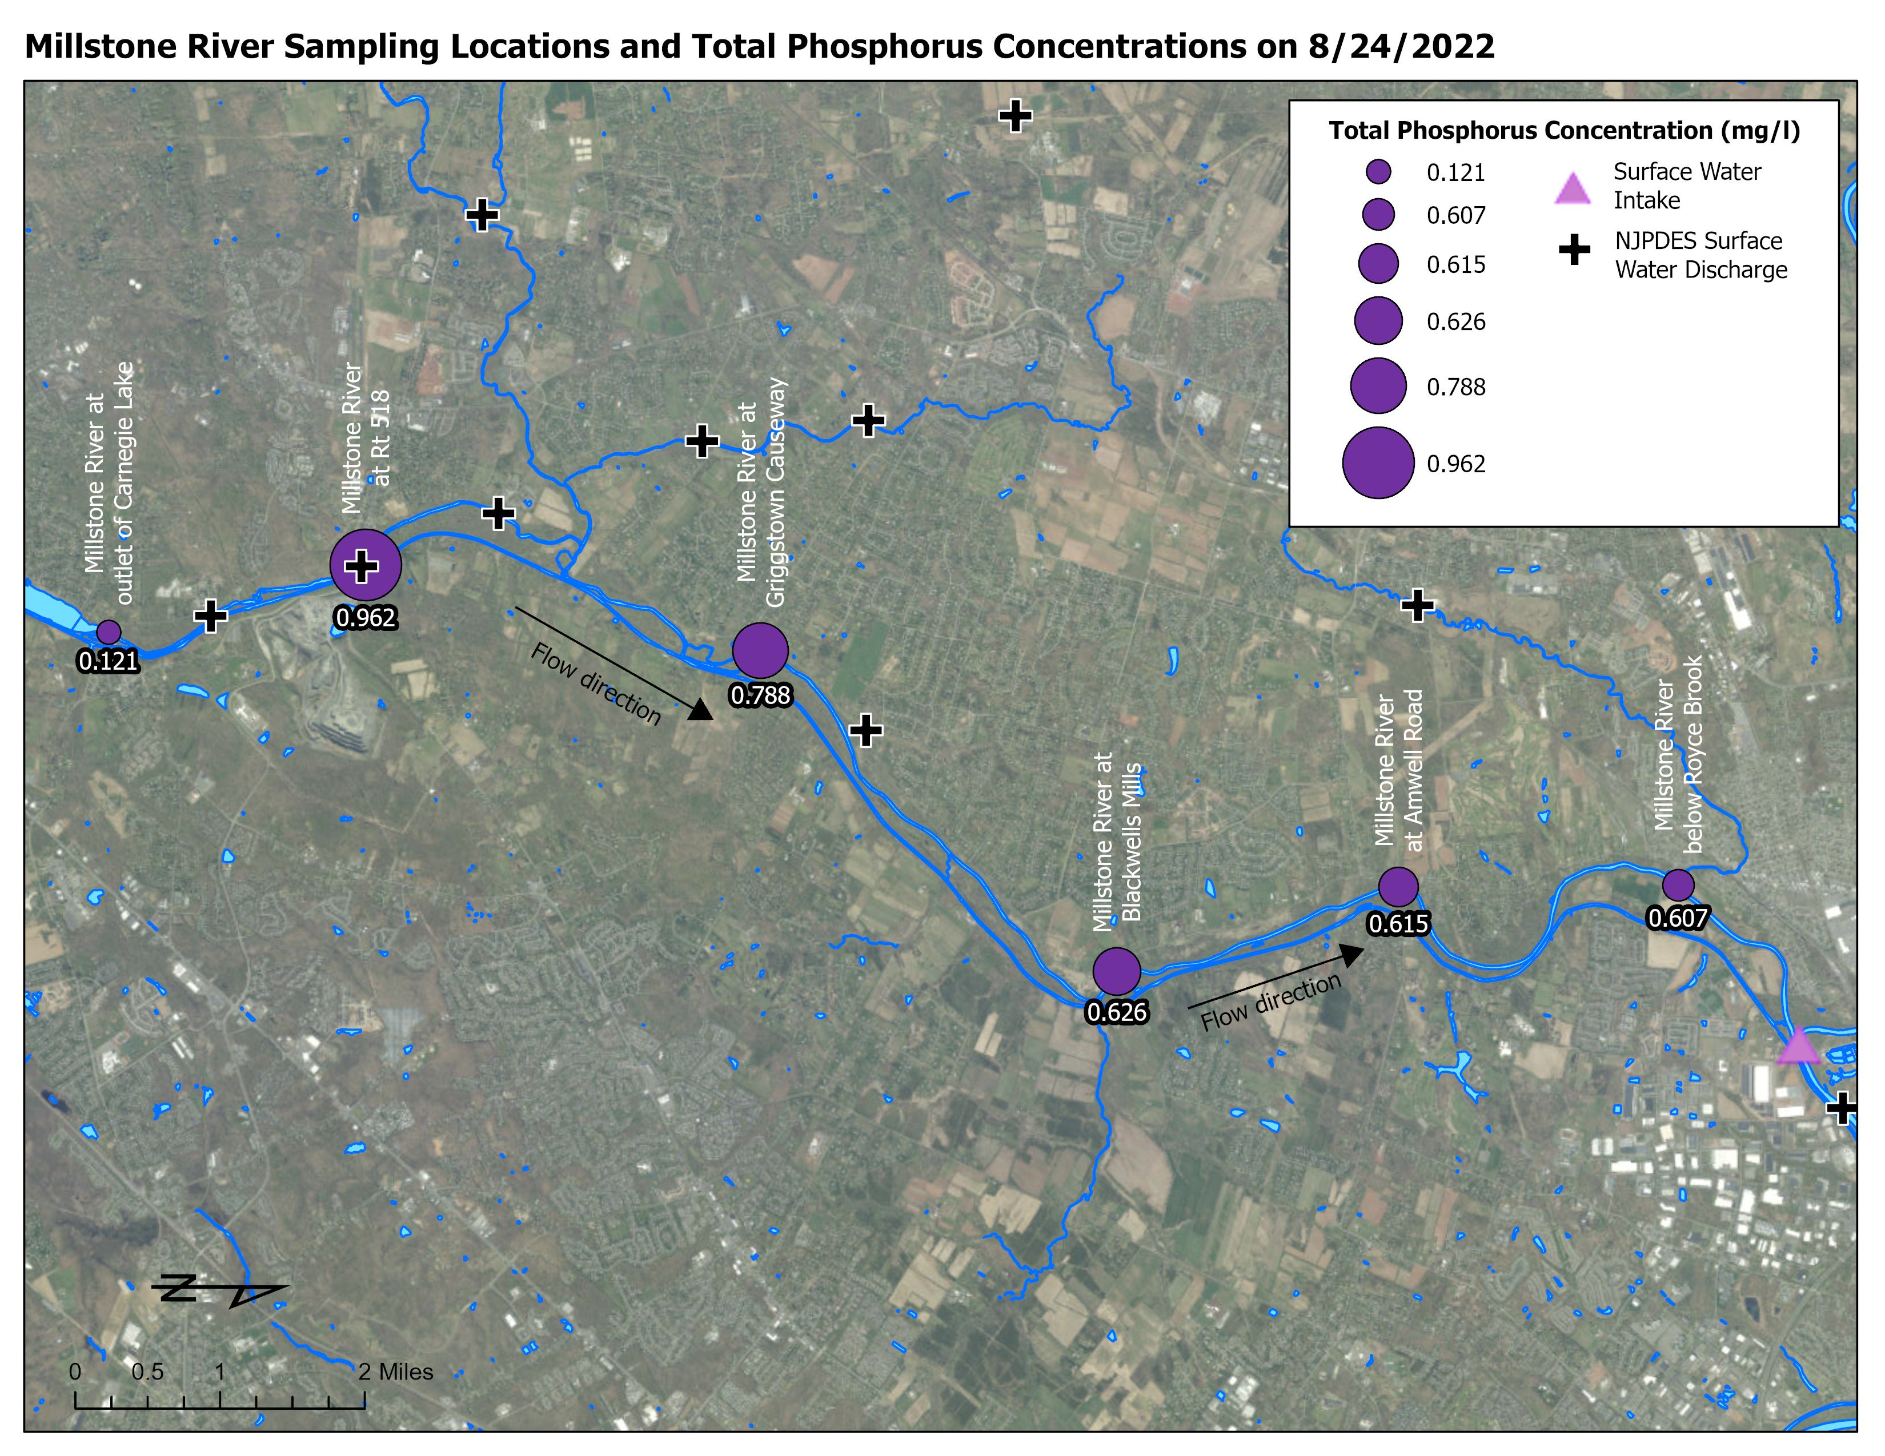

Slide 9
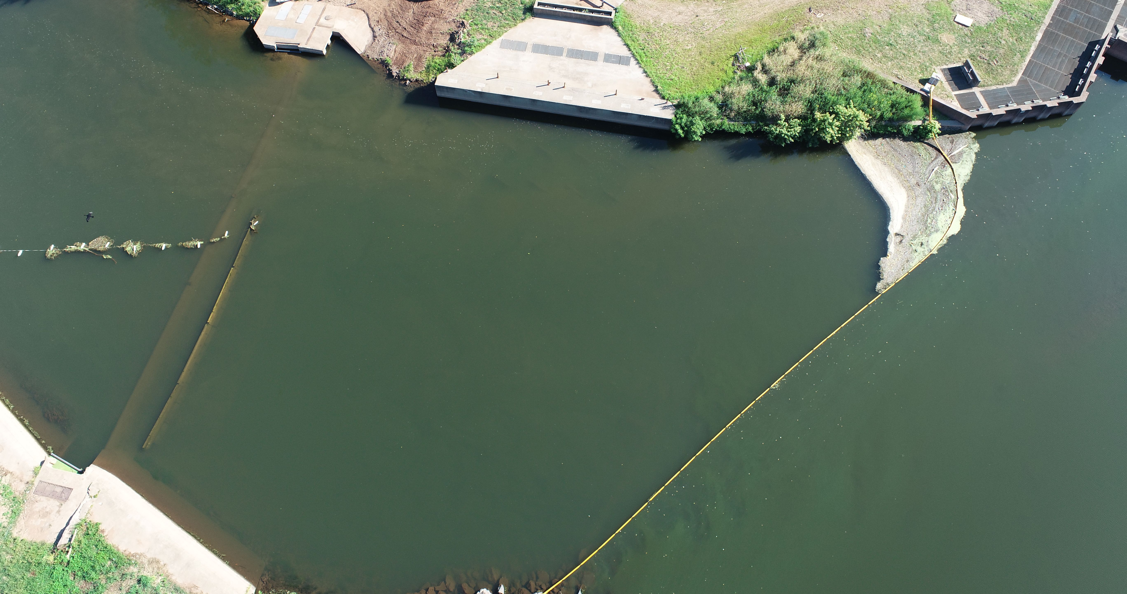
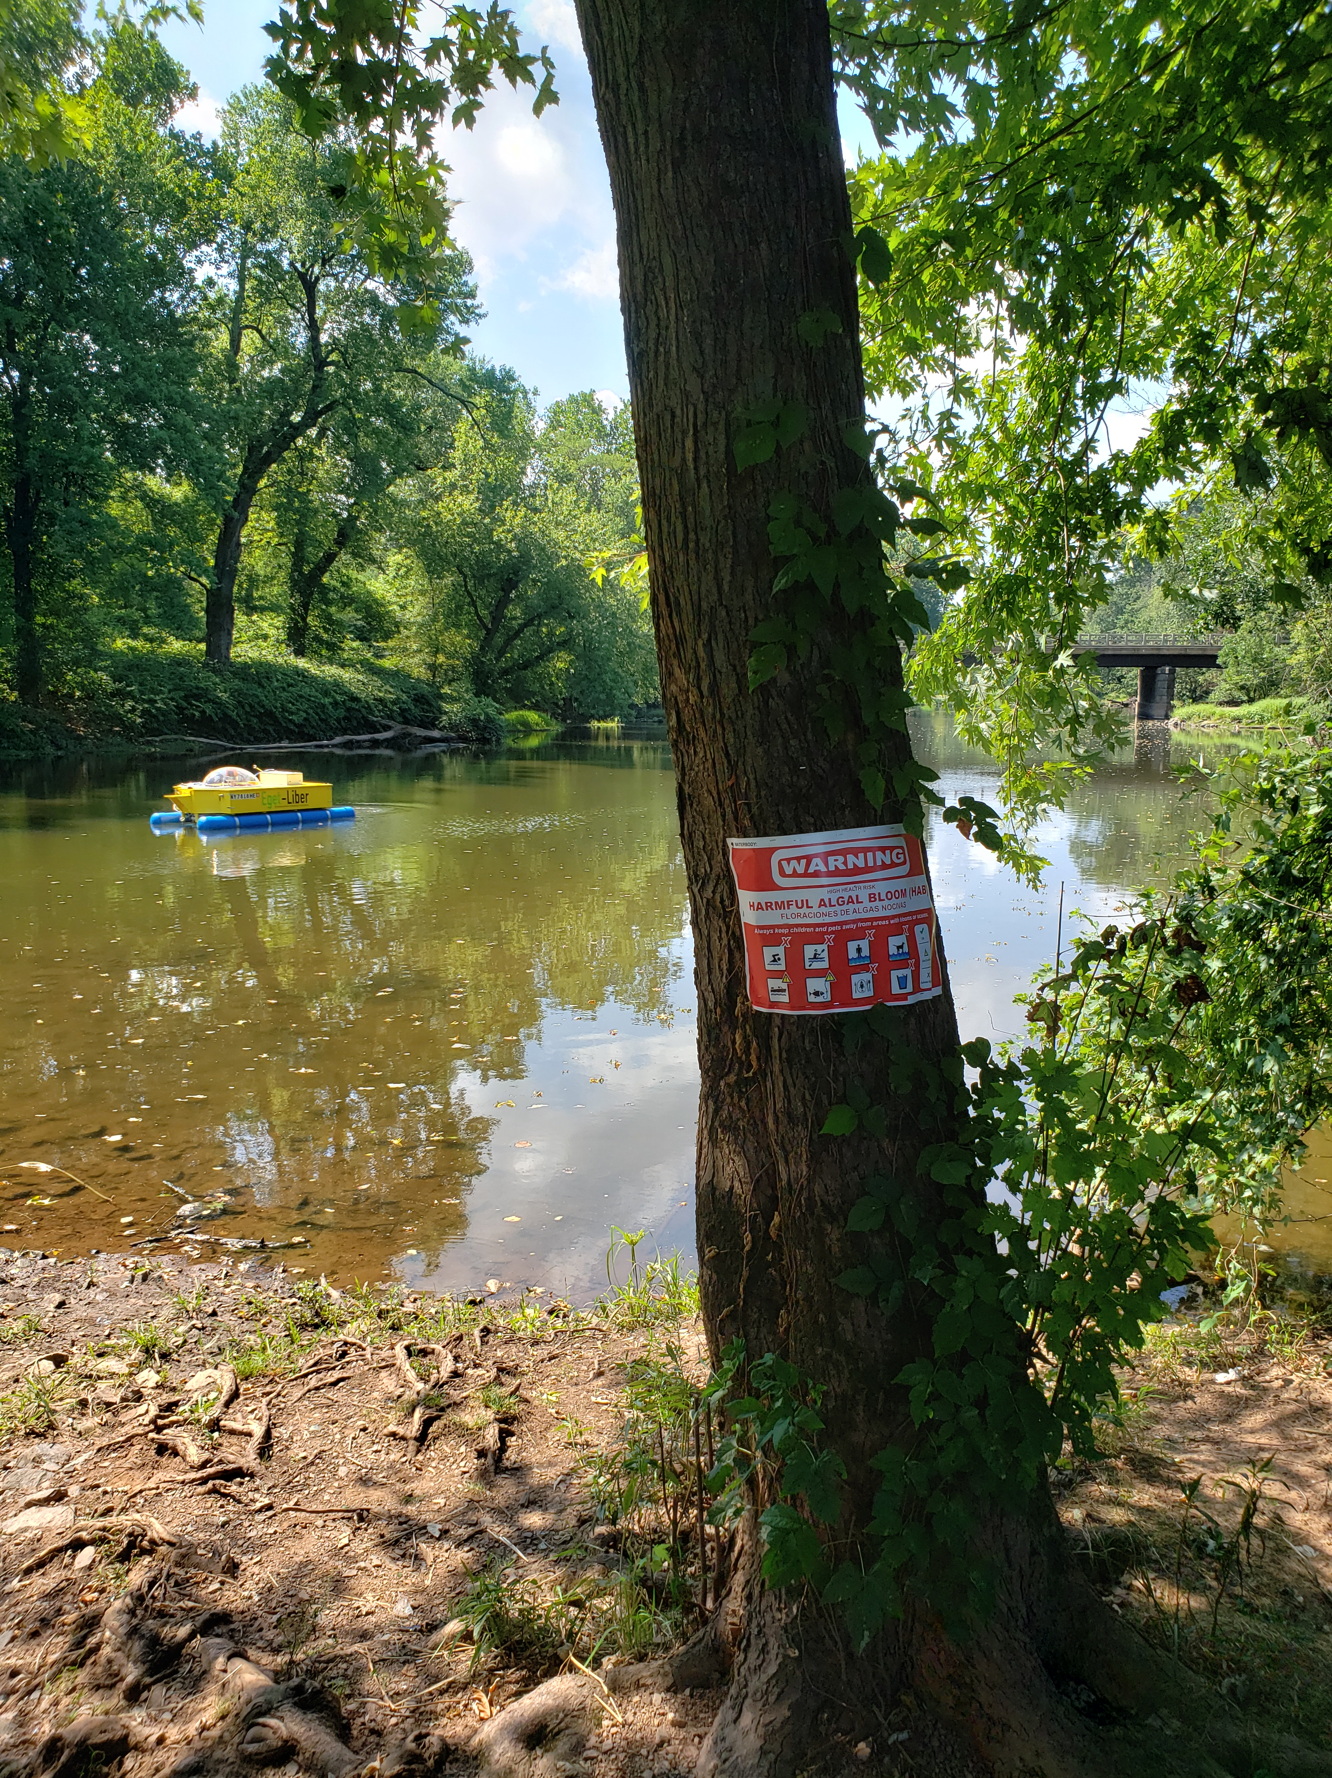
Mitigation
What can you do in this situation?
Treat
DEP explored using peroxide or alum to treat the entire 9-mile run.
Extremely cost prohibitive and would have a very short effective life
DEP initiated a pilot with on water treatment using an experimental ROV
Increase Flows
5 BG of water was discharged from other reservoirs to keep the bulk of the bloom away
Not sustainable as we were in the middle of a water supply drought watch. The utility constructed a weir on the South Branch of the Raritan to try to increase the velocity to help “push” the bloom away.
Other Initiatives
The utility conducted daily testing of raw and finished drinking water for toxins
The utility explored alternate sources, but had challenges due to PFAS
The utility installed a turbidity curtain along the South Branch at the confluence to minimize cells backing up into the South Branch from the Millstone
Weir wall extension
Turbidity curtain

Slide 10
Lessons Learned
•Most of our understanding of blooms come from studying planktonic events
•Events in flowing water are rare but have been documented
•Bloom starts in one waterbody and moves to another through the water column
•Bloom begins to grow in low flow regions of flowing water or in shallow areas where temperature can increase
•Globally we see benthic events more in flowing water than planktonic events

Slide 11
Conclusions
Based on the trackdown study, the 9-Mile long Millstone HAB of 2022 was able to propagate because:
Low flow/Lake-like conditions due to the drought
Significant levels of total phosphorus being discharged to the Millstone River.
DEP is working with partners and investigating ways to decrease TP inputs and increase stream flow.
Monitoring at Carnegie Lake as well as the Millstone will continue in 2023.
We hope to be able to identify a HAB if it happens again before conditions increase to 2022 levels so we can take appropriate action before a threat to DW occurs.

Slide 12
Questions? Contact
robert.newby@dep.nj.gov
www.nj.gov/dep/hab
Rob Newby, Ph.D.
Microbiologist
Division of Science and Research
Like & follow us!
@newjerseydep
@nj.dep

