Slide 1
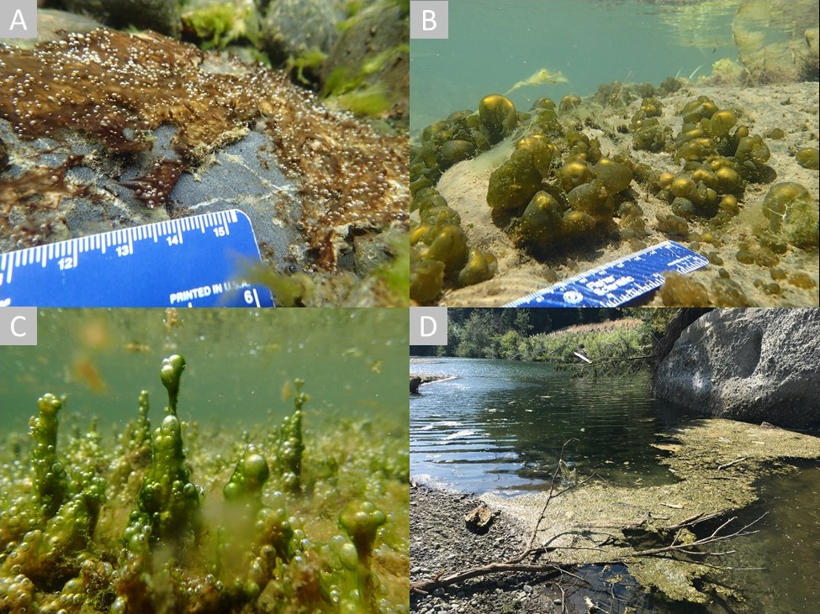
Columbia River 2022 Cyanotoxin response and monitoring project
We work with others to protect the health of the people of Washington State by ensuring safe and reliable drinking water.
WQTC Cincinnati
November 2022
Nancy Feagin and Steve Deem
Office of Drinking Water
Gopal Mulukutla
Division of Climate and Health
Washington State Department of Health
Photo credit ITRC Harmful Cyanobacterial Blooms

Slide 2
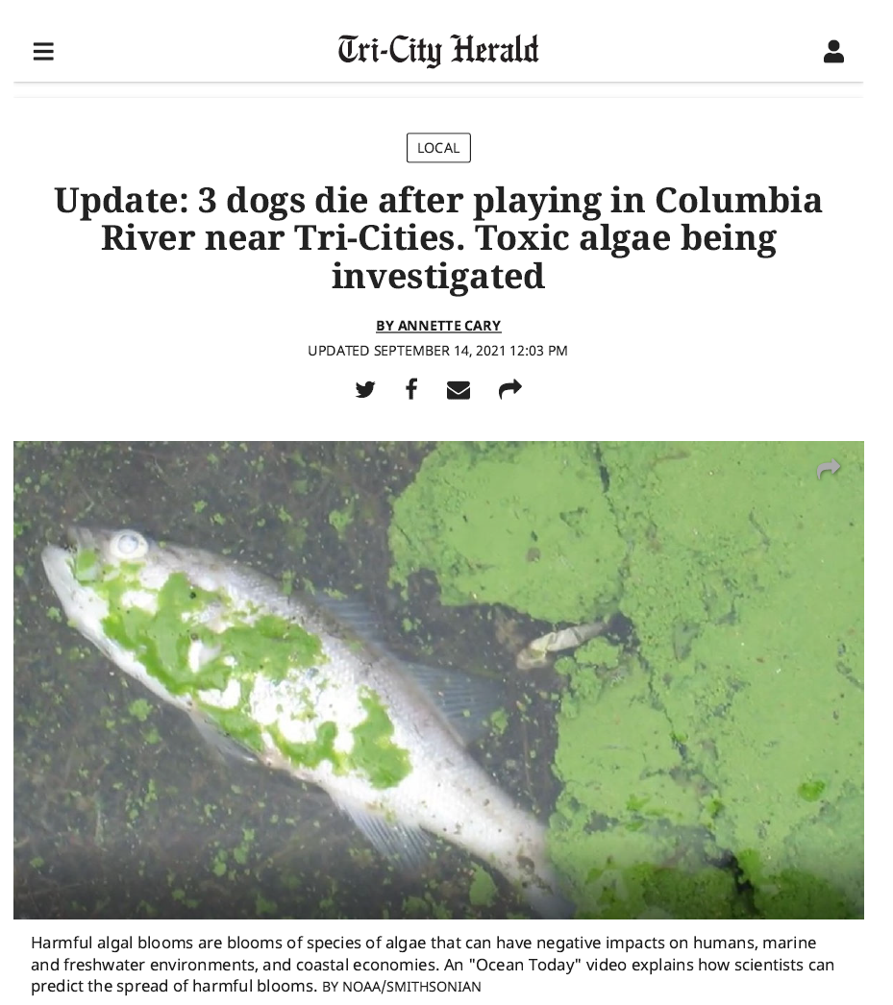
Notes:
9/15/2021 message from ERO: Take a look at today’s headline

Slide 3
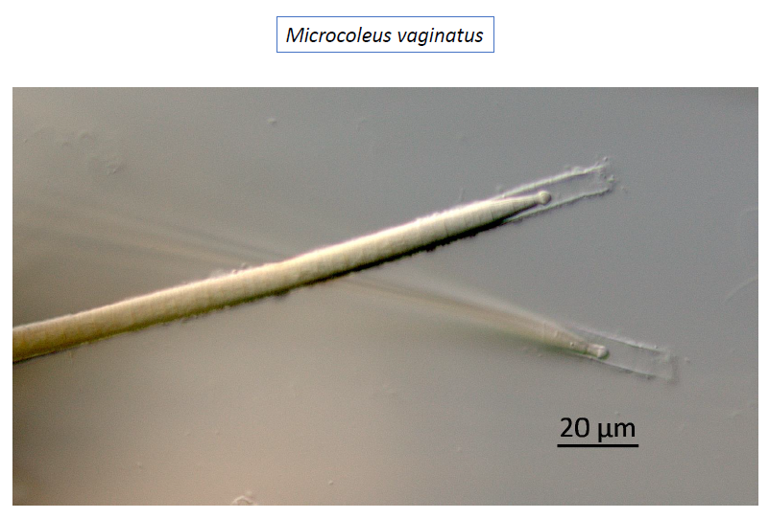
Columbia River 2021 Anatoxin-a event
June heat wave
Dog death reports starting Sep 11-12
Recreational anatoxin-a detections Sept - Nov
Leslie Groves Park max: 14.4 μg/L
Howard Amon Park max: 67.2 μg/L
Cyanobacteria identified in recreational samples (KCEL)
Microcoleus identified in Kennewick settling basin
No signs of an active bloom
KCEL-King County Environmental lab
BFHD-Benton Franklin Health District
Photo courtesy of Dr. Barry Rosen, Florida Gulf Coast University
Notes:
Event preceded by June 30th “heat dome” and August dog deaths Spokane and Little Spokane rivers

Slide 4
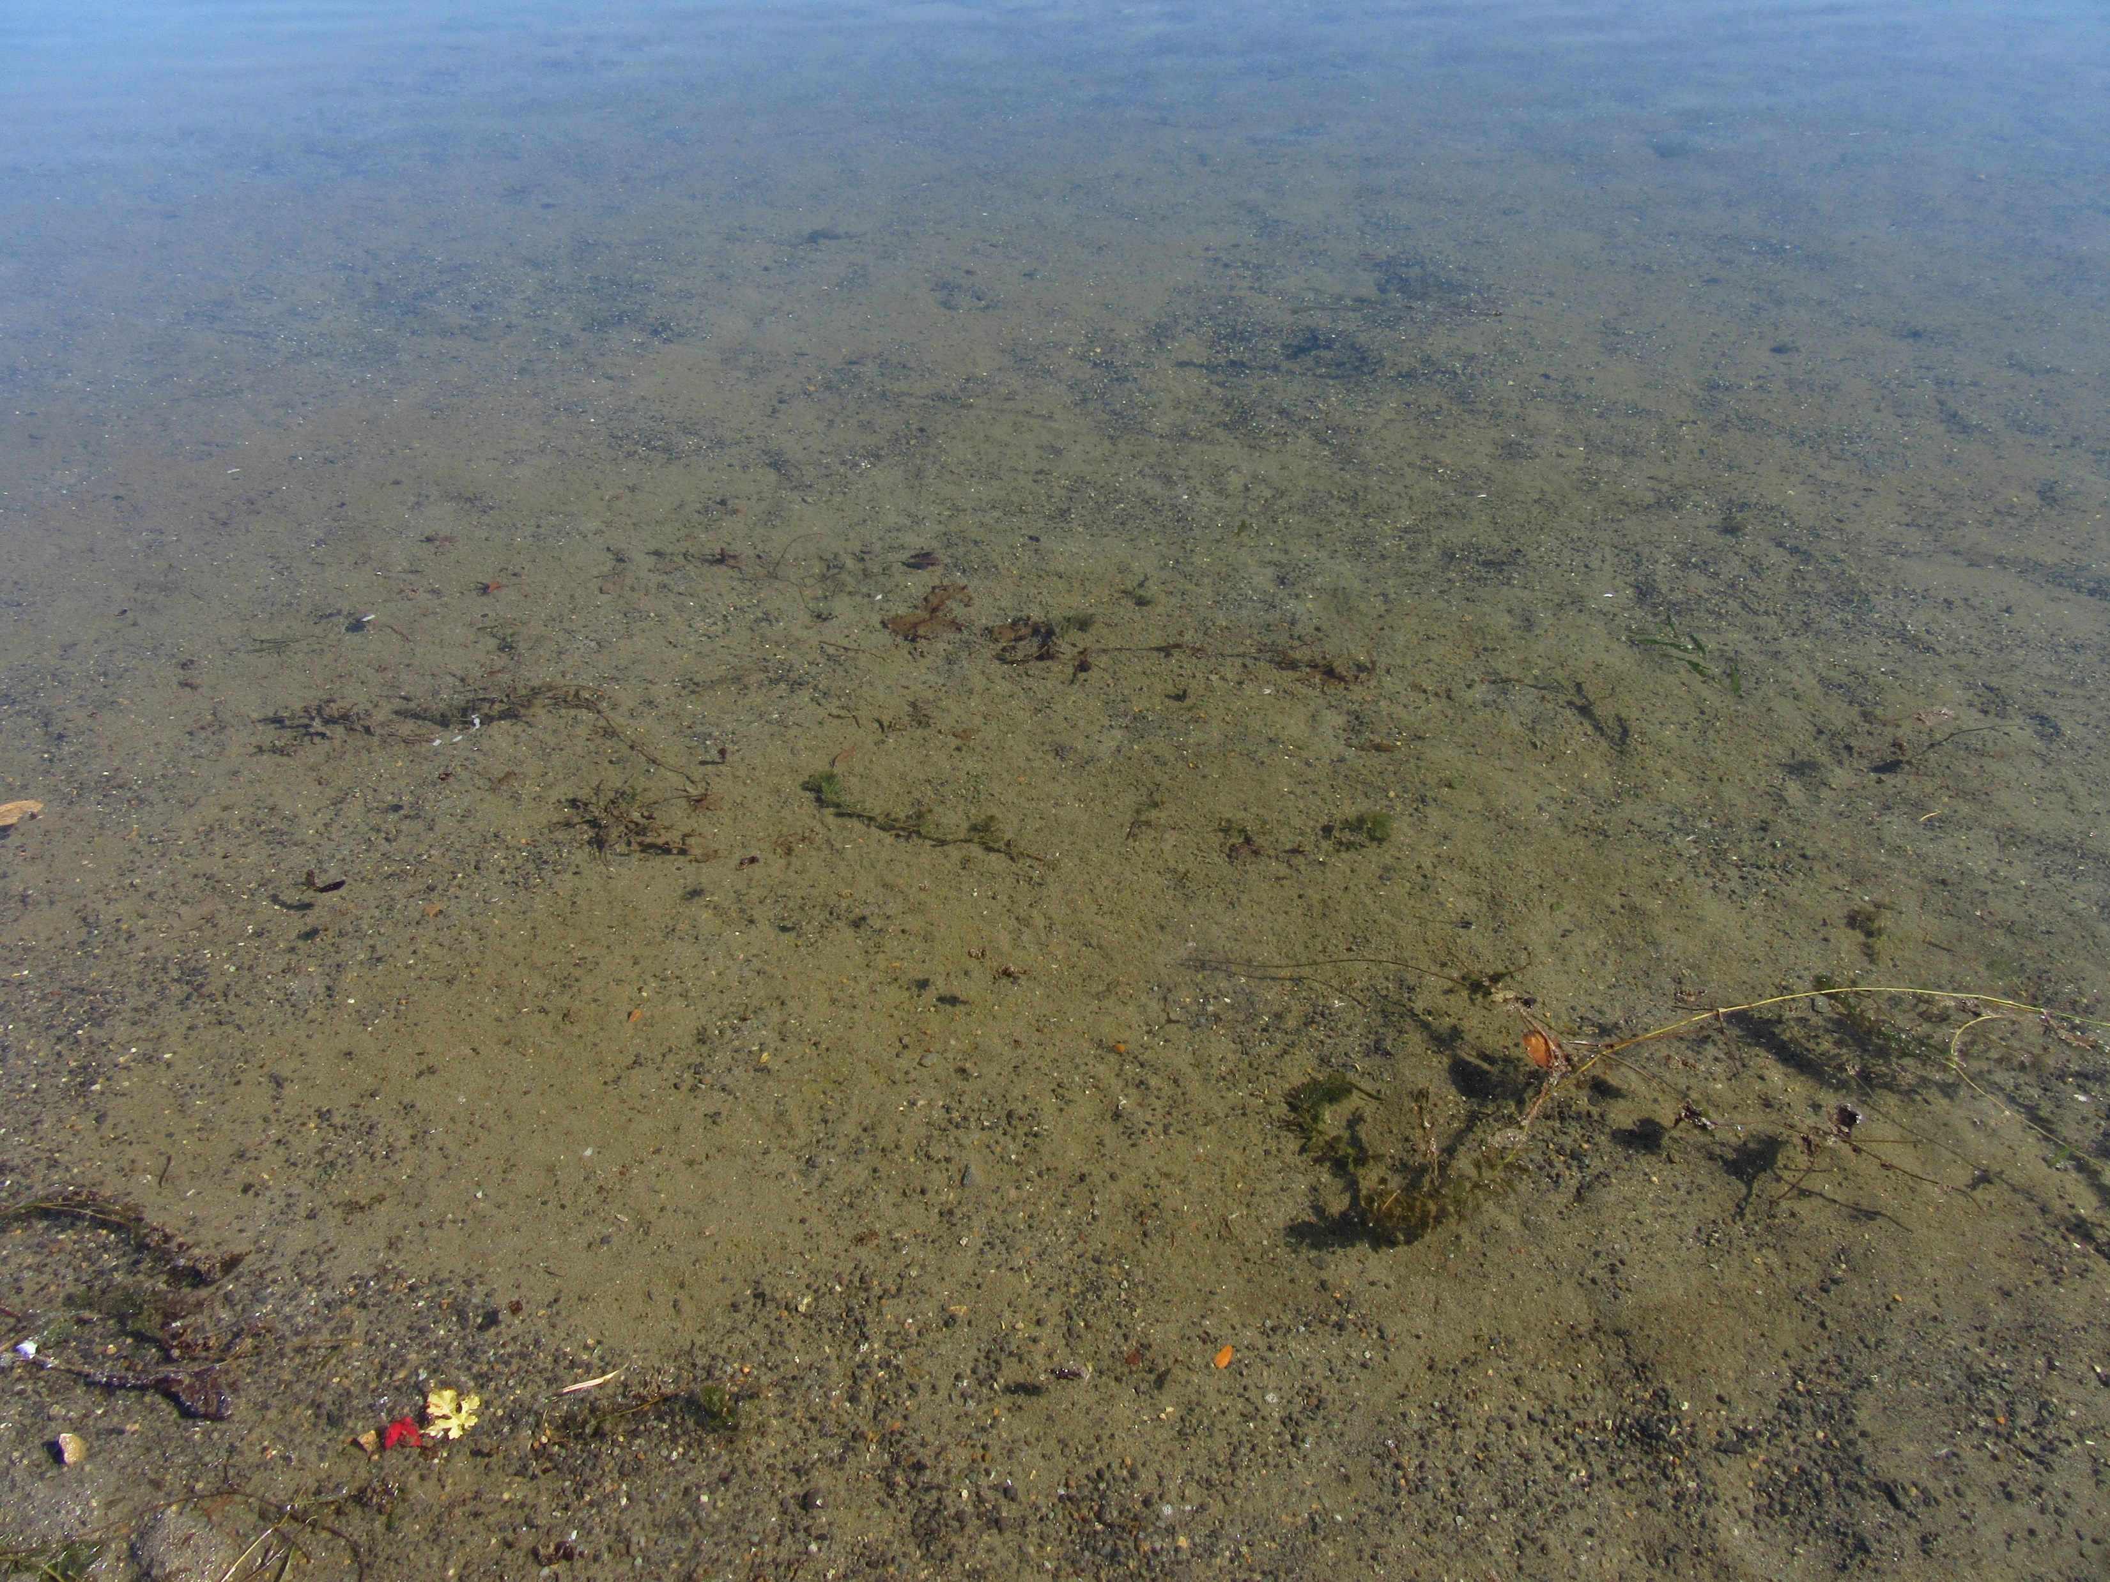
Columbia River Anatoxin-a event
Anatoxin-a
Neurotoxin (Very Fast Death Factor).
Unregulated contaminant
WA recreational guideline value 1.0 μg/L.
DOH-Office of Drinking Water recommends using 0.3 μg/L as trigger level for action.
First ever confirmed cyanotoxin detections in Washington public water systems -- raw or finished water.
Highest at Richland (max raw 0.385 μg/L, max finished 0.362 μg/L).
Last raw detection Oct 21 (0.081 μg/L)
3 public water systems operating 6 water treatment plants potentially impacted, Population > 225,000.
Hanford reach (3 systems): no toxin detected (<0.03 μg/)
Leslie Groves Beach 10.19.2021
Notes:
Dogs died within 15 minutes of exposure. Note Richland plant initially not significantly reducing toxin.
Compare this photo with bloom pics shown earlier.

Slide 5
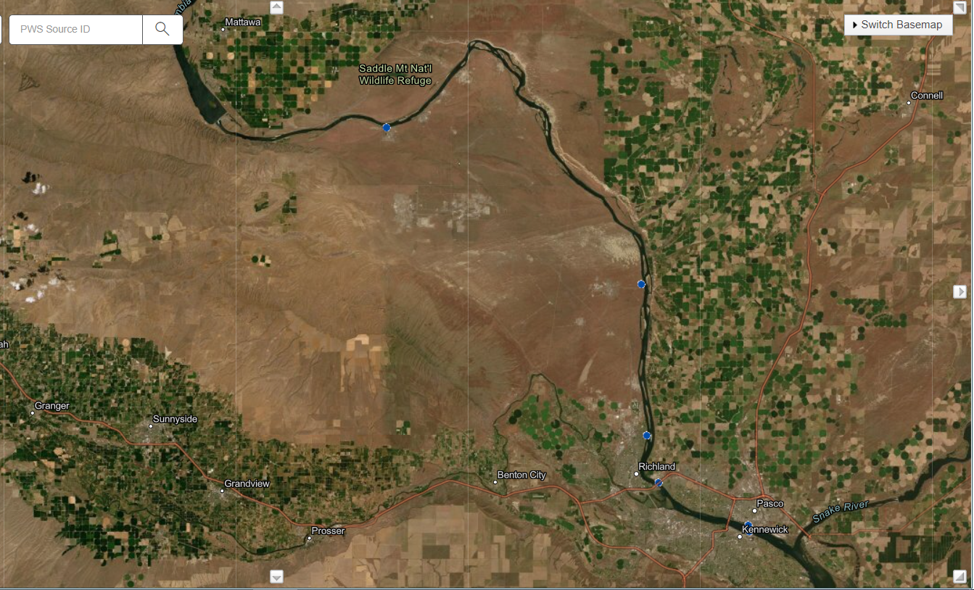
Priest Rapids Dam
Dog deaths
Notes:
Blue dots are PWS intake locations. Point out Hanford reservation, Hanford reach (51 miles only free flowing stretch in US) , agricultural development/wasteways on east bank

Slide 6
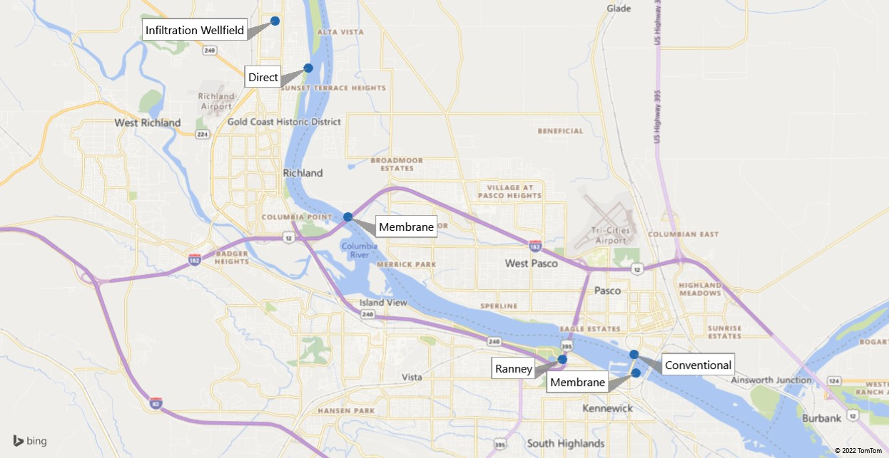
Location | Recreational Sampling Results: Anatoxin-a (μg/L)
Howard Amon park | 0.3 – 67.2
Leslie Groves park | 0.2 – 14.4
Notes:
Close up of tri-cities. Plant intake locations. Point out diversity of WTPs: 2 membrane plants (MF-Pall and UF-Evoqua), 1 conventional, 2 direct, 2 GWI/GWUDI.
Note location of Yakima and Snake Rivers.

Slide 7
Columbia River Anatoxin-a event: Summary
Filtration removes intact cyanobacterial cells, but 70-100% toxin in raw water was extracellular (outside of the cell).
Benthic cyanobacteria suspected.
Chlorine ineffective (unlike microcystins).
Permanganate surprisingly effective. Relatively easy to retrofit. Utilities don’t typically measure residual.
Anatoxin-a not detected (<0.06 μg/L) at Kennewick’s Ranney well, or Richland’s infiltration wellfield.
Worked with each treatment plant to optimize for anatoxin-a reduction. EPA Region 10 and EPA Offices in Cincinnati provided valuable support.
Commercial labs unacceptable levels of service.
EPA lab provided analytical support.
No drinking water health advisories needed.
Notes:
We don’t know the source of the cyanobacteria/cyanotoxins. Here’s what we do know/have learned.
KCEL Anatoxin-a EPA Method 545 (LC/MS/MS)
KCEL Total Microcystins EPA Method 546 (ELISA)

Slide 8
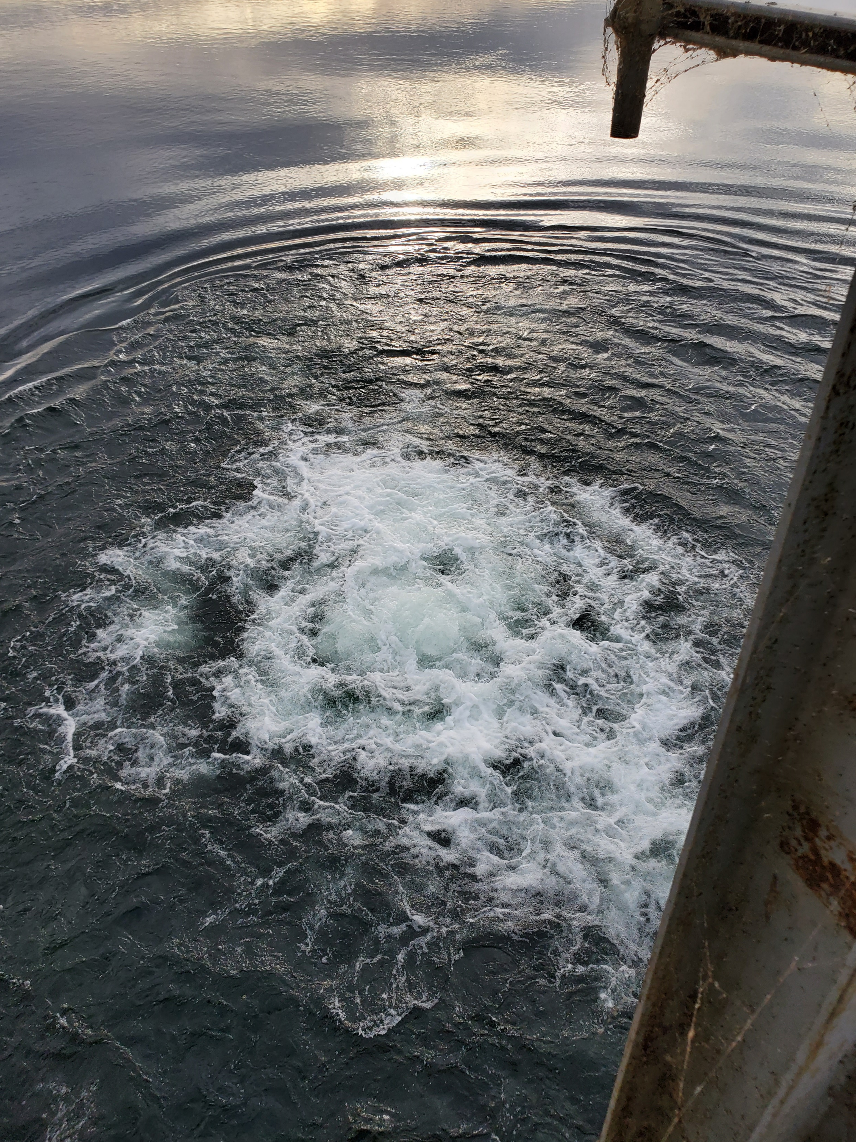
Columbia River Anatoxin-a event: Questions
What cyanobacteria species are present in the Columbia River?
Where are they located and when will they produce toxins?
What site specific factors cause Columbia River cyanobacteria to produce and release cyanotoxins?
What water quality parameters can be used to monitor benthic cyanobacterial and cyanotoxins?
Should we install effective cyanotoxin treatment and operate all year round regardless of surrogate parameters or toxin testing?
Richland intake air scour

Slide 9
Columbia River Cyanotoxin Monitoring Project 2022
Main Goals: Establish and use local lab capacity. What is the extent (time and space) of cyanotoxins? Are there WQ monitoring parameters that can be used to trigger cyanotoxin monitoring for benthic cyanobacteria?
Add ELISA cyanotoxin capacity to BFHD lab
Install multiparameter water quality probe at Richland intake (temperature, conductivity, dissolved oxygen, pH, chlorophyll* and phycocyanin*).
ELISA drinking water samples (≥ 0.15 μg/L microcystins or anatoxin-a) to KCEL for confirmation
Collect screening samples from Tri-Cities water intakes, May-November
Microcystins & anatoxin-a twice per month
Kjedahl nitrogen & total phosphorus, monthly, Pasco & Richland
Chlorophyll-a & phycocyanin, twice monthly, Richland only
*results in relative fluorescence units

Slide 10
Columbia River Cyanotoxin Response & Monitoring Project 2022
Delay. ‘Supply chain’ more delay!
Benton Franklin Health District – ELISA – operational! Began July 2022. Recreational and Drinking Water sampling concurrently
Sonde deployed – August 17, 2022
Data beginning September 2022
Anatoxin-a detections September. Richland: Confirmed low level ATX raw/finished water Oct 12. KMnO4 dose 0.08 mg/L reduced ATX levels to ND in finished water.
King County Environmental Lab (KCEL) contract in place and confirmation sampling enacted.
Identified and initiated permanganate residual measurement procedure.
Tri-cities plus one created joint Cyanobacteria Response Plan – version 1.
Notes:
BFHD – ELISA Microplate Method, Abraxis Anatoxin-a ELISA (96T) PN 520060
Total microcystins ADDA SAES ELISA Microplate Method

Slide 11
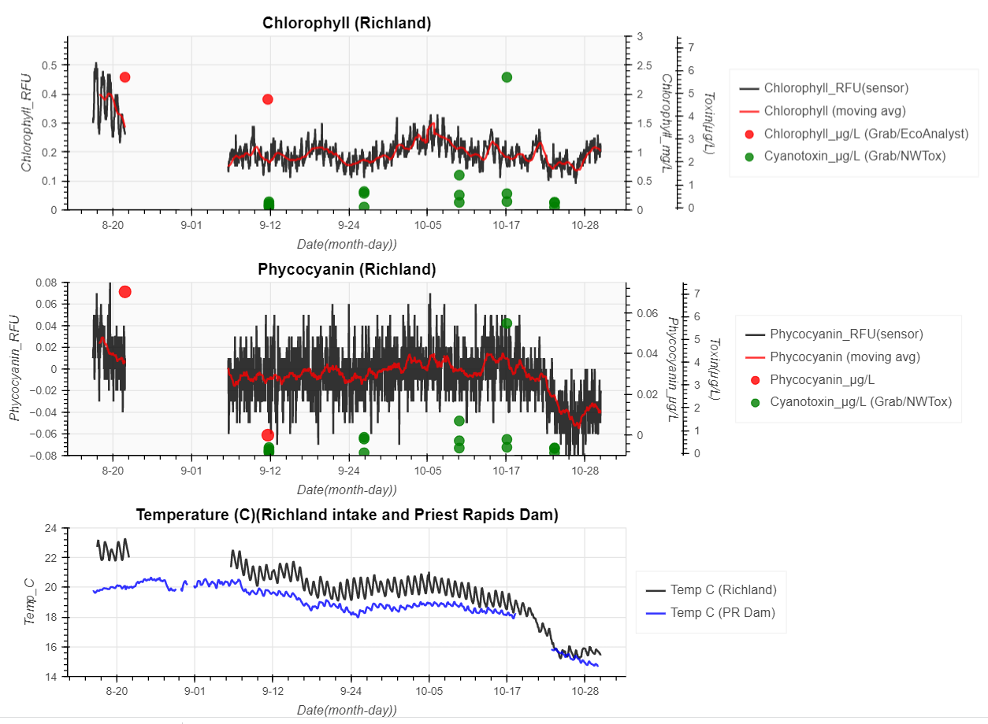
Columbia River Cyanotoxin Monitoring Project 2022 TESTING RESULTS
RFU – relative fluorescence units
Weekly collection of data and examination of relevant variables.
Compilation of data from multiple sources – City of Richland, Ecology/KCEL, Grant County PUD, USGS Priest Rapids Dam gage.
Chlorophyll and Phycocyanin are relatively low even when Anatoxin-a exceeded recreational advisory (1ug/L).
Temperature exceeds 20 C at Richland (same in 2021)

Slide 12
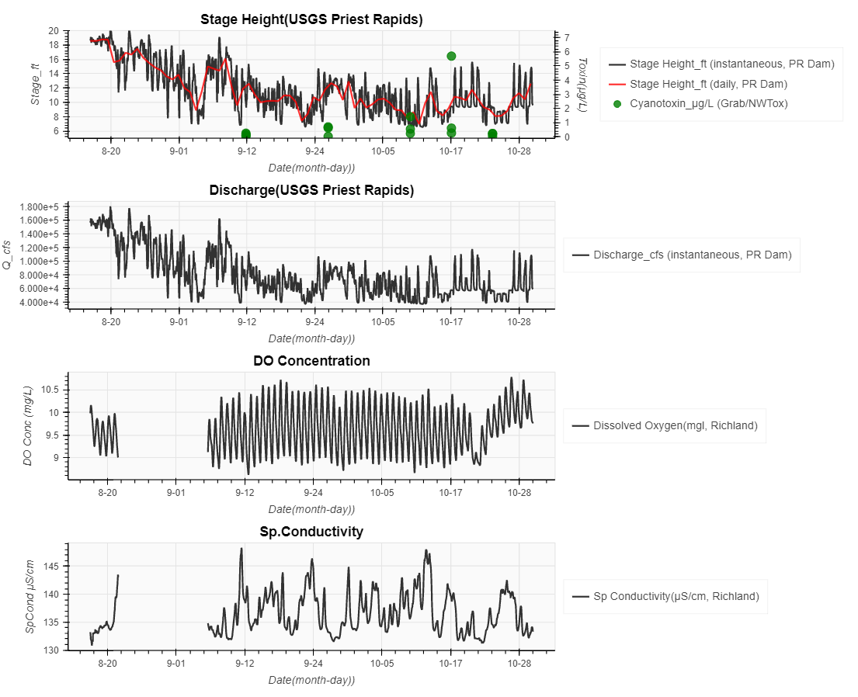
Columbia River Cyanotoxin Monitoring Project 2022 TESTING RESULTS
Wide variability in intra-day stage height due to reservoir management/ water releases at PR dam.
Both Anatoxin-a events (2021 and 2022) occurred during seasonally low water levels in river ( < 15 ft at Priest Rapids dam USGS gage)
Notes:
Richland DO variance maybe impacted by Air scour screen cleaning

Slide 13
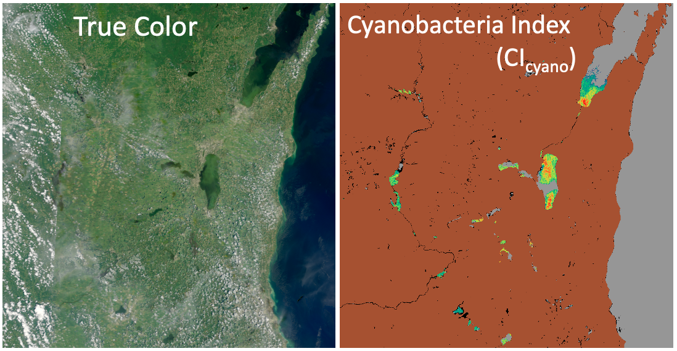
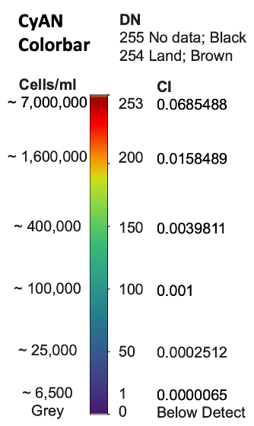
Evaluating the use of Cyanobacterial Assessment Network (Project CyAN) data
Example imagery
Project CyAN is a multi-agency project among EPA, NASA, NOAA and USGS
Uses satellite remote sensing data to detect cyanobacteria blooms.
WA DOH is developing capacity to leverage Project CyAN data for early detection and warning for HAB issues in resolvable waterbodies.
Question: Can Project CyAN data be used to understand cyanobacteria in the Columbia River?
Source: Project CyAN
Notes:
Resolvable – pixel minimum area 300 x 300 meters – need minimum of 3 pixels.

Slide 14
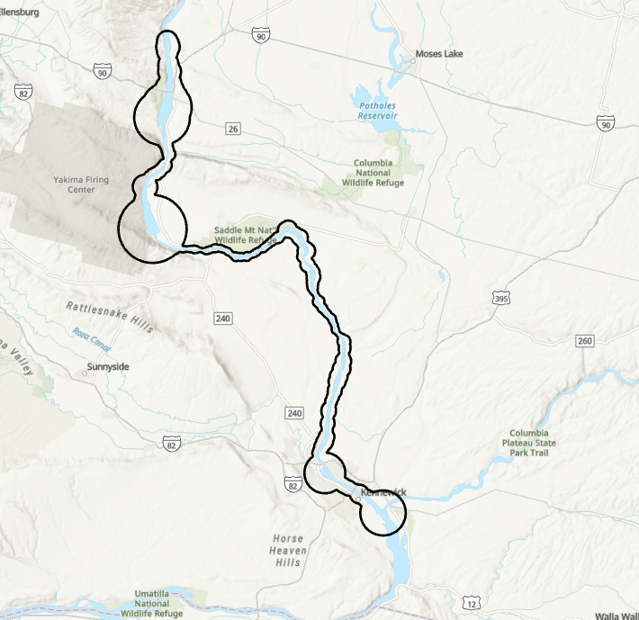
Area of Interest Delineation
Development of a custom polygon incorporating areas upstream of Tri-Cities (Hanford Reach) with two reservoirs (Priest Rapid and Wanapum)
North American river line polygons were buffered by 2X the channel width values (Allen and Pavelsky, 2015*)
National land cover data base (2016) data was used to capture water area within polygon ( ~130 km²)
*Allen, G. H., Pavelsky T.M., (2015), Patterns of river width and surface area newly revealed by the satellite-derived North American River Width data set. Geophysical Research Letters.
Notes:
1,000 pixels in this area

Slide 15
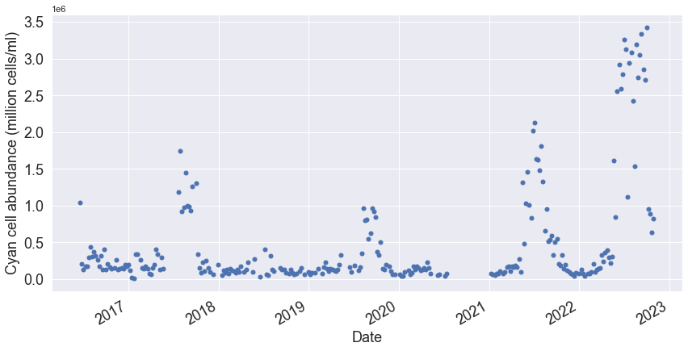
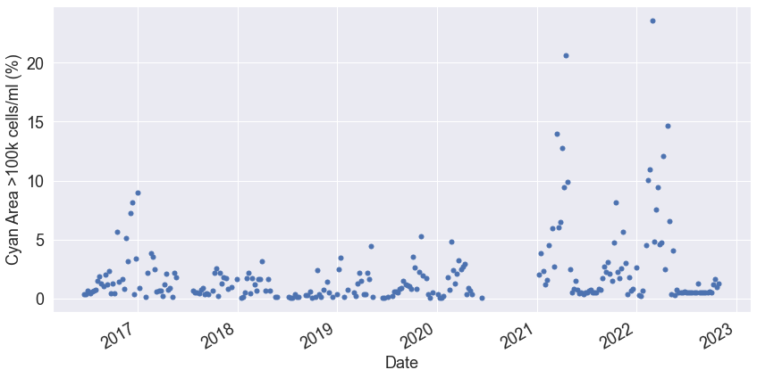
Data Extraction - Preliminary Results
Area Averaged Cell Abundance
Anatoxin-a events
2021, 2022
Data from 7-day composite satellite imagery extracted from June 2016 –present (with significant missing data in 2020)
High cell counts seen during warm season (June-October), but with relatively low water areas with detectable cell counts.
Change in pattern in 2021 and 2022, with much higher recorded values of cell counts (coinciding with Anatoxin-a events).
Reviewing the validity of using Project CyAN data for the Columbia River.
Water area with detectable cell counts
Water area with > 100k cells/ml

Slide 16
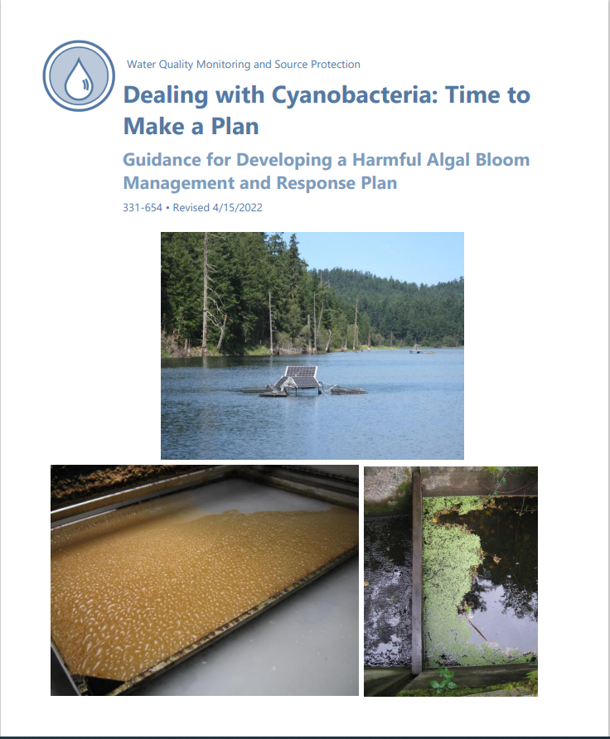
ODW Followup – Updated guidance
Previously focused on lakes. All surface water sources vulnerable. Past history may not be a good indicator of the future.
Benthic cyanobacteria information added-what are they, factors favoring growth, potential parameters to monitor.
Animal deaths/recreational advisory added to response flow chart
Health advisory templates for anatoxin-a
Expanded lab list: National Environmental Laboratory Accreditation Conference (NELAC)
Robust treatment reduces risk. For anatoxin-a permanganate highly effective, chlorine ineffective.

Slide 17
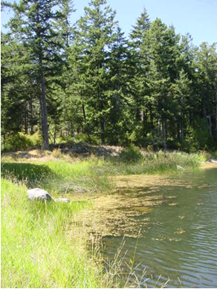
Questions/Comments?
Nancy Feagin, PE and Steve Deem, PE
Engineering & Technical Services
Office of Drinking Water
nancy.feagin@doh.wa.gov
steve.deem@doh.wa.gov
Gopal Mulukutla
Division of Climate & Health
gopala.mulukutla@doh.wa.gov
Washington State Department of Health

