Slide 1
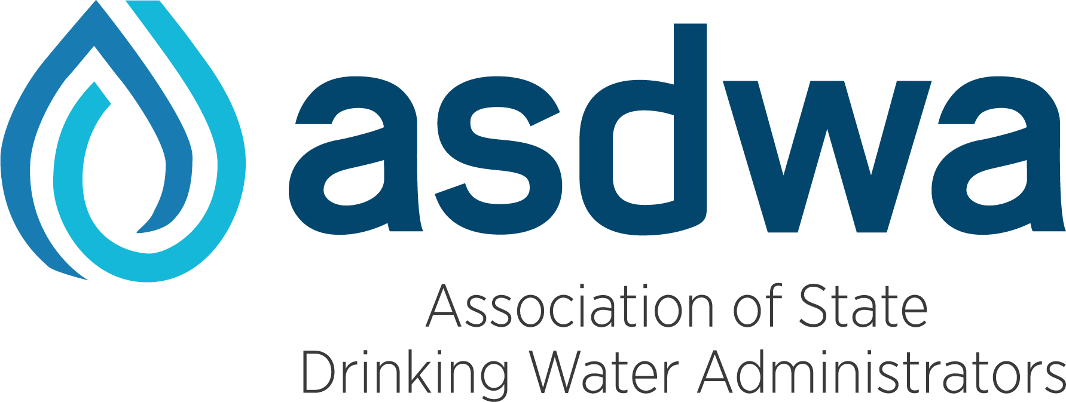
ASDWA HABs Webinar AWOP and State Drinking Water Program Monitoring and Planning Efforts
May 11, 2023

Slide 2
ASDWA State HABs Webinars & MEeting
May 11
State Monitoring and AWOP
July TBD
Coordination Across State Programs
Fall 2023 TBD
Webinar and Meeting with Federal Agencies and Partners

Slide 3
Webinars & Meeting
Goal of Webinars
Share state and federal actions and examples
Gather input to plan the agenda and discussion items for the fall meeting to discuss state drinking water program needs.
Participants
ASDWA members, state labs, and federal agency representatives and partners.
Purpose of Fall Meeting to Address State Needs
Monitoring and predicting HABs
Particularly for cold weather
Lab capacity

Slide 4
State & Federal HABs Efforts
EPA Actions
EPA Drinking Water Health Advisories for Microcystins and Cylindrospermopsin
UCMR4 Monitoring for Microcystins (total and individual), Cylindrospermopsin, Nodularin, and Anatoxin-A
State Harmful Algal Blooms (HABs) Rules
Ohio Drinking Water Rules for HABs Monitoring and Reporting
Oregon Drinking Water Rules for Cyanotoxin Monitoring, Public Notice, and Reporting
Rhode Island Drinking Water Algal Toxin MCLs for Microcystins, Cylindrospermopsin, Anatoxin-a, and Saxitoxin
State HABs Guidance and Resources
Ohio’s HABs Monitoring Mapping Tool
Colorado Monitoring Guidance
Vermont Monitoring and Management Guidance
Iowa Microcystin Study 2016-2017
Kansas Voluntary Monitoring Program 2019
HABs Prevention Work with Partners
State Source Water Protection Programs
USDA Natural Resources Conservation Service
State Clean Water Act and 319 Nonpoint Source Programs
Water utilities
NOAA/NASA Satellite Imagery
USGS Monitoring
APHL – State labs

Slide 5
Today’s Agenda
AWOP Presentation
EPA, Tom Waters: Area-Wide Optimization Program (AWOP) with states and water utilities in EPA Regions 8,9,10
State Presentations
New York, Courtney Davis
New Jersey, Rob Newby
Washington, Steve Deem
Questions and Discussion

Slide 6
Questions & Discussion
Questions from the audience?
What are the greatest state challenges, successes, and needs?
How can federal programs and partners (EPA, USGS, NASA/NOAA and APHL) help address state needs for monitoring and predicting HABs, and lab capacity?

Slide 7
Stay TUNED
July webinar details and registration coming soon!
This webinar is being recorded and the slide presentations will be shared.

Slide 8
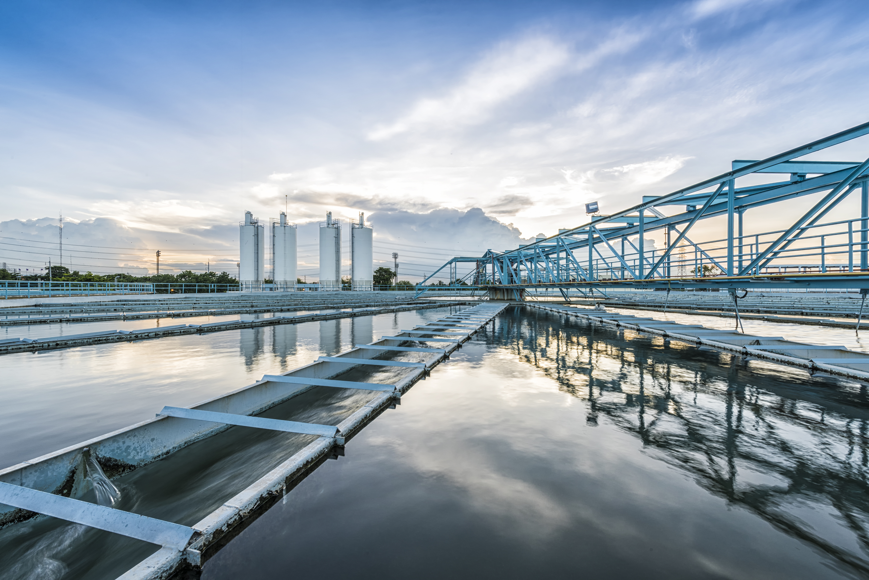
Questions or Suggestions?
Deirdre White
dwhite@asdwa.org

