Slide 1
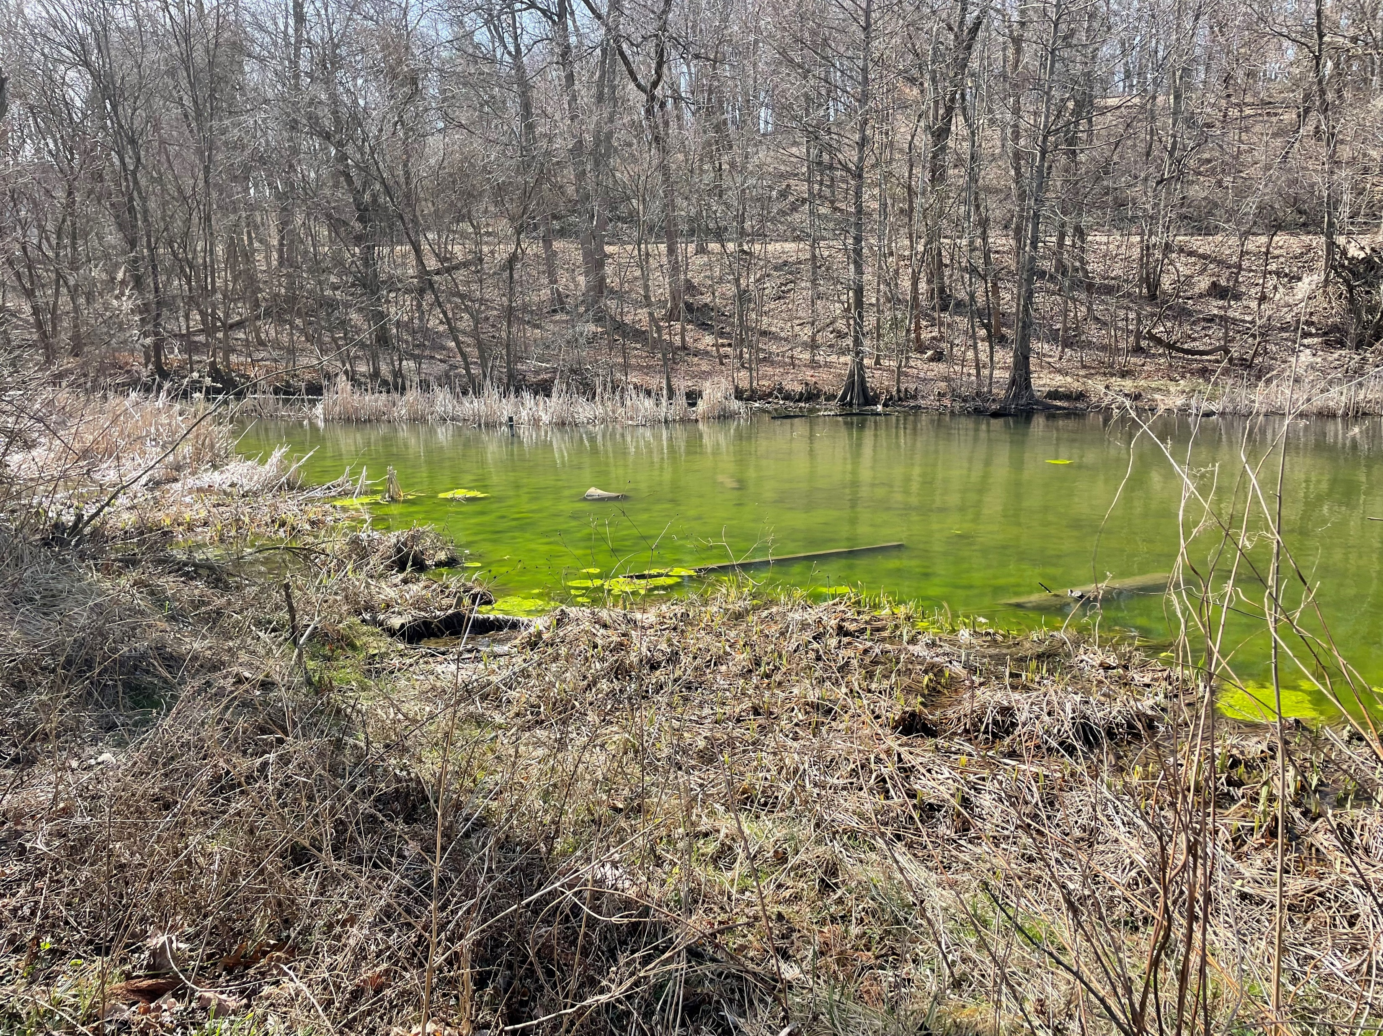
ASDWA HAB Webinar Series
May 2023
Office of Water
www.uswateralliance.org
Notes:
Took this cover picture in February in Ohio – note no leaves on trees. Blooms occurring earlier, extending the bloom season.

Slide 2
The operator’s dilemma
EPA Health Advisories
Potential for HABs in source water
I know the answer is here somewhere, but what do I need to do at my plant?
Operator training manuals
EPA guidance manuals
AWWA, WRF research reports, other literature
Office of Water

Slide 3
Area-Wide Optimization Program (AWOP) solution:
Develop approaches to assess why a treatment plant doesn’t perform as desired.
Develop knowledge and skills to help operators make changes at their treatment plants to achieve desired performance levels.
Measurable improvements at individual plants.
Use existing facilities and enhanced process control.
Transfer knowledge to build capacity at state drinking water programs and water systems.
Office of Water

Slide 4
HAB CPE development pilot project:
Partnered with Ohio EPA in 2016-2018
Series of 4 pilot HAB CPEs at Ohio WTPs
Develop protocol for conducting a HAB CPE by modifying the existing microbial CPE framework
Transfer capability to conduct CPEs to Ohio EPA staff and other states
Ohio EPA HAB water treatment experience at plant level
Office of Water
Notes:
A microbial (turbidity) CPE has already been developed and implemented for over 20 years and is serving as the “template” for the HAB CPE, since turbidity is a good indicator of microbial (and thus cyanobacteria cell) treatment performance.
The project is mutually beneficial for USEPA and Ohio EPA. Ohio EPA has extensive experience optimizing treatment for HABs/cyanotoxins at utilities and contributes this expertise to the development of the HAB CPE. USEPA brings the experience conducting CPEs and will help train Ohio EPA staff to conduct CPEs on their own (i.e. “transfer capability”).
(Additional information, if needed)
The CPE Process:
Assessment of plant performance
Historical data
Data collected during CPE
Evaluation of major unit processes (MUP)
Flocculation, sedimentation, filtration, and disinfection
Based on capability to handle peak instantaneous flow requirements. Develop a performance potential graph.
Rating system for adequacy of each major treatment process and overall plant
Type 1 = Major unit processes are adequate ( > 100% peak flow)
Type 2 = Major unit processes are marginal (80 – 100% peak flow)
Type 3 = Major unit processes are inadequate (< 80% peak flow)
Identification and prioritization of performance-limiting factors (PLFs)
Administrative, design, operation and maintenance categories
PLF prioritization ratings:
A = major effect on long-term, repetitive basis
B = moderate effect on routine basis, or major effect on a periodic basis
C = minor effect
Reporting results of the evaluation

Slide 5
CPE Evaluation Protocol to Address HABs and Cyanotoxins
Water Treatment Optimization for Cyanotoxins
Office of Water
Notes:
USEPA published a document called “Water Treatment Optimization for Cyanotoxins” in November 2016. The document’s purpose is to assist PWS managers and operators with preparing for, and responding to, the drinking water treatment challenges that often arise during HAB events and introduce principles that can be used to achieve optimization goals using a compilation of published approaches and strategies. The document discusses monitoring strategies for source water and treatment train, as well as treatment approaches for intracellular and extracellular toxin removal.
One of the goals of the HAB CPE project, among others, is to gain field experience implementing some of the treatment approaches discussed in the document in order to better refine the document’s recommendations.
To obtain the document, as well as other HAB-related drinking water tools, visit the link above. Katie will be discussing those other tools.

Slide 6
Workshops and Trainings
EPA Region 10, 8, 9 AWOP group:
Remote HAB series: 6/2020, 7/2021, 10/2021
Partnered with states and water systems to deliver training to state staff: City of Salem, Oregon Health Authority, EPA Region 8, Kemmerer-Diamondville Water System (WY), Alaska DEQ, and Utquiavik Water System (AK)
Series focused on monitoring, treatment basics, case studies, assessing vulnerability to HABs and developing HAB response plans.
Repeated training with EPA Region 6 and 7 states in Des Moines, Iowa in 5/2022.
Office of Water

Slide 7
Workshops and Trainings (continued)
Remote Idaho DEQ HAB training for water system operators and managers – 11/2022
Attendees included Idaho water system operators and managers, Idaho DEQ and Washington DOH primacy agency staff, EPA Region 10 staff, and technical assistance provider organizations (Idaho Rural Water, RCAC)
Training covered sampling, monitoring, treatment optimization, assessing vulnerability to HABs, and developing HAB response plans.
Included 3 hands-on workshops
Office of Water

Slide 8
Other ongoing work
Partnering with ORD (Nick Dugan) to conduct research study on PAC adsorption in model source water in presence of typical water treatment chemicals
Model source water: lab grade water matrix with added NOM, inorganics and turbidity
NOM reconstituted, lyophilized Ohio River water NOM
Model water spiked with about 100 µg/L microcystin-LR
Objective: how is PAC adsorption of microcystin-LR impacted by NOM, inorganics, turbidity and coagulants?
Office of Water

Slide 9
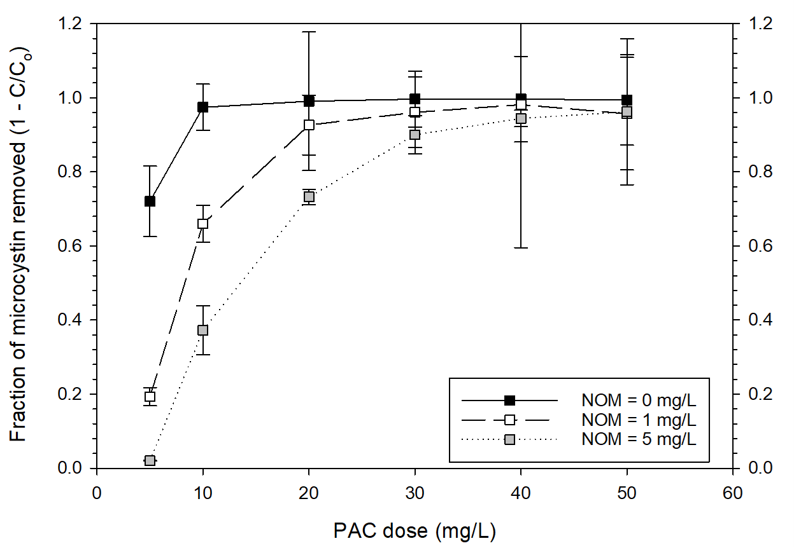
Preliminary results: confirm that increasing background NOM → increasing competition for adsorption sites → reduced microcystin-LR adsorption.
Theory: presence of multi-valent cations affects NOM molecule shape, thereby affecting its adsorption affinity.
Future work: NOM characterization to better understand how the reconstituted Ohio River NOM specifically behaves in presence of multivalent cations with respect to adsorption to PAC.
Office of Water

Slide 10
Future HAB-related work: EPA HAB Strategic Plan
Continue holding webinars and workshops with states, tribal and local entities to strengthen the understanding on preventing, monitoring, and managing HABs
Continue to support utilities during cyanotoxin drinking water emergencies
OW and ORD partnering to better understand adsorption of cyanotoxins to powdered activated carbon in surface water in the presence of competitive adsorbates such as natural organic matter and treatment chemicals.
Develop drinking water system prioritization tools (e.g., spreadsheet templates) to help primacy agencies prioritize vulnerable source waters and public water supplies to better direct technical assistance to systems that need it for optimizing treatment to prevent and/or manage cyanotoxins in the treatment plant.
Office of Water

Slide 11
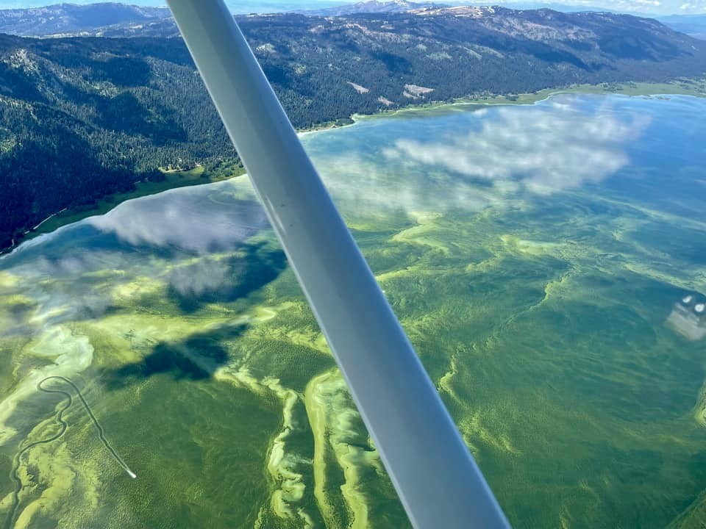
Tom Waters
waters.tom@epa.gov
513-569-7611
Office of Water
www.uswateralliance.org

